Slide 1
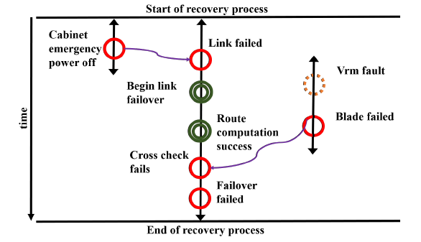
Resiliency of HPC Interconnects: A case study of interconnect failures and recovery in Blue Waters, TDSC, 2017
Scientific Achievement
Developed an interconnect FaiLOver Analysis Toolkit (FLOAT), to measure applications and system resiliency in HPC
Empirically showed that longer recovery times increase chances for the system to experience additional failures which can lead to failure of the recovery
Significance and Impact
Shed light on fault-to-failure paths and timings for network-related failures that were heretofore largely unknown
Gained insights on failure mechanisms and performance impacts which can be used to increase efficiency, performance, and science output of current and future HPC platforms
Research Details
Quantified impact of network failures: 27.7% of system-wide outages are due to network-related failures
Applications can fail with a non-negligible probability even during a successful recovery of the network
Large-scale applications (occupying > 50% nodes) 33x more vulnerable than single-node applications
Noticeable chances of multiple failures during recovery operations. The probability of a recovery being impacted by additional failures (across all recoveries) is 48%, and increases with the length of recovery time
Fig. 1 – Fault-to-failure propagation and network recovery sequence recreated using FLOAT. The tool allows to observe adjudged cause of a failure (an emeregency power off for the case in Fig. 1).
Fig. 2 – Probability of recovery failure for t > T
Duration of recovery (s)
Notes:
Submitted and currently under revision: TDSC – IEEE Transactions of Dependable and Secure Computing
Failure occurrences typically expose themselves in log files (field-failure data), but sequences of events leading from an initial problem to a related failure are not correlated in this information and the relationships can be obscure. To be able to diagnose fault causes and take the earliest action possible requires understanding the fault-to-failure propagation paths, and understanding the impact of faults and failures on both systems and applications.
In this paper, we studied network-related failures and their propagation in the Blue Waters Leadership system located at University of Illinois, using 27 months of field-failure data. We developed an interconnect FaiLOver Analysis Toolkit (FLOAT) to understand the fault-to-failure propagation in the Cray interconnection network (Example Output Fig. 1), and measure application and system resilience. We found that:
27.7% of system-wide outages are due to network-related failures;
the probability of recovery failure increases with recovery time duration (Fig. 3);
chances of multiple failures during recovery operations can lead to failure of recovery (0.48 probability in Fig. 2);
applications can fail with a non-negligible probability even during a successful recovery of the network, and
large-scale applications are 33x more vulnerable than single-node applications to have an application impact..

