Slide 1
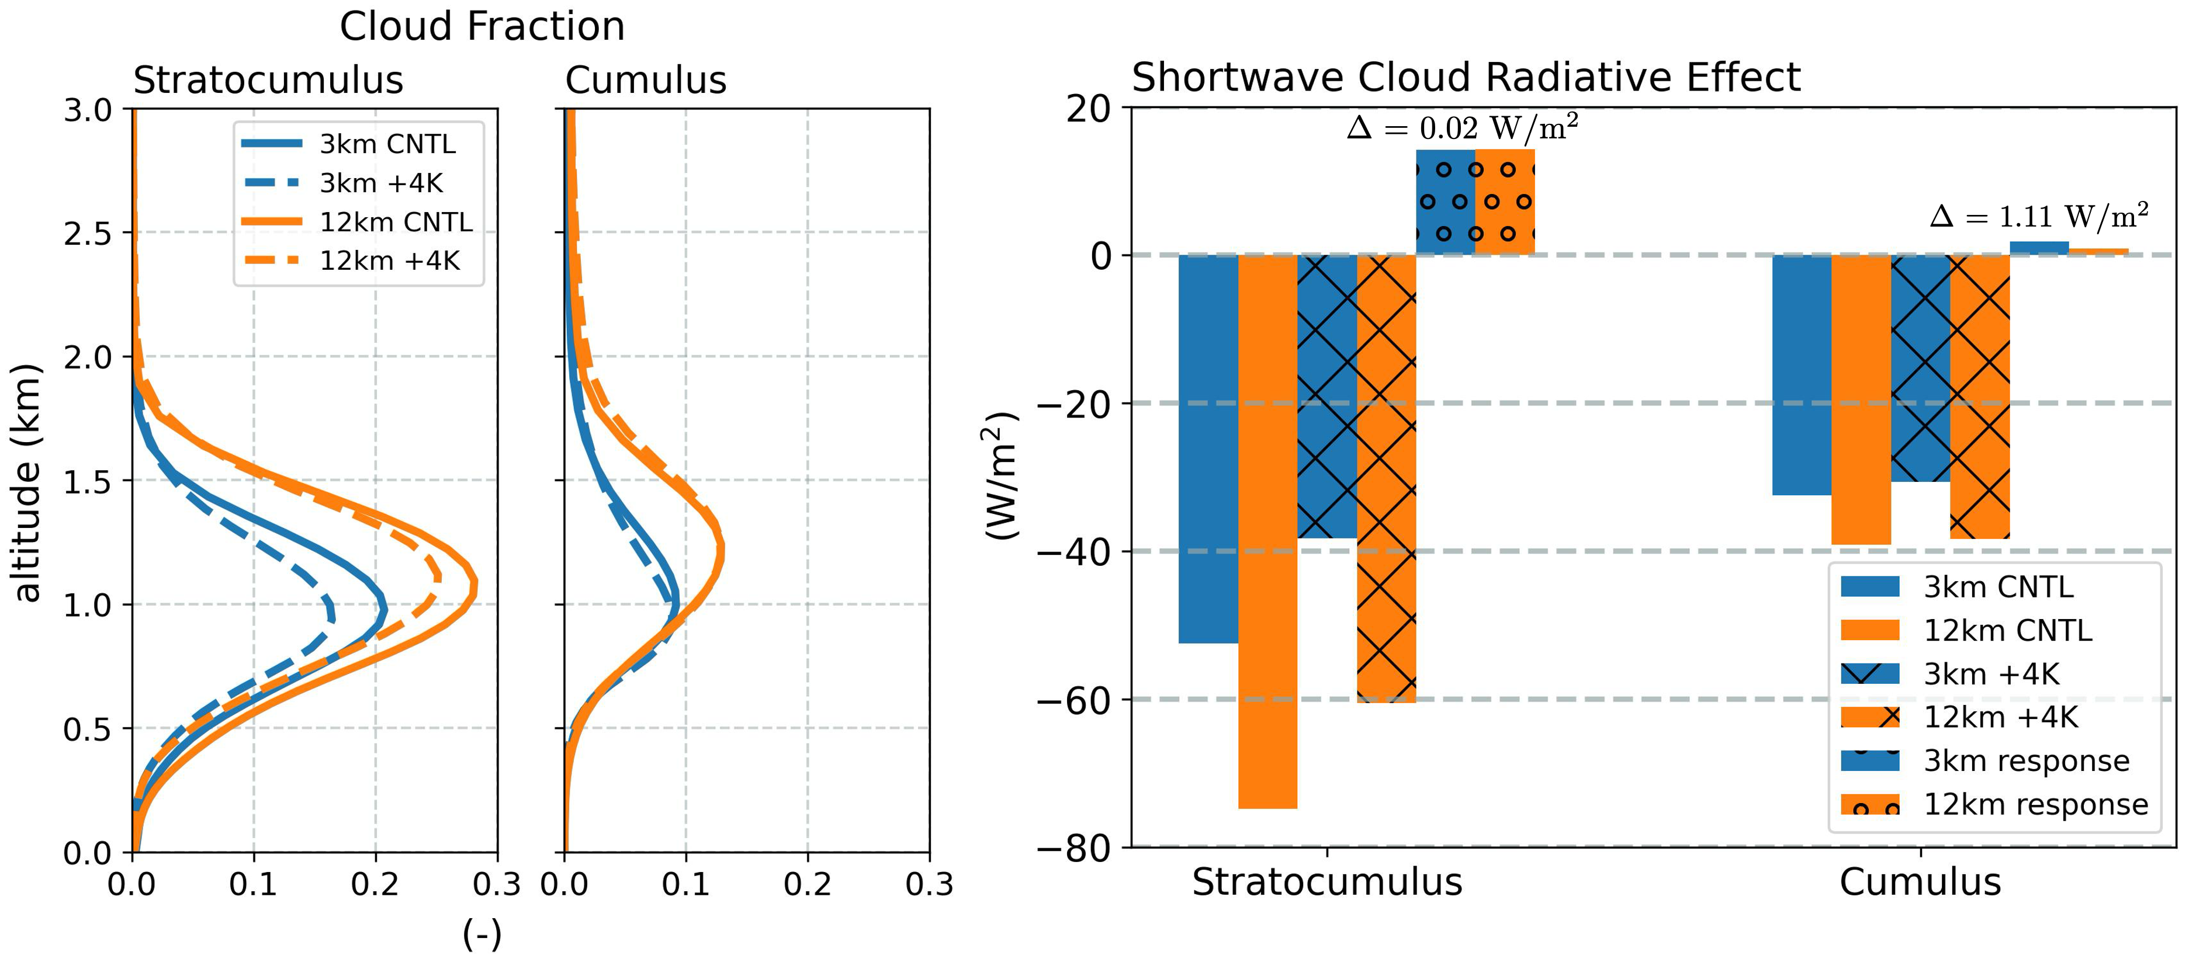
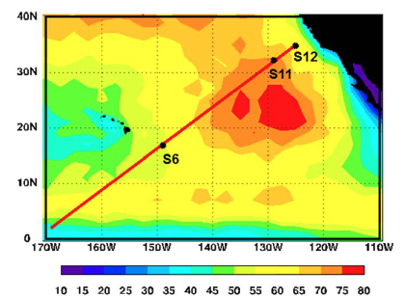

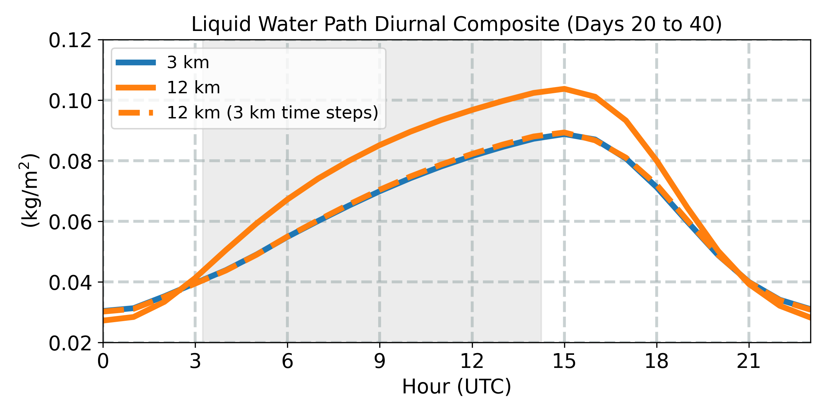
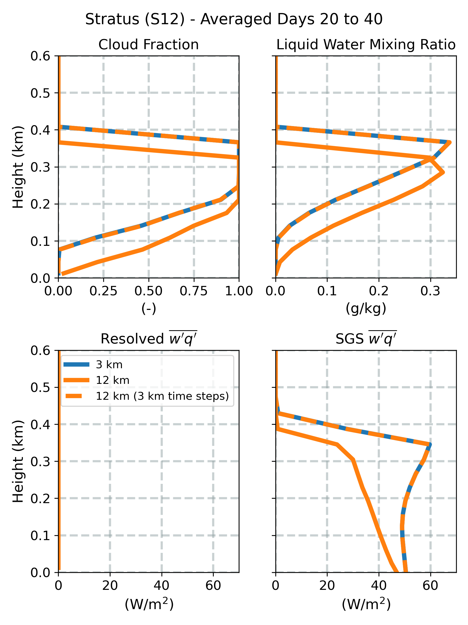
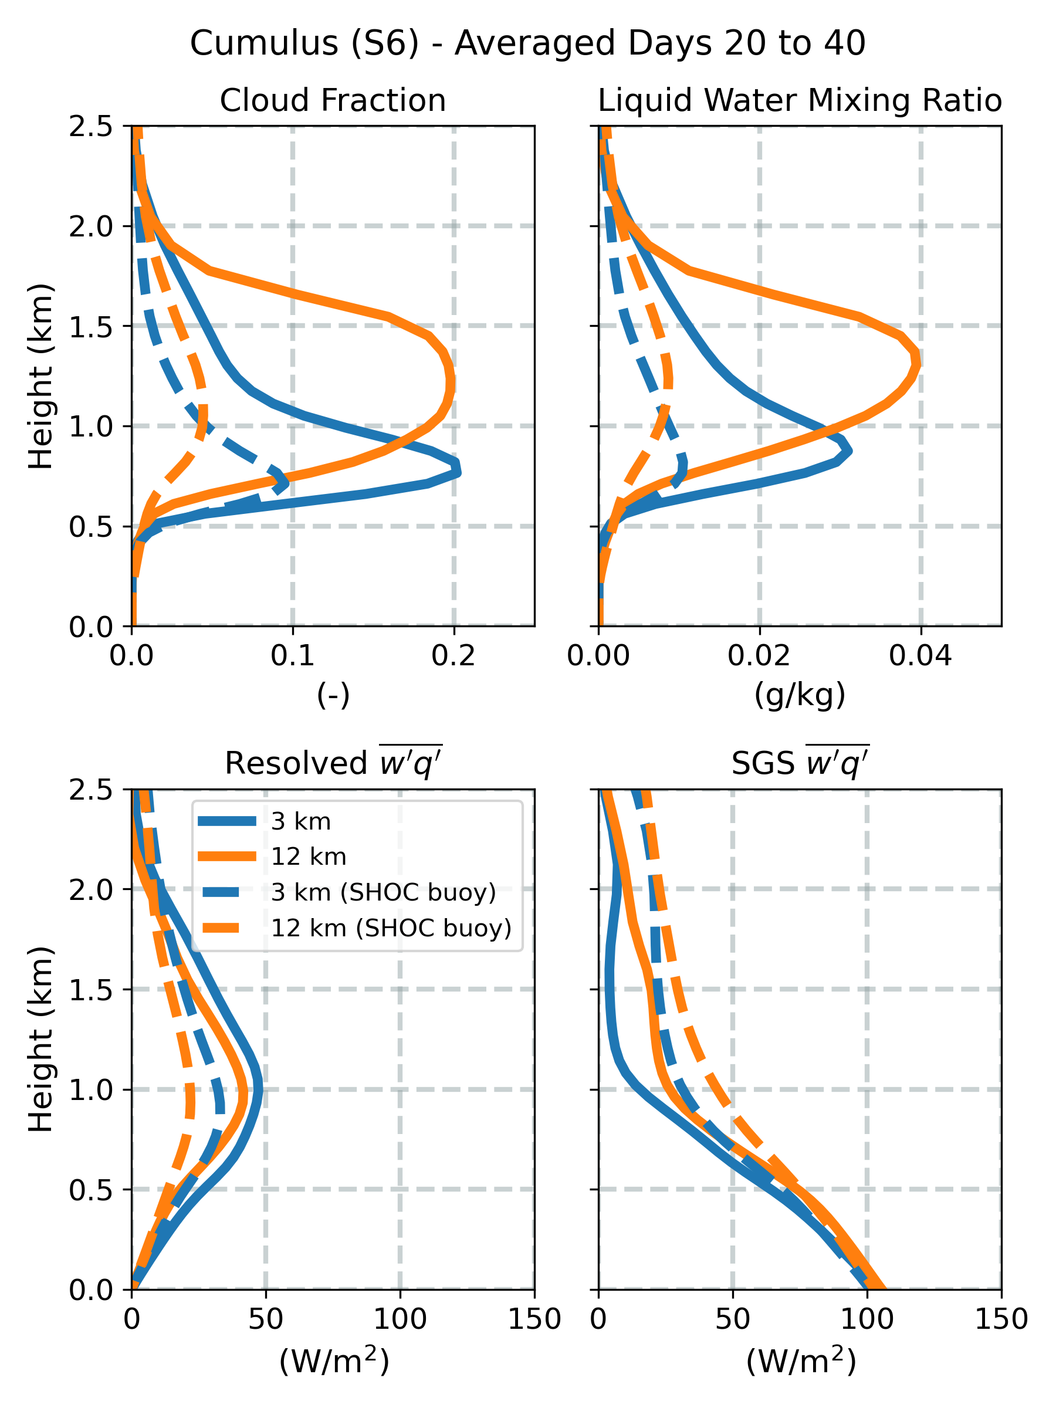
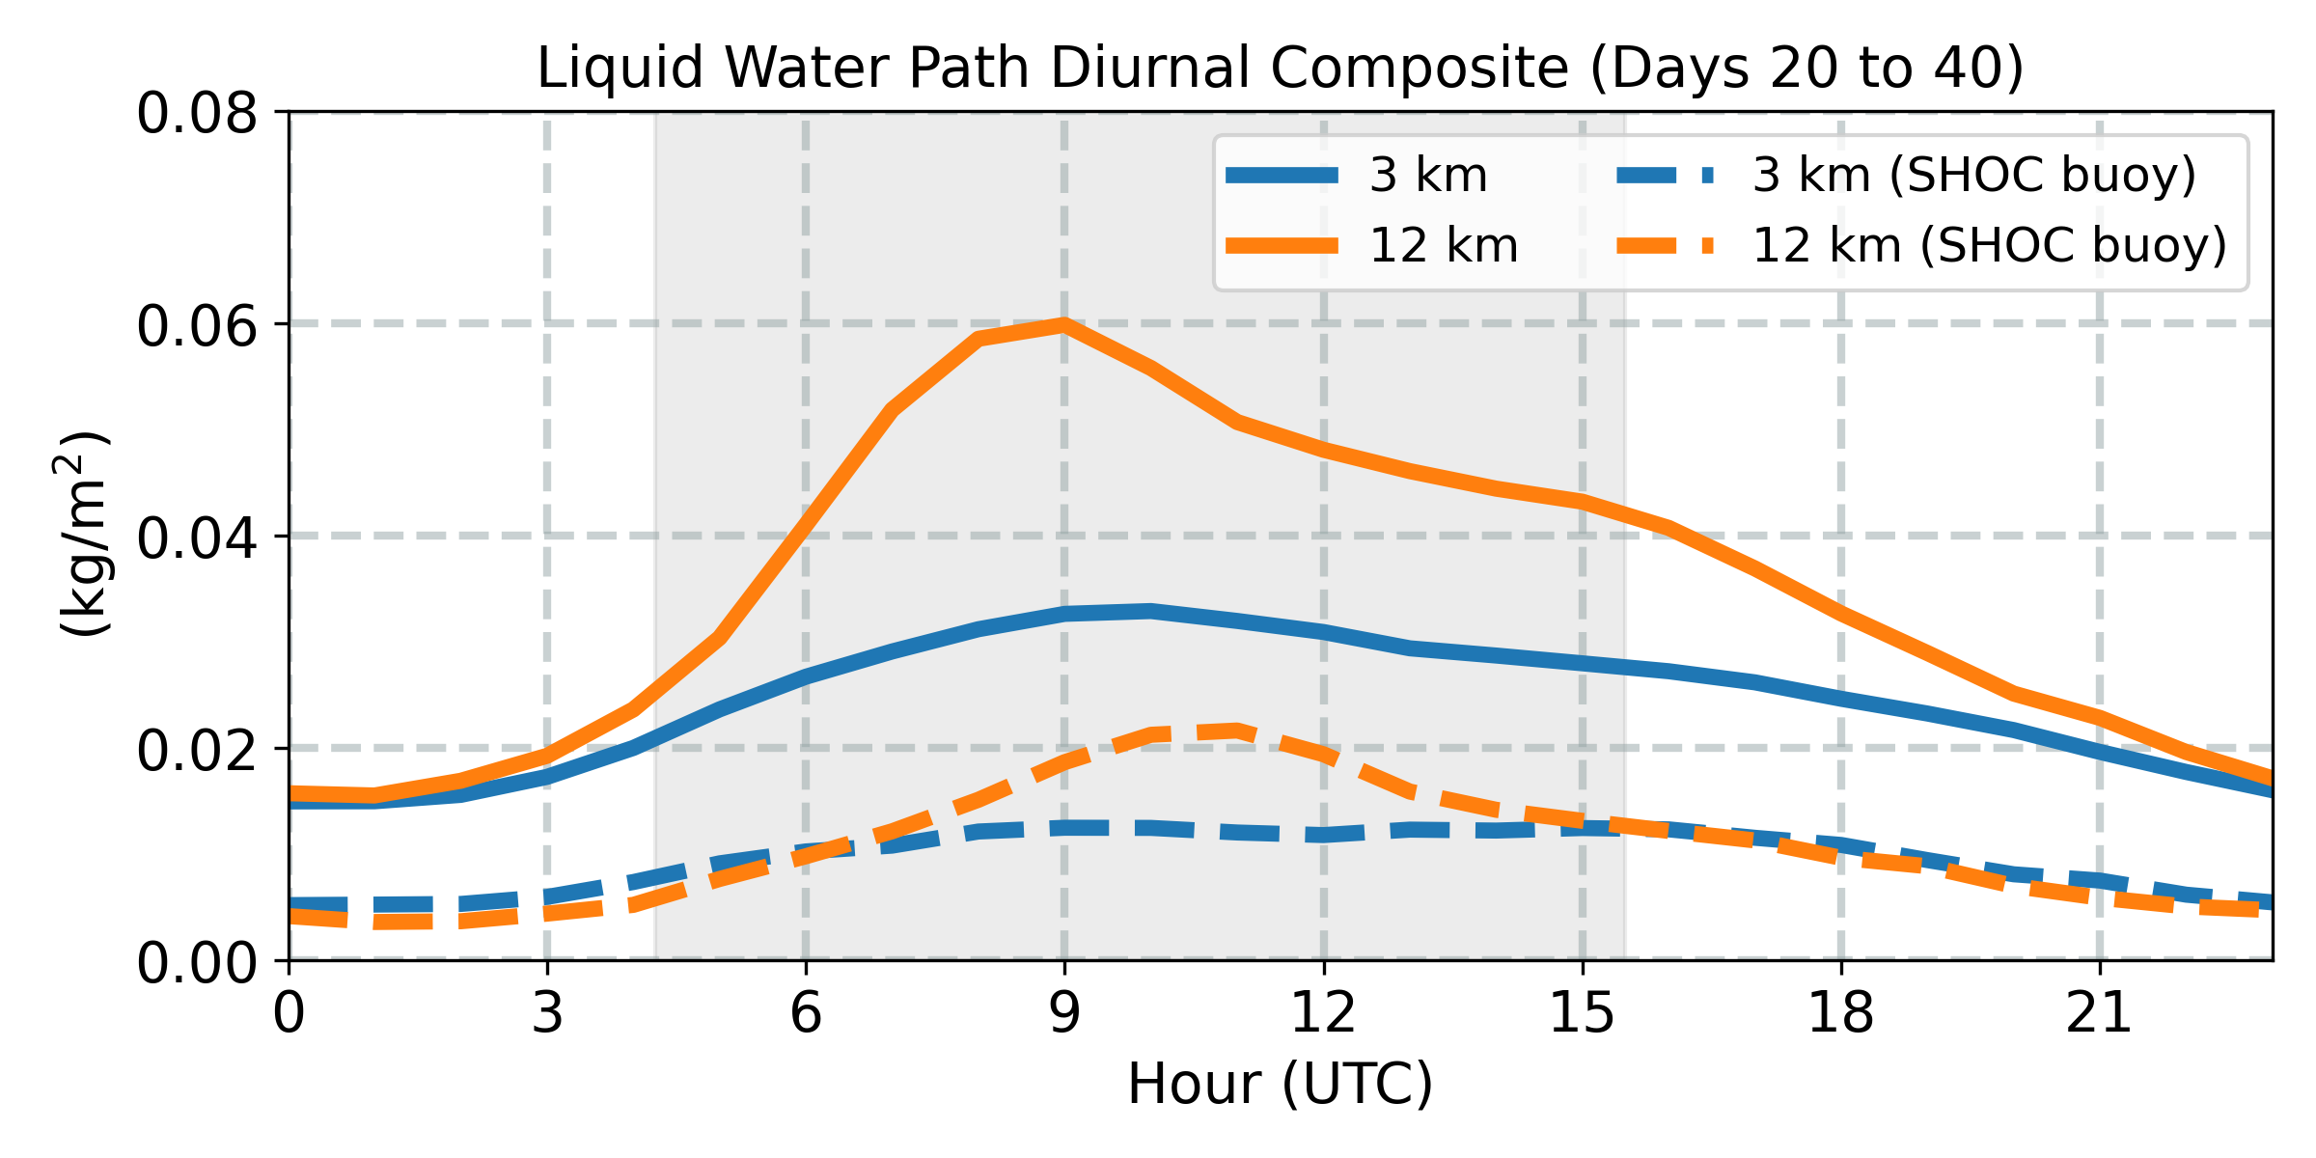
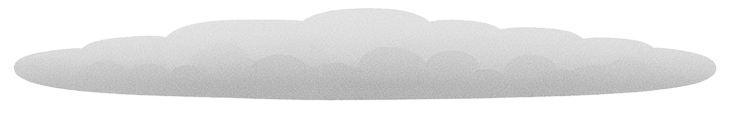
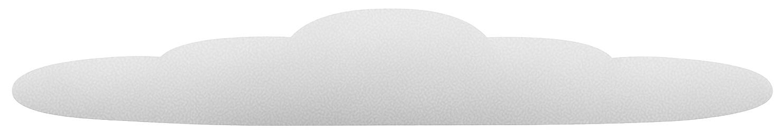
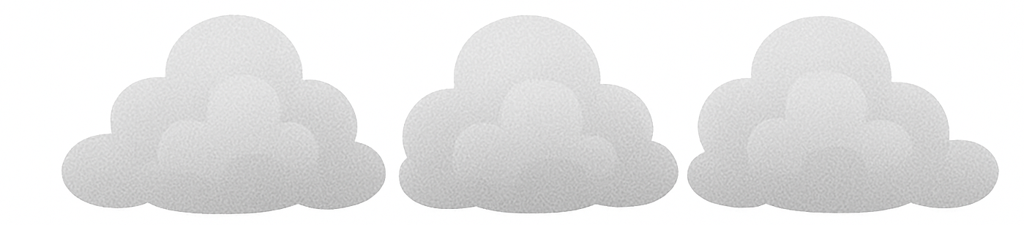

Untangling The Low Cloud Resolution Sensitivity in EAMxx
Peter Bogenschutz, Chris Terai, and Yi Qin
MOTIVATION
EXPERIMENT DESIGN
3 km vs 12 km Low Cloud Sensitivity Identified in CESS Experiments:
Results from the CESS experiments revealed that the largest differences cloud feedbacks between ne256 (~12 km ) and ne1024 (~3 km) configurations occurred in the subtropical low cloud regions.
Resolution sensitivity found to be due to local cloud processes rather than differences in large-scale circulation.
What is the culprit behind this resolution sensitivity?
Hypothesis: Combination of time step sensitivity and turbulence parameterization error.
Efficiently Reproduce the Resolution Sensitivity in DP-EAMxx:
We run the original CGILS cases (Blossey et al. 2013) using the doubly periodic DP-EAMxx configuration (Bogenschutz et al. 2025), which replicates global model behavior in a matter of minutes.
Simulations include stratocumulus, transitional, and cumulus cases, each run for 40 days over a 200 km x 200 km domain at both 3 km and 12 km resolution.
In this work, we focus only on the present day control simulations to isolate and understand the resolution sensitivity.
Figure 1. From Terai et al. (2025, in review). Left two panels show averaged conditionally sampled profiles of cloud fraction over the subtropical ocean while the right panel represents the conditionally averaged shortwave cloud radiative effects for stratocumulus and cumulus. The conditional sampling between stratocumulus and cumulus is based on Medeiros and Stevens (2011). For both regimes the latitude is bound by 30 S and 30 N, only oceanic columns are considered (ocean fraction equal to 1), and omega500 > 10 Pa/s. For Stratocumulus the lower tropospheric stability (LTS) is required to be > 18.5 K while for Cumulus 18.5 > LTS >= 11.3 K.
Figure 2. From Zhang et al. (2013). Averaged amount of low clouds in JJA from C3M satellite data. The red line is the northern portion of the GPCI transect. The symbols ”S6”, ”S11”, and “S12” denote the locations of the cases studied in this paper, specifically the “cumulus”, “transitional”, and “stratocumulus” locations, respectively.
DP-EAMxx Resource Page
Scan me!
RESULTS
Coupled Stratus (S12)
Shallow Cumulus (S6)
Figure 3. Diurnal composite of liquid water path over days 20 to 40 of S12 CGILS case. Shaded area denotes night time hours.
Figure 6. Diurnal composite of liquid water path over days 20 to 40 of S6 CGILS case. Shaded area denotes night time hours.
12 km run produces a thicker, moister stratocumulus deck.
Using 3 km time steps in the 12 km run eliminates resolution sensitivity.
Differences arise from surface coupling frequency, not physics time step sensitivity.
Cumulus shows little time step sensitivity (unlike stratus; not shown).
Boosting buoyancy in SHOC cumulus layers (“SHOC buoy” simulations) cuts resolution sensitivity by ~80%.
More SGS buoyancy -> Deeper SGS cumulus -> less CAPE buildup -> weaker dynamical triggering -> lower resolution sensitivity.
Figure 4. Profiles averaged over days 20 to 40 of the S12 CGILS case.
Figure 5. As figure 4 but for S6. Dotted lines denote experiment configuration where liquid water flux was boasted by a factor of two (following Bogenschutz et al. 2025).
TAKE HOME MESSAGE
Resolution sensitivity of maritime low clouds in EAMxx is primarily driven by time step and turbulence parameterization. However, the dominant source of error varies by regime and shifts along the stratocumulus-to-cumulus transition:
Stratus (S12)
Transitional Stratocumulus (Sc over Cu; S11)
Cumulus (S6)
Time step sensitivity is the dominate source. Additional (unshown) experiments reveal that surface coupling frequency, not the physics or dynamics time steps themselves, is the main culprit.
Time step and parameterization errors contribute equally. Though not shown in this poster, preliminary experiments suggest that reducing resolution sensitivity for this regime requires changes to both time step and parameterization structure.
Turbulence parameterization is the dominate source. SHOC cannot efficiently exhaust CAPE, causing the dynamics to resolve clouds that should remain subgrid at both 3 km and 12km resolutions.
e3sm.org
For additional information, contact:
Peter Bogenschutz
Staff Scientist
Lawrence Livermore National Laboratory
(925) 422-0551
bogenschutz1@llnl.gov
This work was performed under the auspices of the U.S. Department of Energy
under contract DE-AC52-07NA27344. LLNL IM:

