Slide 1

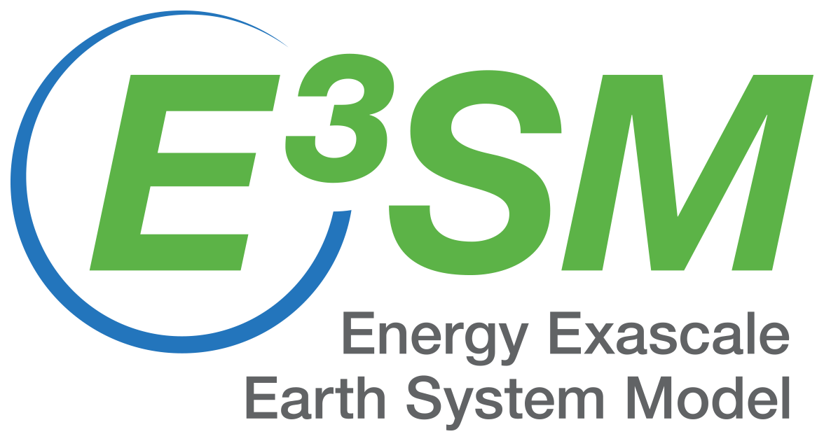
Evaluating DOE’s Energy Exascale Earth System Model (E3SM) for renewable wind and solar energy production
J﻿ean-Christophe Golaz, Robert S. Arthur, Matthew V. Signorotti, Thomas A. Edmunds, Hsiang-He Lee, Jean-Paul Watson
Lawrence Livermore National Laboratory, Livermore, CA
AMS 104th Annual Meeting
Baltimore, MD
January 29, 2024

Slide 2
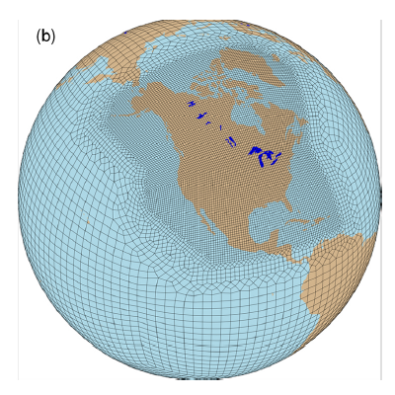
Energy Exascale Earth System Model (E3SM)
DOE's E3SM is a state-of-the-science Earth system model development and simulation project to investigate energy-relevant science using code optimized for DOE's advanced computers.
For this work:
E3SMv2 North American Regionally Refined Model configuration (NARRM).
Global climate model with atmosphere grid spacing 110 km -> 25 km.
Atmosphere-land configuration (imposed sea surface temperature, aka AMIP).
E3SMv2 model references
Golaz et al. (2022, JAMES)
Tang et al. (2023, GMD)

Slide 3





How well can E3SM simulate renewable energy production?
Methodology
Pipeline
Evaluation
Energy Information Administration (EIA) plant data forms 860/923
Monthly data
2013-2022
pySAM
wind
solar
Default settings
Hourly output
of relevant variables
300 GB per year
2010-2014
vecteezy.com
vecteezy.com

Slide 4
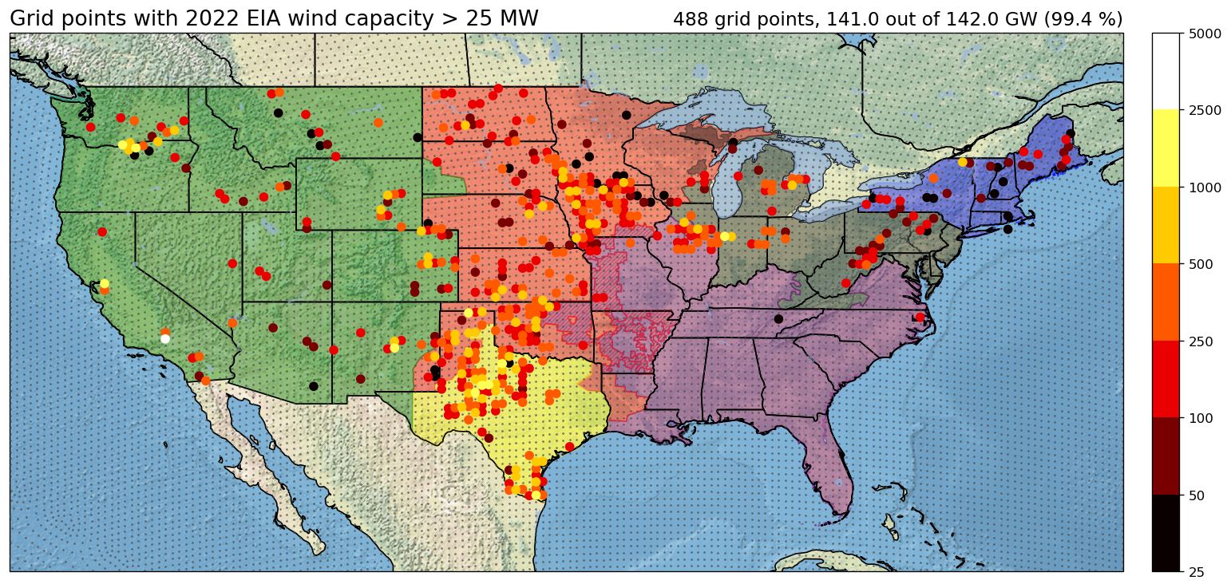
EIA site selection - Wind
Legend
Colored dots: EIA plants aggregated to nearest NARRM grid point. Colored by total 2022 installed capacity.
Small gray dots: E3SM NARRM grid points.
Background colors: NERC (North American Electric Reliability Council) regions.
Aggregate EIA plants on E3SM NARRM grid points.
Retain grid points with > 25 MW nameplate capacity (2022).
488 grid points, ~1260 EIA plants, 141.0 GW (99.4% of installed capacity).
MW

Slide 5
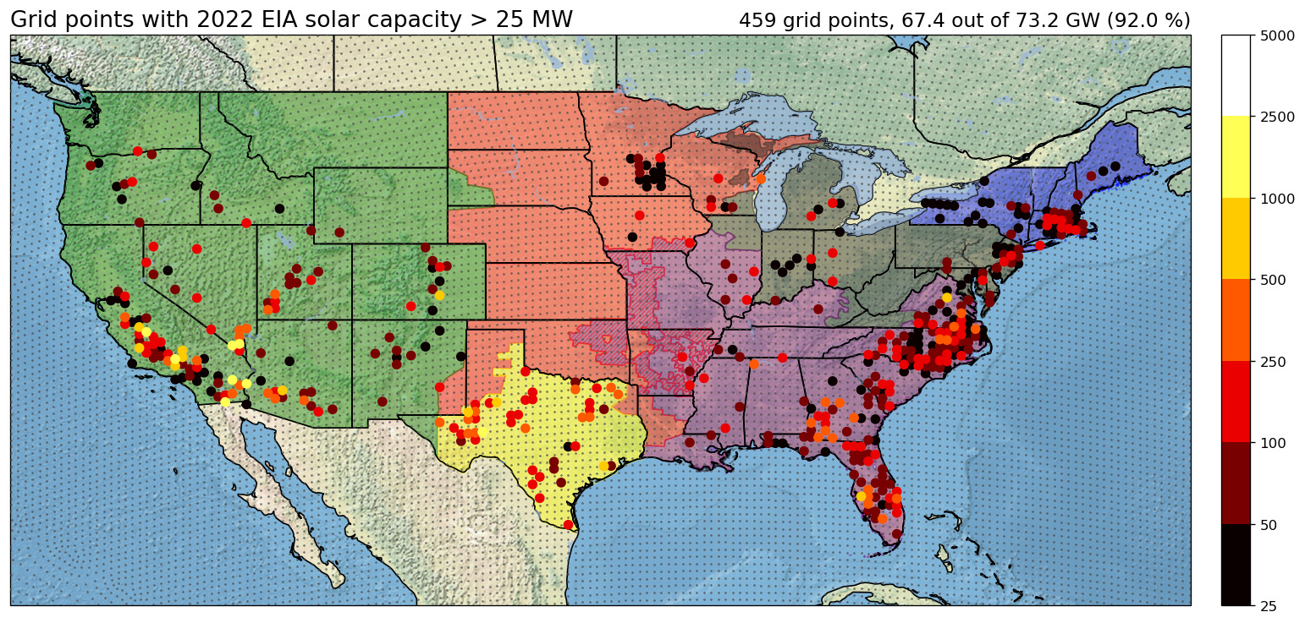
EIA site selection – Utility-scale solar
Legend
Colored dots: EIA plants aggregated to nearest NARRM grid point. Colored by total 2022 installed capacity.
Small gray dots: E3SM NARRM grid points
Background colors: NERC (North American Electric Reliability Council) regions.
460 grid points, ~3894 EIA plants, 67.4 GW (92.0 % of installed capacity).
MW

Slide 6
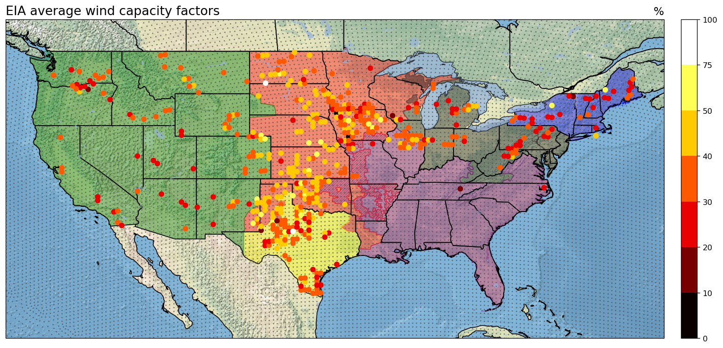
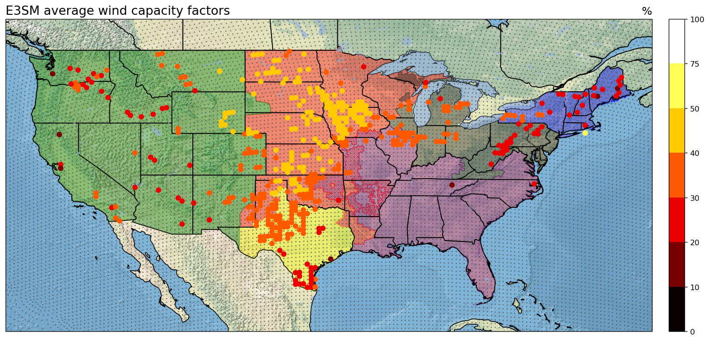
Capacity factor for wind: E3SM vs EIA (multi-year averages)
Grid point average EIA capacity factor weighted by plant nameplate capacity.
Note apparent outliers in EIA data; to be investigated.
E3SM captures overall regional distribution with largest values in the Midwest.

Slide 7
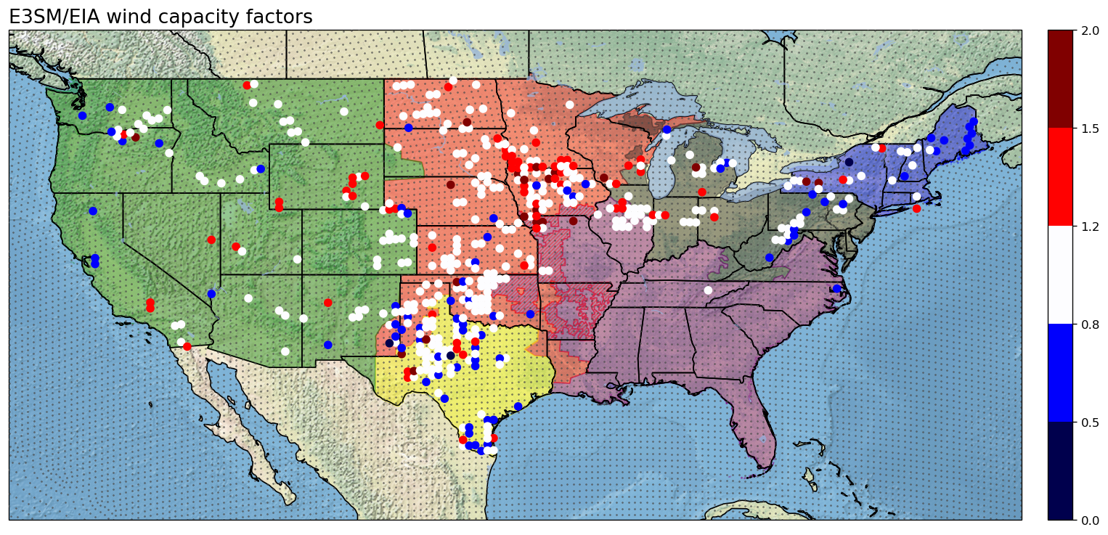
Capacity factor for wind: E3SM vs EIA (cont’d)
E3SM / EIA capacity factor
Many grid points within ±20%, but E3SM more likely to underestimate wind capacity factor.

Slide 8
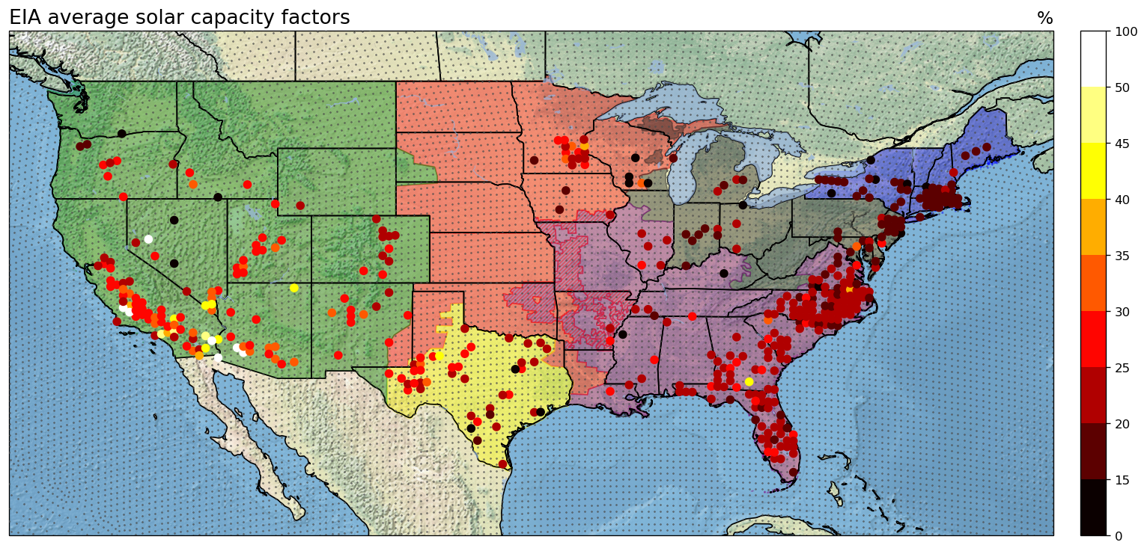
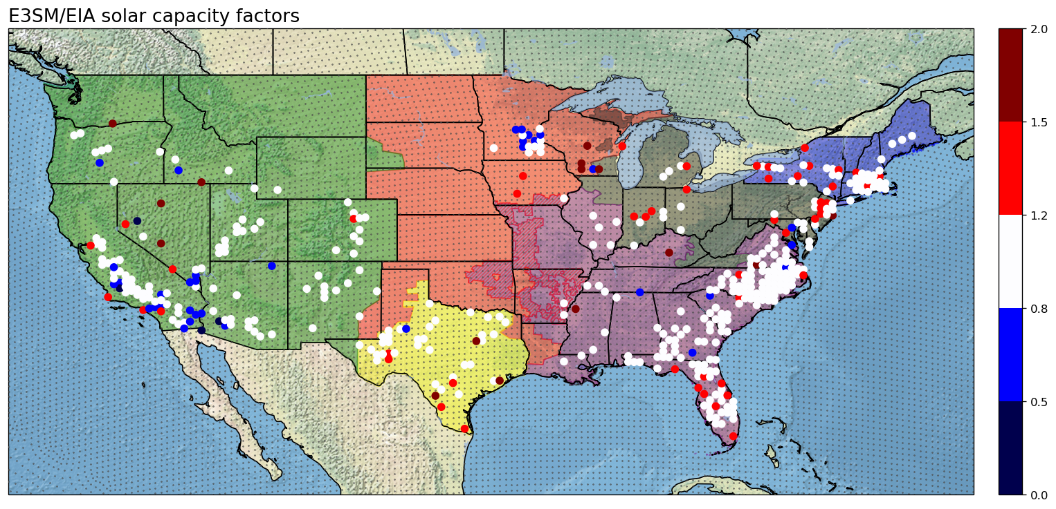
Capacity factor for solar:
E3SM vs EIA (multi-year averages)
EIA solar capacity factor
Some apparent outliers in EIA data. To be investigated.
E3SM / EIA capacity factor
- Large number of points within ±20%
- Under-estimation in the West
- Over-estimation in the East

Slide 9
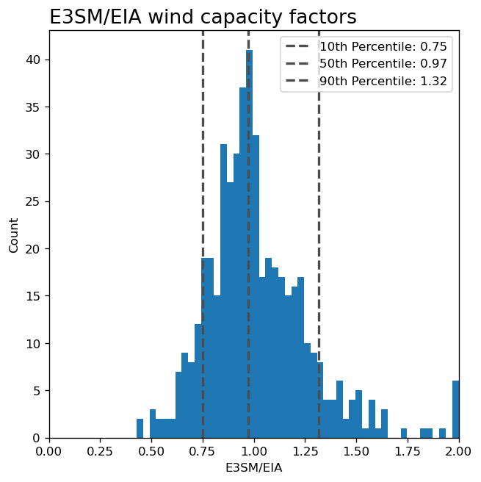
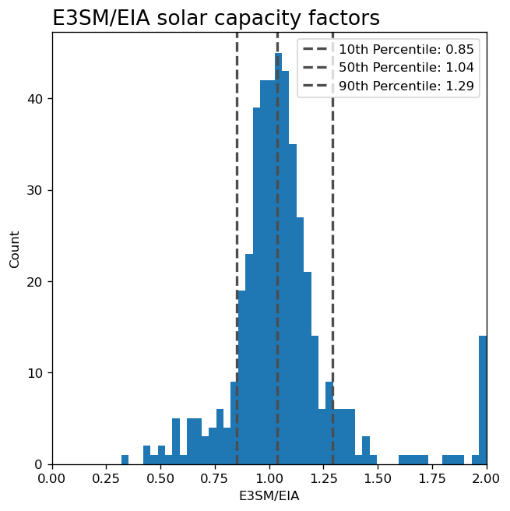
Quantitative comparison
Wind
Solar
80% of locations between -25% and +32%
80% of locations between -15% and +29%

Slide 10
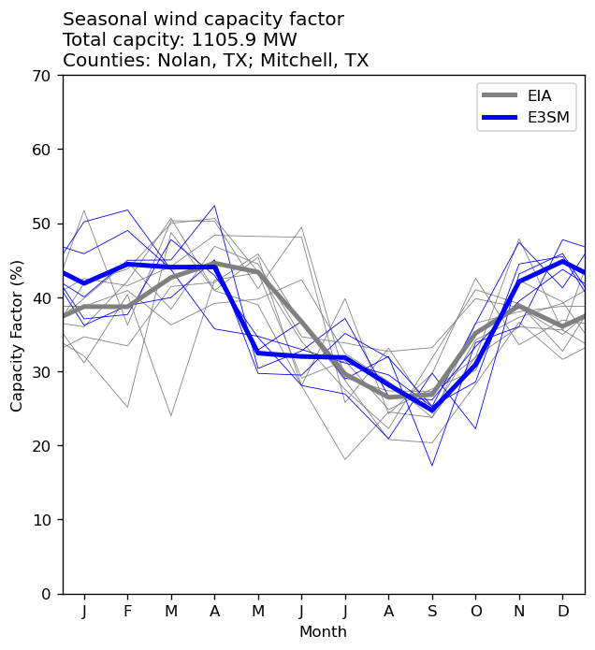
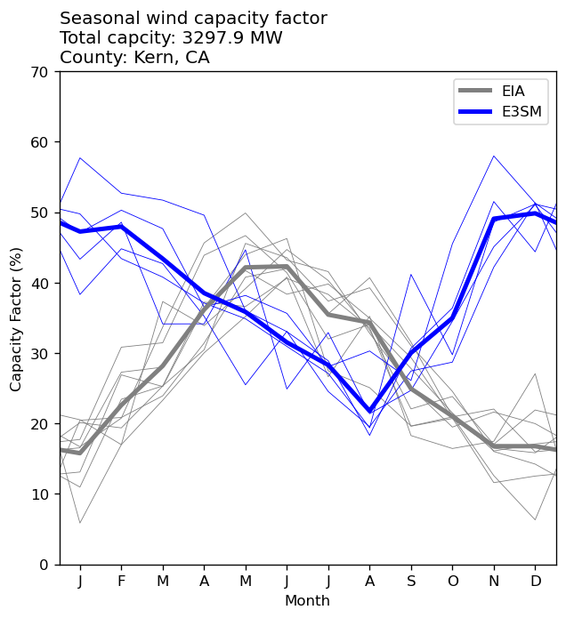
Seasonal comparison for selected locations - Wind
Legend
Thin lines: individual years.
Thick lines: multi-year averages.
E3SM
E3SM
EIA
EIA
Pretty good in TX...
...not so great in CA!

Slide 11
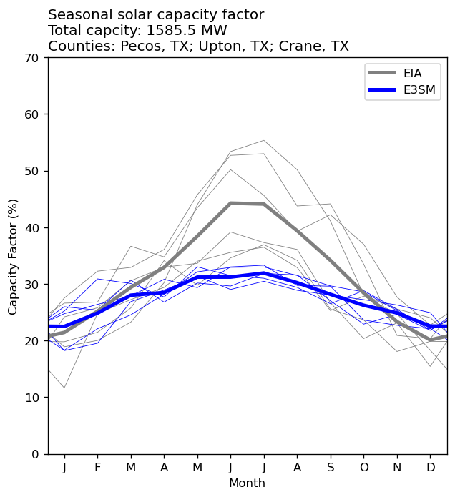
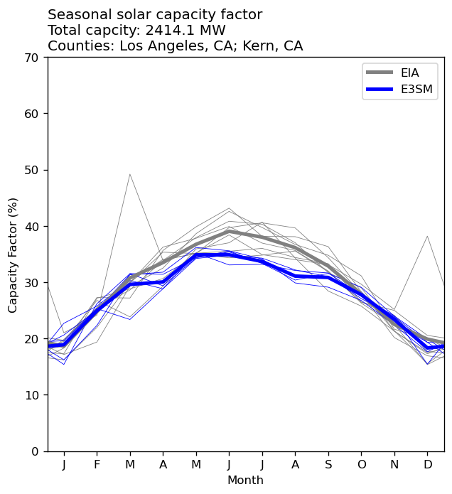
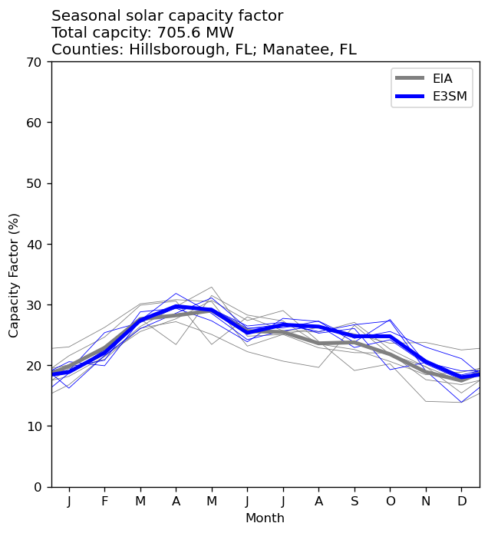
Seasonal comparison for selected locations - Solar
EIA
FL, nice overall match.
E3SM
TX, possible underestimate during summer months.
CA, much better for solar than wind.
But note possible issues with EIA data.

Slide 12
Summary and next steps
EIA 860/923 is a treasure trove of data!
  But EIA monthly data pre-processing requires further refinement (automated QC).
Built workflow to estimate renewable energy capacity factors from E3SM using NREL pySAM.
Compared to EIA data, E3SM multi-year average capacity factor predictions appear to be reasonable (“in the ball park”).
  But there are clearly some regional and seasonal challenges.
More in-depth comparison needed.
Climate projection simulations.
Thank You!

Slide 13
Disclaimer
This document was prepared as an account of work sponsored by an agency of the United States government. Neither the United States government nor Lawrence Livermore National Security, LLC, nor any of their employees makes any warranty, expressed or implied, or assumes any legal liability or responsibility for the accuracy, completeness, or usefulness of any information, apparatus, product, or process disclosed, or represents that its use would not infringe privately owned rights. Reference herein to any specific commercial product, process, or service by trade name, trademark, manufacturer, or otherwise does not necessarily constitute or imply its endorsement, recommendation, or favoring by the United States government or Lawrence Livermore National Security, LLC. The views and opinions of authors expressed herein do not necessarily state or reflect those of the United States government or Lawrence Livermore National Security, LLC, and shall not be used for advertising or product endorsement purposes.
Clipart credits: www.vecteezy.com

