Slide 1
Evaluating DOE's Energy Exascale Earth System Model (E3SM) for Energy Applications
Jishi Zhang, Hsiang-He Lee, Jean-Christophe Golaz, Robert S. Arthur, Matthew V. Signorotti, Peter Bogenschutz, Minda Monteagudo, Paul A. Ullrich, Jessica L. Wert, Stephen Po-Chedley, Philip Cameron-Smith, and Jean-Paul Watson
Lawrence Livermore National Laboratory (LLNL), Livermore, CA
106th AMS Annual Meeting, from January 25 - 29, 2026, Houston, TX
28 January 2026

Slide 2
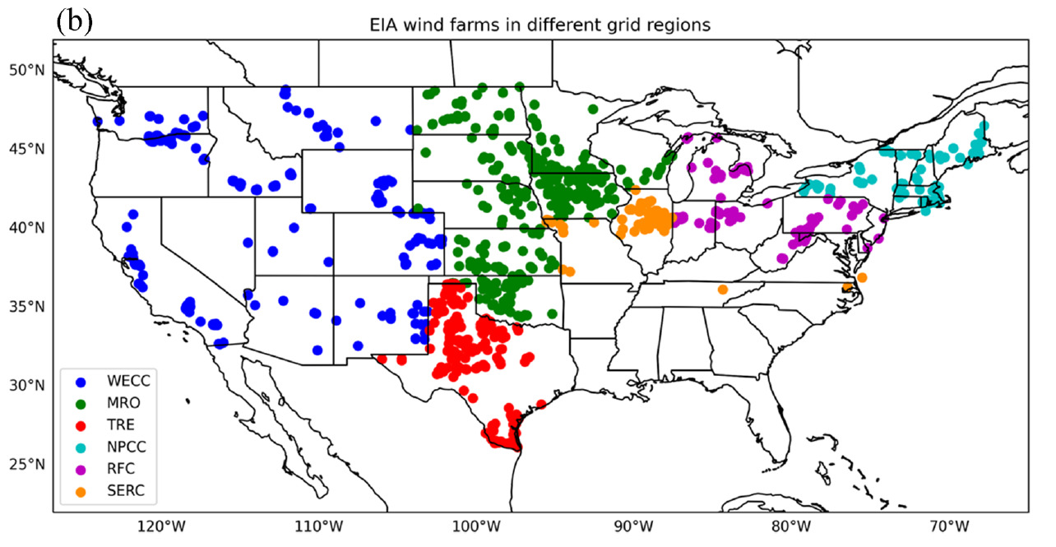
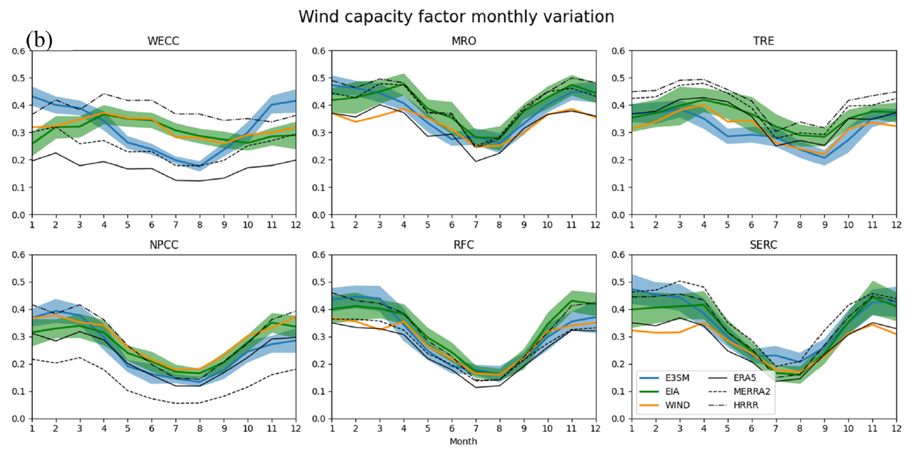
Previously... E3SM refined to 25 km over CONUS
Wind monthly capacity factors
WECC
Western Electricity
Coordinating Council
MRO
Midwest Reliability
Organization
TRE
Texas Reliability Entity
E3SM 25 km
EIA monthly data
NPCC
Northeast Power
Coordinating Council
RFC
Reliability First
Council
SERC
Southeastern Electric
Reliability Council
For wind, E3SM 25 km matches EIA and other data products well, except in the WECC.
Lee et al. (2025, AIP Advances)

Slide 3
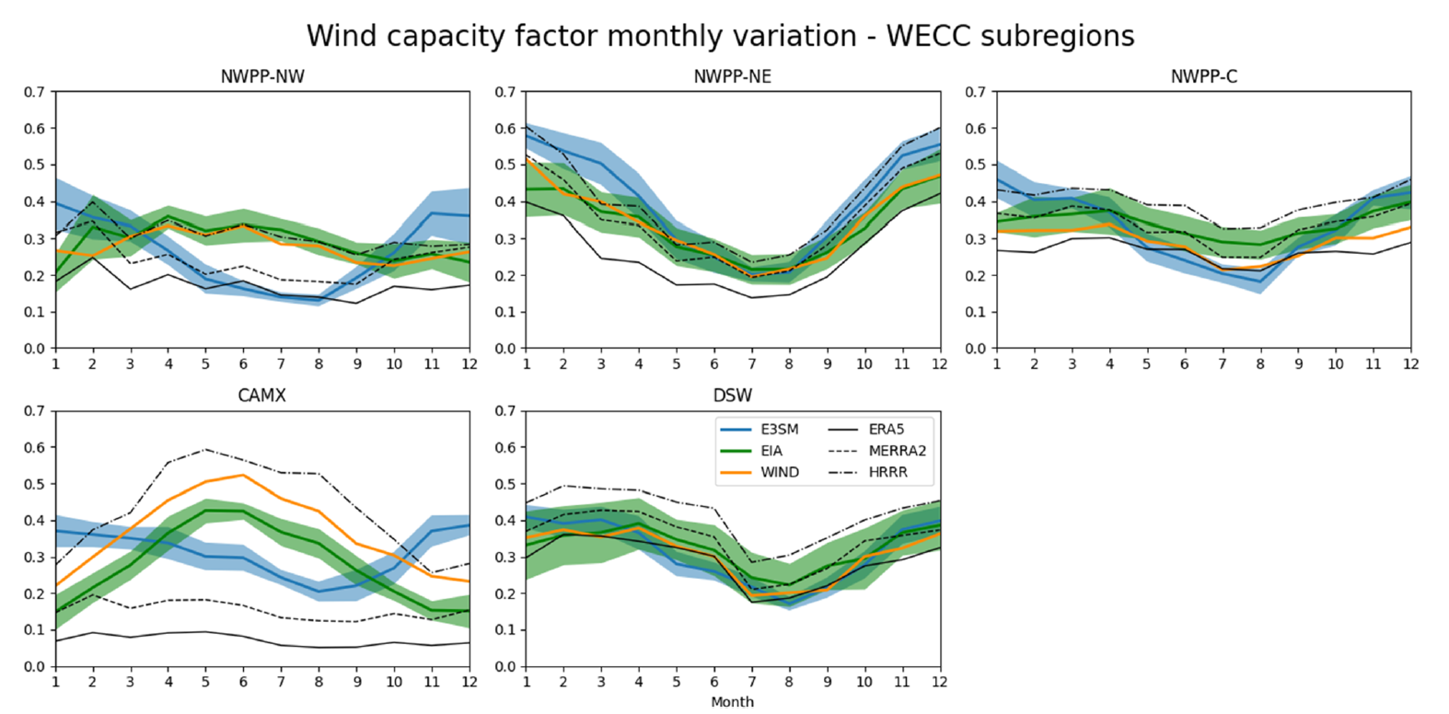
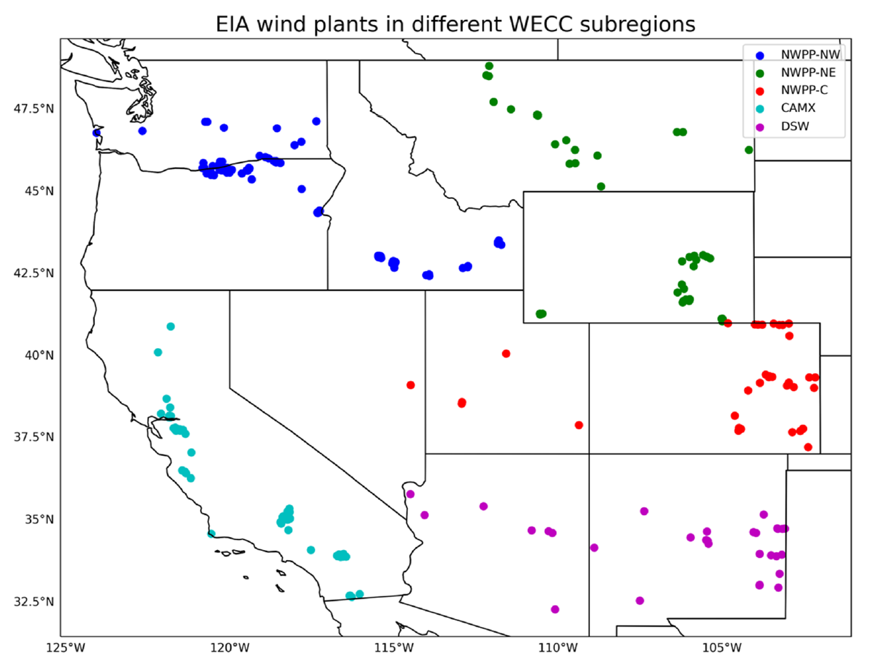
Previously... Zooming in over WECC
NWPP-NW
NWPP-NE
NWPP-C
In the WECC, California is particularly problematic for E3SM 25 km.
CAMX
DSW
E3SM 25 km
EIA monthly data
Lee et al. (2025, AIP Advances)

Slide 4
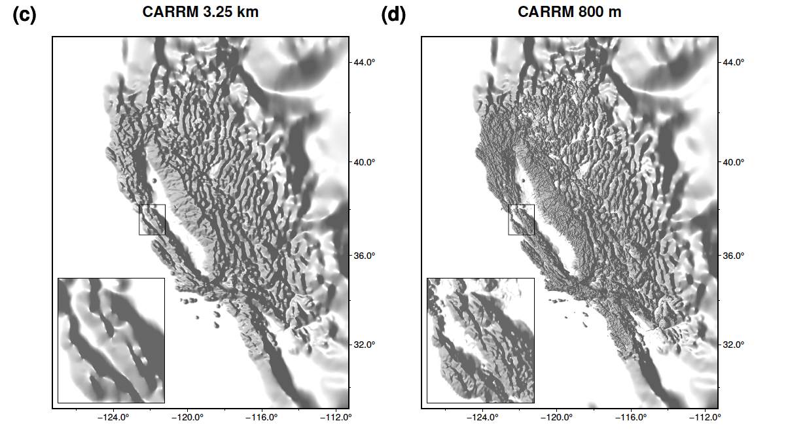
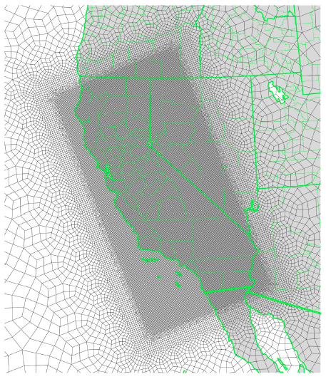
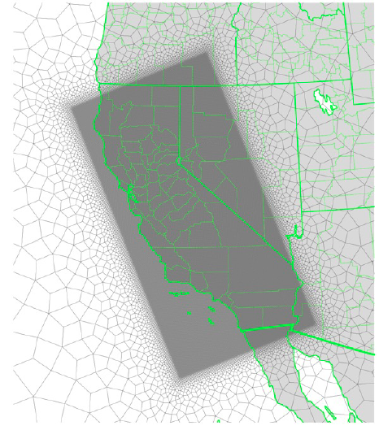
New E3SM simulations Let’s increase resolution over California
Dynamical down-scaling from low-resolution E3SM simulations (SST and nudging)
Zhang et al. (2026, GMD, under review)

Slide 5
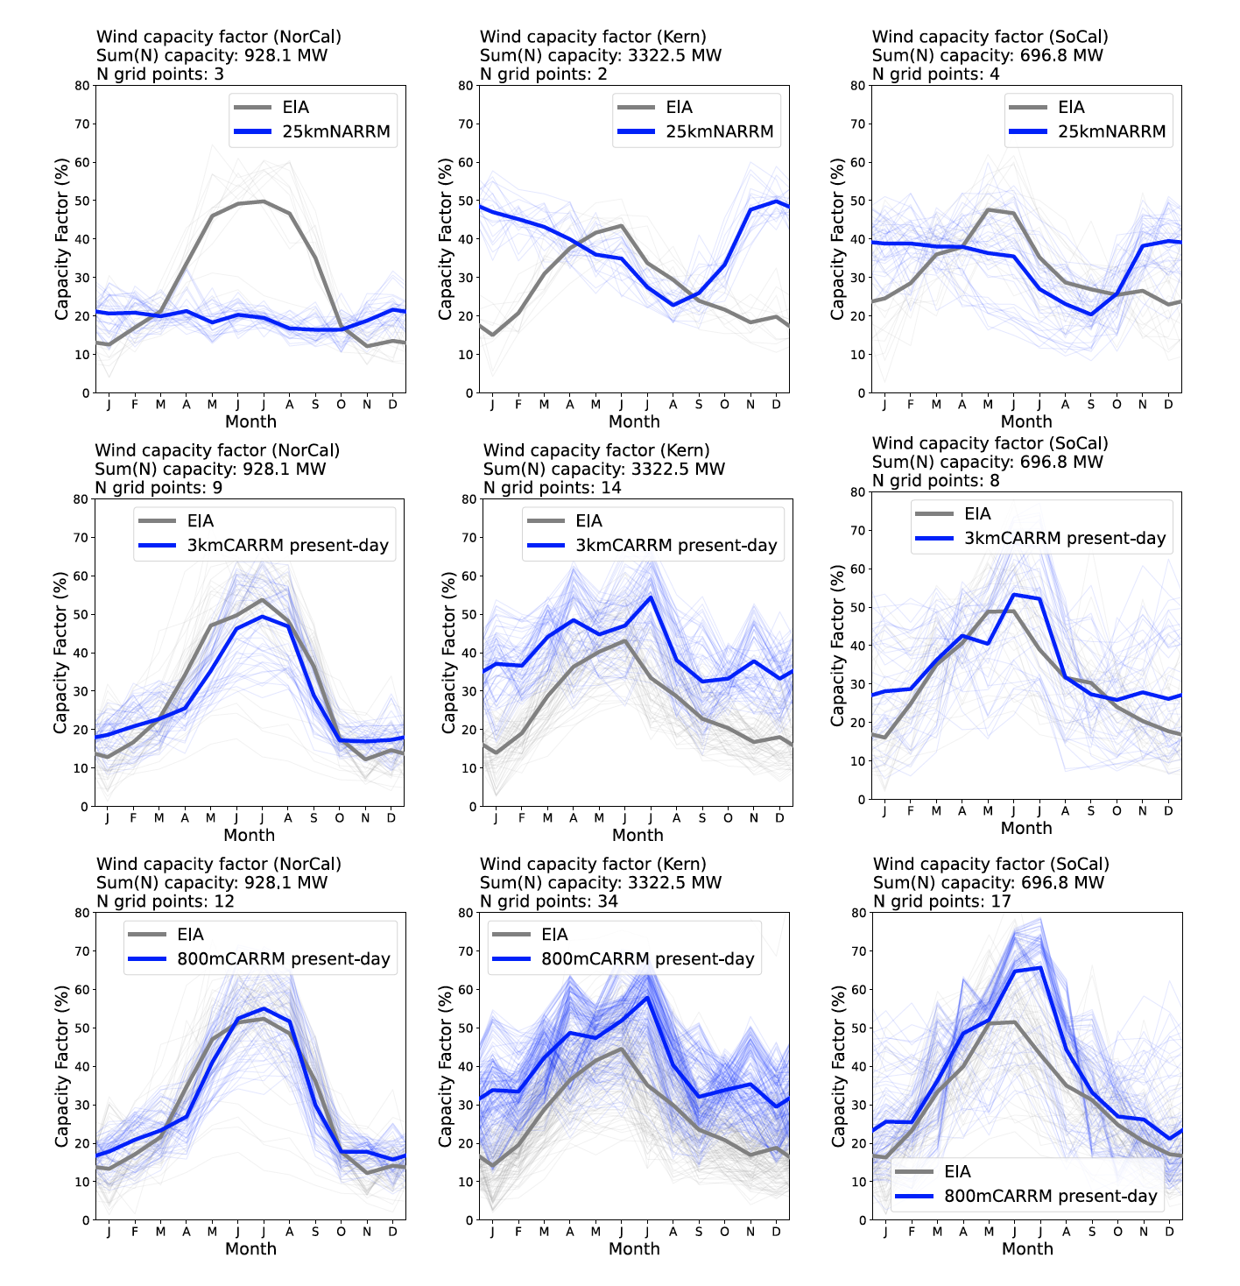
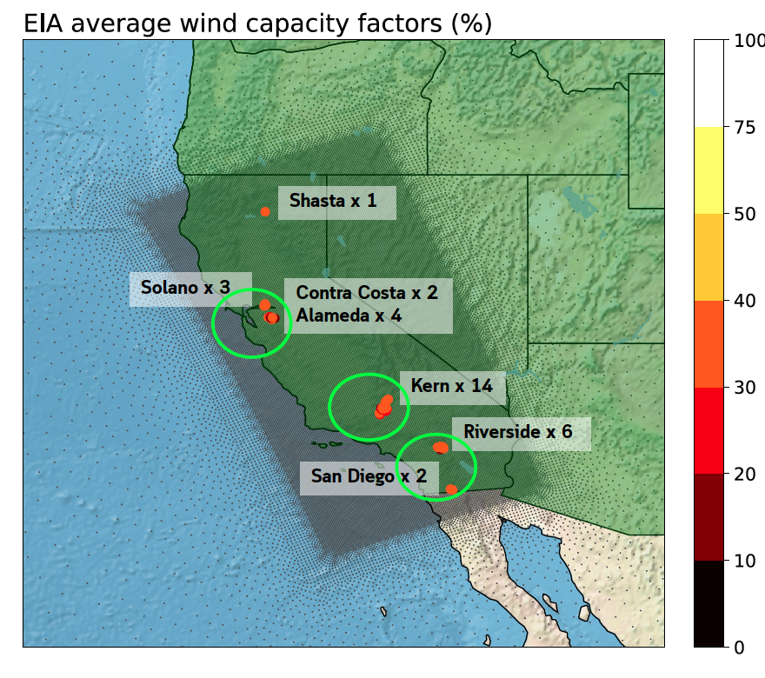
Wind capacity factors in CA
NorCal
Kern County
SoCal
E3SM
25 km
E3SM
3 km
Significant improvement at 3 km and 800 m compared to 25 km.
800 m doesn’t add nearly as much value.
E3SM
800 m
Thin lines: individual years / Thick lines: multi-year climatology
Zhang et al. (2026, GMD, under review)

Slide 6
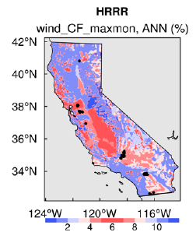
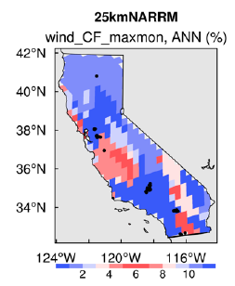
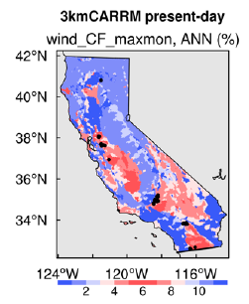
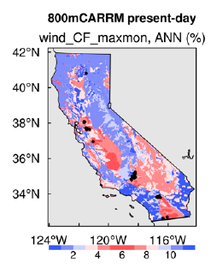
Month of peak wind capacity factor
Significant regional differences in wind seasonal cycle.
Winter-time peak (blue)
Summer-time peak (red)
25 km mis-represents NorCal region (blue instead of red)
Zhang et al. (2026, GMD, under review)

Slide 7
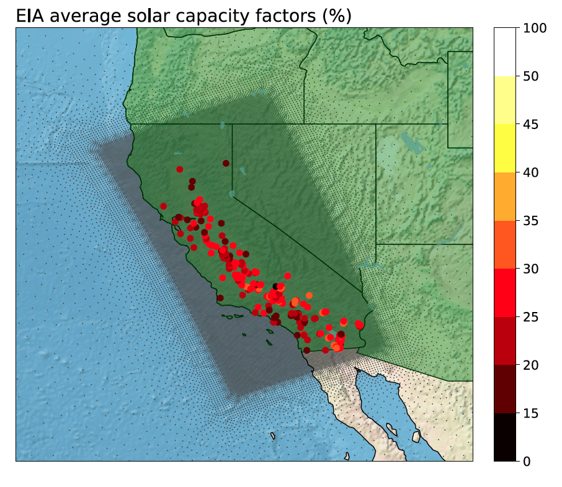
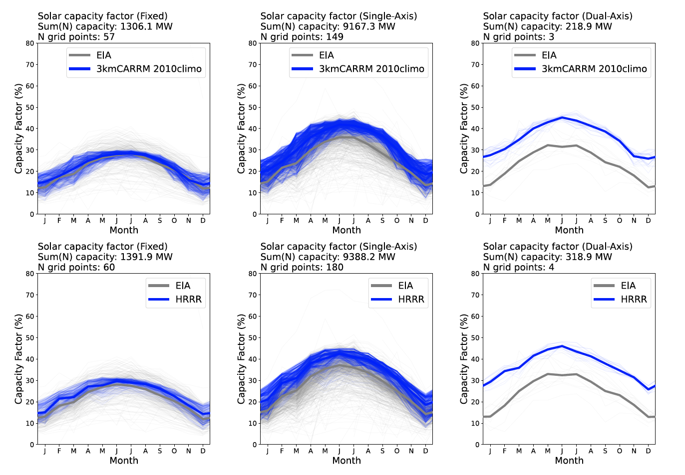
Solar capacity factors in CA
Fixed axis
Single-axis
Dual-axis
E3SM
3 km
HRRR
High-resolution E3SM and HRRR do comparatively well.
Fixed axis matches EIA amplitude and seasonal cycle.
Overestimation for single and dual axis.
Thin lines: individual years
Thick lines: multi-year climatology
Zhang et al. (2026, GMD, under review)

Slide 8
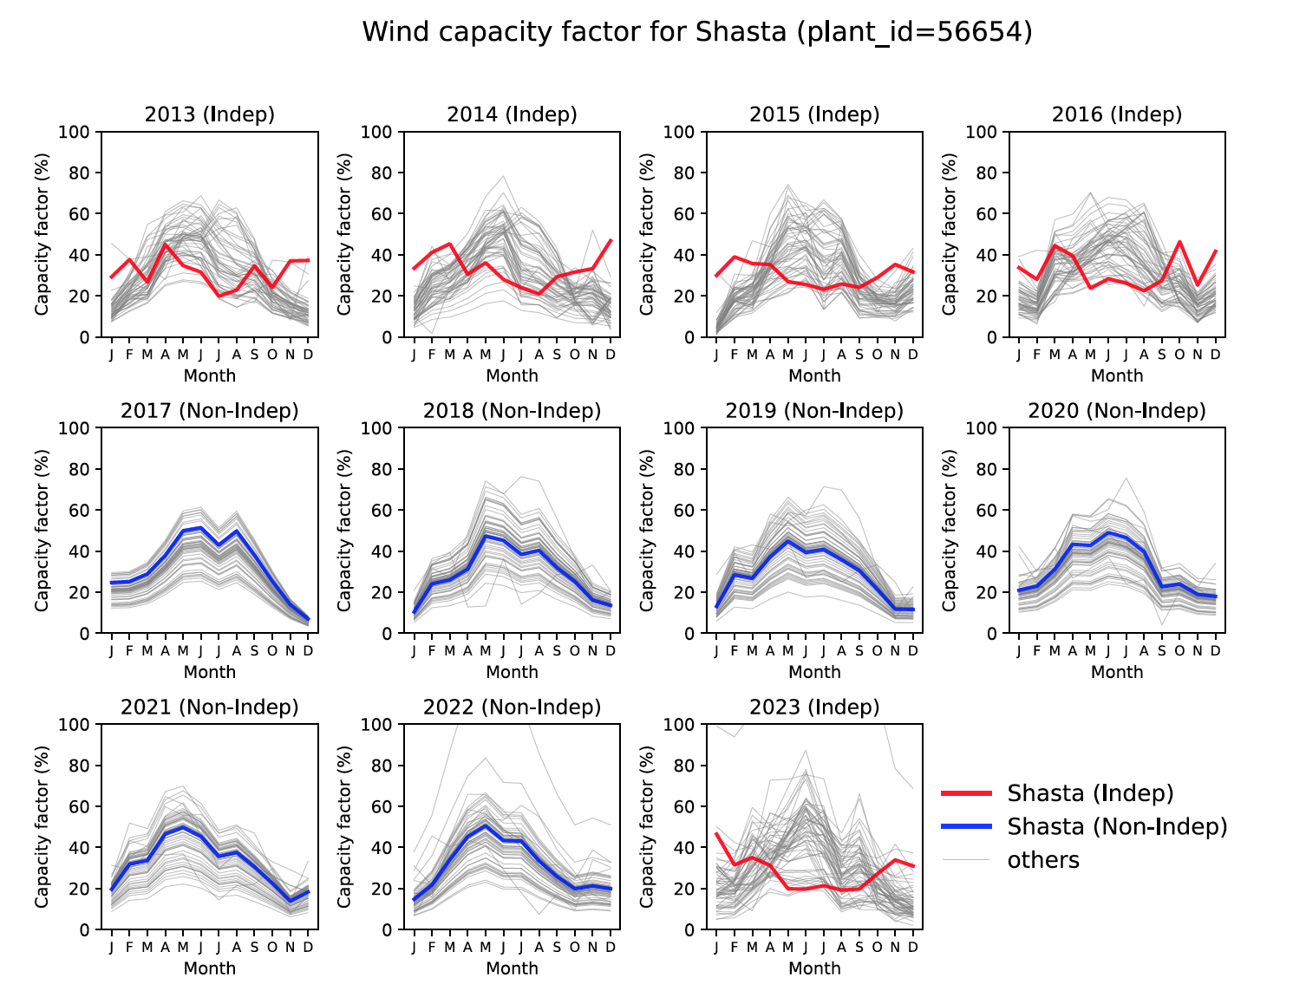
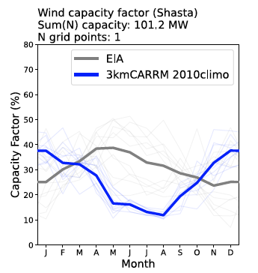
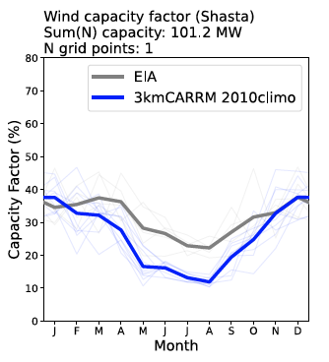
Shasta wind farm (The problem child)
EIA all-years
EIA years without filling
Initial comparison revealed poor performance of E3SM (3 km / 800m) for Shasta wind farm.
Artifact of in-filling with nearby plants for missing years in EIA data.
Indep (red): monthly EIA data for Shasta is real
Non-Indep (blue): monthly EIA data is filled from nearby plants
Zhang et al. (2026, GMD, under review)

Slide 9
Take home messages
E3SM 3 km and 800 m improves poor simulation of wind capacity at 25 km.
E3SM 25 km fails to capture regional differences in wind seasonal cycle (summer vs winter peak).
800 m adds little additional value compared to 3 km given its huge cost.
There are smaller improvements in solar with high-resolution E3SM because solar is easier (at least for sunny California).
On a climatological sense, E3SM 3 km performs competitively with NOAA HRRR.
Caution with EIA data in-filling (e.g. Shasta)

Slide 10


References
Hsiang-He Lee, Robert S. Arthur, Jean-Christophe Golaz, Matthew V. Signorotti, Jessica L. Wert, Jean-Paul Watson; Using multiple high-resolution datasets to benchmark the energy exascale earth system model (E3SM) for renewable resource assessment. AIP Advances 1 October 2025; 15 (10): 105316. https://doi.org/10.1063/5.0274286
Zhang, J., Golaz, J., Signorotti, M. V., Lee, H., Bogenschutz, P., Monteagudo, M., Ullrich, P. A., Arthur, R. S., Po–Chedley, S., Cameron–smith, P., and Watson, J.: Simulation of wind and solar energy generation over California with E3SM SCREAM regionally refined models at 3.25 km and 800 m resolutions, EGUsphere [preprint], https://doi.org/10.5194/egusphere-2025-3947, 2025.
Acknowledgements. The development of SCREAM is supported by the Energy Exascale Earth System Model (E3SM) project funded by the U.S. Department of Energy, Office of Science, Office of Biological and Environmental Research. This work was supported by LLNL LDRD project [25-SI-007] “Framework for Optimal Critical-Infrastructure Solutions and Decision Support”, LLNL LDRD project [23-ERD-010], “Forecasting and mitigating the impacts of climate change on renewable energy resources and grid reliability” and LLNL LDRD project [22-SI-008] “Climate Resilience for National Security”. LLNL Institutional Computing Grand Challenge program provided the computing support for this work.
Work at LLNL was performed under the auspices of the U.S. DOE by LLNL under contract no. DE-AC52-07NA27344.

