Slide 1

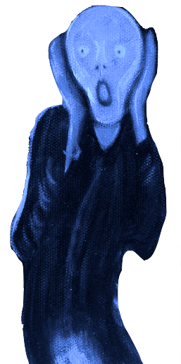
Using Short Simulations to Automate Tuning in a Global Storm-Resolving Model (GSRM)
Peter Caldwell, Jennifer Paige, Luca Bertagna, Hassan Beydoun, Gavin Collins, Peter Bogenschutz, Andrew Bradley, Aaron Donahue, Oksana Guba, Walter Hannah, Ben Hillman, Noel Keen, Jungmin Lee, Wuyin Lin, Hsi-Yen Ma, Naser Mahfouz, Andy Salinger, Lyndsay Shand, Chris Terai, and Benj Wagman
contact: caldwell19@llnl.gov
This work was performed under the auspices of the U.S. Department of Energy by Lawrence Livermore National Laboratory under Contract DE-AC52-07NA27344 IM Release Number LLNL-PRES-871628

Slide 2
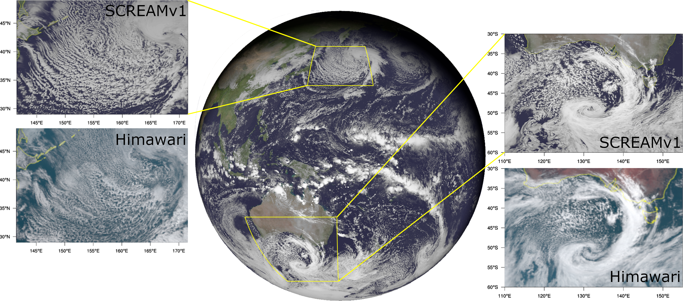
Introduction to GSRMs
Increased computing power + frustration with the rate of Earth System Model (ESM) improvement have made GSRMs (global atmosphere models with dx<5 km) popular
The Simple Cloud-Resolving E3SM Atmosphere Model (SCREAM) is DOE’s GSRM
  It was written in C++/Kokkos to take advantage of all of the world’s fastest supercomputers
  With only a few days of tuning, SCREAM’s skill is comparable to ESMs
Tuning is less important when more processes are explicitly resolved – Caldwell et al. (JAMES, 2021)
Fig: Snapshots of a cold-air outbreak (left) and a cyclone (right) from a global SCREAM forecast (center) compared to Himawari satellite validation (bottom panels).
Notes:
Remember to say that tuning is needed to make GSRMs better than ESMs as the slide transition!

Slide 3
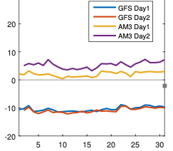
Climatological Tuning from Short Simulations?
Hypotheses:
Cloud biases develop rapidly and clouds are the main thing we tune… so short runs should be sufficient
Bias is similar every day so only a few hindcasts are needed
We tested this with 2x ~150 member ensembles:
  5-day simulations starting Aug 1, 2016 (DYAMOND1)
  2-day simulations starting Jan 26th, 2020 (DYAMOND2)
  varied 15 cloud + turbulence parameters
  Used 𝚫x=3.25 km globally. 𝚫t=8.33 s for dynamics
  and 𝚫t=100 s for most other processes
GFS 24 hr
GFS 48 hr
AM3 24 hr
AM3 48 hr
Global-average OSR bias (W m⁻²)
Day of month model was initialized
Fig: Global-average bias in outgoing shortwave radiation (OSR) for 24 and 48 hr hindcasts from the GFS and AM3 global atmospheric models for each day of July 2013. Courtesy Chris Jones and Chris Bretherton

Slide 4
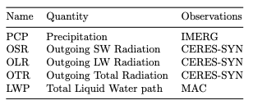
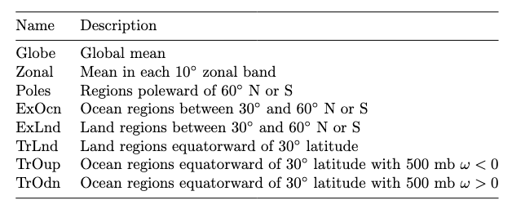
What Outputs to Optimize?
Cloud variables equilibrate rapidly… but circulation variables don’t
  Hindcast tuning ensures realistic response to correct large-scale conditions
  A final “optimize skill at all costs” step is still needed
Table: target variables
Averaging is needed to minimize noise
As a start, each region and variable is given equal weight in our cost function
Table: target regions
Short forecasts can’t replace climatological tuning

Slide 5
Which Parameters Matter?
1
2
3
4
5
1
2
3
4
5
1
2
3
4
5
1
2
3
4
5
1
2
3
4
5
1
2
3
4
5
1
¾
½
¼
0
Poles
ExLnd
Exploring parameter values for the best-performing ensemble members is useful…
  aerosol activation should always be weak
  Large upper bound on stability correction is better
  turbulent lengthscale is generally better at large values
  rain accretion rate are generally better at large values
  parameters with random colors probably don’t matter
ExOcn
TrLnd
Just exploring your ensemble is valuable!
TrOup
Fig: parameter values for the 5 ensemble members with lowest bias for each region (summed over all variables). Parameters have been normalized as fractional distance between min and max allowable values.
TrOdn

Slide 6
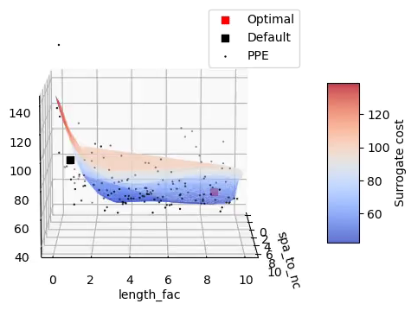
Automated Calibration
To optimize uncertain physical parameters we:
  Build an AI surrogate for time-averaged behavior as a function of the uncertain parameters
    Use principal component analysis to reduce dimensionality and orthogonalize dimensions
    Emulate each principal component independently using polynomial chaos expansion
  Optimize parameters for a desired cost function using scipy.minimize (L-BFGS-B method)
Fig: Cost surface for the most important parameters considered in this work
See Yarger et al. (JAMES 2024) for methodology

Slide 7
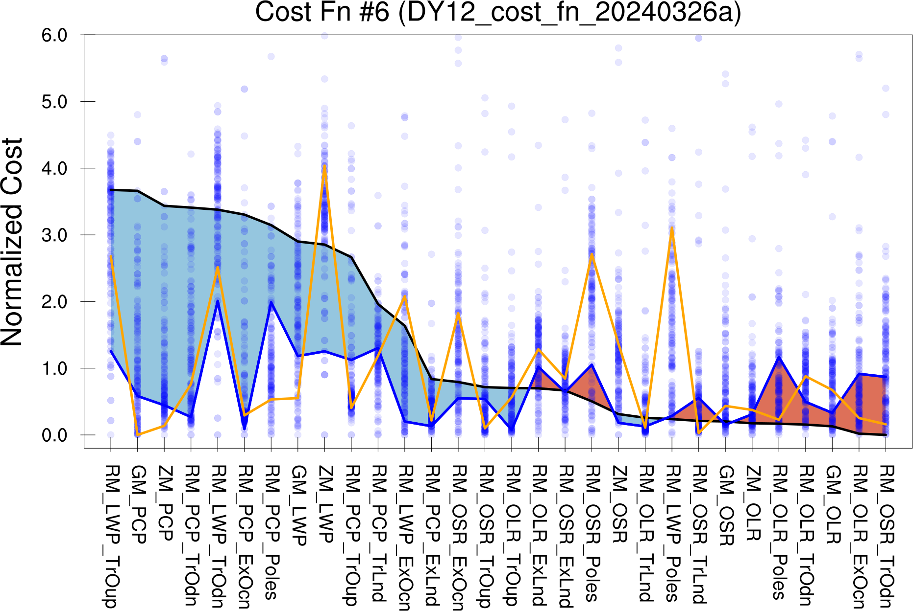
Improved Parameters
Our optimal tuning improves most of our target metrics, some by a lot (blue versus red shading)
Random guessing (by trying PPE values, see orange line) is substantially worse
Fig: Model skill at a variety of metrics. Black line=default and blue line=optimized. Blue areas indicate improvements and red areas show worsening. The orange line is the PPE member with minimum cost.

Slide 8
Conclusions
Tuning becomes less important as more scales of motion are resolved
Tuning with short hindcasts is useful as a first look but isn’t by itself sufficient (because it ignores slow-changing variables)
  A multi-resolution surrogate is probably needed for climatological tuning of GSRMs
Large ensembles of short GSRM runs are very doable on exascale computers

Slide 9

Questions: caldwell19@llnl.gov
Disclaimer
This document was prepared as an account of work sponsored by an agency of the United States government. Neither the United States government nor Lawrence Livermore National Security, LLC, nor any of their employees makes any warranty, expressed or implied, or assumes any legal liability or responsibility for the accuracy, completeness, or usefulness of any information, apparatus, product, or process disclosed, or represents that its use would not infringe privately owned rights. Reference herein to any specific commercial product, process, or service by trade name, trademark, manufacturer, or otherwise does not necessarily constitute or imply its endorsement, recommendation, or favoring by the United States government or Lawrence Livermore National Security, LLC. The views and opinions of authors expressed herein do not necessarily state or reflect those of the United States government or Lawrence Livermore National Security, LLC, and shall not be used for advertising or product endorsement purposes.

Slide 10
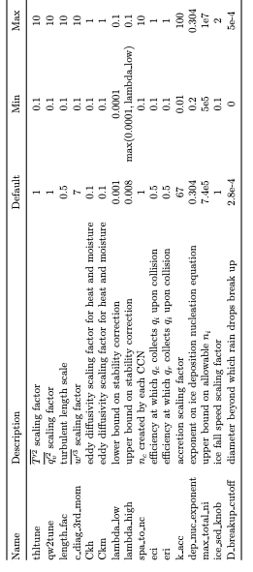
Tuning Parameters
Focus on cloud parameters b/c they are most important and clouds equilibrate quickly
Ensemble members were created via Latin Hypercube sampling
Table: Tuning parameters used in this study

Slide 11
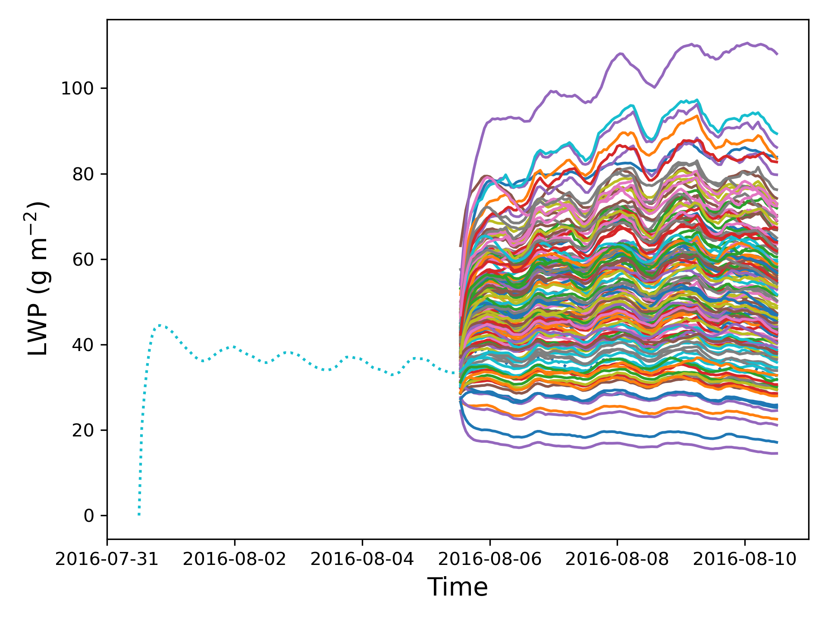
Spin-Up
Initial conditions via a 5 day run with:
  default tuning
  6 hrly ERA5 nudging
Day 1 of each ensemble member is discarded as spin up
DYAMOND1 PPE
Turned out to be unnecessary since the model needs to re-equilibrate after subsequent parameter changes
Decreasing ice fall speed from its default slows equilibration, forcing us to exclude these runs
Fig: We use a 5 day run nudged to ERA5 as the initial condition for our PPE, which includes 2- or 5-day runs

Slide 12
The Need for a Precise Surrogate
The surrogate is able to predict better parameters
But the surrogate is only accurate to within 20%
Model Verification of Surrogate Optimum
Default
20% uncertainty in surrogate vs model value
  and ”best” usually includes some luck, so actual model value is worse
Since default tuning is usually <20% from optimal, autotuning lacks the precision needed to be helpful
Cost
Surrogate-Predicted Optimum

Slide 13
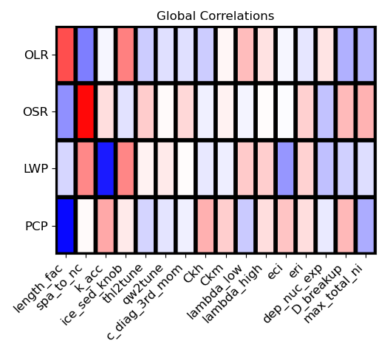
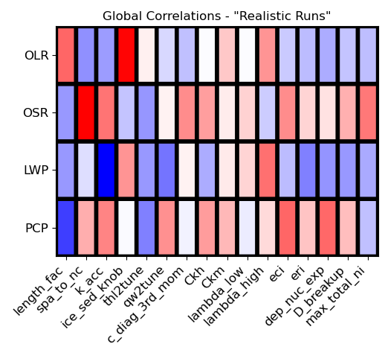
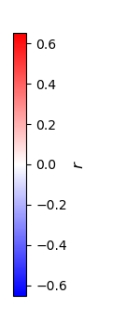
Don’t Abandon That Tuning Parameter!
Perturbed Physics Ensemble (PPE)
Calibrated Physics Ensemble (CPE)
Figures: Correlations between global-average target variables and parameters for all runs (left) and 25 most accurate runs (right)
Parameters causing a large diversity of output values necessarily include many unrealistic values.
CPEs therefore down-weight leading PPE parameters relative to better-behaved parameters

Slide 14
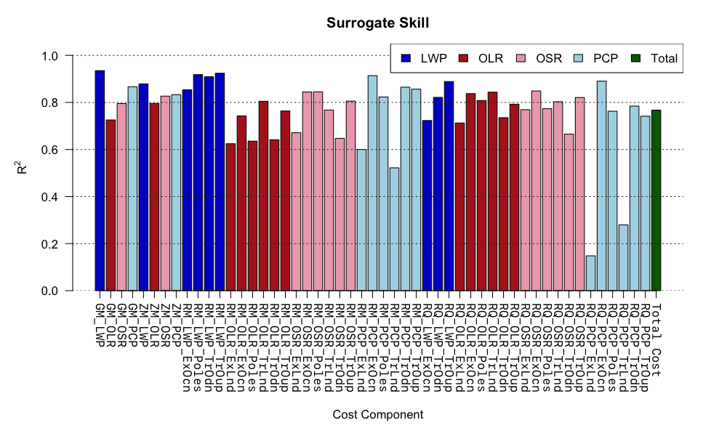
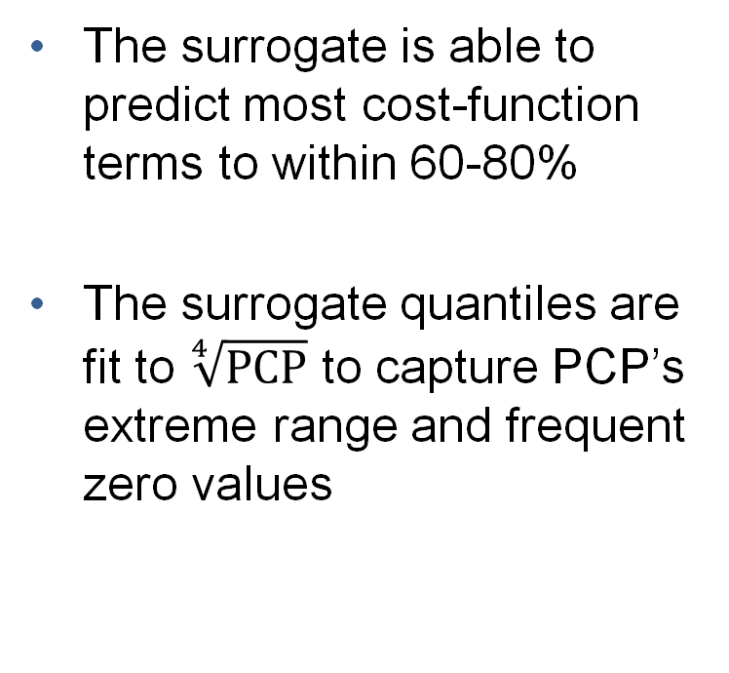
Surrogate Skill
The surrogate is able to predict most cost-function terms to within 60-80%
The surrogate quantiles are fit to $\sqrt[4]{\text{PCP}}$ to capture PCP’s extreme range and frequent zero values
Fig: Fraction of PPE variations in cost-function terms (averaged over DYAMOND1 and DYAMOND2 values) captured by surrogate

Slide 15
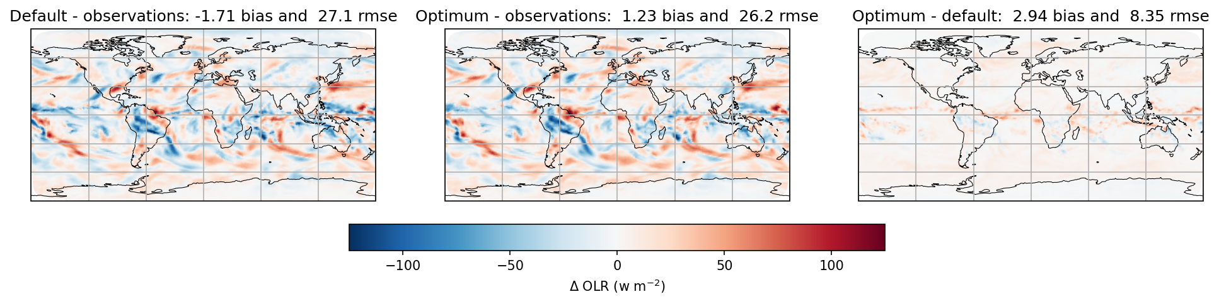
Regional Improvements
Tuning improves bias and RMSE through small but globally pervasive changes
Fig: OLR bias in DYAMOND2 default and optimized tunings (left and middle) and difference between optimized and default (right panel)

Slide 16
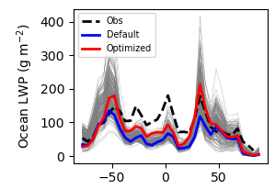
Improvement of Zonal Averages
Optimization generally improves agreement with observations (especially for LWP)
At lower latitudes, no ensemble members overlap the observations
  Separating structural from parametric error is useful for setting future development priorities
Fig: Zonal average LWP (excluding land) for DYAMOND2 observations, original tuning, and our optimization. All ensemble members are included in gray.

Slide 17
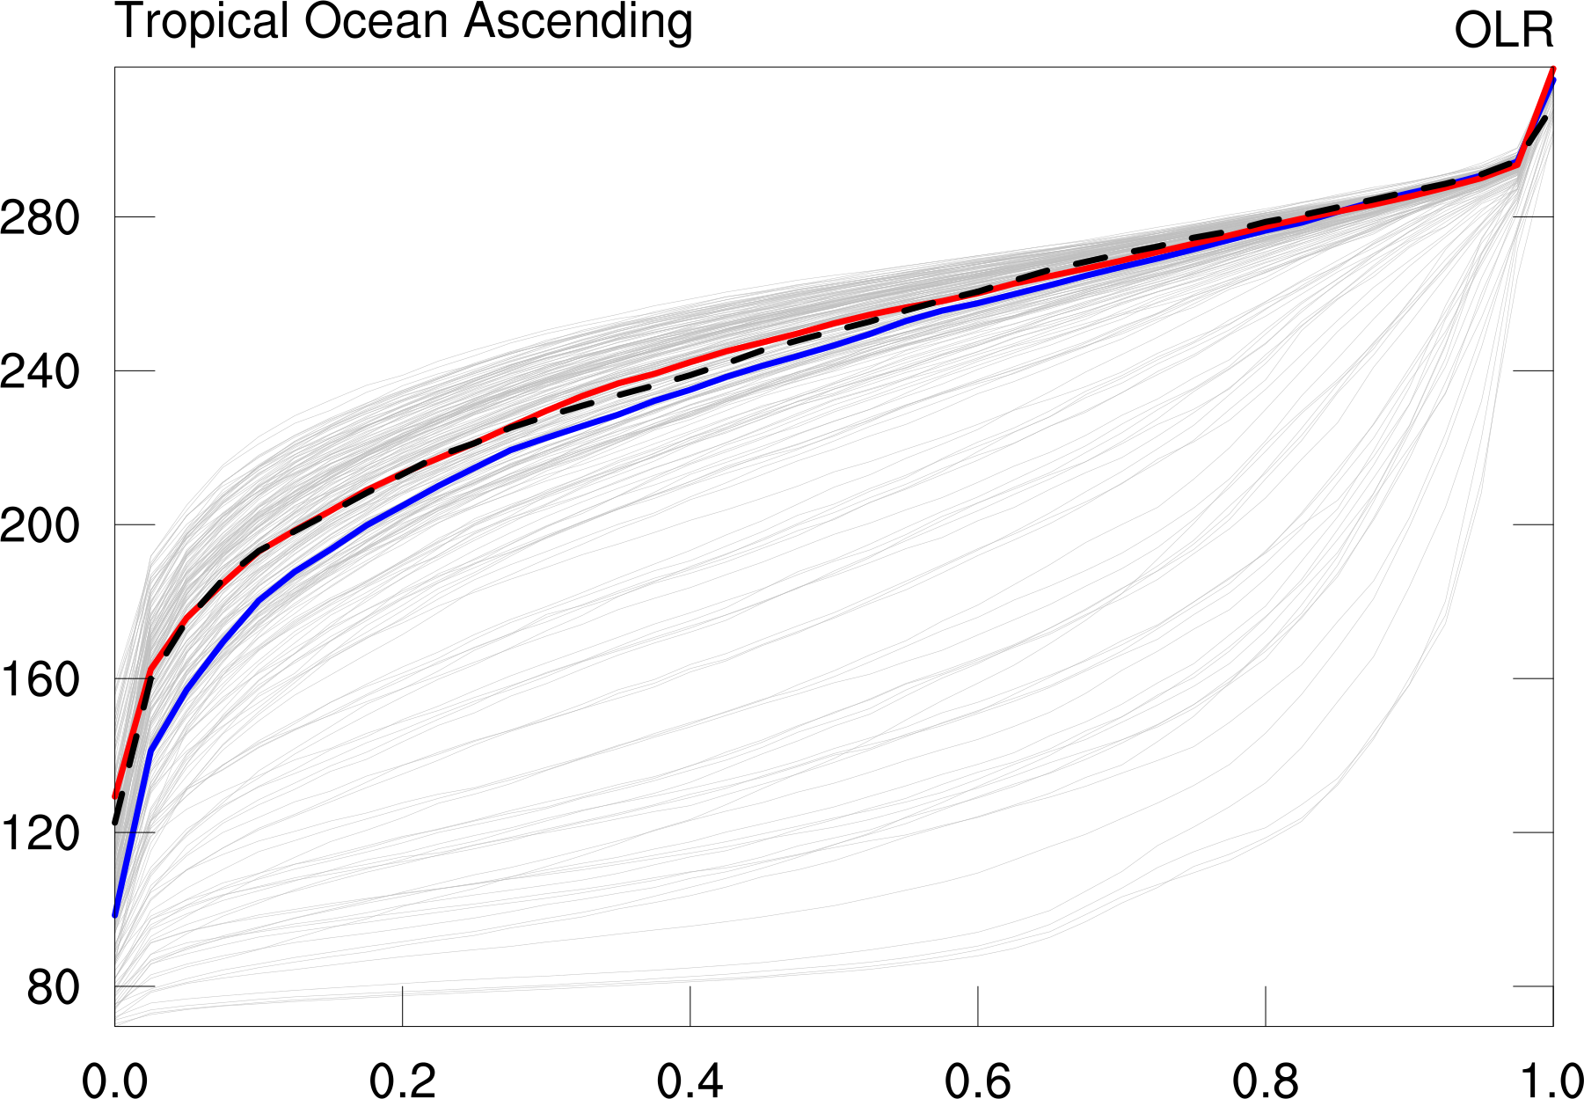
Improvement of PCP Distribution
Getting the right frequency of radiant intensities or intense rain events is important for realistic simulations of clouds and their impacts
We are able to tune the model to reproduce observed quantiles of our target quantities
Fig: Quantiles of OLR sampled across the ascending branch of the tropical ocean for each PPE member (gray), default tuning (blue), optimization (red) and observations (black).

