Slide 1

E3SM’s high resolution model is foundational to DOE’s water availability prediction
Because cloud dynamics occurs on small scales and local geography dominates hydrology
Our atmosphere model has been run with regional refinement to 100 m and our upcoming v4 release features ~10 km dx in all components
AI is supercharging model improvement:
The ACE-E3SM emulator closely replicates E3SM behavior much faster and at far lower computational expense
Replacing expensive and/or crude parameterizations improves model skill
Automated tuning of uncertain physical constants saves human time and – by leveraging lower-resolution runs – makes km-scale tuning possible
Embracing AI workflow tools has improved and accelerated our model development process
AI-based data assimilation will be essential for predicting water availability weeks to years into the future
Fig: Clouds simulated in an E3SM run with 3.25 km grid spacing

Slide 2
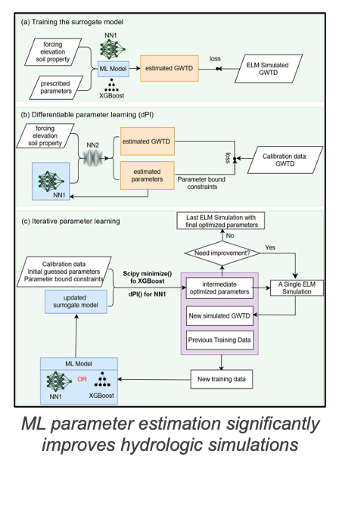
Past uses of AI for hydrological modeling of E3SM’s land+ river models
Differentiable parameter learning significantly improves groundwater simulations
AI-generated datasets (e.g. median sediment particle size) enable global modeling of sediment river transport for floodplain management and planning
Upcoming targets for AI in E3SM hydrological modeling
lateral flow, land-river-lake-wetland interactions at km scale
Multi-objective floodplain management of water, energy, and food
AI land data assimilation will improve hydrological forecasting
E3SM coupling with the GCAM human systems model enables analysis of water footprints and constraints related to energy demand

