Slide 1
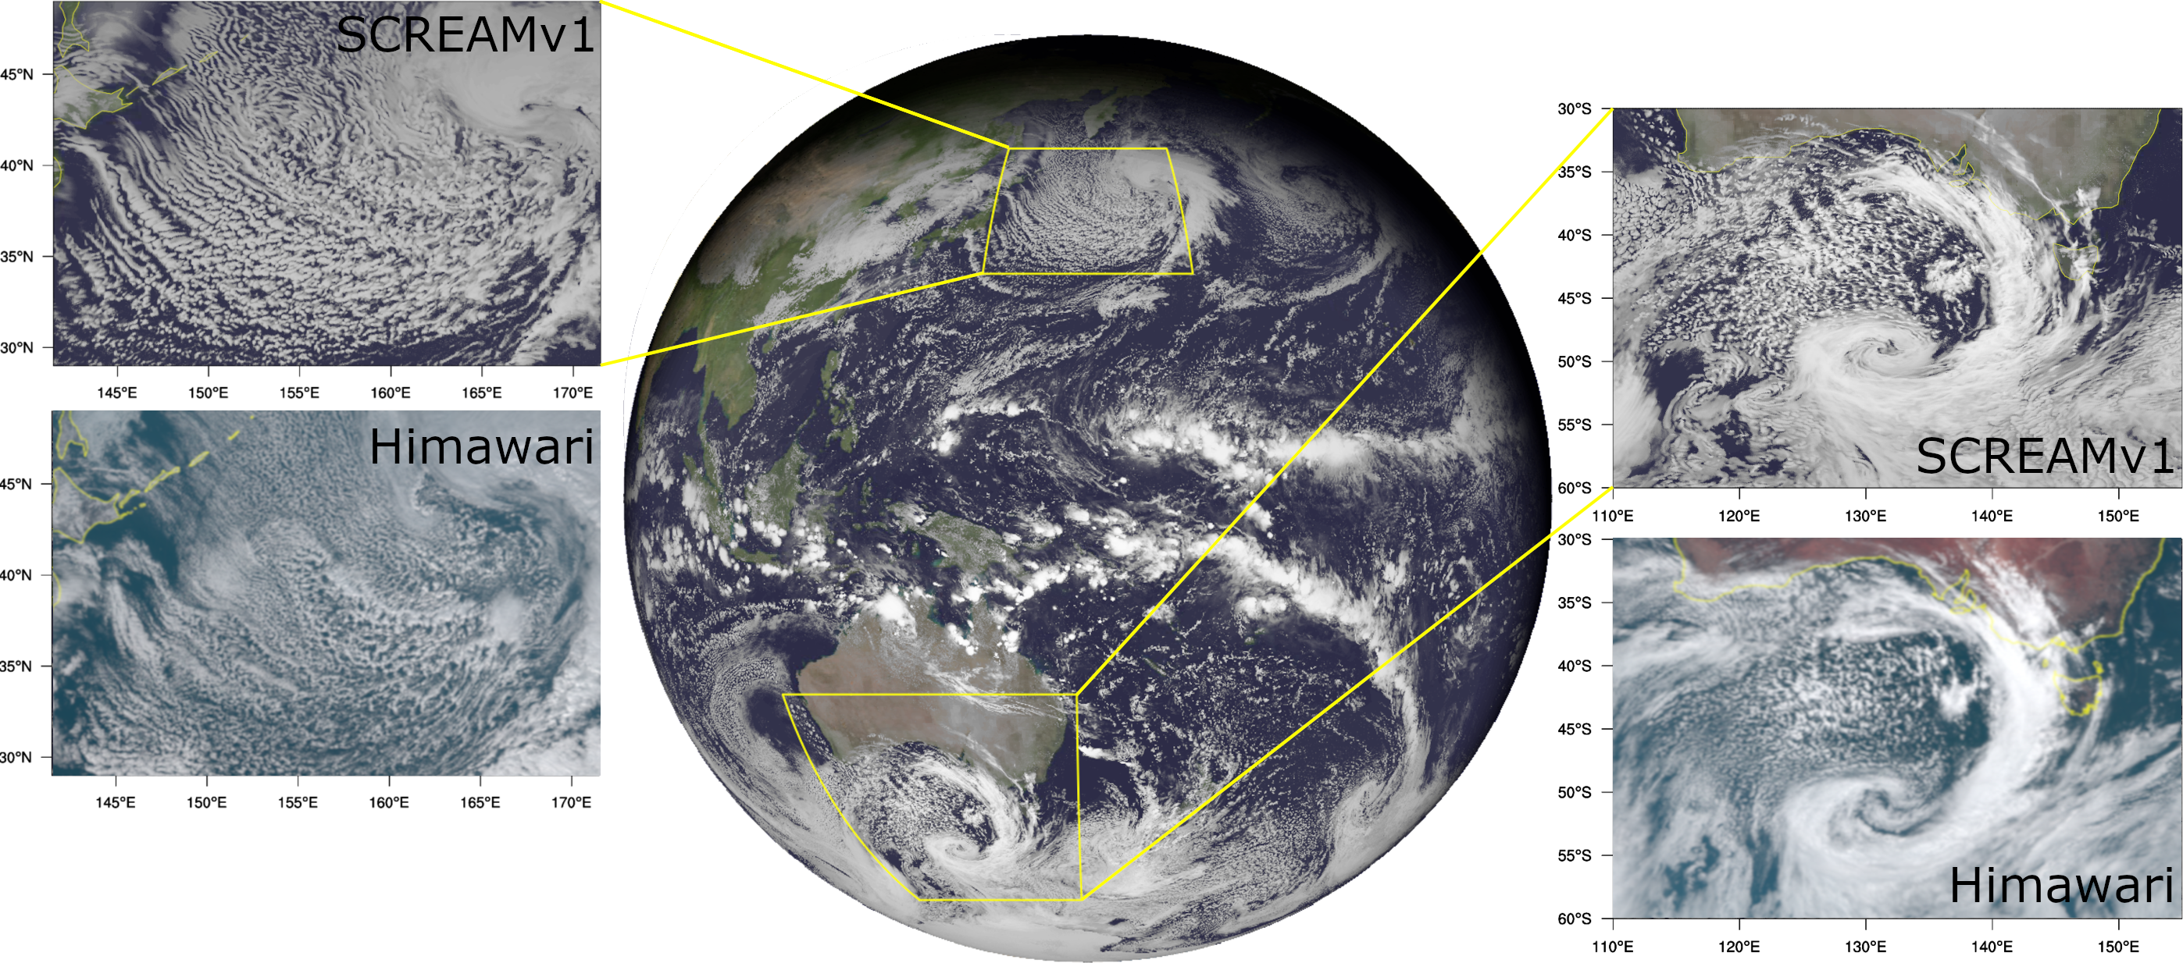

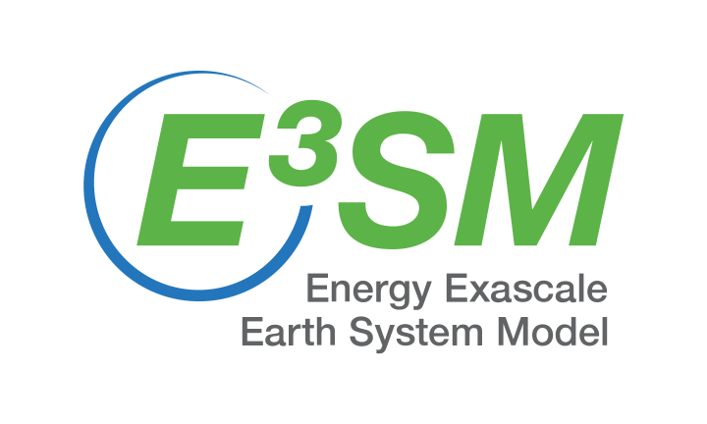
(2024 E3SM Tutorial)
E3SM Regionally Refined Model
and Its Applications
Qi Tang (tang30@llnl.gov), Peter Bogenschutz, and Shaocheng Xie
Lawrence Livermore National Laboratory, Livermore, CA, USA
This work was performed under the auspices of the U.S. Department of Energy by Lawrence Livermore National Laboratory under contract DE-AC52-07NA27344. LLNL-CFPRES-2012650

Slide 2
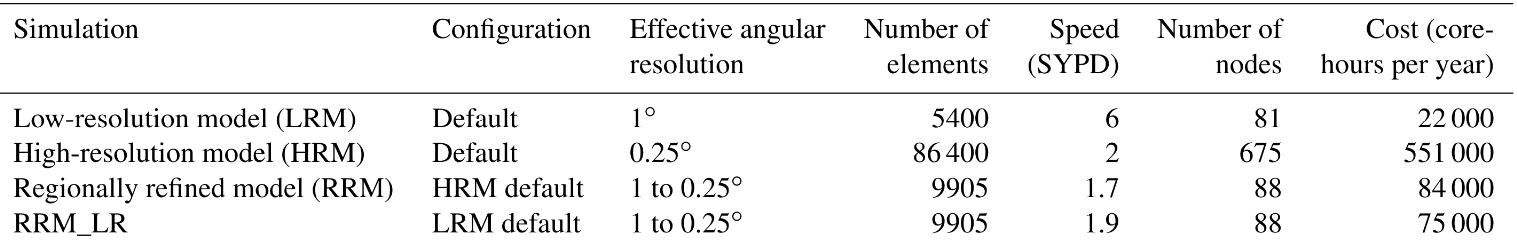
Why Regionally Refined Model (RRM)?
A computationally efficient configuration: ~10-20% of uniform high-res model
High-resolution (high-res) over regions of interest
Long (centuries) and ensemble simulations (internal variability, extremes)
costs of EAMv1 atmosphere-only cases (Tang et al., 2019)
SYPD – simulation years per wall-clock day

Slide 3
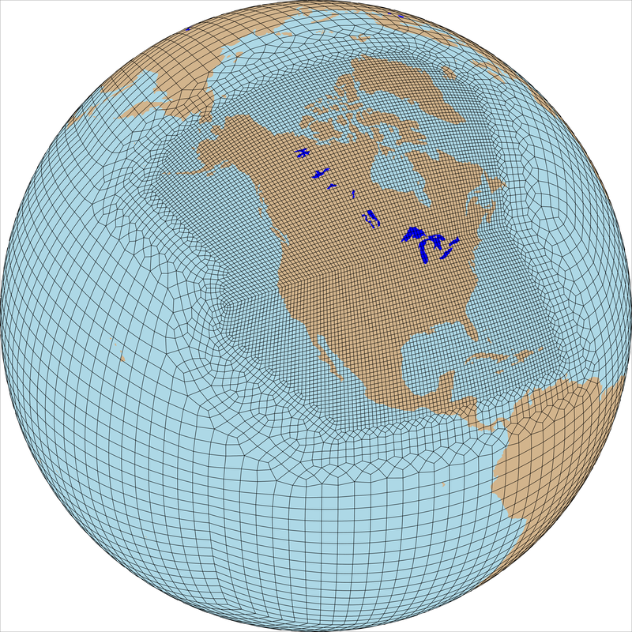
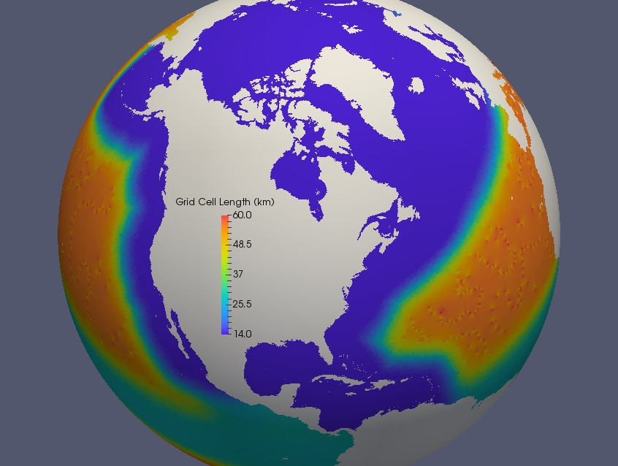
E3SMv2 North American RRM (NARRM)
Tang et al., 2023
RRM in all major components, accomplished CMIP6 climate simulation campaign
Key achievements
  Improved climate at refined mesh without degrading the fidelity over low-res (LR) mesh
  Novel hybrid timestep strategy in EAM
    dt = high-res dycore + LR physics
    Avoids recalibration beyond v2.LR
    Large time-truncation errors at 25 km
  Efficient throughput (12 SYPD on Chrysalis)
Atm, Land (25 -> 100 km)
Ocean, Sea ice (14 -> 60 km)

Slide 4
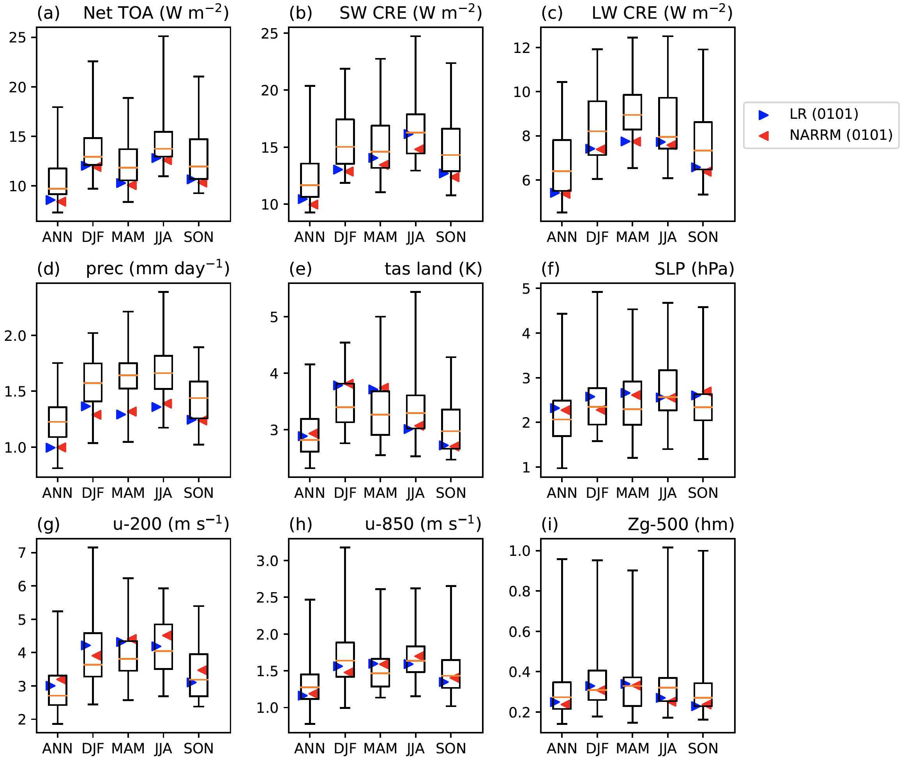
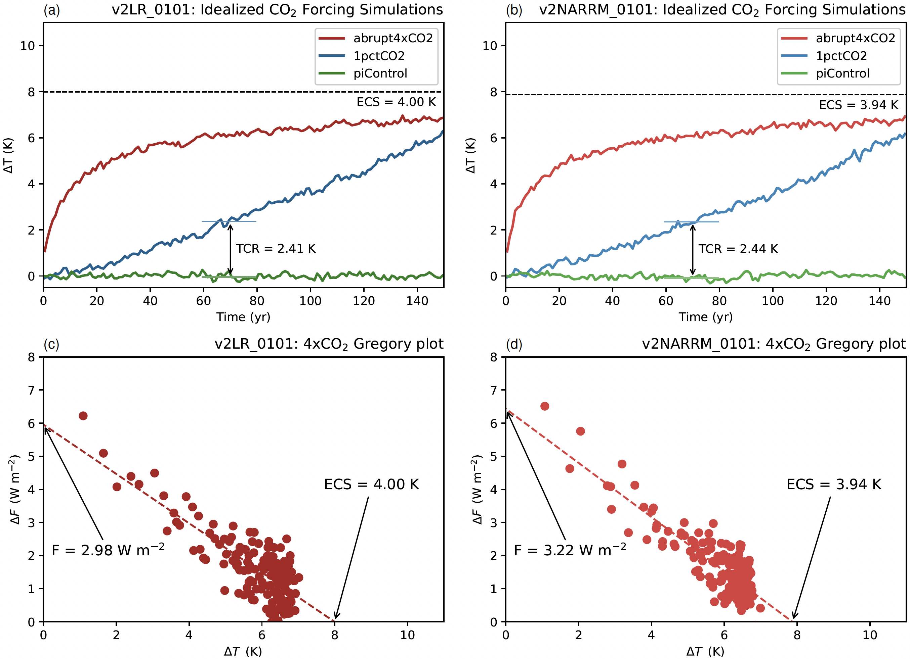
Global results
Tang et al., 2023
LR
NARRM
Worse
Better
Left: global NARRM climatology is the same as or slightly better than its low-resolution (LR) counterpart compared to observations and CMIP6 models.
Right: NARRM and LR have similar climate sensitivities and feedbacks.

Slide 5
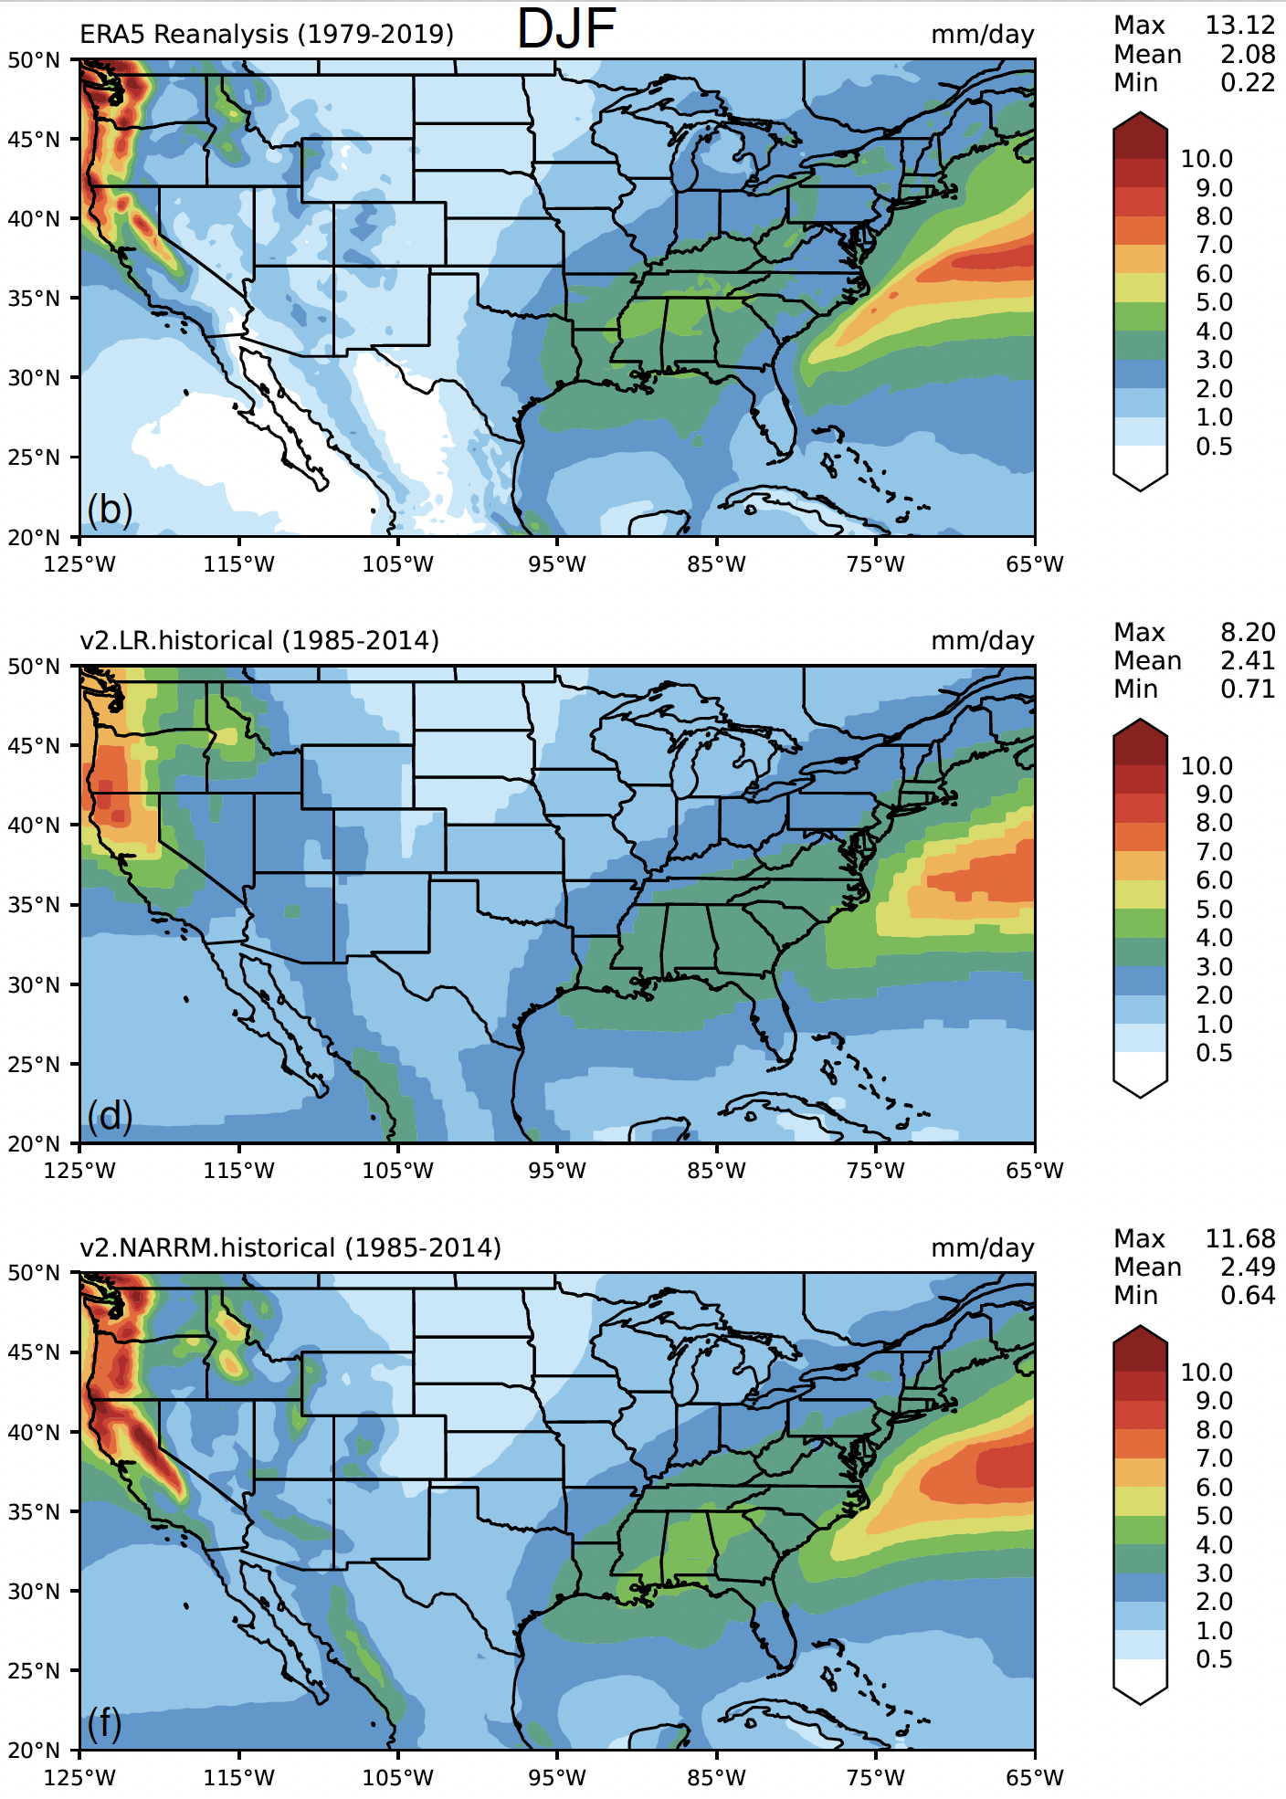
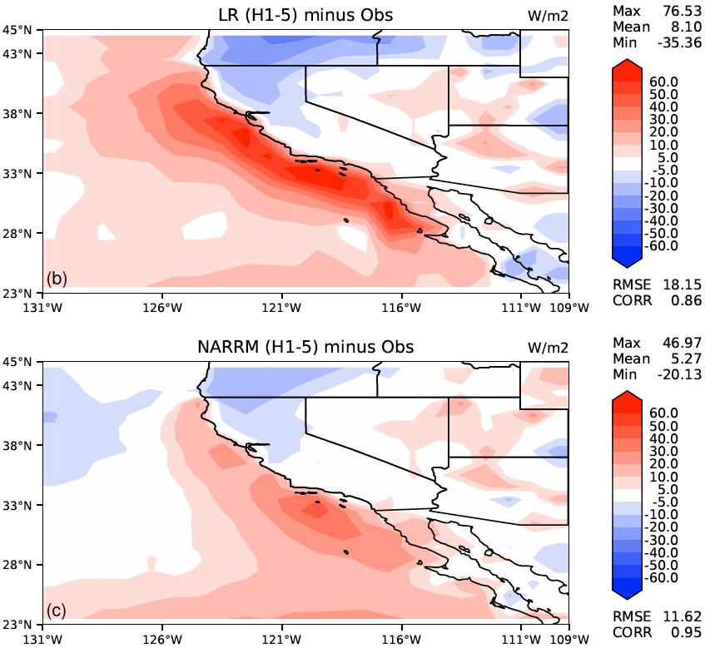
Regional climate improvements
Tang et al., 2023
Precipitation
NARRM simulates better precip (left) related to the finer topography.
Reduces the biases in marine stratocumulus clouds off the California coast (right).
Obs
SWCF
LR
NARRM

Slide 6
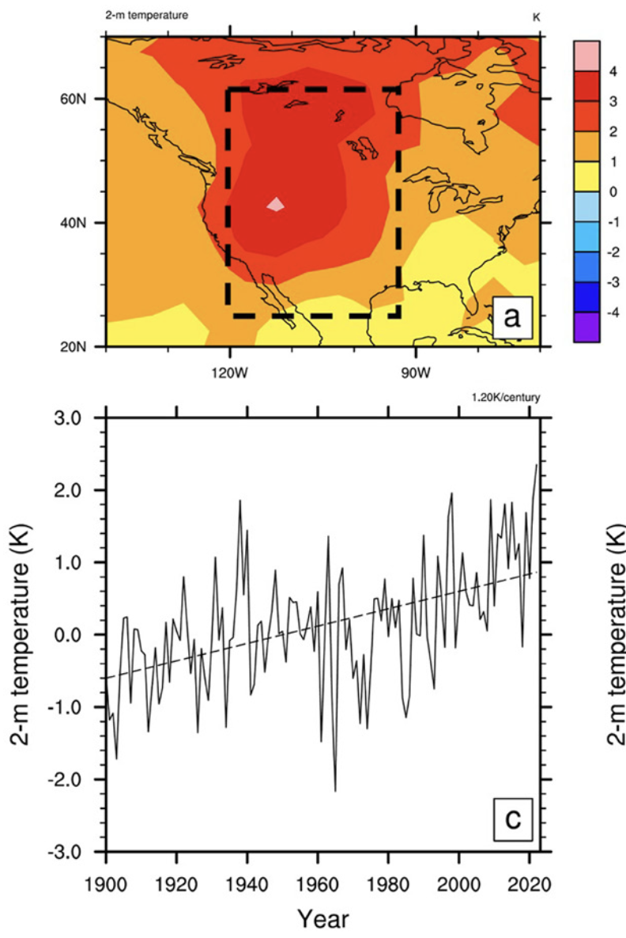
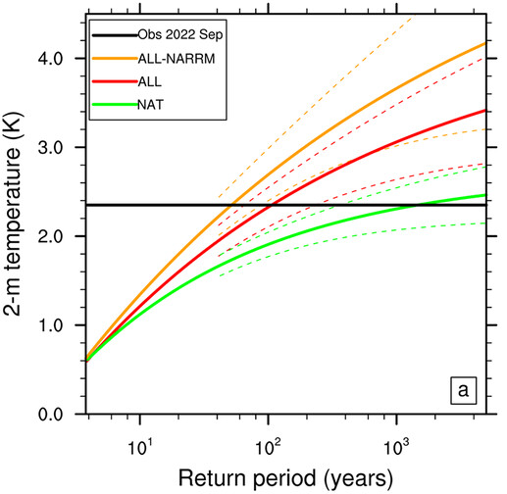
Extreme heat wave, 25-km RRM
Xie et al., 2024
2.35 K
2.35 K
September 2022 = highest T anomaly observed since year 1900, 300+ died in California
Return period: LR = 80-130 years; RRM = 20-90 years
RRM resolves more variabilities (better topography, blocking & atmosphere-land coupling).

Slide 7
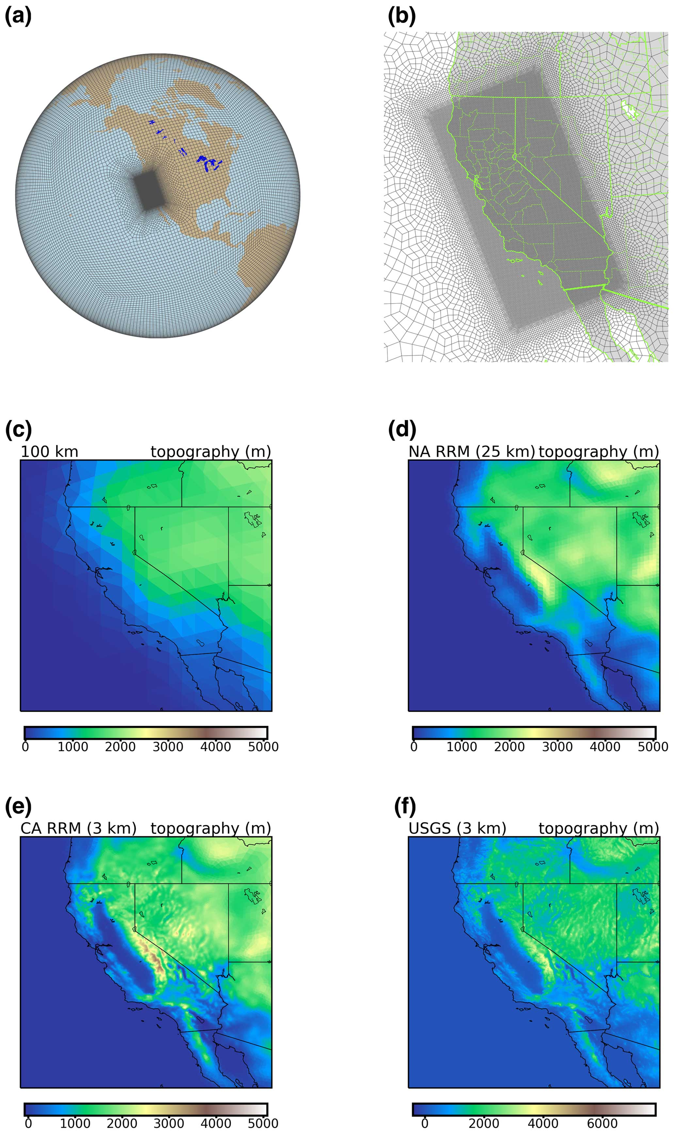
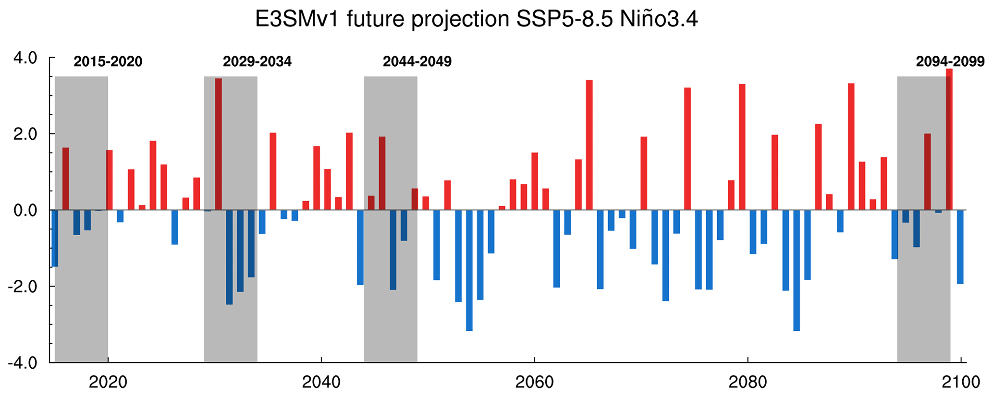
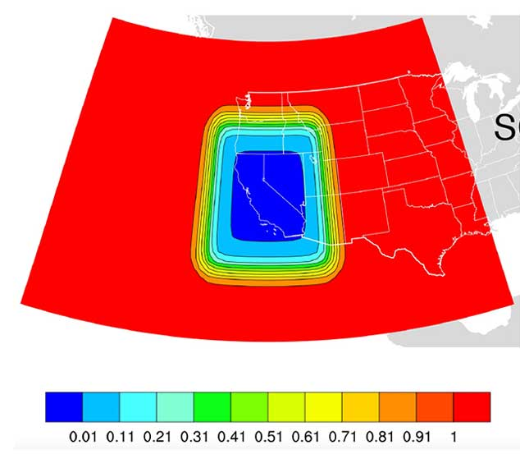
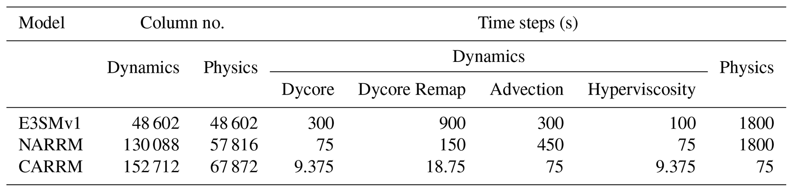
Convection-Permitting (3-km)
California RRM (CARRM) future climate
Zhang et al., 2024
Complex California topography requires high-res mesh
0.7 SYPD, affordable for decadal runs

Slide 8
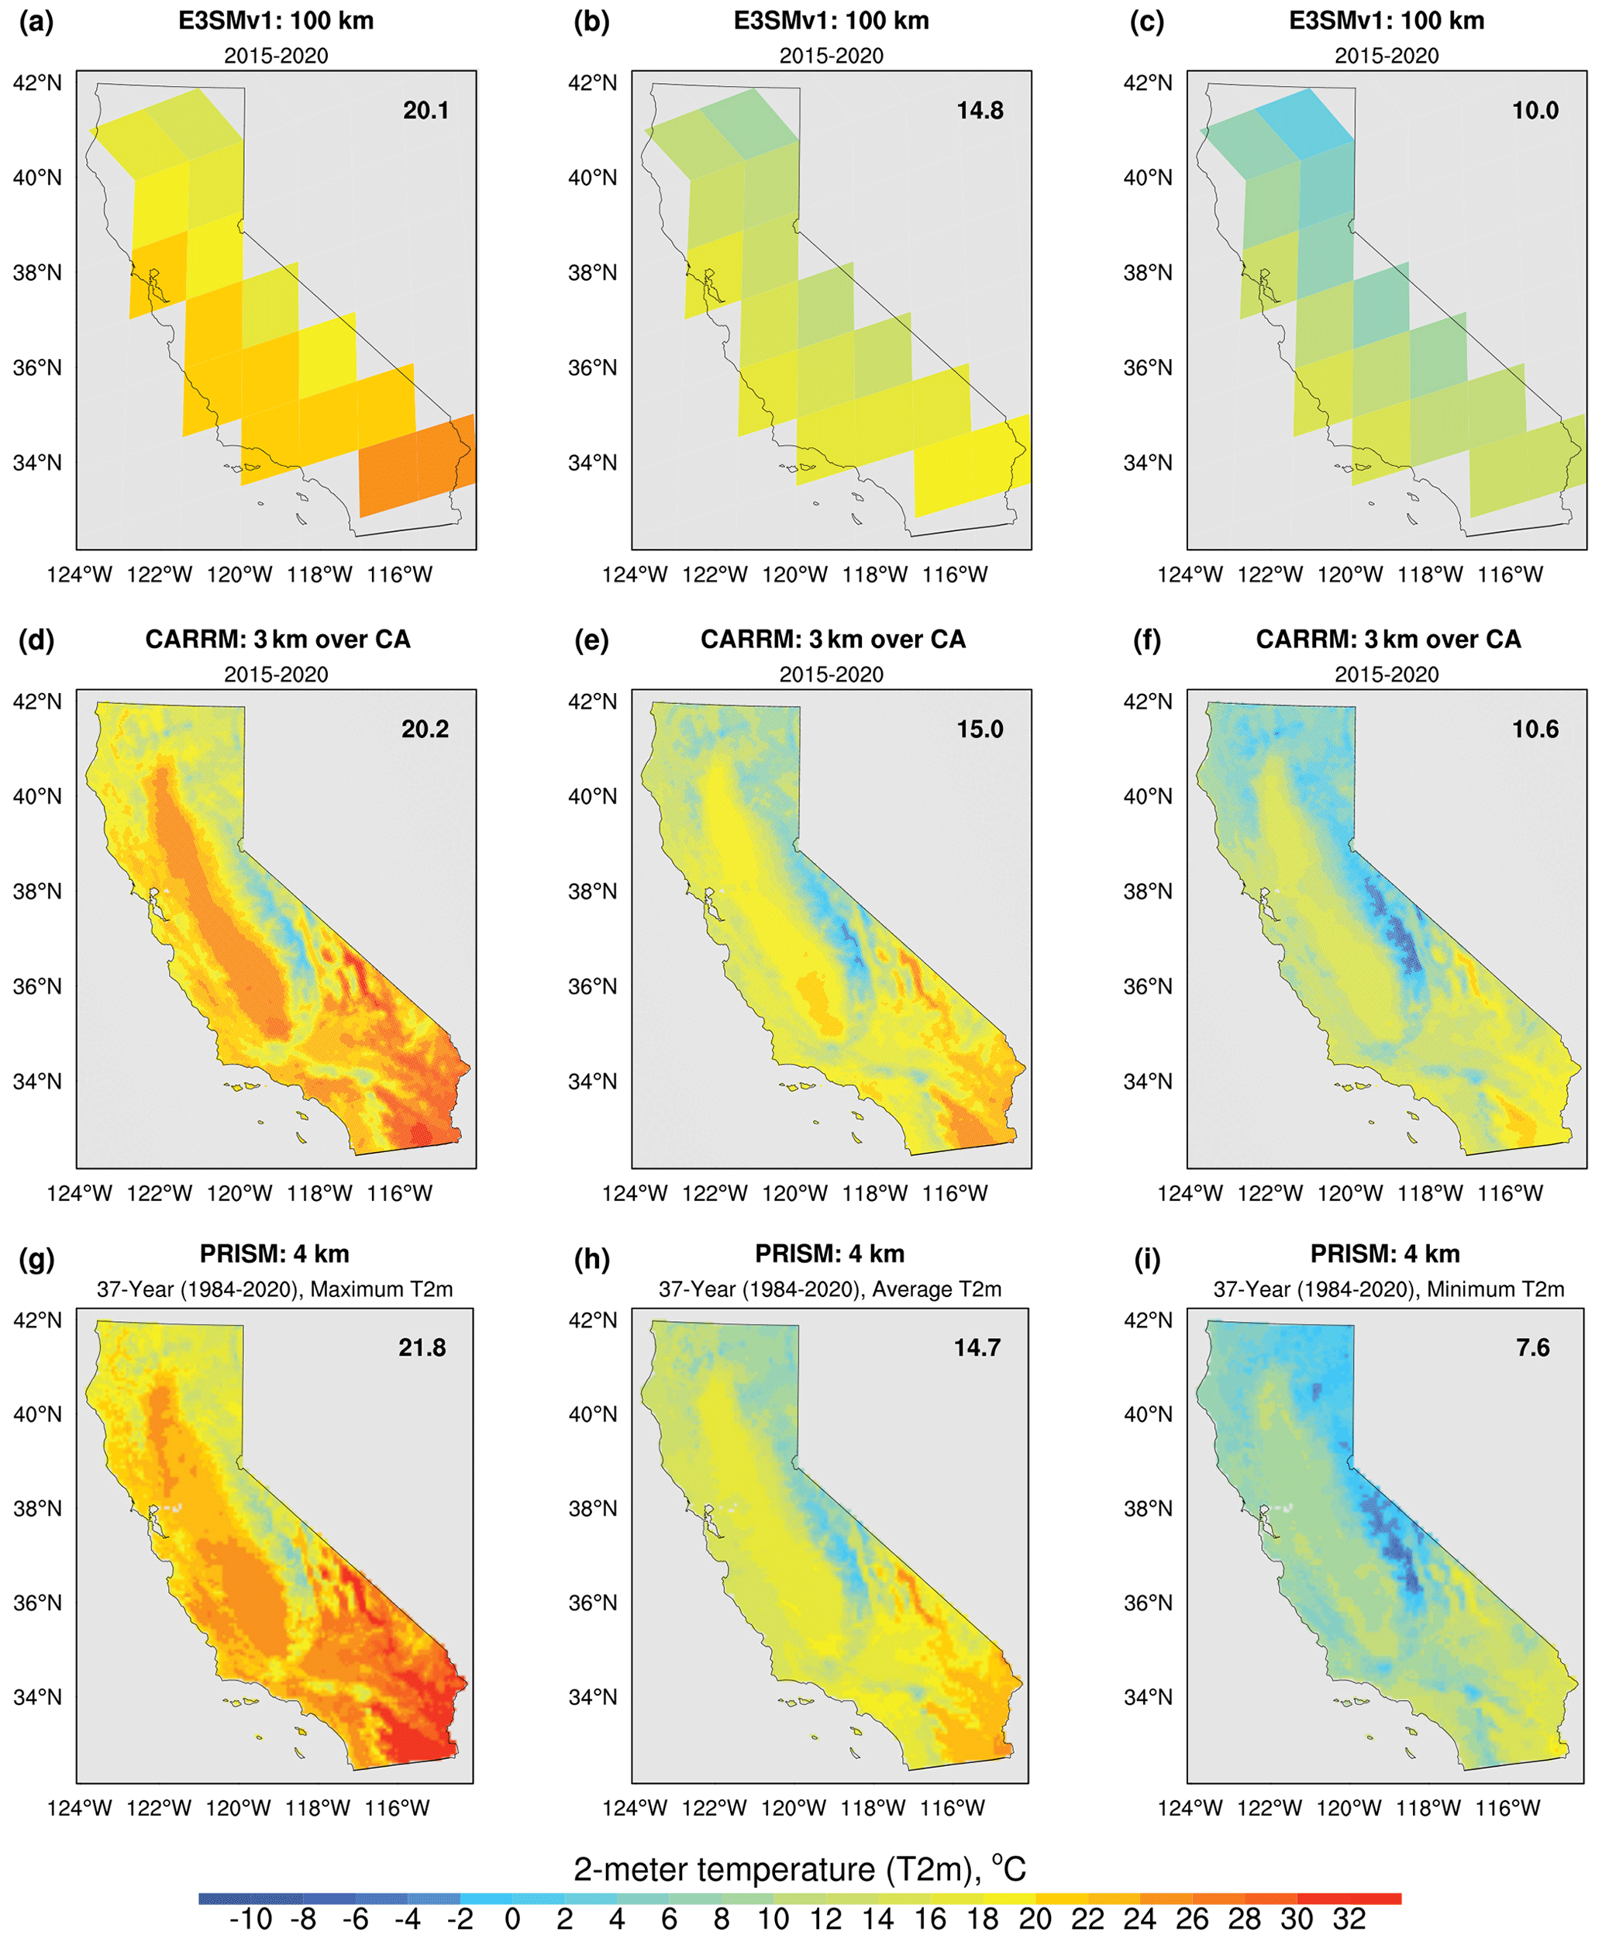
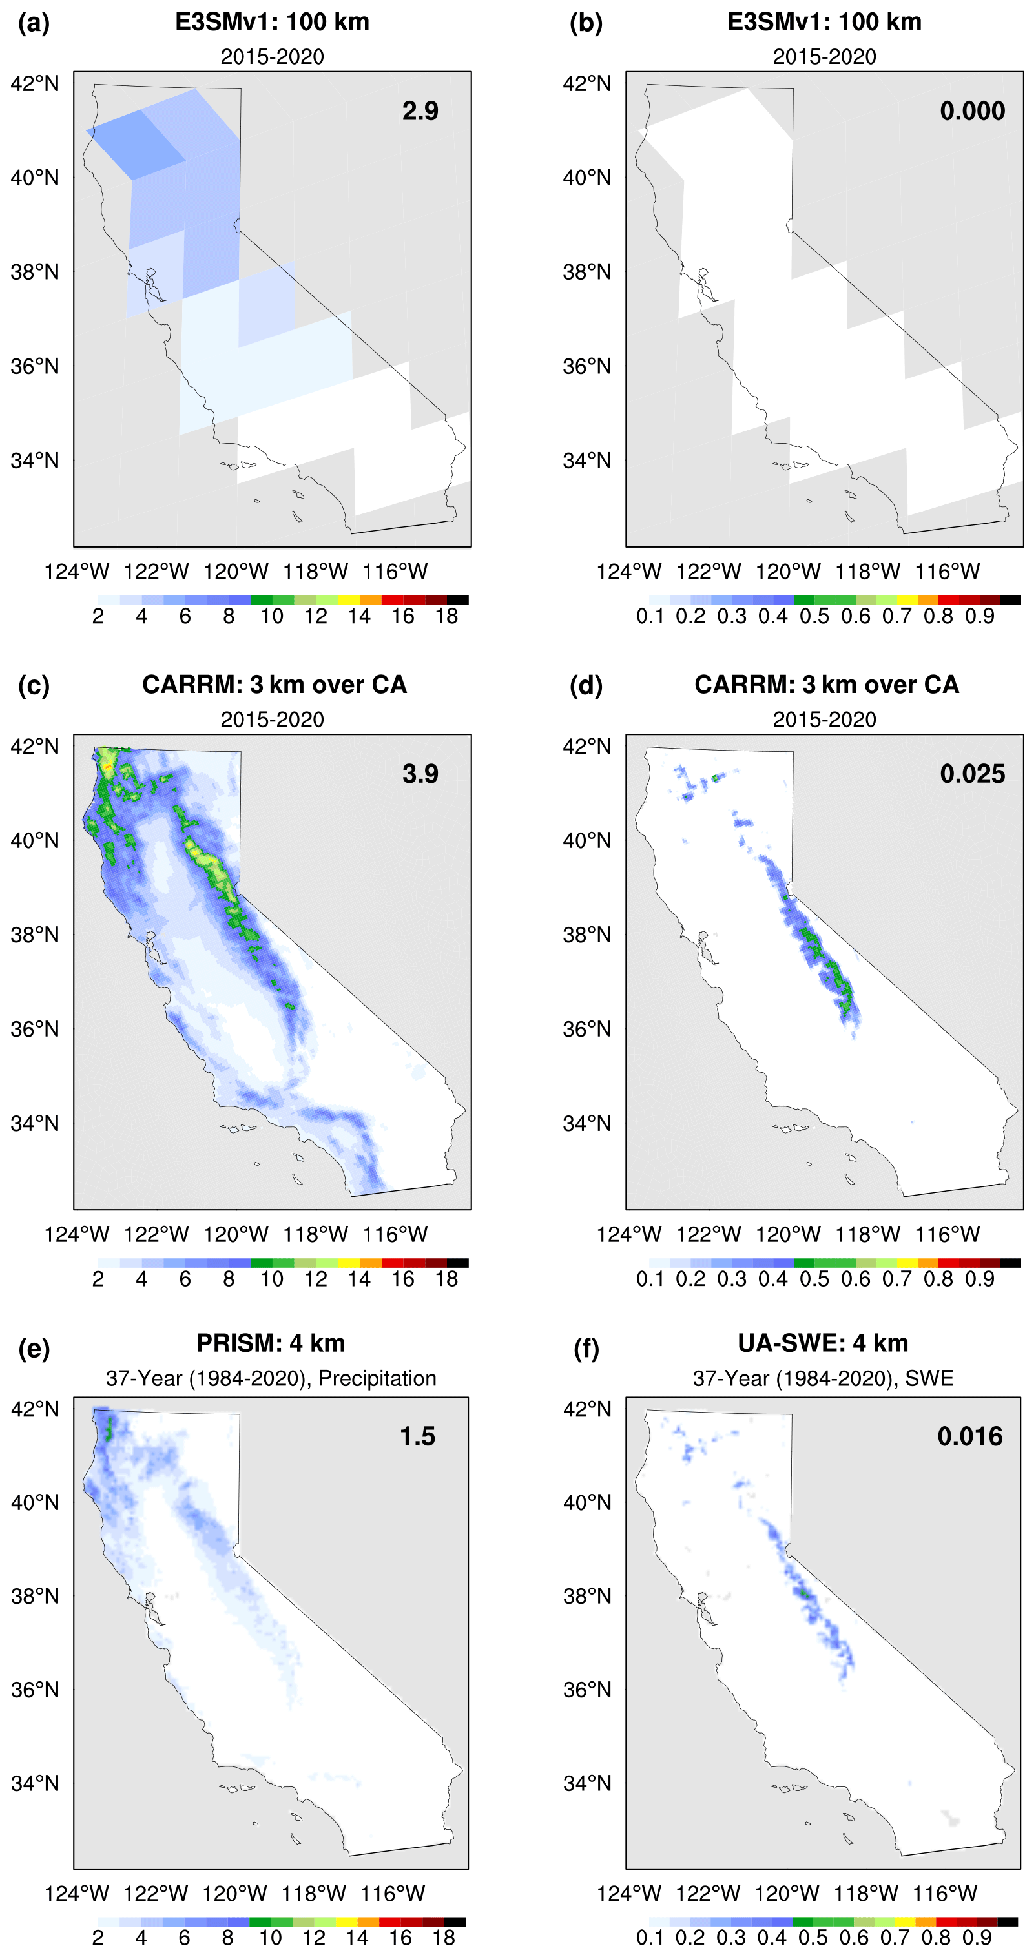
T2m
Precip
SWE
LR
Historical period
  Model: 2015-2020
  Observation: 1984-2020
Spatial distributions of climatology are improved in CARRM.
T2m, precipitation, snow water equivalent (SWE)
CARRM
Obs
Zhang et al., 2024

Slide 9
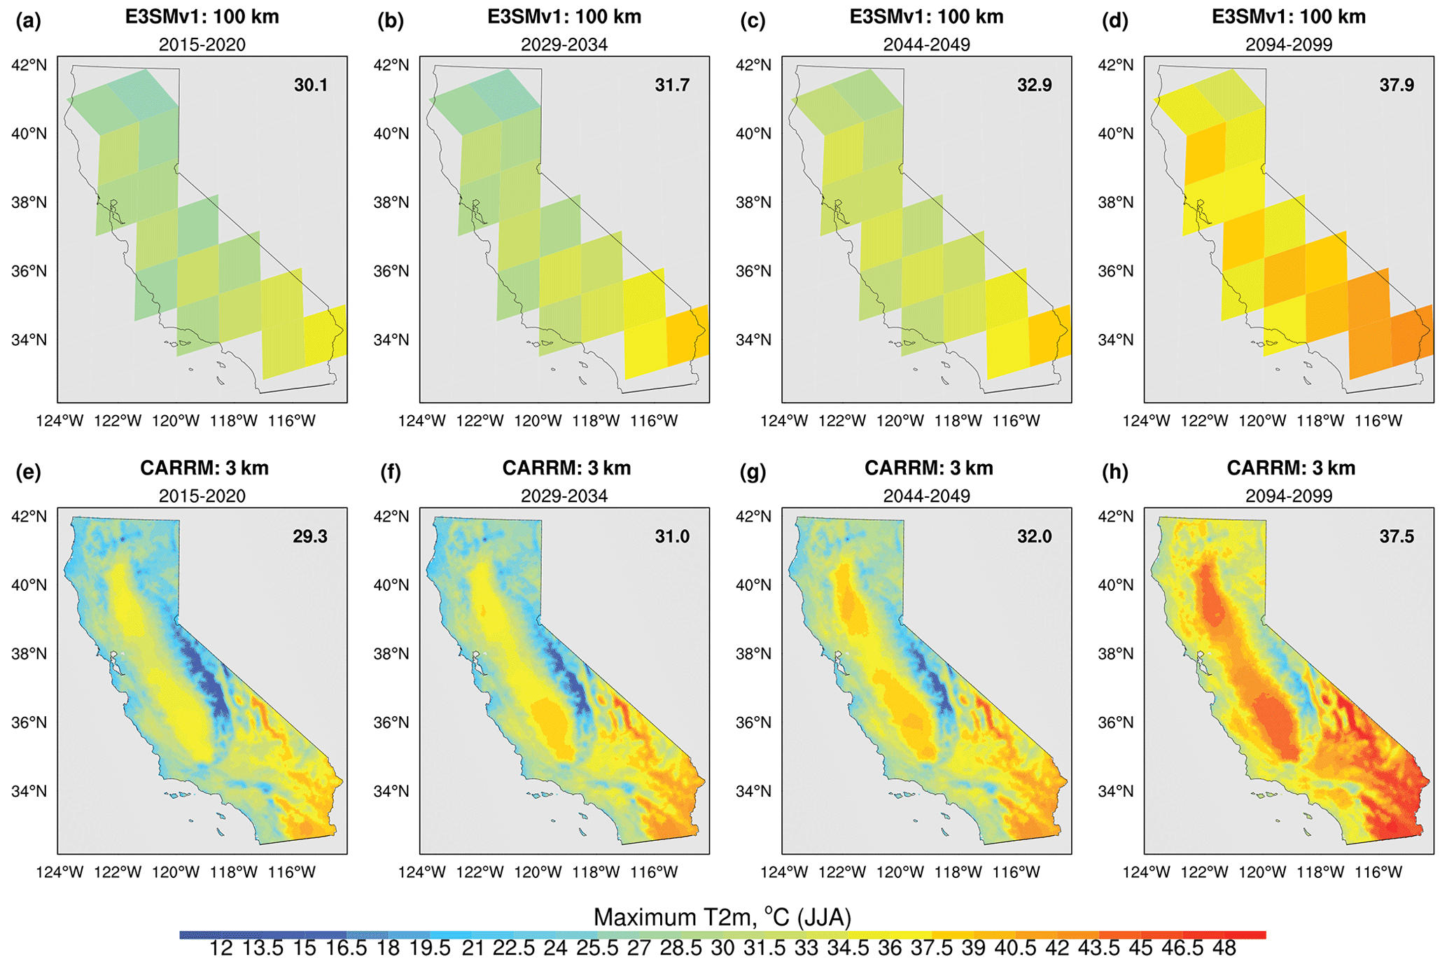
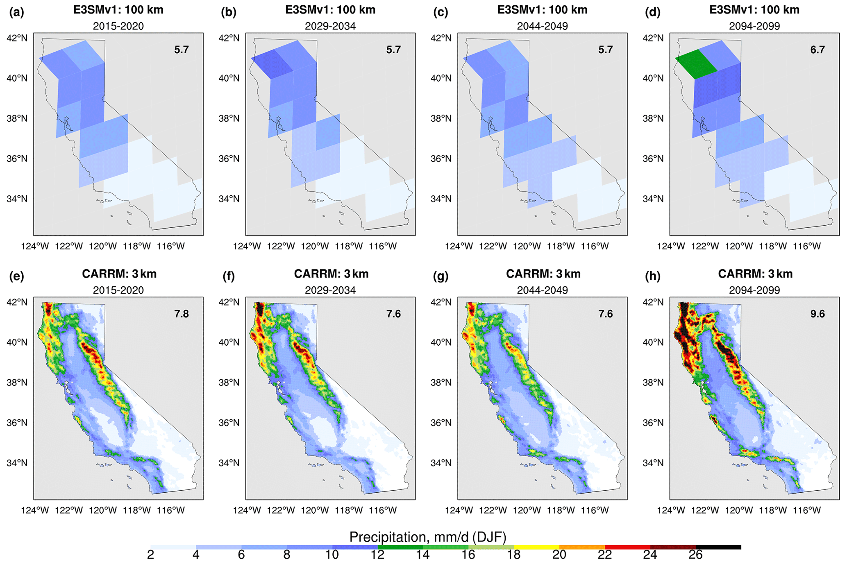
Convection-Permitting (3-km) RRM
California future climate
Zhang et al., 2024
LR
CARRM
3-km CARRM adds considerable value to the prediction of the California climate changes.
More realistic high temperatures in the Central Valley and much improved spatial distributions of precipitation and snowpack in the Sierra Nevada and coastal stratocumulus.
Under the SSP5-8.5 scenario, CARRM simulation predicts widespread warming of 6–10 °C over most of California, a 38 % increase in statewide average 30 d winter–spring precipitation, a near-complete loss of the alpine snowpack, and a sharp reduction in shortwave cloud radiative forcing associated with marine stratocumulus by the end of the 21st century.

Slide 10
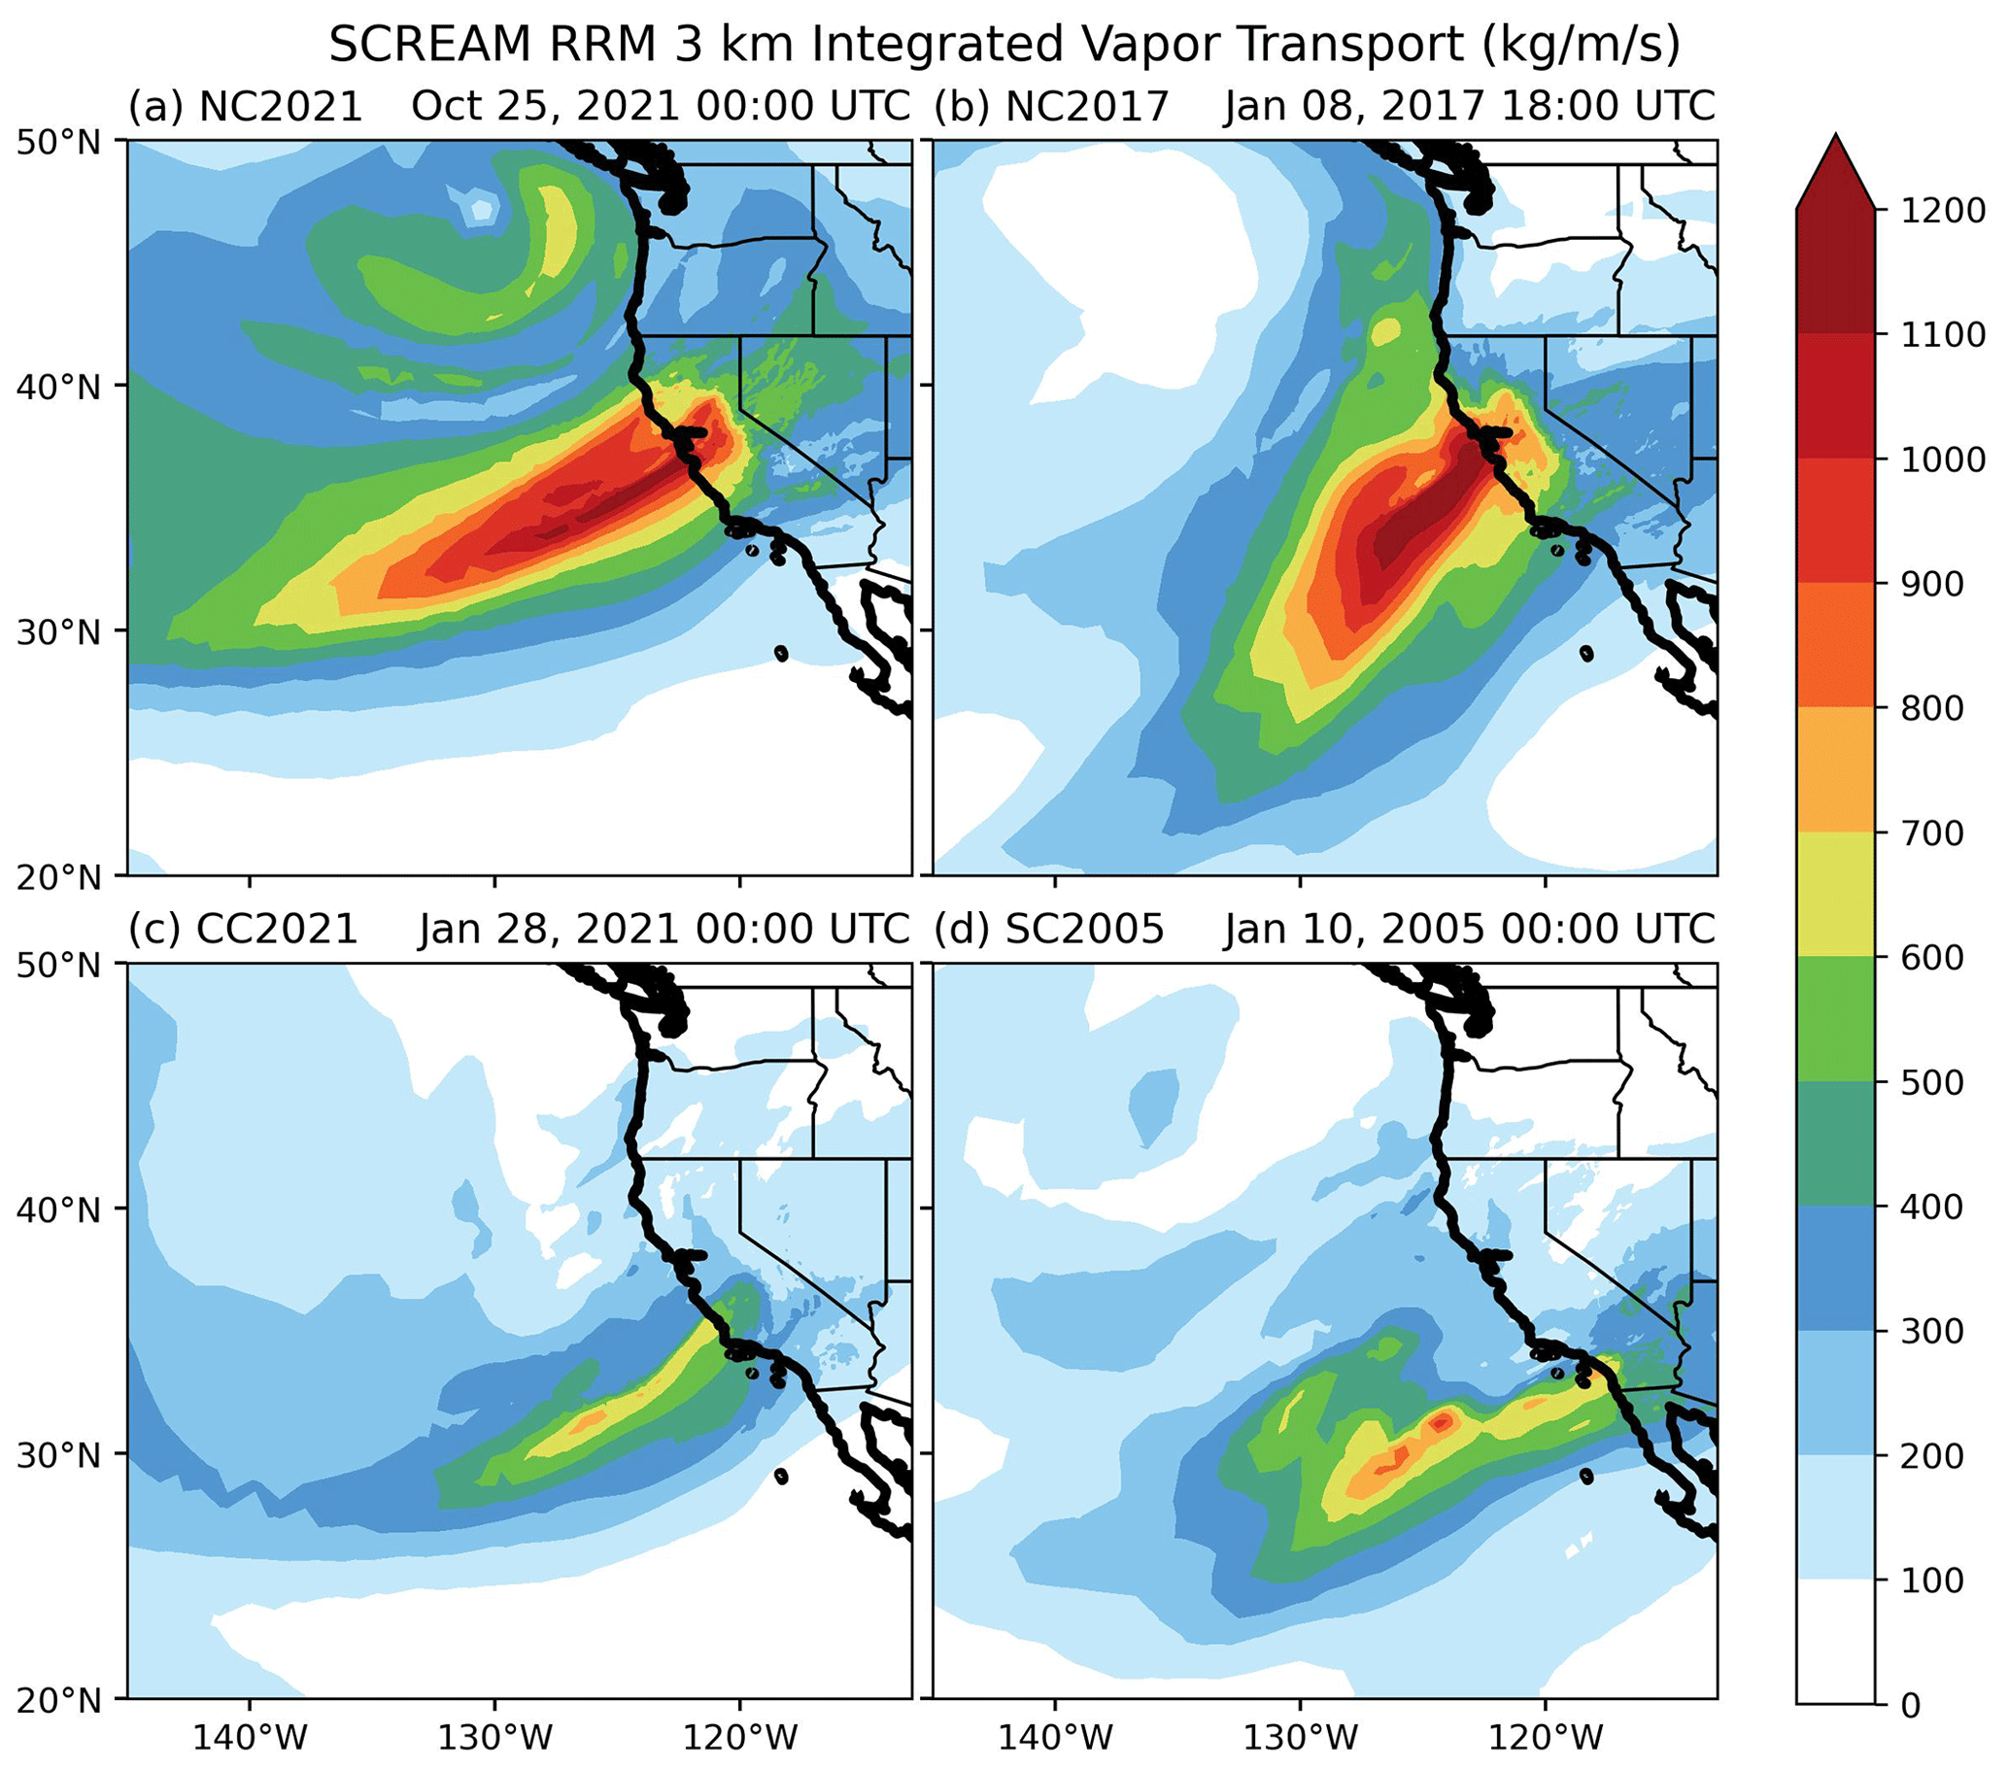
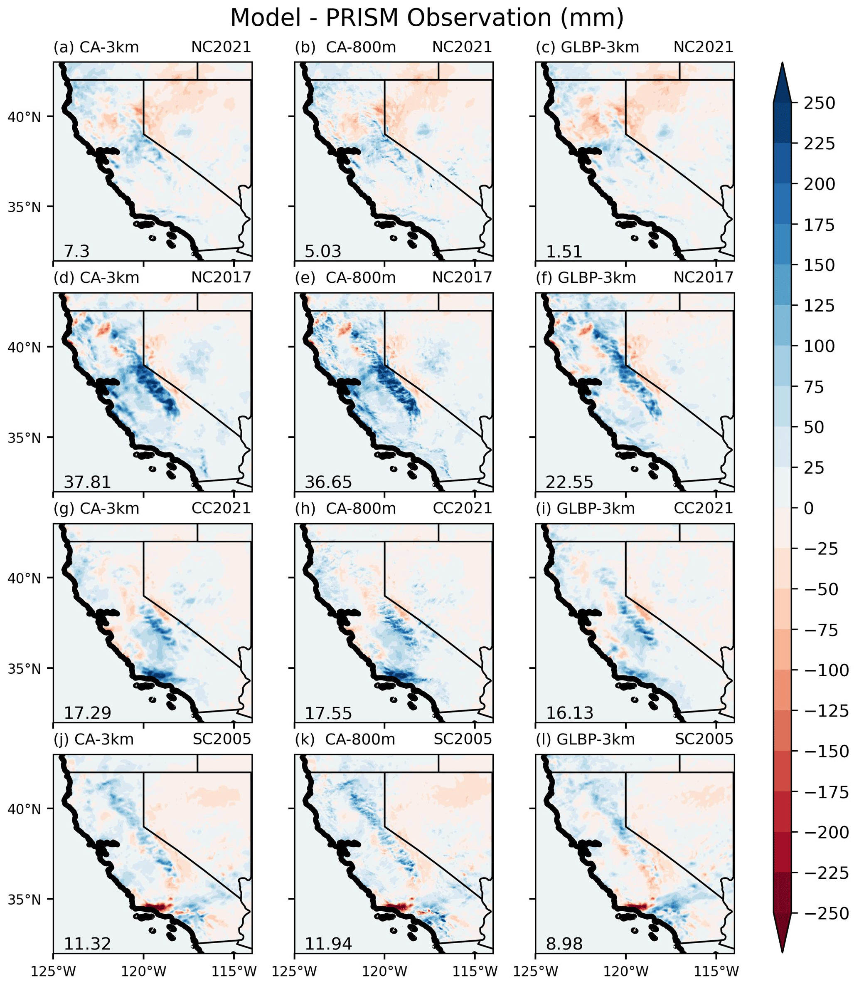
California atmospheric river (AR) in CARRM
Bogenschutz et al., 2024
3-km CARRM generally has a good representation of the AR-generated precipitation in CA
A small 3 km patch can capture the fine-scale regional distributions that are controlled largely by the fine-scale topography of the state.

Slide 11
Wildfires in enhanced CARRM
Ke et al., 2025
A first-of-its-kind multiscale Pyrocumulonimbus (pyroCb) simulation framework
Incorporated a plume rise model and a vertical water vapor transport scheme.
Developed a high-resolution (500 m, hourly) dataset of fire radiative power, emissions, and sensible heat flux using satellite observations for surface boundary conditions.

Slide 12
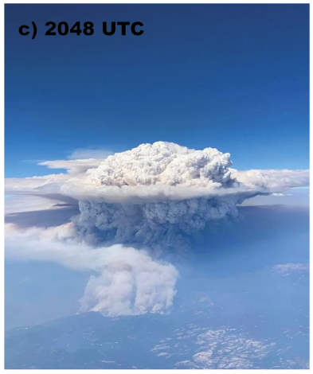
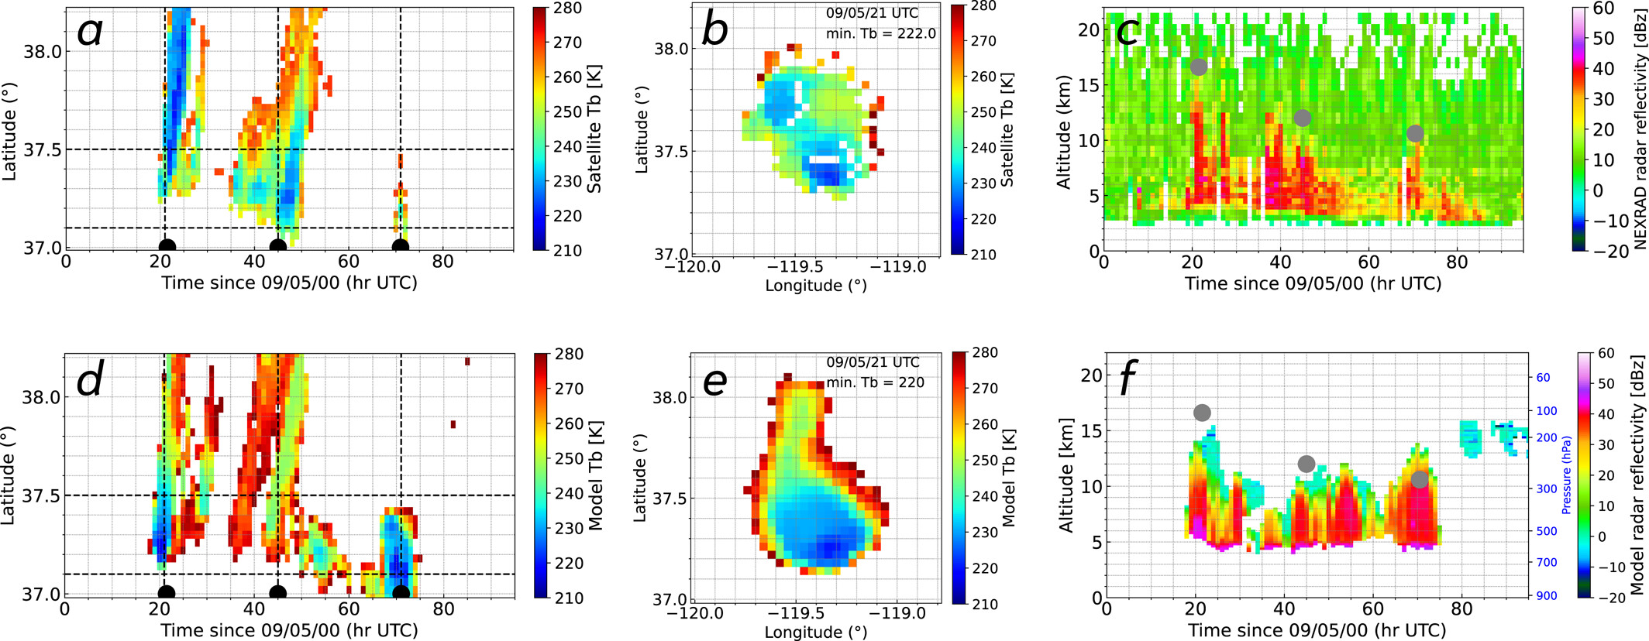
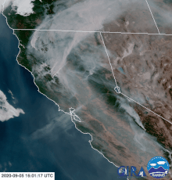
PyroCb during 2020 Creek Fire
Ke et al., 2025
(Lareau 2022)
Successfully reproduces many pyroCb features, including cloud height, spatiotemporal evolution, and convective intensity
Reveals vertical transport of ambient near-surface water vapor as a key factor.
https://en.wikipedia.org/wiki/Creek_Fire_(2020)

Slide 13
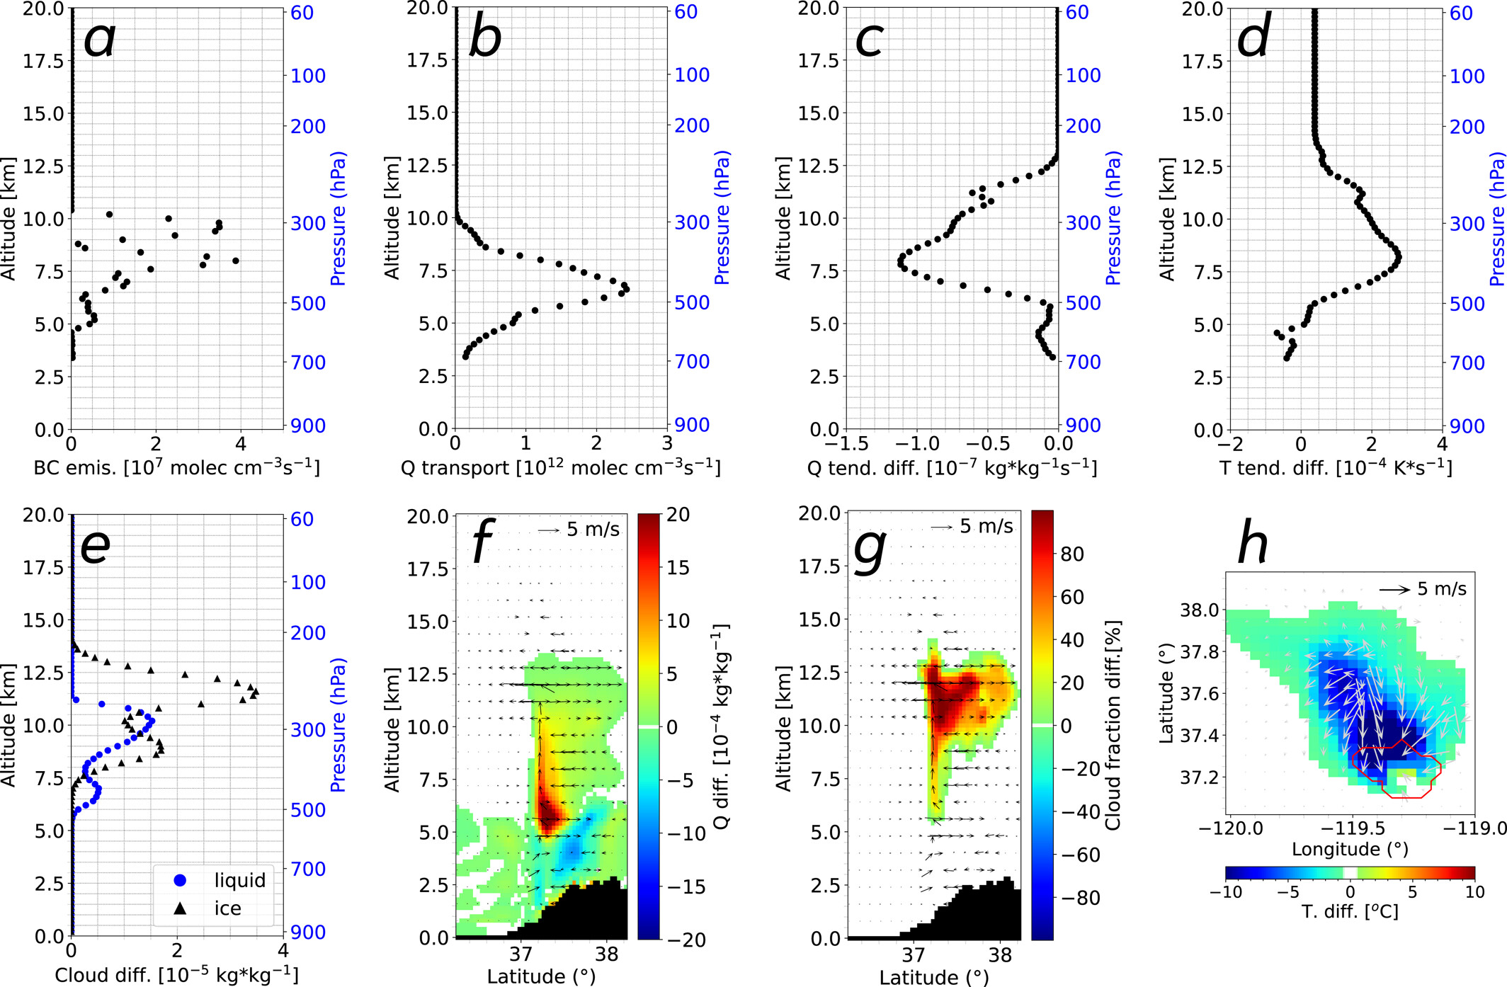
PyroCb during 2020 Creek Fire
Ke et al., 2025

Slide 14
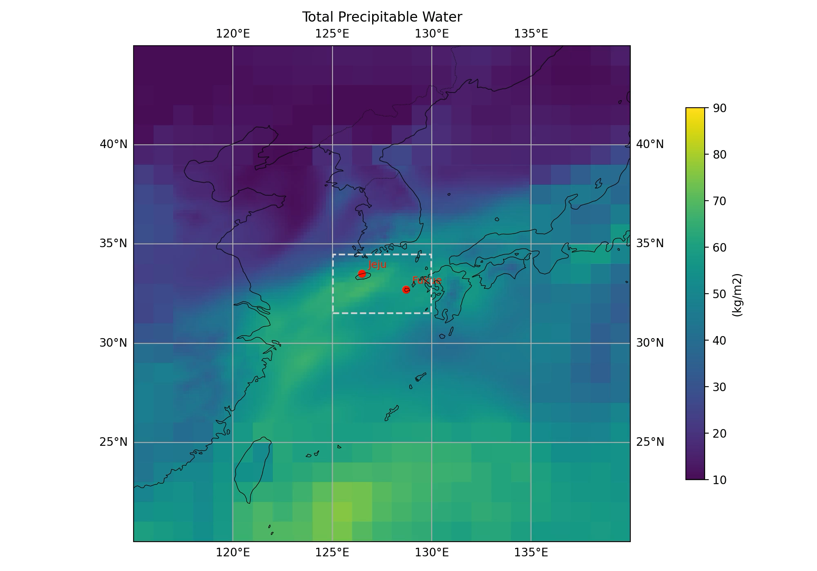
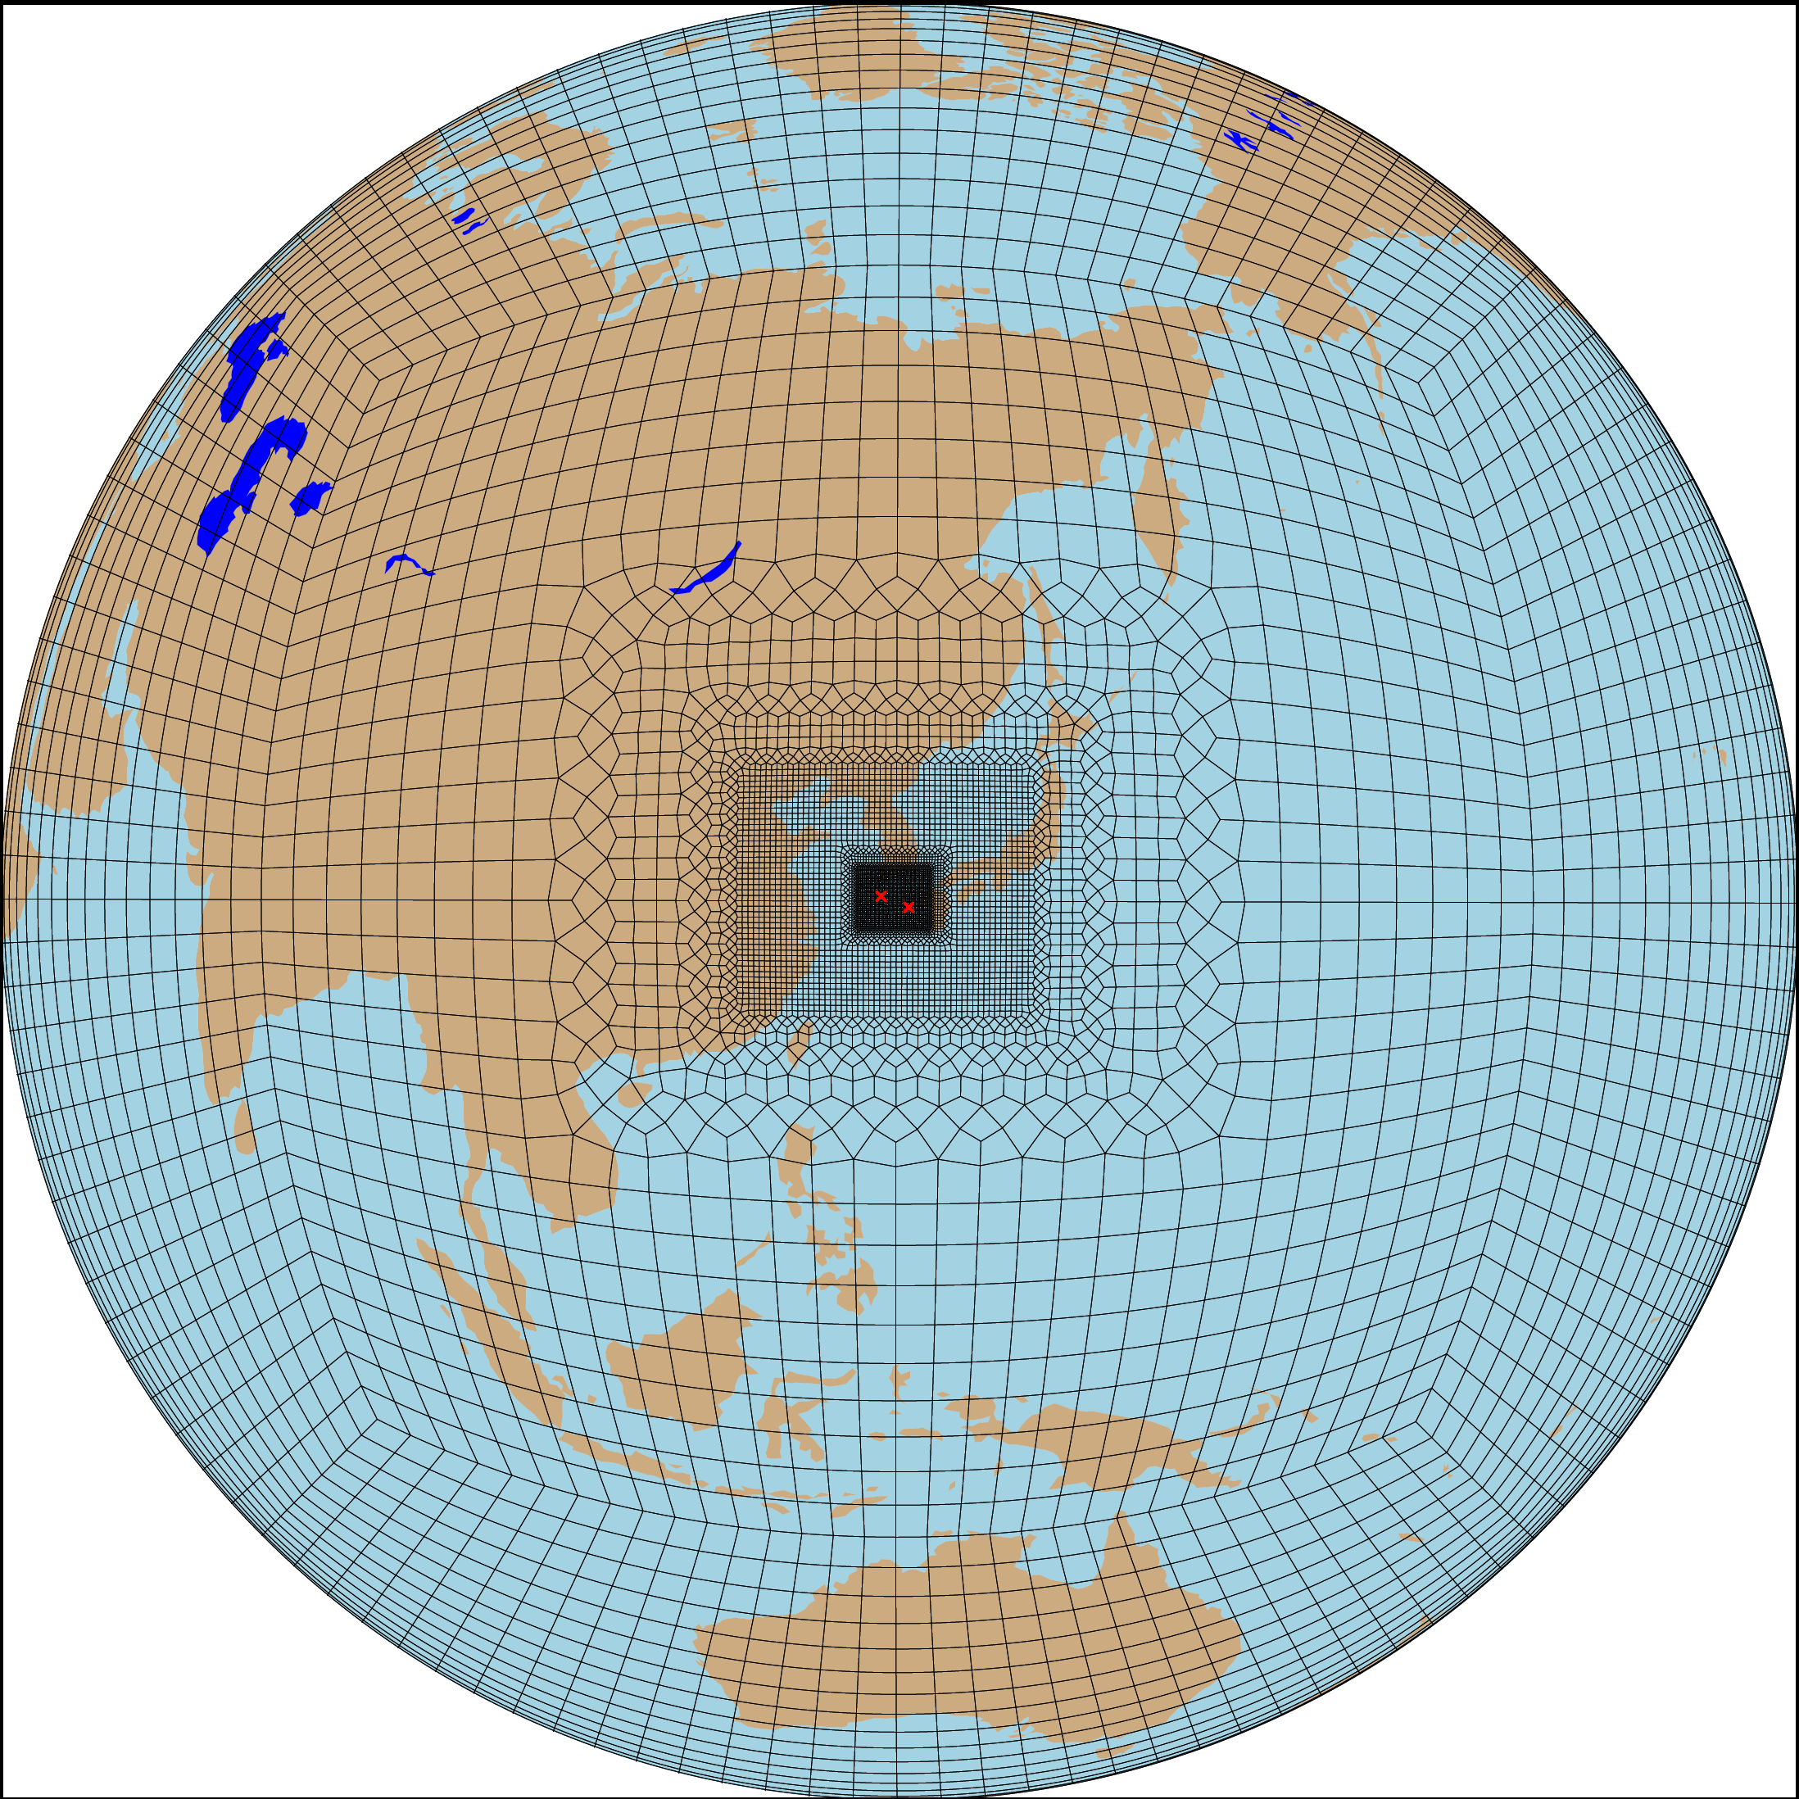
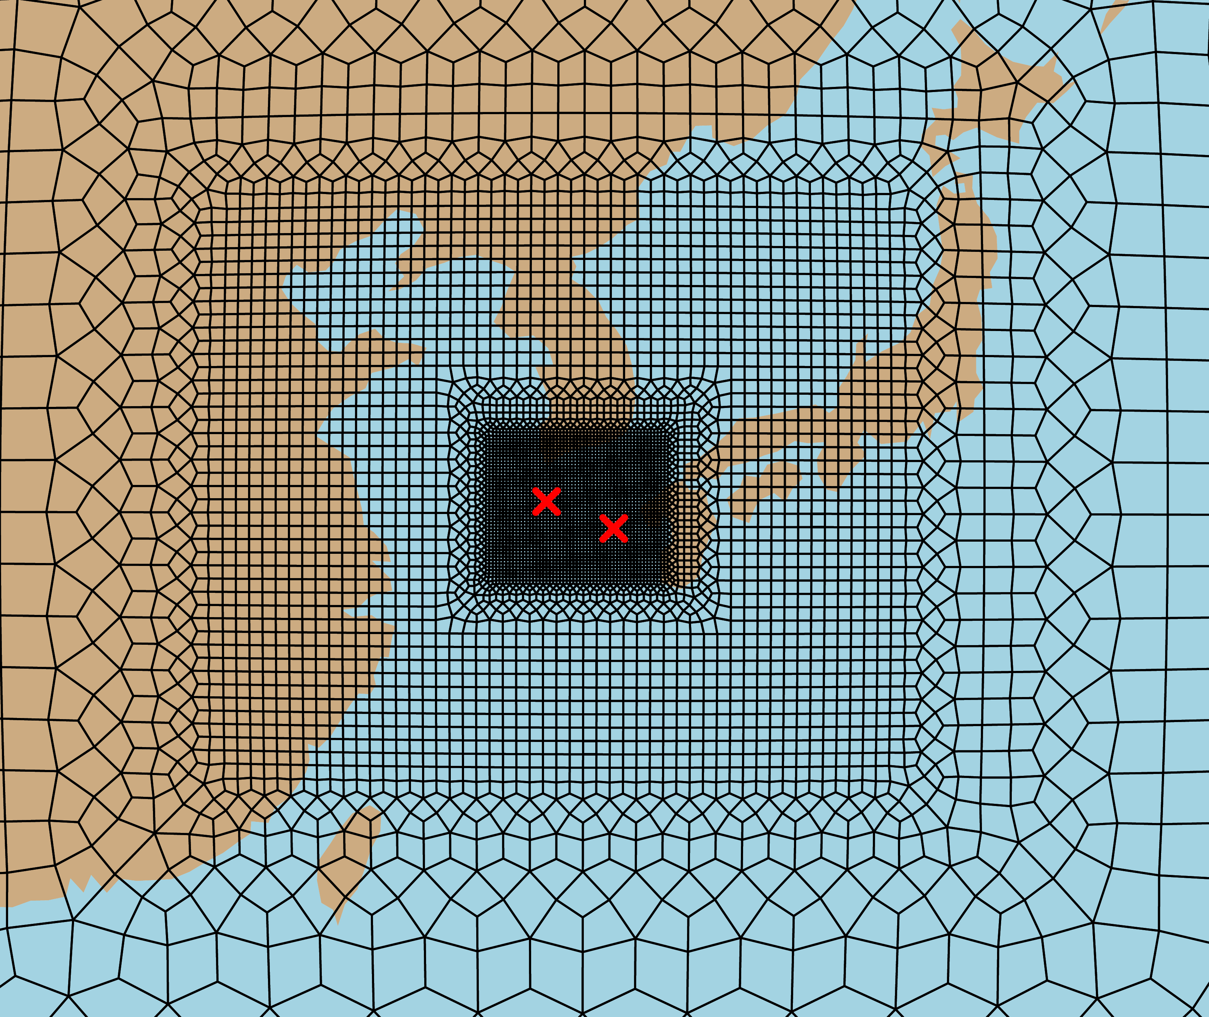
Developed 3-km East Asia Island RRM
Trilateral project among LLNL, KIST, and JAMSTEC
Three levels of resolutions (e.g., 100 km → 12.5 km → 3 km) with transition zones in between.
Typhoon Hinnamnor
September 2022
The initial test represents Typhoon Hinnamnor reasonably well.

Slide 15
Summary
E3SM regionally refined model (RRM) is efficient for high-resolution simulations. Official releases use 25-km finest grid spacing with regional improvements.
Extending to a convection-permitting scale (3 km), RRM demonstrates great advantages in representing California (CA) future climate and atmospheric river.
With further improved physics, 3-km RRM simulates pyrocumulonimbus (pyroCb) thunderstorm triggered by intense wildfires.
A new 3-km RRM (centered at East Asia Islands) developed and tested for the trilateral project to study aerosols and their impacts on environment.

