Slide 1




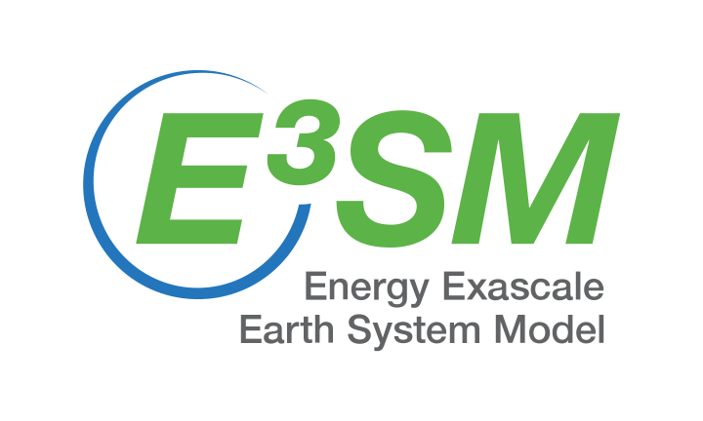

Modeling Fire-Driven Pyrocumulonimbus: New Uncertainty Quantification Opportunities
Qi Tang¹ (tang30@llnl.gov), Zhiheng Wang², Roger Ghanem³
¹Lawrence Livermore National Laboratory, ²Texas Tech University, ³University of Southern California
SIAM GS25, Baton Rouge, Louisiana
October 14-17, 2025
Funded by the U.S. Department of Energy, Office of Science, Office of Biological and Environmental Research. Performed under the auspices of the U.S. Department of Energy by Lawrence Livermore National Laboratory under Contract DE-AC52-07NA27344. LLNL-PRES-XXXXXX

Slide 2
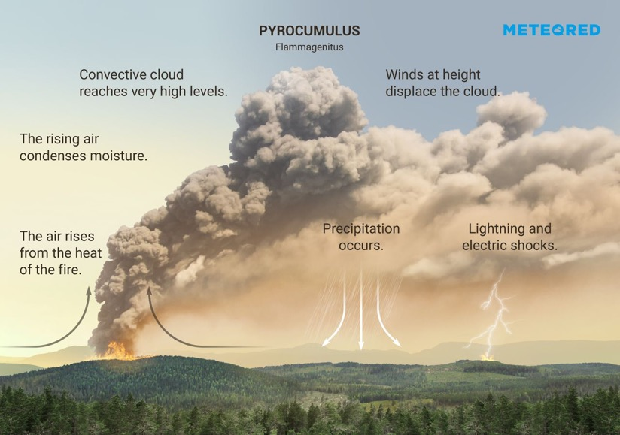
Wildfire-driven thunderstorms pump smoke into the stratosphere
Aerosol Mass (Tg) injected into the stratosphere
from Wildfires and Volcanoes
Pyrocumulonimbus (PyroCb)
Stratosphere
Peterson et al., 2018
Troposphere
Fire smoke enters the stratosphere by PyroCb convection or self-lofting
Smoke absorbs & reflects sunlight = long-time negative radiative forcing (RF)
Aerosols = heterogeneous chemistry = stratospheric O₃ depletion & UV-B increase

Slide 3
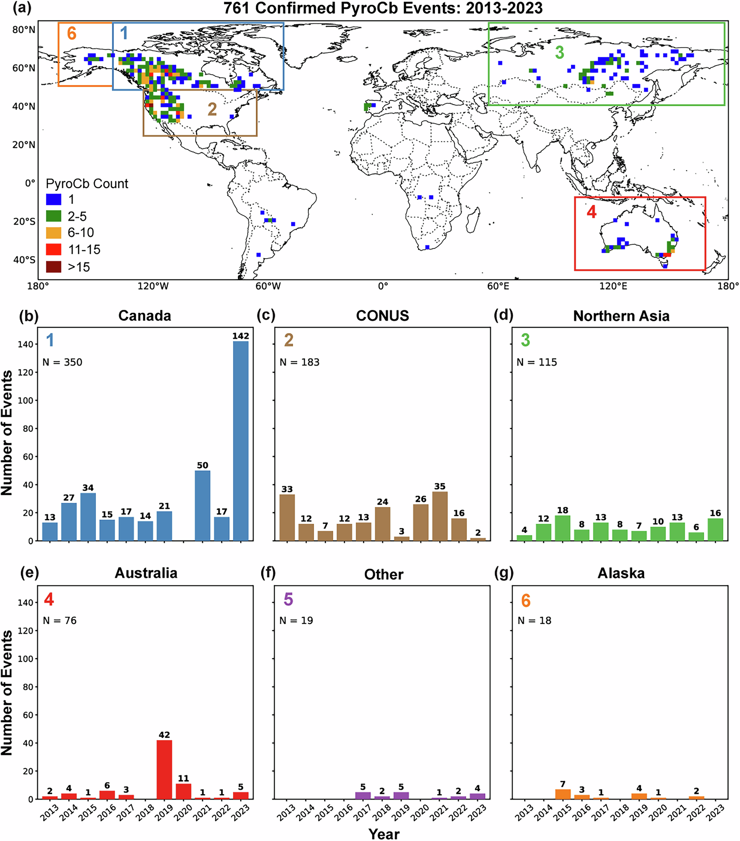
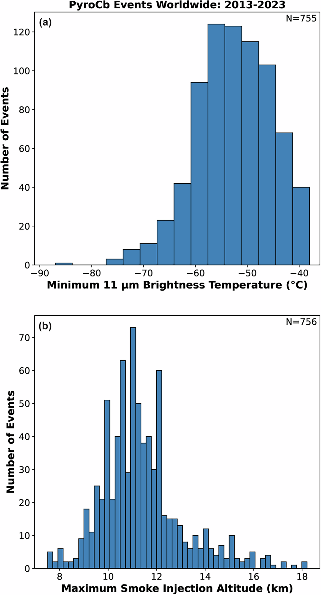
Pyrocumulonimbus (PyroCb) distribution & intensity
Peterson et al., 2025

Slide 4
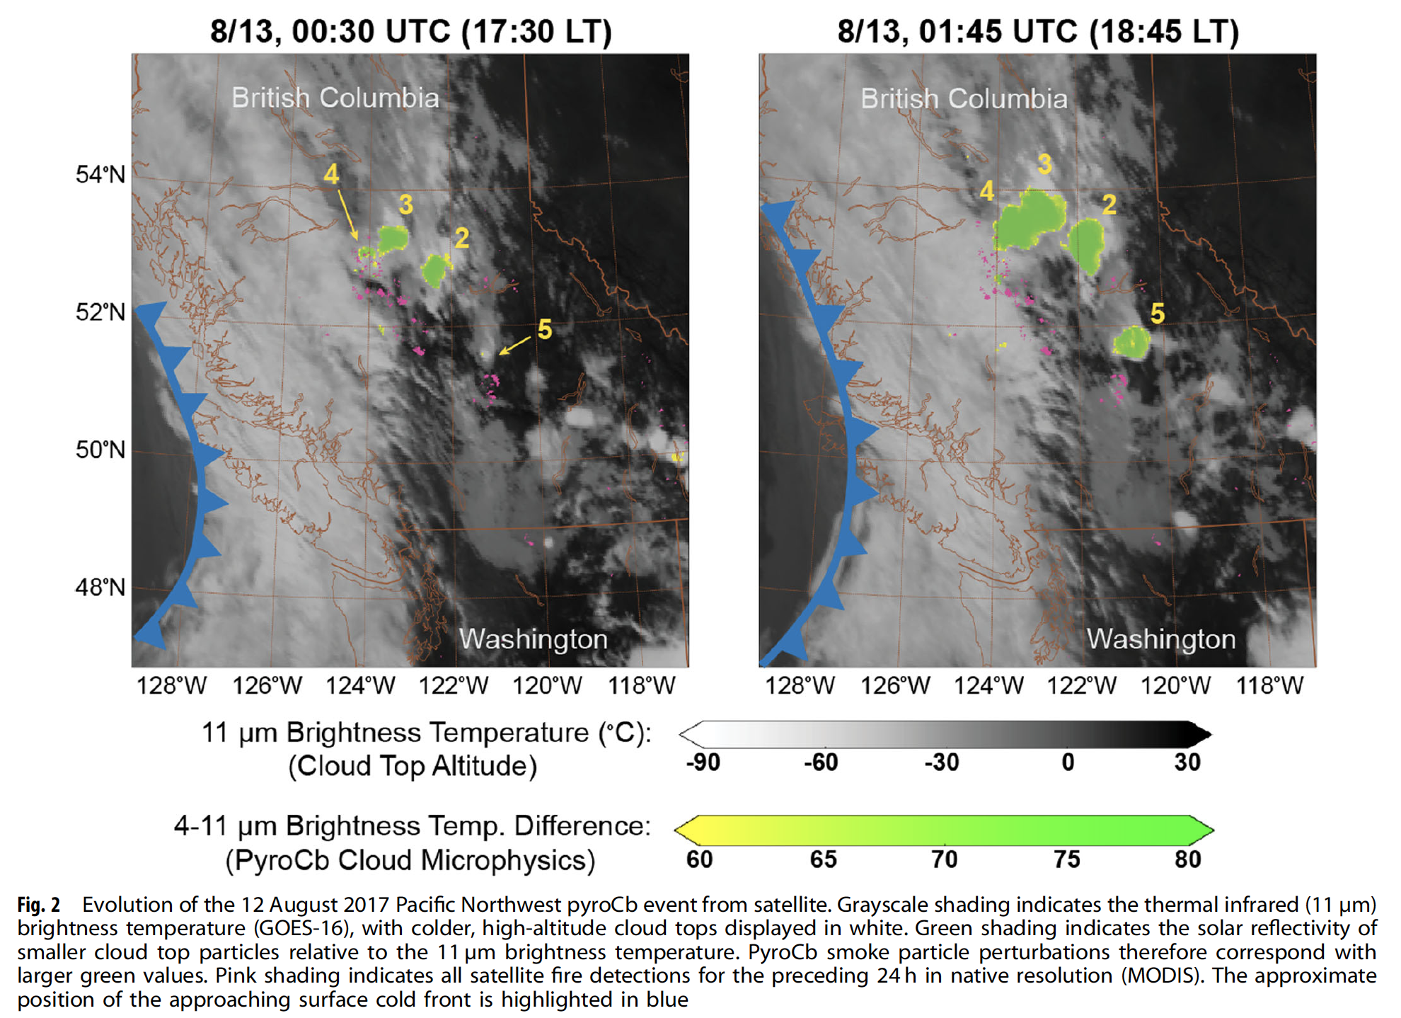
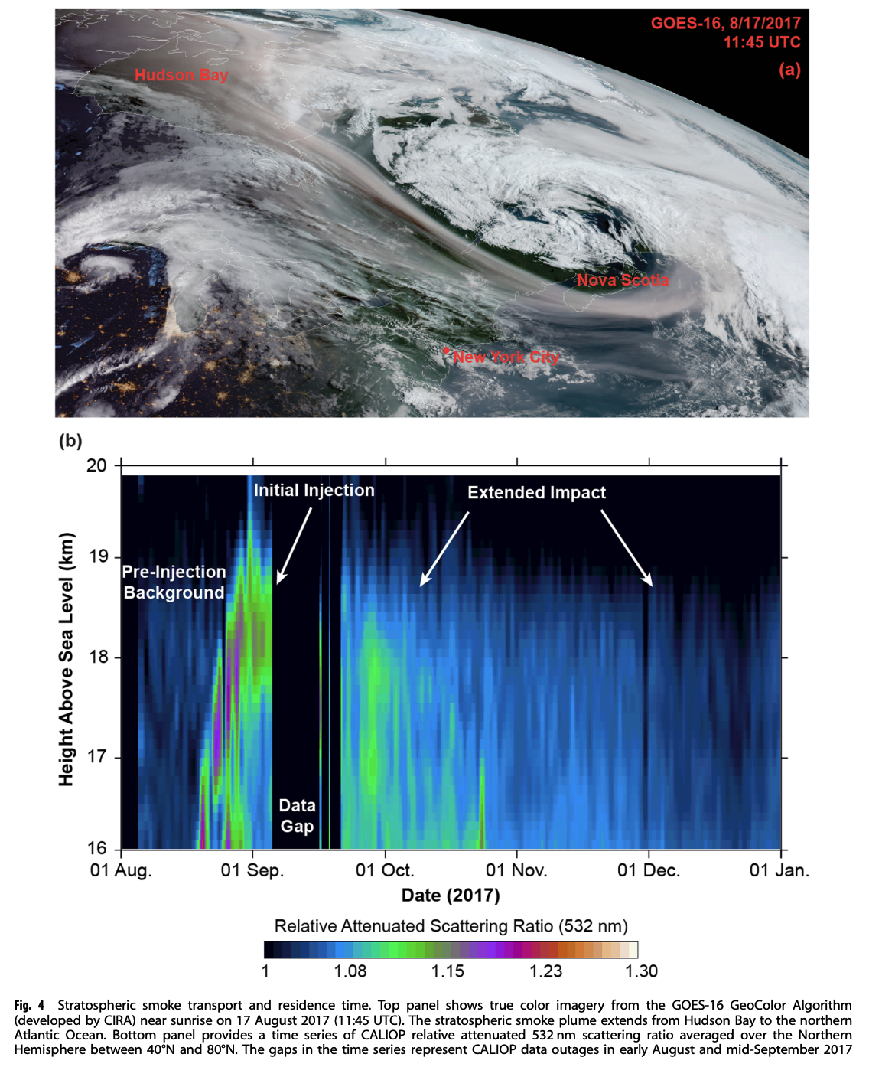
British Columbia 2017 (BC2017) fire
Peterson et al., 2018

Slide 5
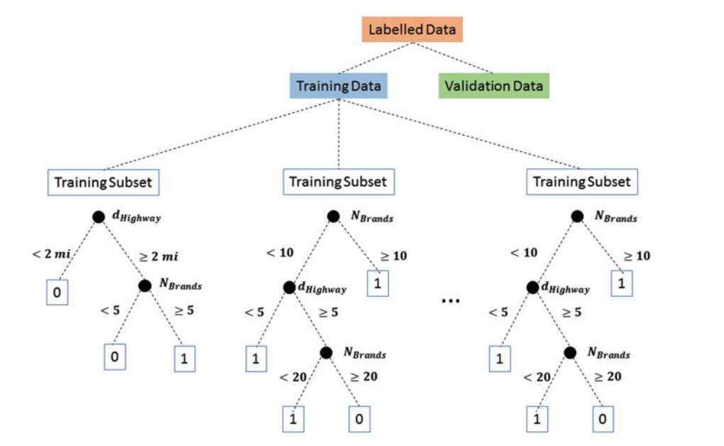
Which parameters are more important?
Lee et al. (2023) is one of the first applications of uncertainty quantification (UQ) for the BC2017 fire.
144 low-resolution (100 km) simulations from Energy Exascale Earth System Model (E3SM)
Random forest regressor
U, V and T nudged with ERA-I (50 hrs)
Ensemble free run
2017/1/1
2017/8/11
2018/5/31
Fire plume
Inject smoke for 5 hours from 19 UTC Aug. 12 to 00 UTC Aug. 13
An ensemble of 144 runs (4 parameters):
Fire smoke amount: 0.2 Tg, 0.3 Tg, and 0.4 Tg
Black carbon (BC) %: 1%, 2%, 3%, and 5%
Injection height: 12 km, 12.5 km, 13 km and 13.5 km
gamma factor for O₃-POM reaction: 10⁻⁷, 10⁻⁶ and 10⁻⁵

Slide 6
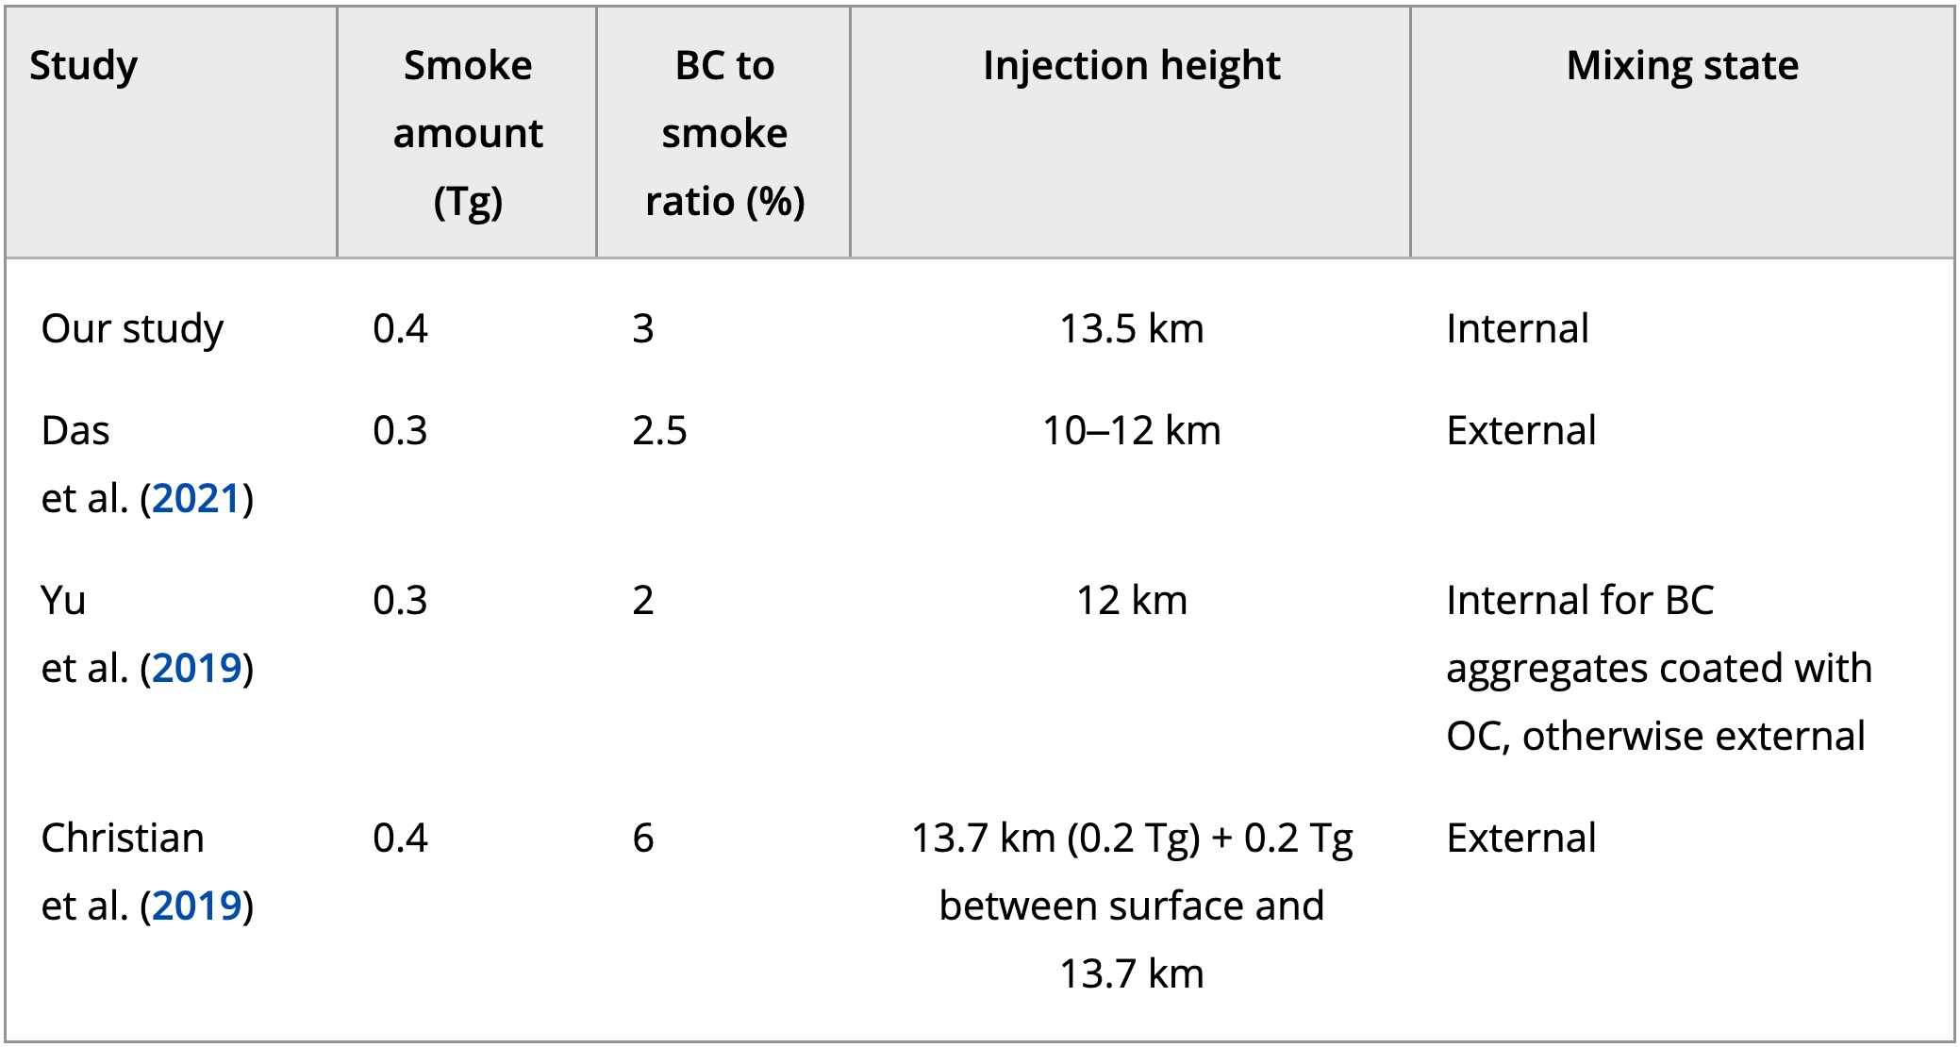
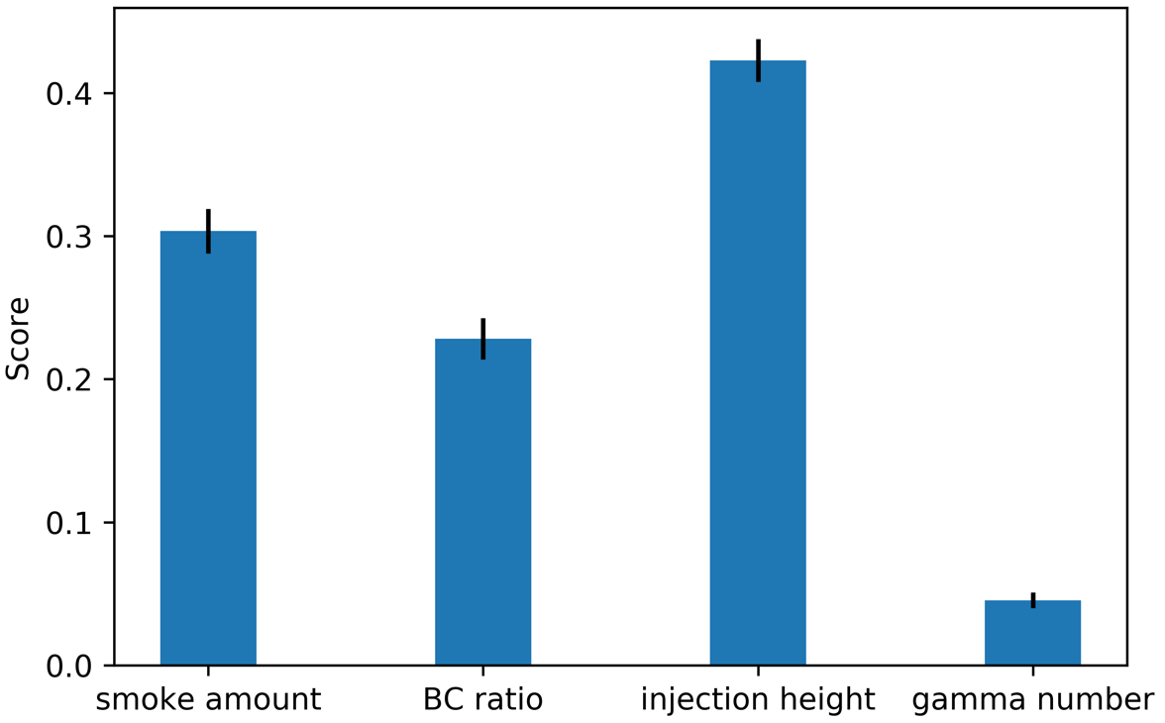
Feature importance
Lee et al., 2023
Score is based on extinction coefficient at 18 km and maximum plume height.
Injection height is quantified as the most important parameter.
Not possible in previous “manual tuning” studies.
Not enough to explain differences among previous studies.

Slide 7
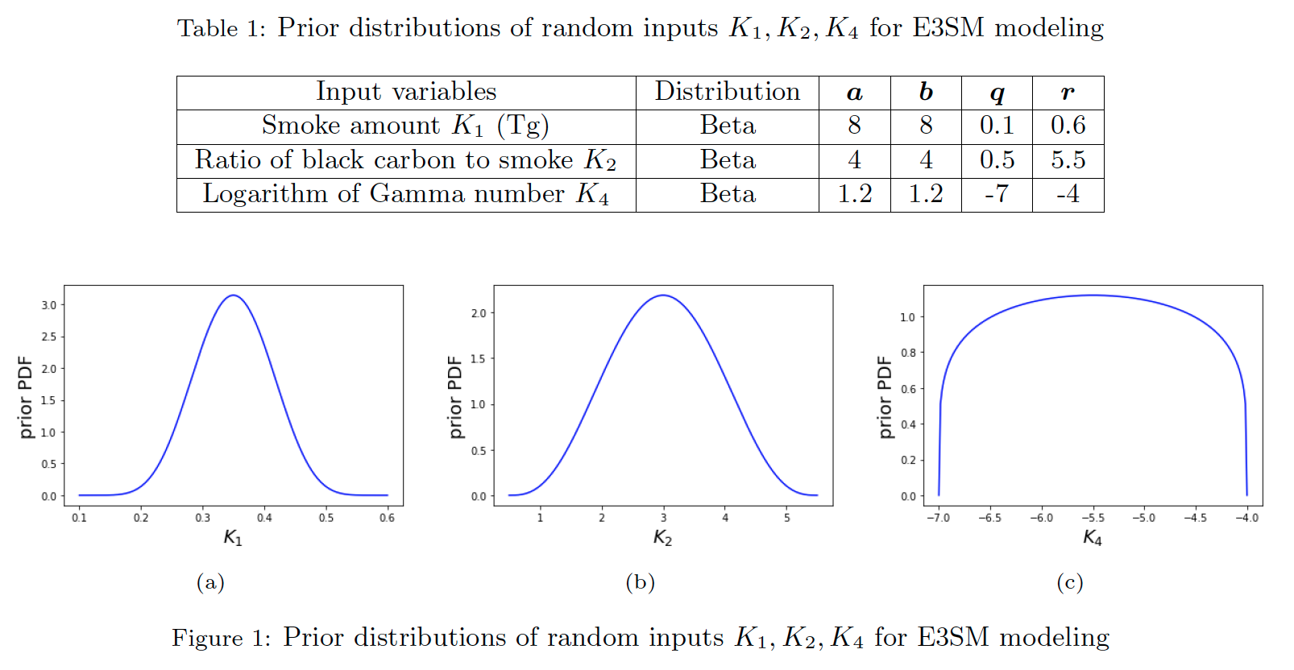
Probabilistic Learning on Manifolds
Principal component analysis
Diffusion map
Data augmentation
Conditional update
Wang et al., in prep.

Slide 8
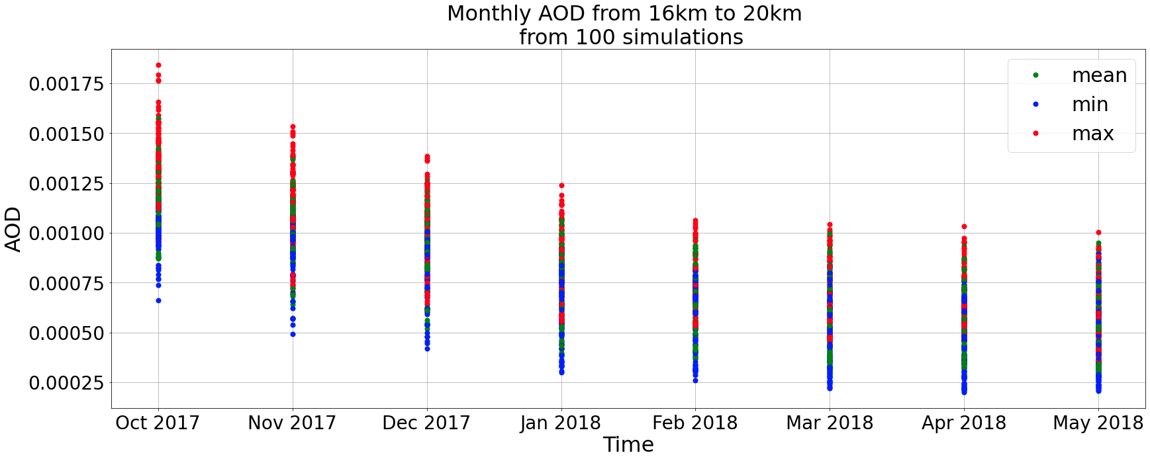
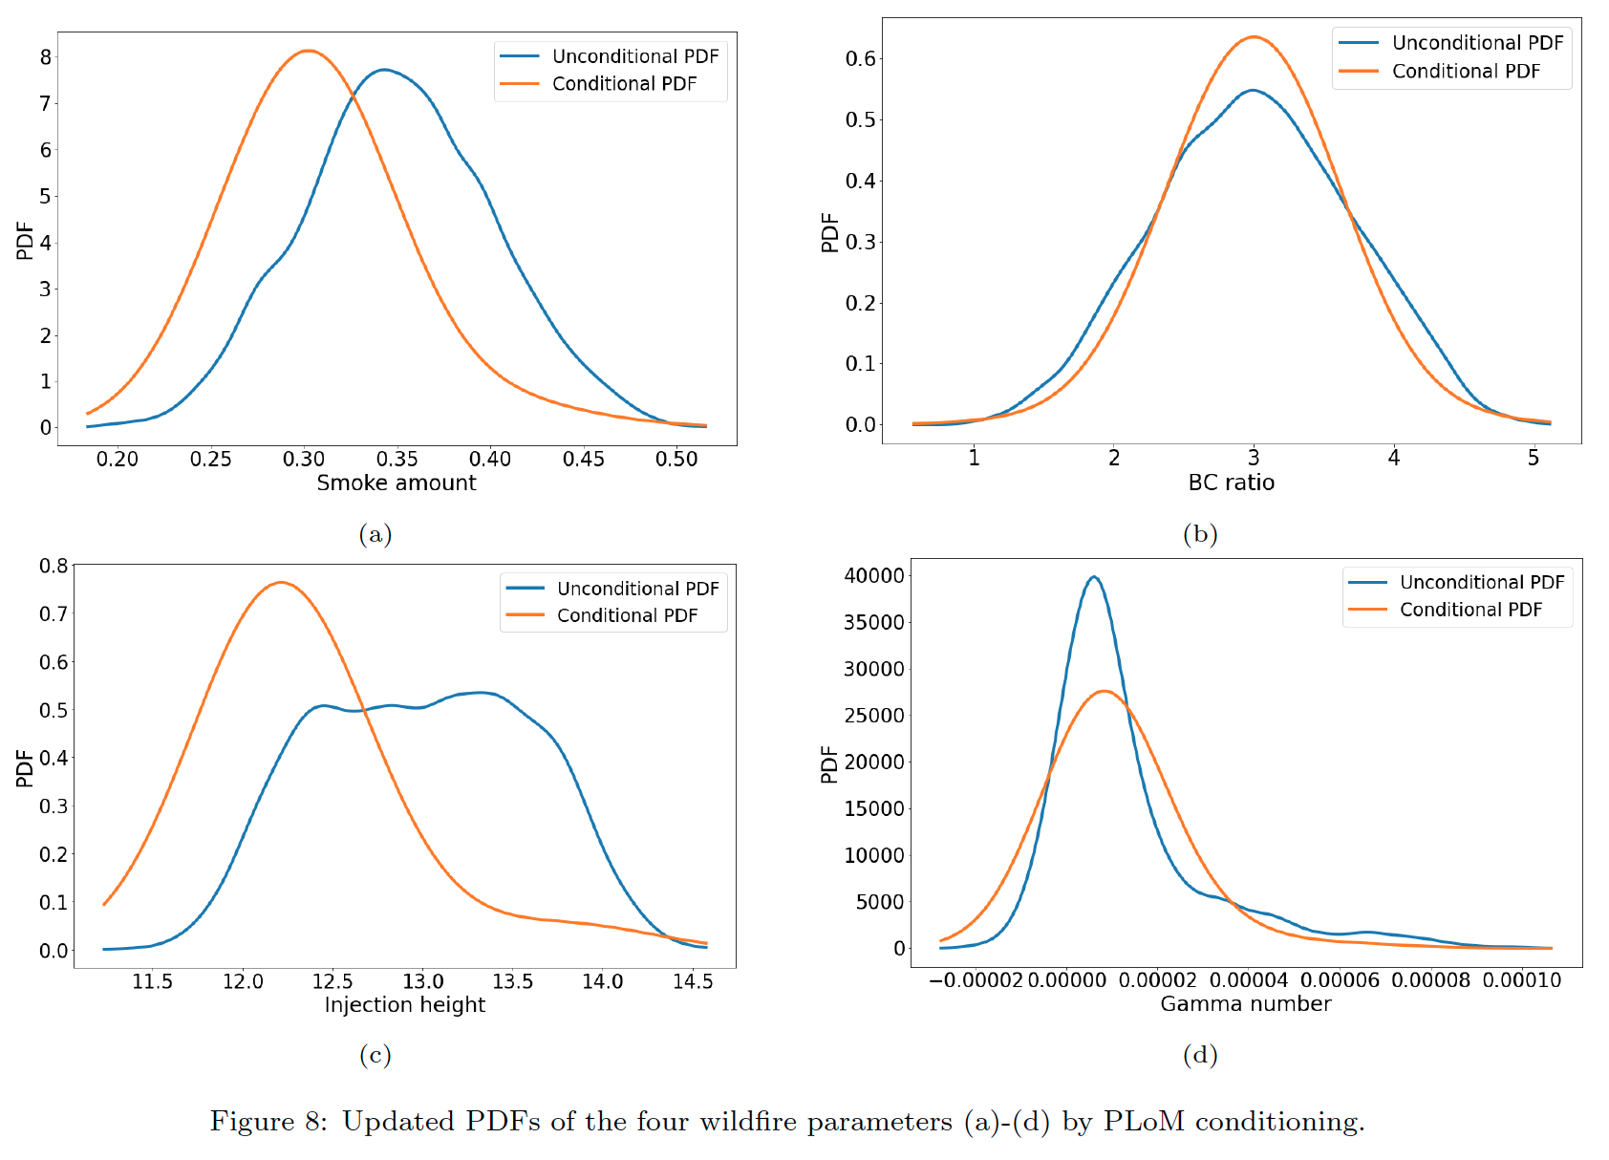
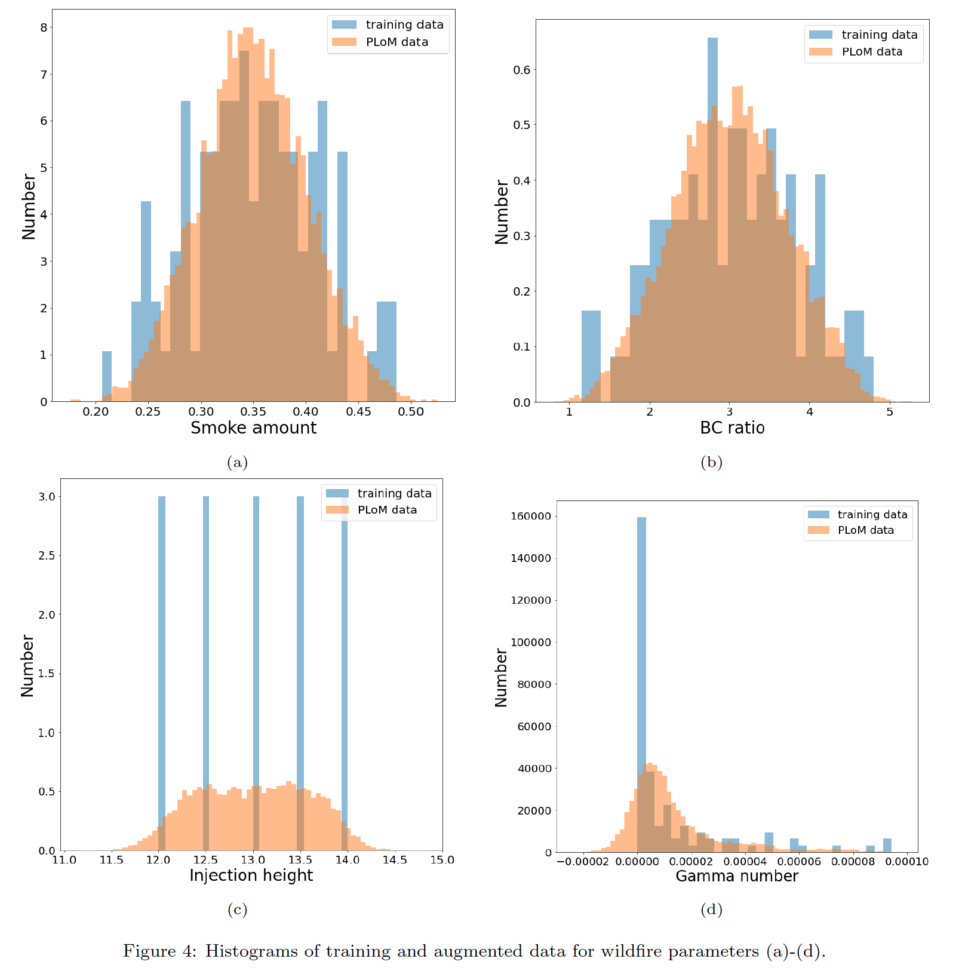
Wang et al., in prep.

Slide 9
A first-of-its-kind multiscale pyroCb simulation framework
Ke et al., 2025
Extended the E3SM Regionally Refined Model (RRM) capability to a 3-km resolution over California (CARRM) and incorporated a plume rise model and a vertical water vapor transport scheme.
Developed a high-resolution (500 m, hourly) dataset of fire radiative power, emissions, and sensible heat flux using satellite observations for surface boundary conditions.

Slide 10
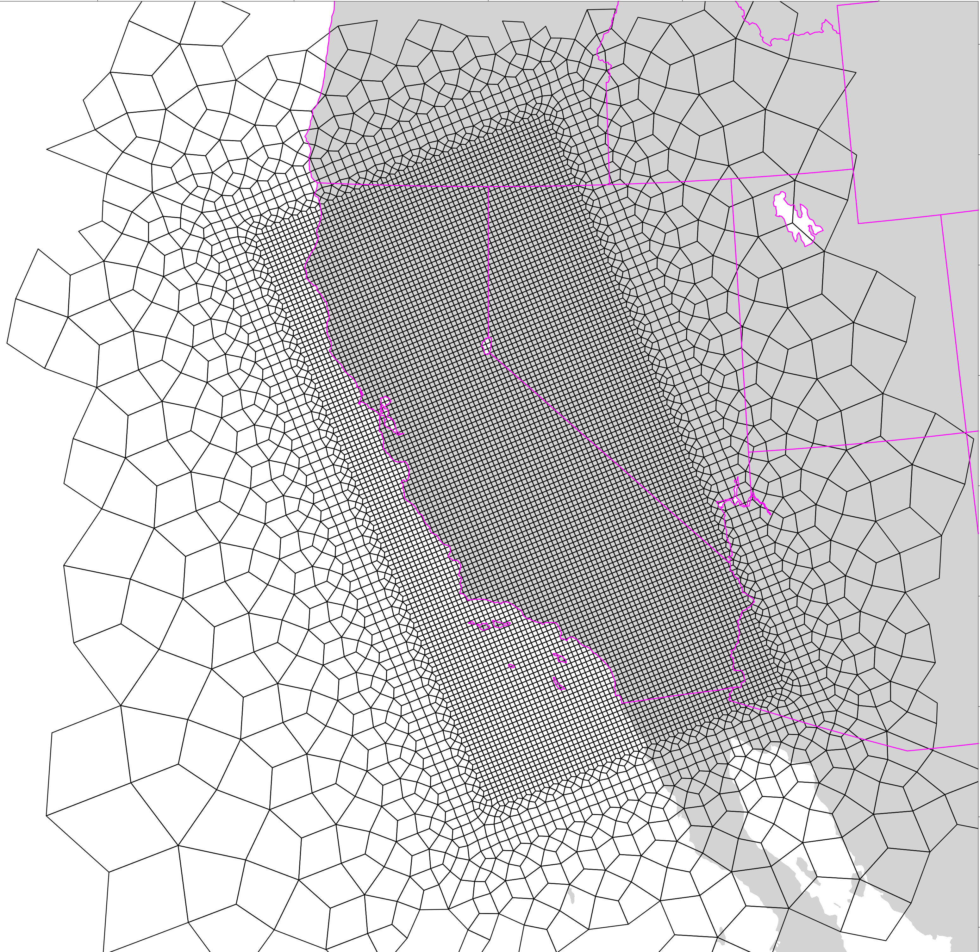
California (CA) RRM (3->100 km)
Topography
3 km
CARRM mesh (3->100 km) for atmosphere and land.
Throughput is ~1 simulation month per wall-clock day: Multi-year & ensemble runs are affordable.

Slide 11
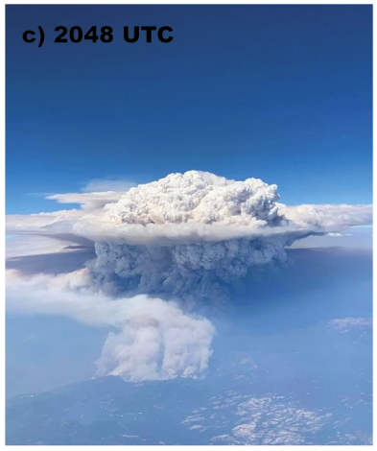
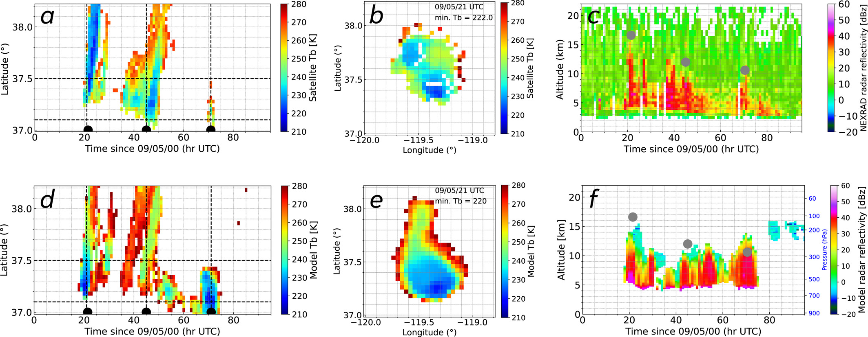
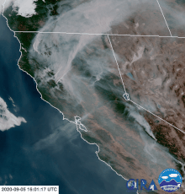
PyroCb during 2020 Creek Fire
The largest single blaze in the history of California (until 2020)!
(Lareau 2022)
Ke et al., 2025
Successfully reproduces many pyroCb features, including cloud height, spatiotemporal evolution, and convective intensity
Reveals vertical transport of ambient near-surface water vapor as a key factor.
https://en.wikipedia.org/wiki/Creek_Fire_(2020)

Slide 12
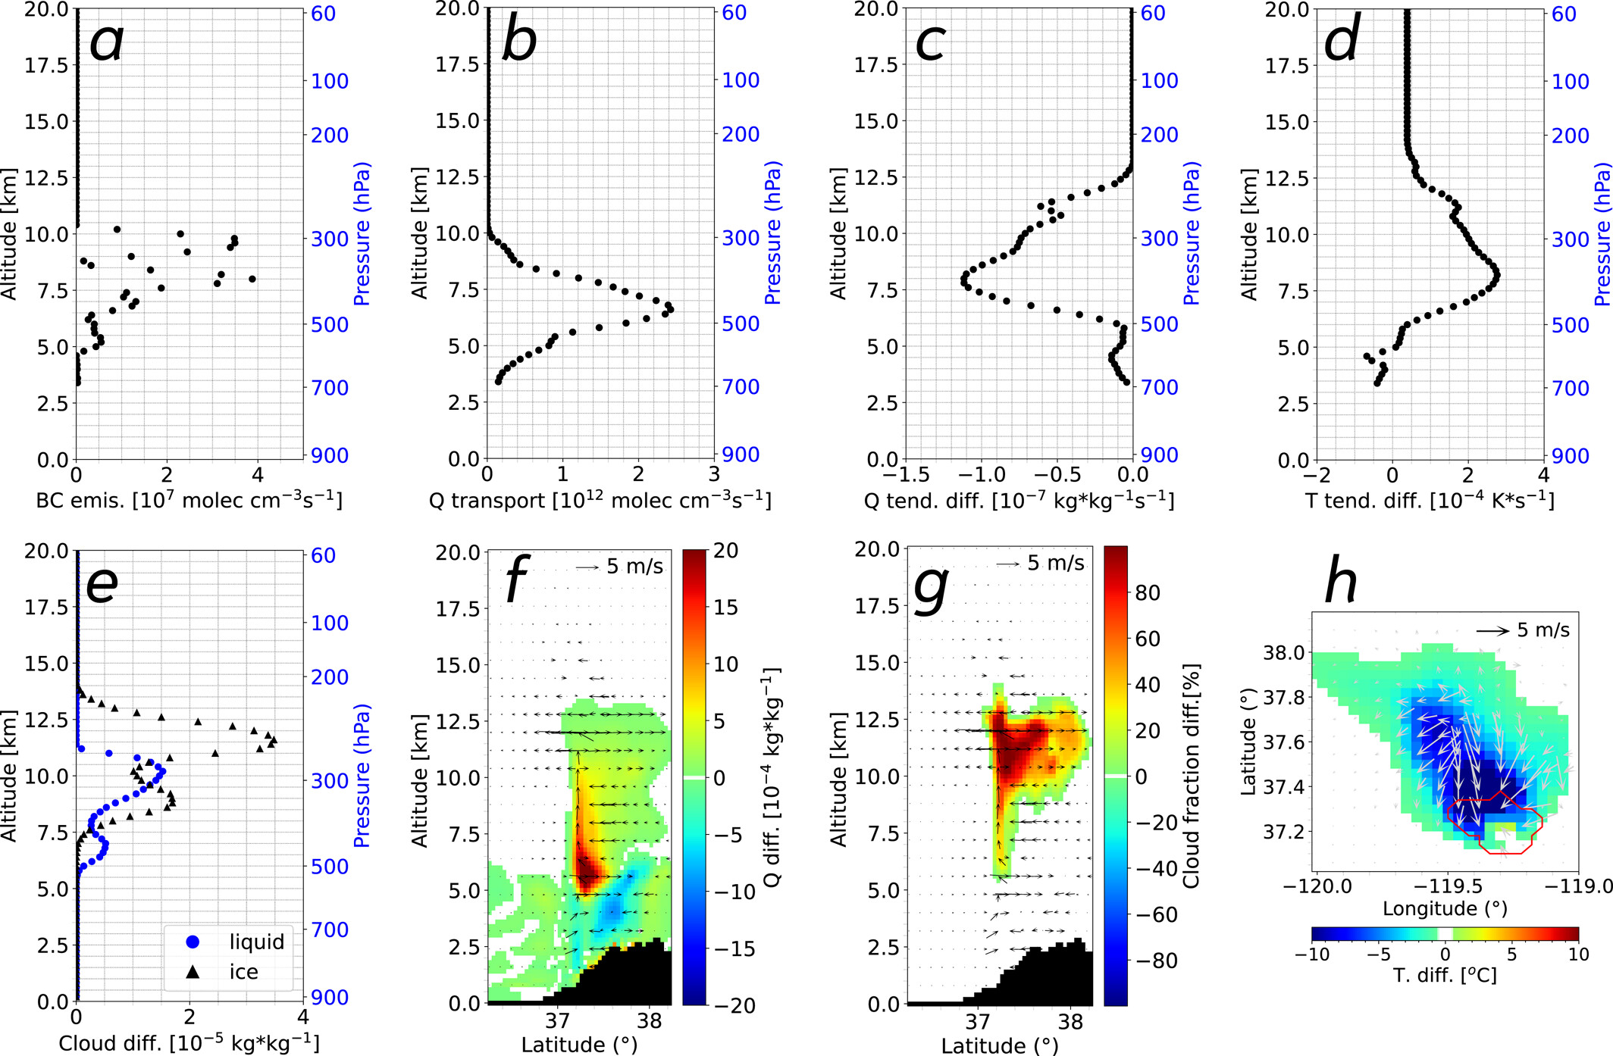

Slide 13
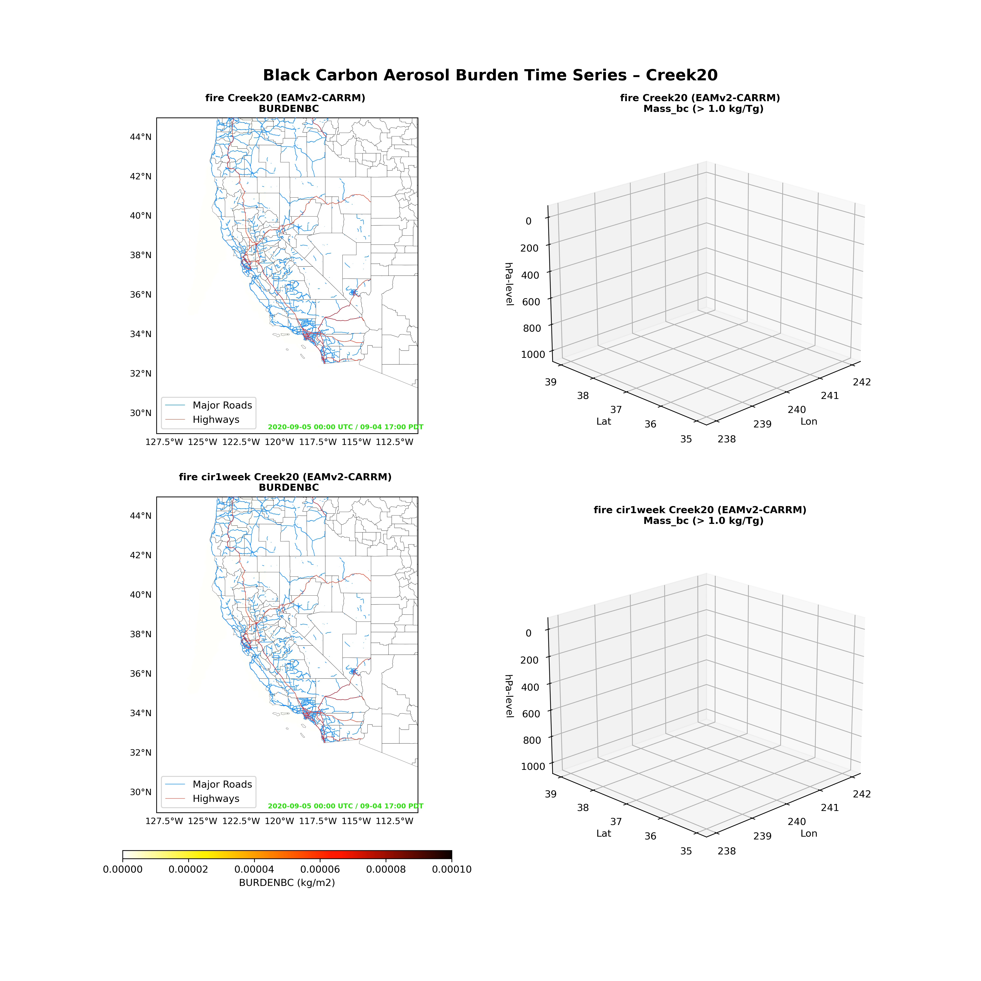
Courtesy of Jishi Zhang

Slide 14
Summary
Based on E3SM standard low-resolution (100 km) ensemble simulations:
Random forest regressor identified smoke injection height as the most important factor for the BC2017 simulations to mimic satellite observations.
Probabilistic learning on manifolds shows encouraging results on generating an emulator and calibrating the distribution of inputs given observations of output through conditional update.
A new emission-driven multiscale (3->100 km) wildfire simulation framework was established.
Opens door for future UQ opportunities to study wildfire.

