Slide 1
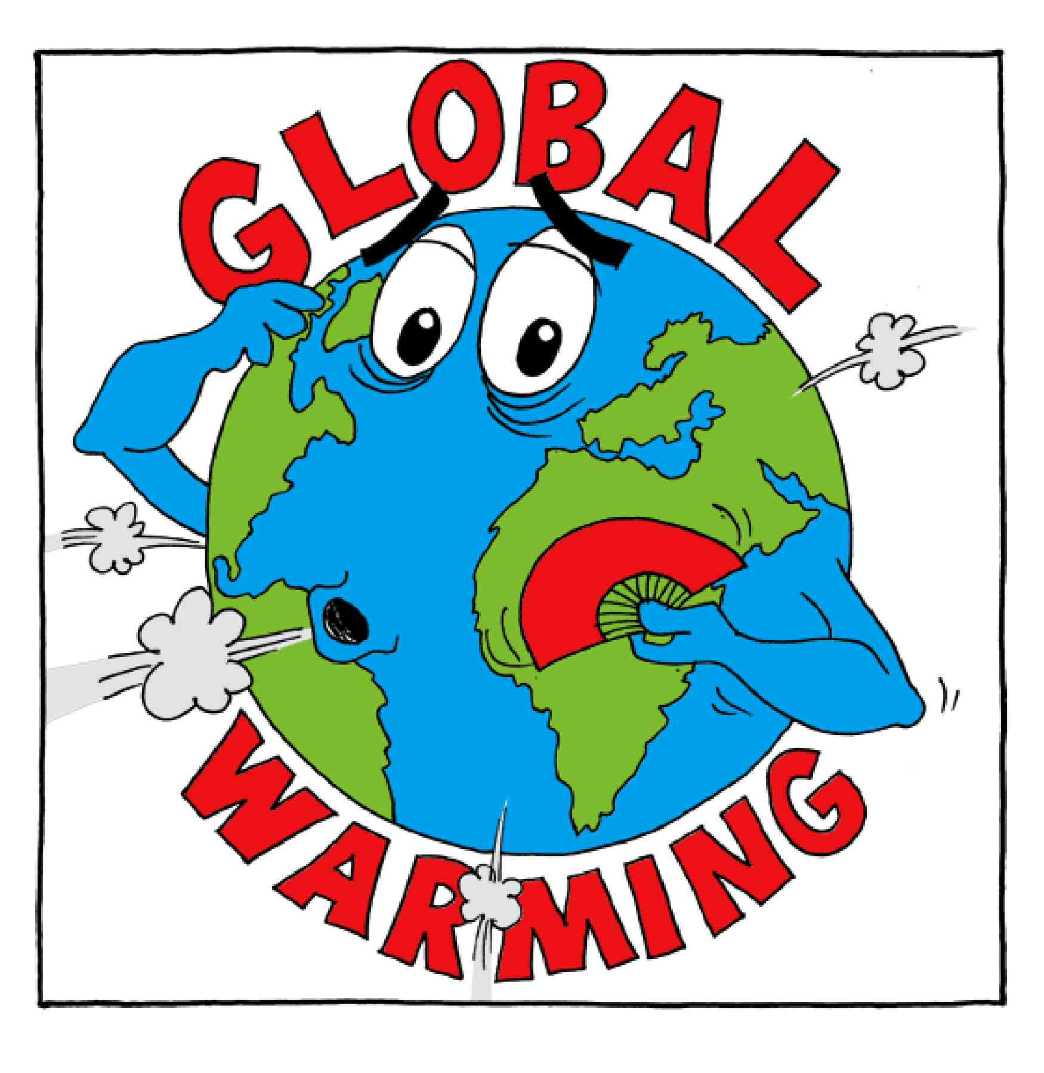
Warming Planet:
What sets the Earth’s temperature?
SJEYH 2024

Slide 2
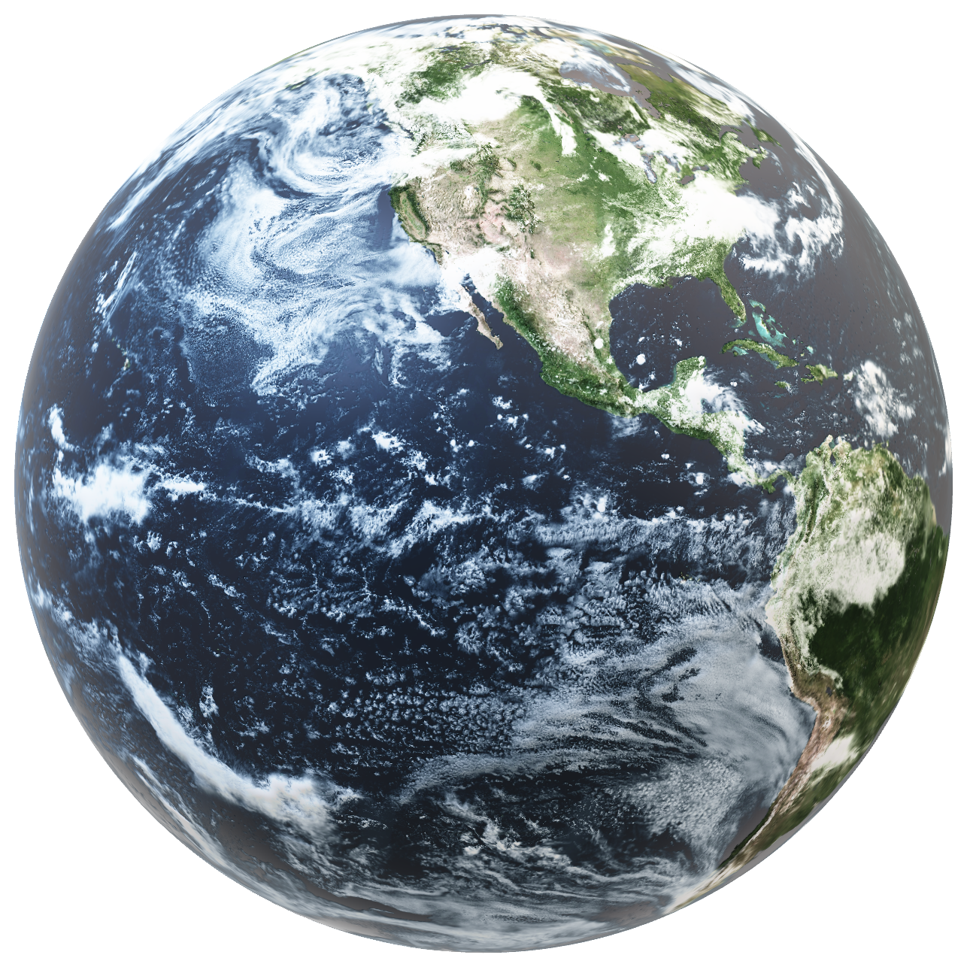
What determines the Earth’s temperature?
What warms the planet?
What cools the planet?

Slide 3
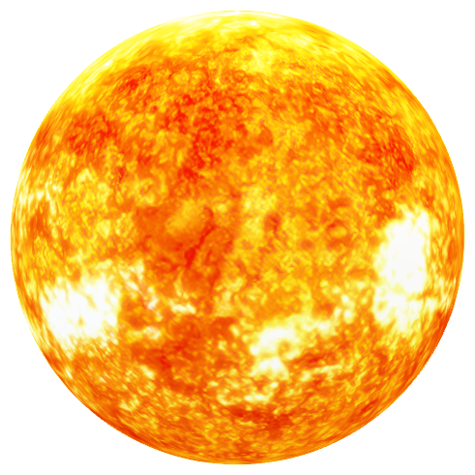
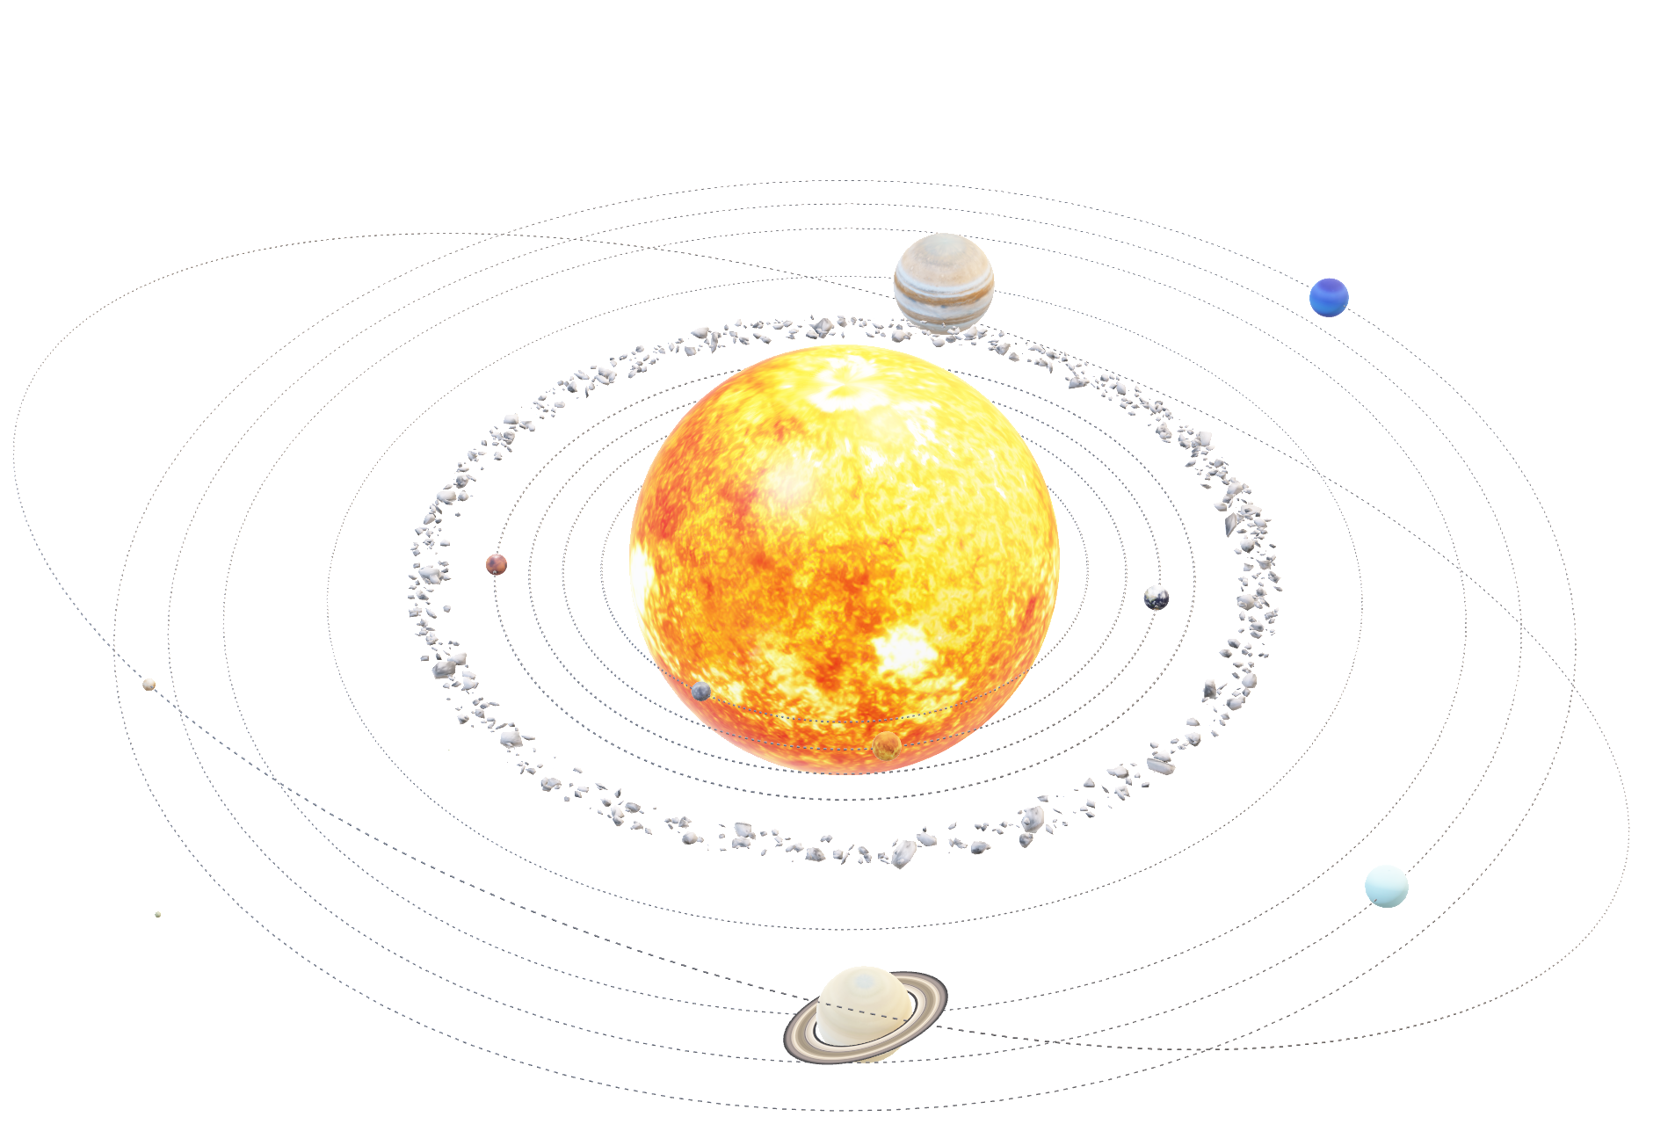

What warms the planet?
What cools the planet?

Slide 4
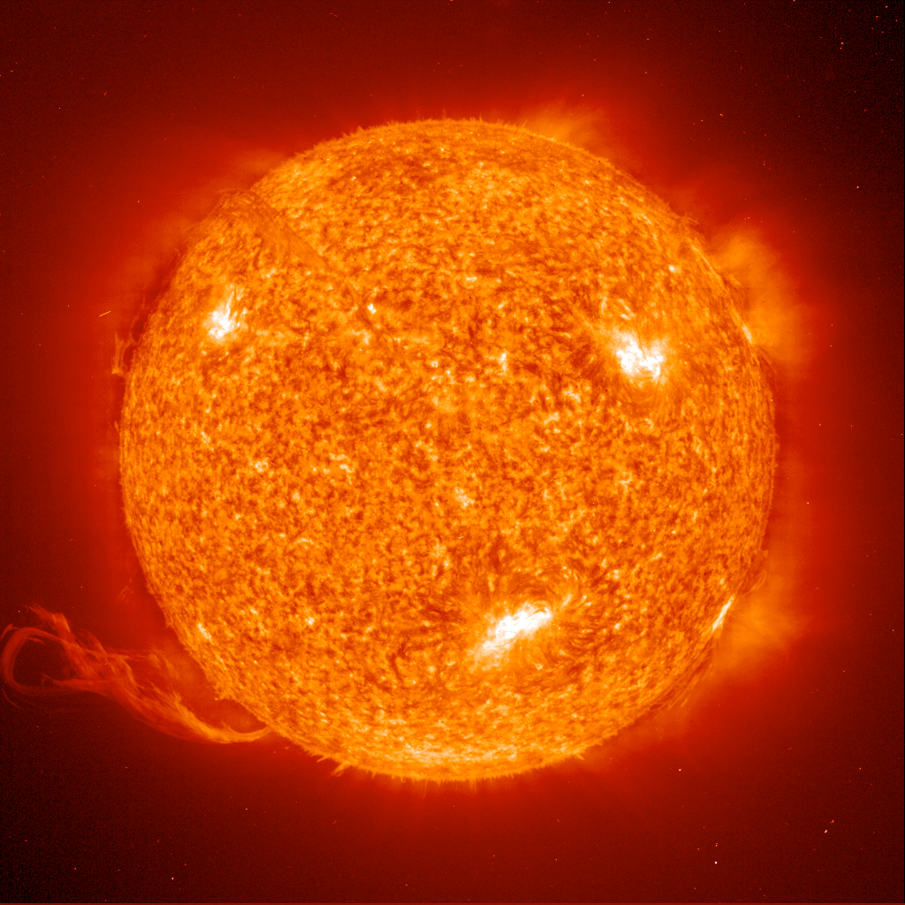
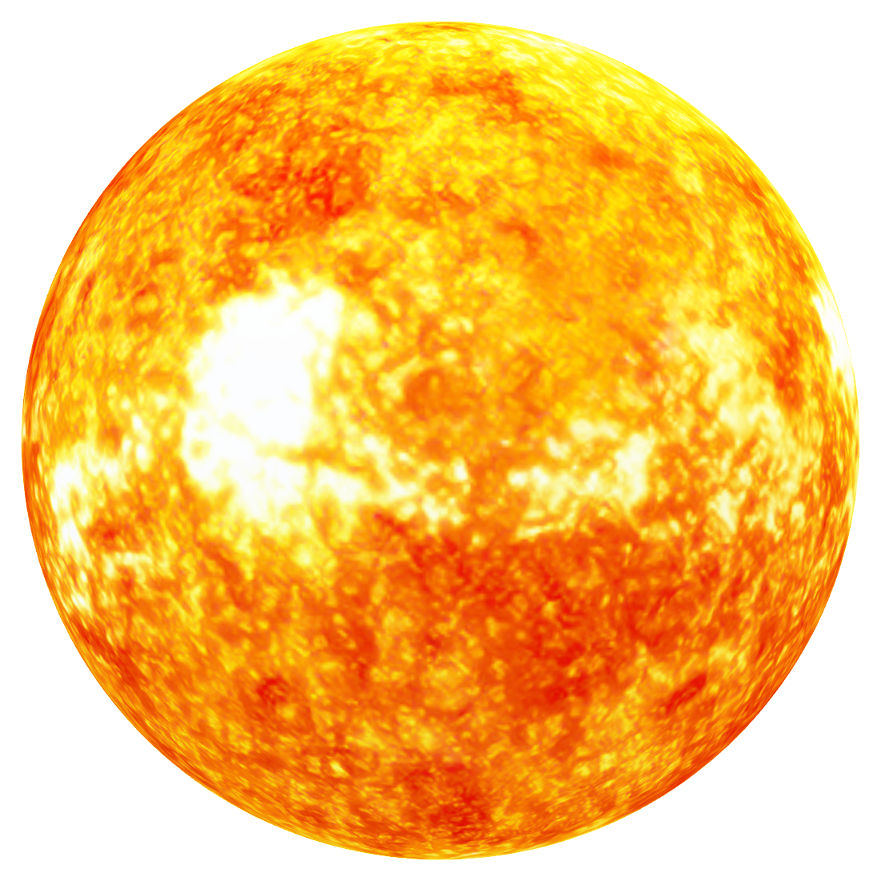
SUN
all our energy comes from the sun

Slide 5
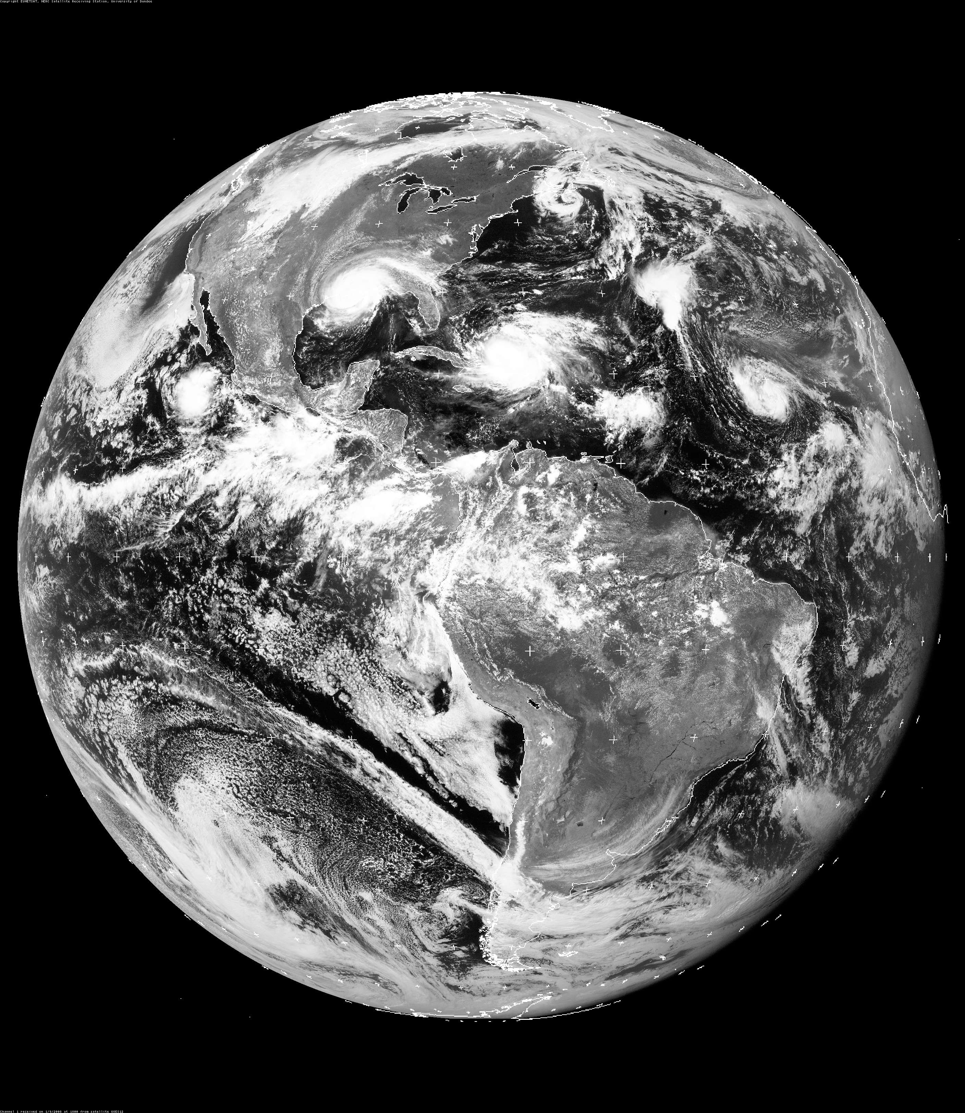
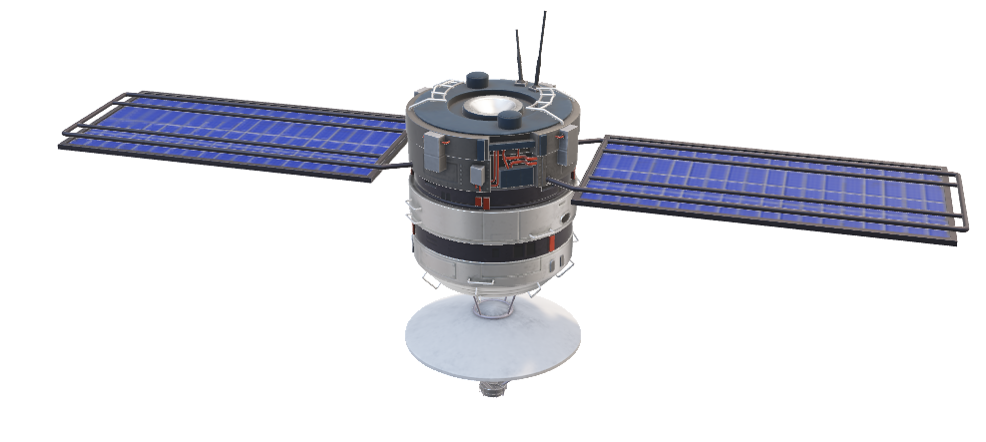

Slide 6
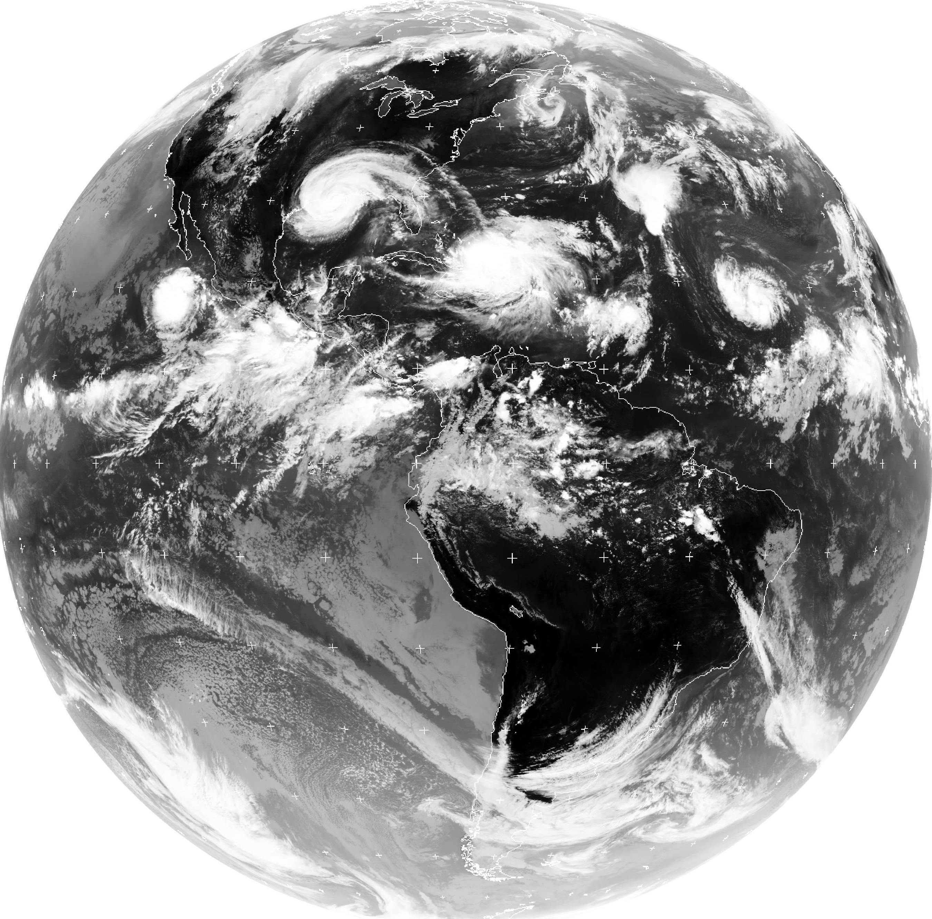
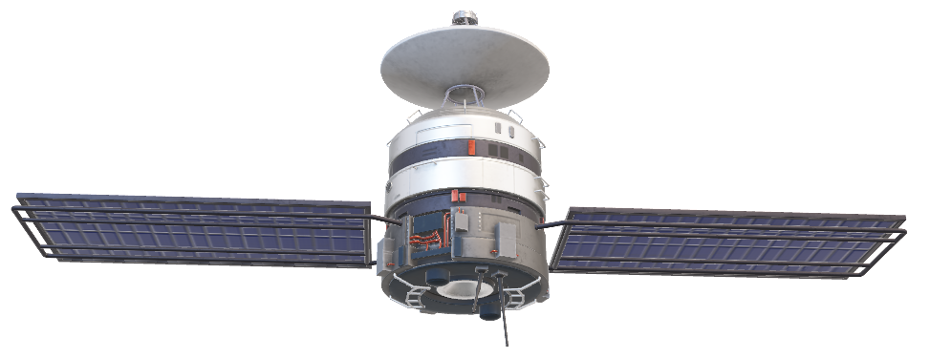
Infrared
light/radiation

Slide 7
Infrared
light/radiation
Visible Light
Do you see the difference?

Slide 8
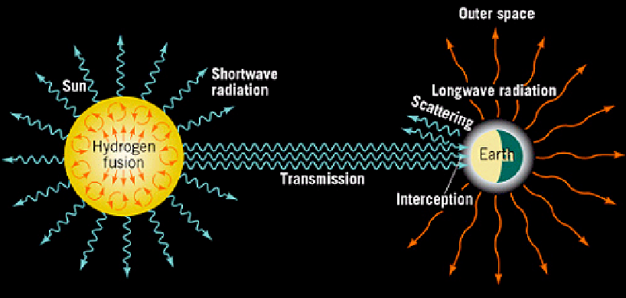
Energy gained = energy lost

Slide 9
Recently, we’ve been tipping the scale so we gain more energy than we lost energy
Link

