Slide 1
On-Demand Infrastructure for Data Analytics and Storage
Franck Cappello^{1,2}, Katrin Heitmann¹, Gabrielle Allen², Sheng Di¹, William Gropp², Salman Habib¹, Ed Seidel², Brandon George⁴, Brett Bode², Tim Boerner², Maxine D. Brown³, Michelle Butler², Randal L Butler², Kenton G. McHenry², Athol J Kemball², Rajkumar Kettimuthu¹, Ravi Madduri¹, Alex Parga², Roberto R. Sisneros², Corby B. Schmitz¹, Sean R Stevens², Matthew J Turk², Tom Uram¹, David Wheeler², Michael J. Wilde¹, Justin M. Wozniak¹.
¹Argonne National Laboratory, ²NCSA, ³UIC, ⁴DDN
Notes:
The principle to extend the computing, analytics and storage infrastructure beyond the limits of a single site
There are 3 factors pushing toward this principle:

Slide 2
Sciences produce gigantic datasets that are hard to transfer, store & analyze
Today’s scientific research is using simulation or instruments and produces extremely large of data sets to process/analyze
Example:
  Cosmology Simulation (HACC):
    A total of >5PB of data when
    simulating trillion of particles
    Petascale systems FS ~20PB
    → data reduction is needed
    → currently keep 1 snapshot in 5
Notes:
The first factor is that extreme scale scientific simulations and experiments produce gigantic data sets that are hard to transfer, store and analyze in current infrastructure
Let’s see the example of cosmology simulation with the HACC code developped at Argonne.
So the solution, at least often in simulation, is data decimation, or data omission.
The price is inaccurate data analysis. Researchers want both large scale and high accuracy (or at least better accuracy)

Slide 3
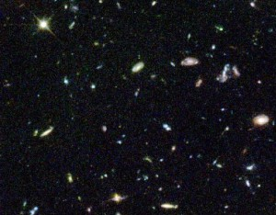
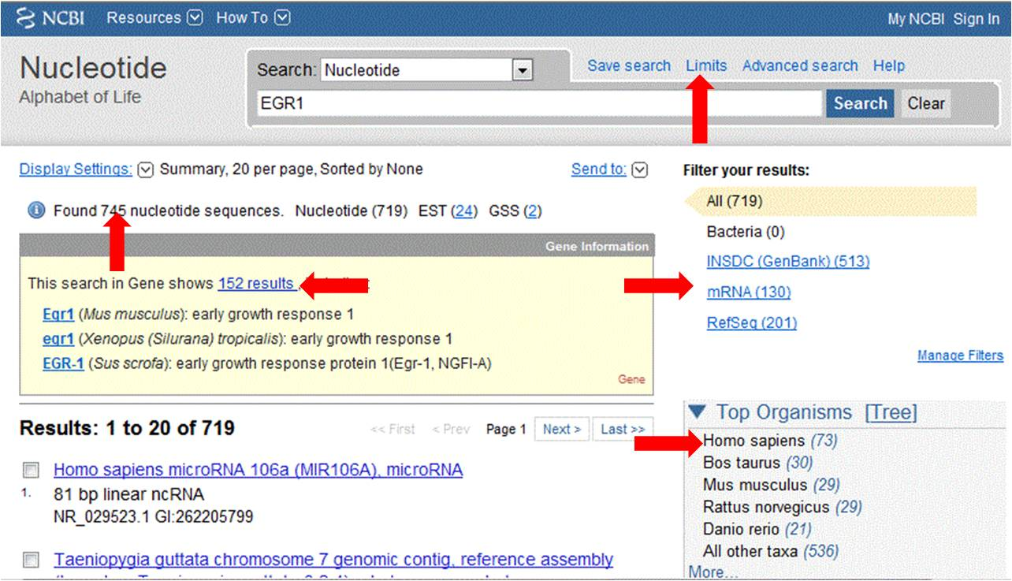
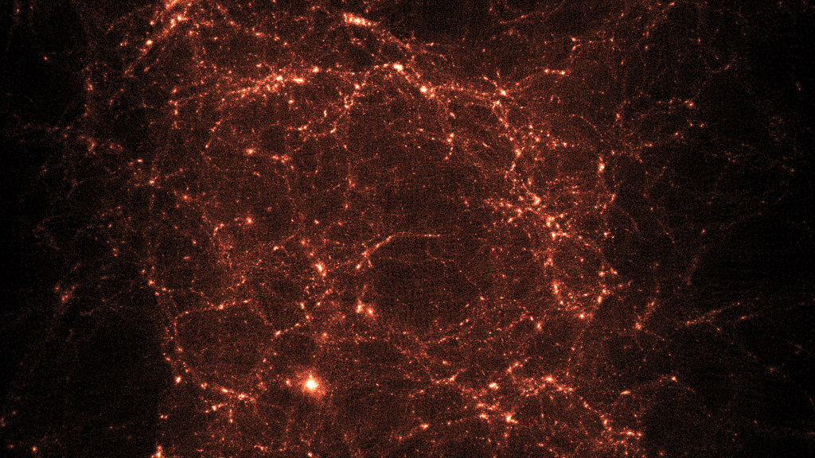
Cost of producing, moving and storing science data pushes toward sharing
From 1 producer, 1 user to 1 producer, many users
Examples:
  LHC
  The Cancer Imaging Archive
  Cosmological surveys (e.g. Dark Energy Survey)
  Nucleotide sequence, genome sequence, protein, etc. databases
  Climate simulations (International Panel on Climate Change)
  Cosmology simulations
  Open Access Directory
  Etc.
Notes:
The second factor pushing toward extending the infrastructure and using aggressive compression is the cost of producing, moving and storing scientific data.
At small and medium scale the model is often 1 producer, 1 consumer.
But for extreme scale simulations and experiments, the cost pushes toward sharing the data. The model becomes 1 producer, many users.
This is already the case in many domains: LHC, Cancer Imaging Archiive, Cosmology, etc.

Slide 4
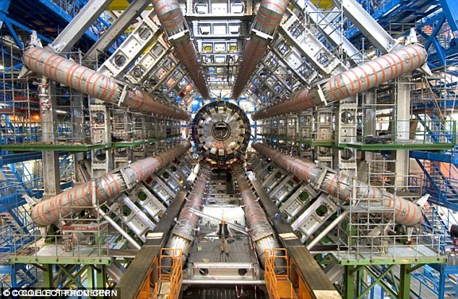
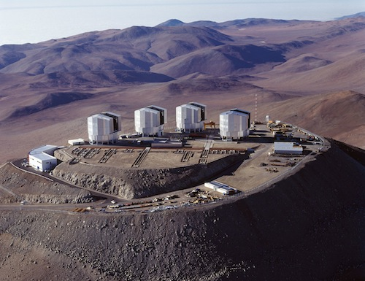
Systems and sites tend to specialize
Scientific instruments are specialized
Some systems are better for simulation
than data analytics. The opposite is also true.
For example BlueWaters has exceptional
data analytics capabilities. And Mira at ANL
has exceptional CPU computing capabilities.
HPC Centers may not be preliminary designed
for data sharing. They are more focused on data
production.
Data centers & Clouds designed for storage and access (not the priority of scientific instruments and HPC centers)
The end of Moore’s law may accelerate this specialization
Notes:
The third factor pushing at least toward extending the infrastructure is that systems tend to specialize.
Scientific instruments are already specialized.
But we can observe some specialization in simulation and data analytics.
And the end of Moore’s law will accentuate specialization, since this is a way to improve performance when technology is not progressing anymore.

Slide 5
ANL-NCSA experiment: On demand infrastructure for data analytic and storage
Objectives:
1) Cosmology simulation and analysis at full resolution
2) Share the data with other sites
→ Need to produce and analyze all snapshots
→ Need to create a virtual infrastructure
of complementary resources
Notes:
The idea is to build on-demand an infrastructure that will allow for the production, transfer, analysis and storage and sharing of extreme scale scientific data.
Specifically, we run an experiment since more than 10 months associating Argonne and NCSA for cosmology research.
The goal is to a 29 billion particles simulation on Mira at Argonne and perform the analysis at full resolution on BlueWaters.
The results of BW data analytics is stored on a 2PB storage system on the NCSA booth at SC16. Other sites (NERCS and ORNL) can then pull the data for other type of analytics.
The big difference with what is currently done is that we will generate and use all snapshots.

Slide 6
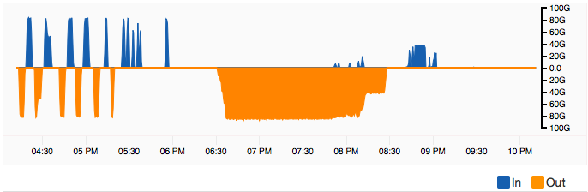
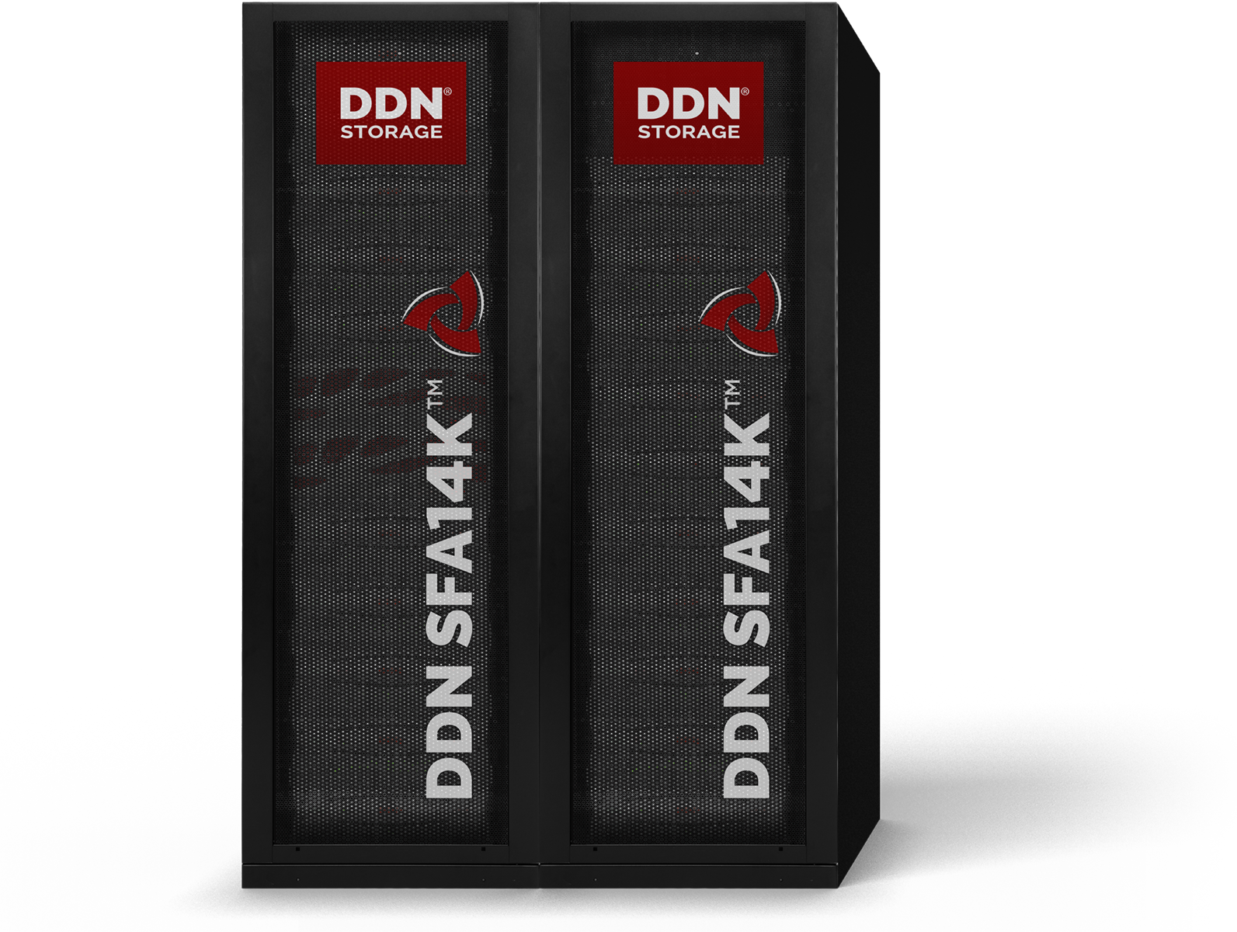
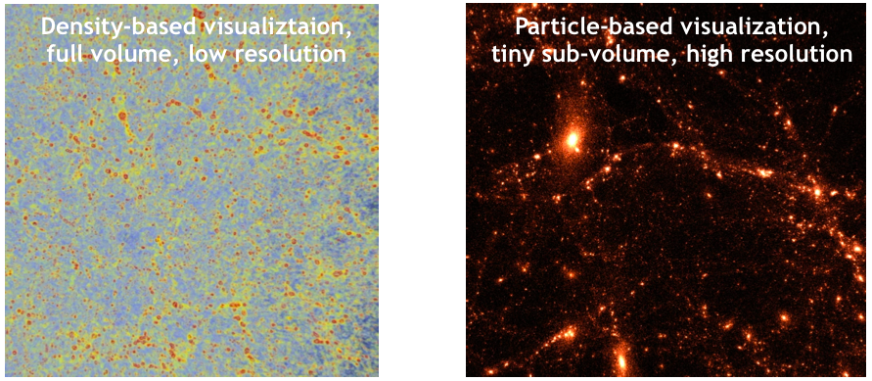
On demand infrastructure: Challenges
1) Simulation and science: Katrin Heitmann, ANL
2) Data transfer: Rajkumar Kettimuthu, ANL
  3) Orchestration: Justin Wozniak, ANL
  4) Storage: Brandon George, DDN
  5) Visualization: Roberto Sisneros, NCSA
  6) Scinet: David Wheeler, NCSA
  → Question/discussion
Notes:
To realized this on-demand infrastructure, several challenges need to be addressed.
The first one is that we need to move the snapshots as soon as they are produced since they cannot be stored on Mira. So we need some coordination between Mira and BlueWaters to transfer the snapshots.
Second we weed to move the data quickly and in a sustained way. We can move 1PB/day, but we want to generate multiple PB. So this needs to work in sustained mode. This is not trivial because Mira and BW file system are shared resources
The third challenge is to assemble a storage system that will serve the remote site for their analysis. You can see that as a very datacenter with very large connection to remote sites
The fourth challenge is the visualization of the full data set at full resolution. This will be the first time that Cosmologist see and explore such ultra high quality data set

Slide 7
Simulation and Science
Notes:
To realized this on-demand infrastructure, several challenges need to be addressed.
The first one is that we need to move the snapshots as soon as they are produced since they cannot be stored on Mira. So we need some coordination between Mira and BlueWaters to transfer the snapshots.
Second we weed to move the data quickly and in a sustained way. We can move 1PB/day, but we want to generate multiple PB. So this needs to work in sustained mode. This is not trivial because Mira and BW file system are shared resources
The third challenge is to assemble a storage system that will serve the remote site for their analysis. You can see that as a very datacenter with very large connection to remote sites
The fourth challenge is the visualization of the full data set at full resolution. This will be the first time that Cosmologist see and explore such ultra high quality data set

