Slide 1
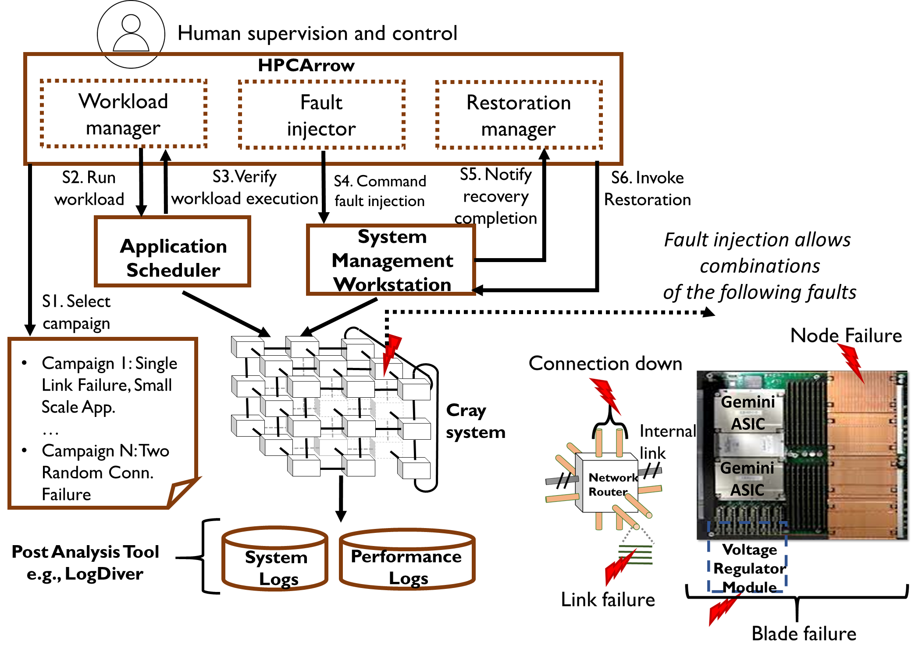
Understanding Fault Scenarios and Impacts through Fault Injection Experiments in Cielo, Cray User Group, 2017
Scientific Achievement
Developed HPCArrow: A software tool for injecting faults into HPC systems
Identified critical errors associated with network deadlock and application hangs
Discovered actionable fault indicators for early notification to applications and system
Significance and Impact
Enabled repeatable experiments and more reliable fault propagation characterization than from log analysis alone
Potential for significant impact on development of more productive next generation systems and applications
Fig. 1 - HPCArrow: A fault injector for HPC Supercomputers
Research Details
Executed large scale (9 thousand nodes) fault injection experiments on a Cray XE platform “Cielo” at Los Alamos National Lab using multiple failure profiles and concurrent jobs with a range of sizes
Recreated failure severity levels ranging from single component to multi-component unrecoverable failure (network deadlock)
Actionable fault indicators for system and application software were obtained through analysis of data (timing, fault, and failure) from performance counters and system logs generated during the fault injection experiments
Notes:
Paper submitted in CUG 2017 and presented in CUG 2017 held in Seattle, Washington, USA.
Data analysis and statistical learning techniques can only capture events that are logged, and often the logging on production systems does not include the complete set of information that could be made available. Lack of holistic measurements make it hard to assess the value of current instrumentation for assessing fault impact. In production systems, it often is not possible to identify whether a complete set of information is being made available.
Controlled fault-injection experiments can help to provide increased insights to failure scenarios not sufficiently explained using data from production systems.
In this work, we conducted fault injection experiments on compute and network components to assess system resilience to failures. We are fortunate to be able to this on a large scale system.
We developed HPCArrow, a methodology and tool for injecting faults into the system component, control workload, recreate failure scenarios observed from field-failure data analysis, and restore the system into initial state. We injected faults into links, blades, compute nodes, connections (i.e., multiple directional link failures), and multiple connections. We identified critical errors for detecting network deadlock and application hangs, based on hardware error logs.
We recommended notification and instrumentation improvements, in particular at application and system levels, that represent opportunity for checkpointing and/or application-specific fault tolerance. This work provided initial experience in applying our fault injectionapproach to the Cray XC platform (newer Cray technology) which employs the Cray Aries router (an evolution of the Gemini router).
Citation:
“Understanding Fault Scenarios and Impacts through Fault Injection Experiments in Cielo”
Valerio Formicola, Saurabh Jha, Fei Deng, and Daniel Chen (University of Illinois at Urbana-Champaign); Amanda Bonnie and Mike Mason (Los Alamos National Laboratory); Annette Greiner (National Energy Research Scientific Computing Center); Ann Gentile and Jim Brandt (Sandia National Laboratories); Larry Kaplan and Jason Repik (Cray Inc.); Jeremy Enos and Michael Showerman (National Center for Supercomputing Applications/University of Illinois); Zbigniew Kalbarczyk (University of Illinois at Urbana-Champaign); William Kramer (National Center for Supercomputing Applications/University of Illinois); and Ravishankar Iyer (University of Illinois at Urbana-Champaign)

