Slide 1
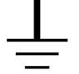
Power supply DCR80-33
50V/33A DC
plus
gnd
accident 1
208VAC
Coil: approx. 1 Ohm
minus
gnd
gnd
accident 2
gnd
accident 3

