Slide 1
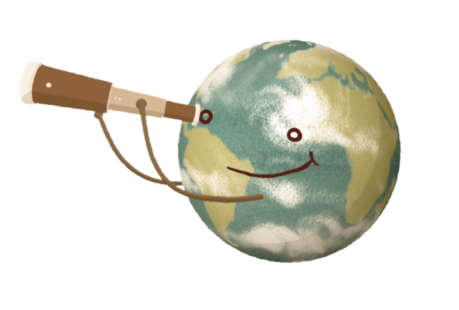

Spitzer Follow-up of Extremely Cold Brown Dwarfs Discovered by the Backyard Worlds: Planet 9
Citizen Science Project
Aaron Meisner (NSF’s NOIRLab)
The Backyard Worlds: Planet 9 Collaboration
http://backyardworlds.org

Slide 2
Backyard Worlds is Much Deeper than Prior WISE-based brown Dwarf Searches

Slide 3
Time-resolved unWISE Coadds Reveal Otherwise Imperceptible Motions
this cutout is roughly one hundred millionth of the entire sky → crowdsource all-sky visual inspection

Slide 4
W2-only Moving Object Discoveries:
Prime Y Dwarf Candidates
Spitzer PID 14076, 14299 (PI: Faherty)

Slide 5
Backyard Worlds Spitzer Sample:
Cold & Wide Co-moving Companions
T8 companion to a 0.5 M_{sun} white dwarf at 23 pc ; projected physical separation = 400 AU

Slide 6
Backyard Worlds Spitzer Sample:
Cold & Wide Co-moving Companions
(candidate) T7.5 companion to a 0.6 M_{sun} white dwarf at 26 pc ; projected physical separation = 8,700 AU

Slide 7
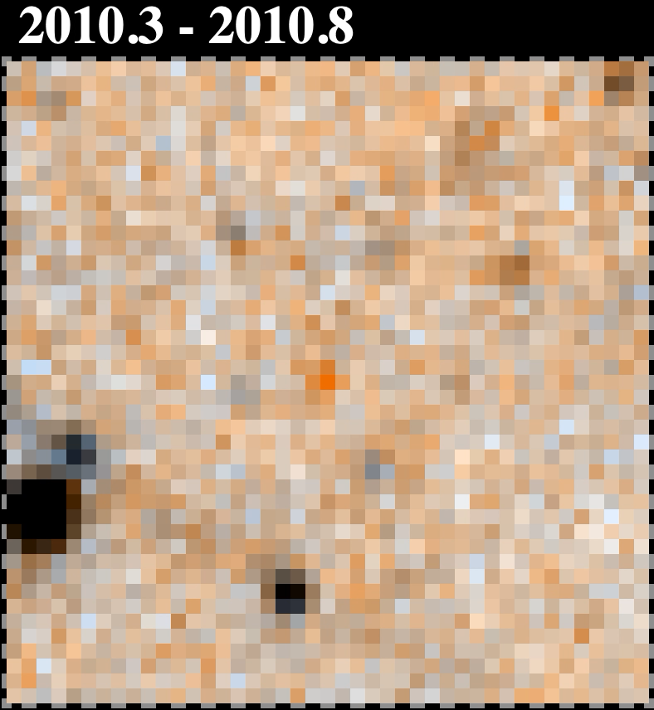
Backyard Worlds Spitzer Sample:
New Y Dwarf Discoveries
WiseView (Caselden+ 2018)
WISE 0830+2837 (Bardalez Gagliuffi+ 2020), discovered by Backyard Worlds citizen scientist Dan Caselden – the second coldest known brown dwarf?

Slide 8
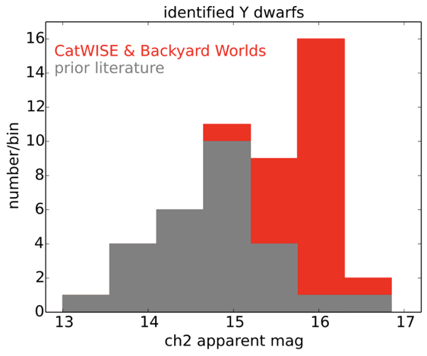
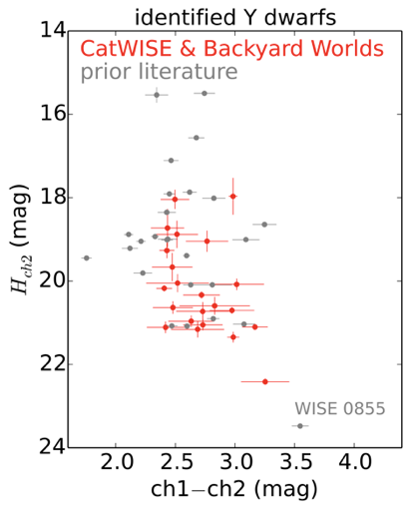
Backyard Worlds + CatWISE:
Doubling the Y Dwarf Sample
Meisner+ (2020a,b), Bardalez Gagliuffi+ 2020

