Slide 1
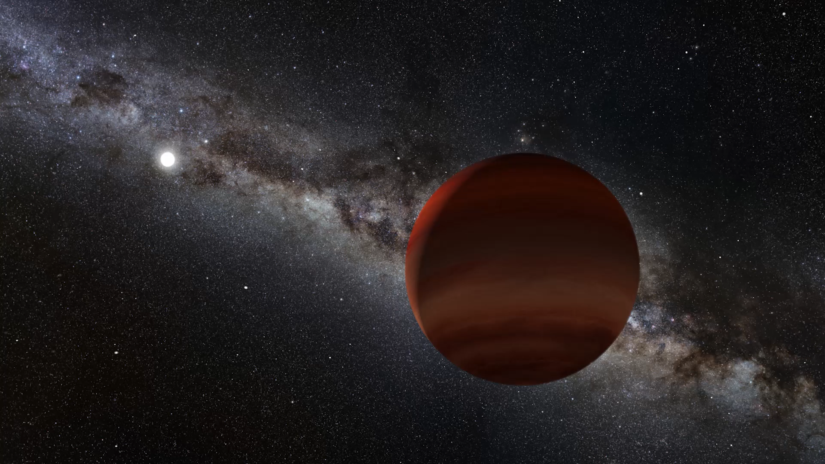

Citizen Scientists Discover Extremely Cold Brown Dwarfs
Aaron Meisner (NSF’s NOIRLab)
aaron.meisner@noirlab.edu ; (650) 714-8643
Backyard Worlds: Planet 9 Collaboration
CatWISE Team
NOIRLab/NSF/AURA/P. Marenfeld

Slide 2
The time-honored quest to find our Sun’s closest neighbors
NASA/Penn State University

Slide 3
The time-honored quest to find our Sun’s closest neighbors
discovered recently by NASA’s
Wide-field Infrared Survey Explorer (WISE) mission
NASA/Penn State University

Slide 4

DESI imaging processed a quarter petabyte of raw WISE data to create the deepest, most comprehensive all-sky infrared maps

Slide 5

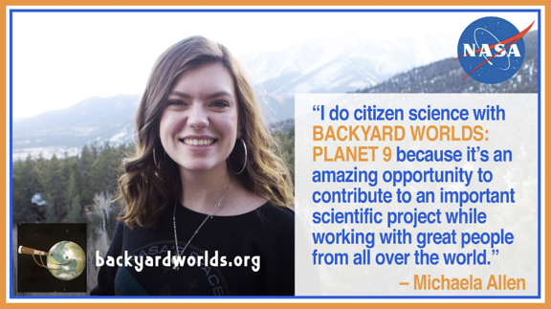
the Backyard Worlds: Planet 9
citizen science project
Launched in February 2017 via Zooniverse
More than 7 million user ‘classifications’
Over 64,000 registered users
Roughly 150,000 unique contributors
Participants from all 50 states, plus Puerto Rico and DC
167 countries represented

Slide 6
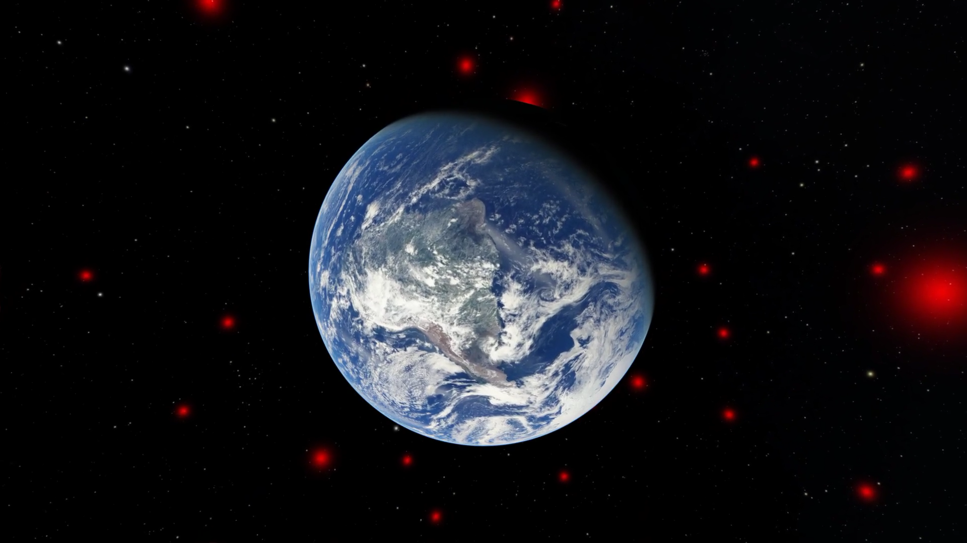
today’s news: best ever 3D map of brown dwarfs in the Sun’s cosmic neighborhood
Lead author: J. Davy Kirkpatrick (Caltech/IPAC)
Video: Jackie Faherty (AMNH)/OpenSpace

Slide 7
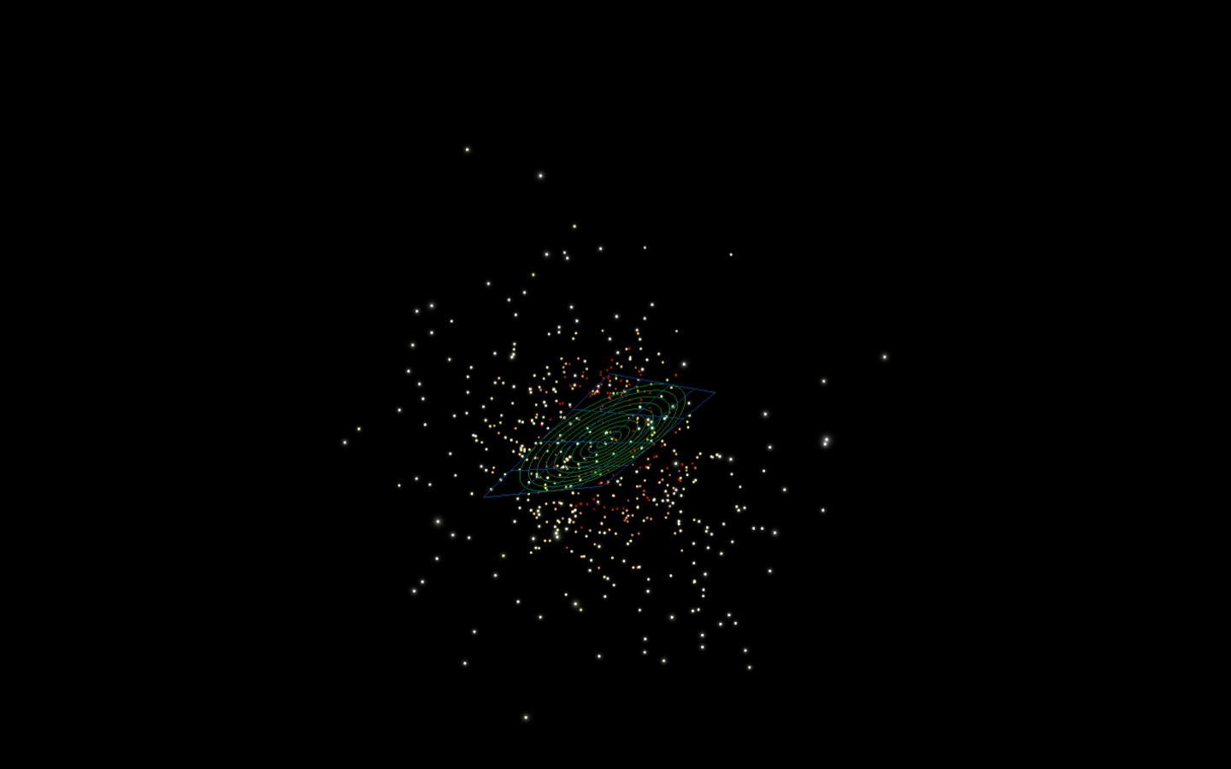
3,000 Backyard Worlds brown dwarf discoveries: more than 2 per day!
Video: Jonathan Gagné (Rio Tinto Alcan Planetarium)

Slide 8
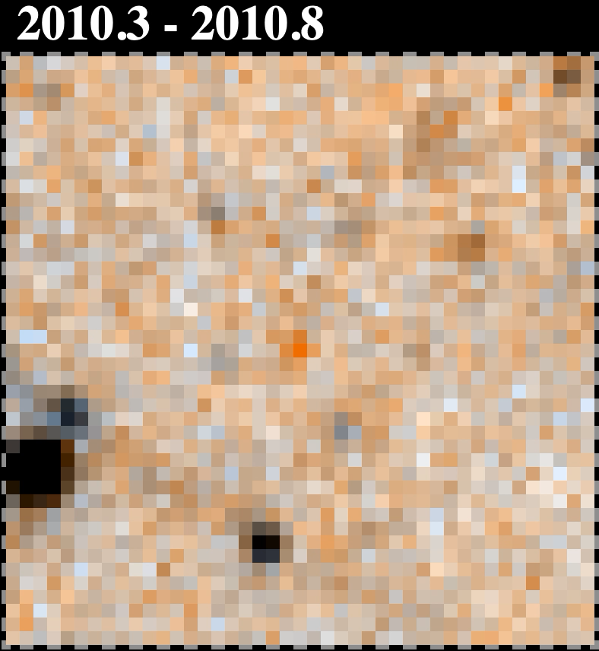
surprise: Sun’s nearest neighbors even weirder than previously thought
WISE 0830+2837, discovered by Backyard Worlds citizen scientist Dan Caselden – the second coldest known brown dwarf?
prior literature
Backyard Worlds,
CatWISE
WISE 0855, the coldest known brown dwarf, still stands alone!
0830+2837
Bardalez Gagliuffi et al. (2020)
coolest
warmest

Slide 9

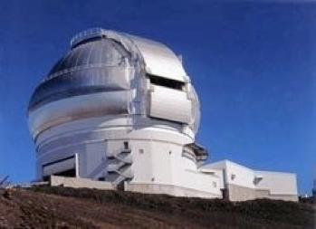
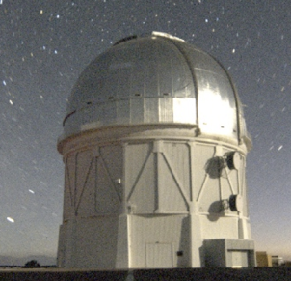
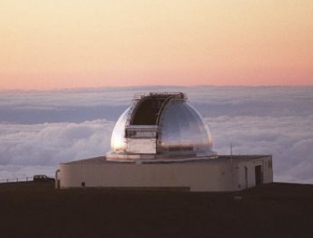
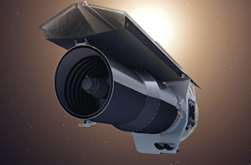
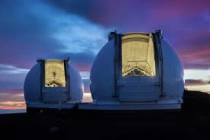

observing citizen scientist discoveries with premier telescopes
Gemini
NASA IRTF
Blanco
Spitzer
Keck
Hubble
crucial distance estimates are based on Spitzer Space Telescope follow-up (Kirkpatrick et al., in press)

Slide 10
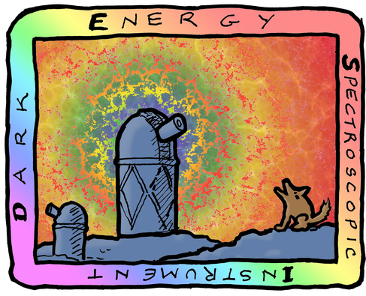
conclusion
With help from DESI imaging sky maps and citizen scientists, we’ve published the best ever 3D census of nearby brown dwarfs.
Our discoveries would not have been possible without WISE and DESI Legacy Surveys ‘open data’ practices.
We could still use much more help from members of the public!
aaron.meisner@noirlab.edu ; (650) 714-8643

