Slide 1


Brief Update: Beam-mapping CHORD dishes (D3A6) with GNSS satellites
Shronim Tiwari
MSc Physics Candidate, McGill University
Supervisor: Prof. Jonathan Sievers

Slide 2
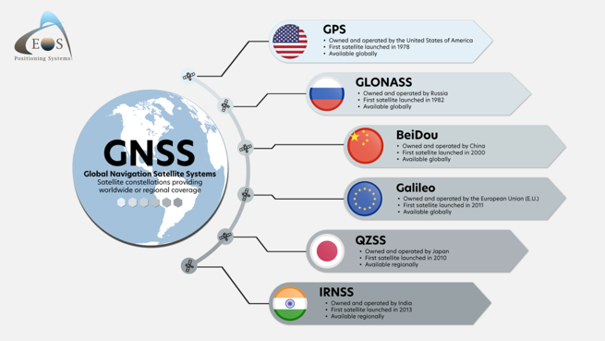
Global Navigation Satellite System (GNSS)
Different satellite constellations:
  GPS (USA), Galileo (Europe), GLONASS (Russia), Beidou (China), and more
Around 40 GNSS satellites visible at any time

Slide 3
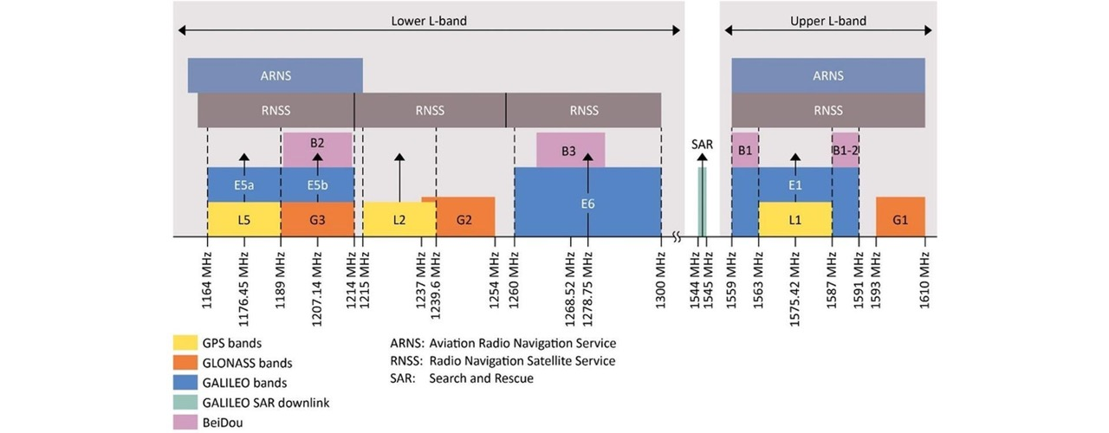
Frequencies
Source: https://gnss.store/blog/post/l1-l2-l5-l3-and-simply-l-frequency-bands.html

Slide 4
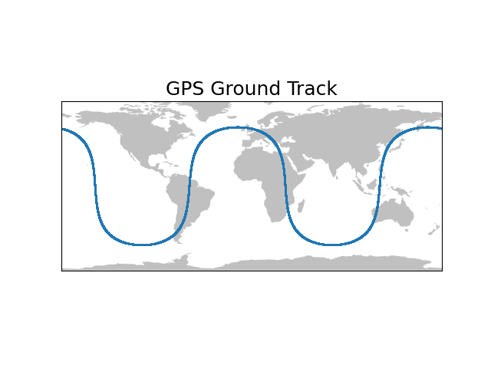
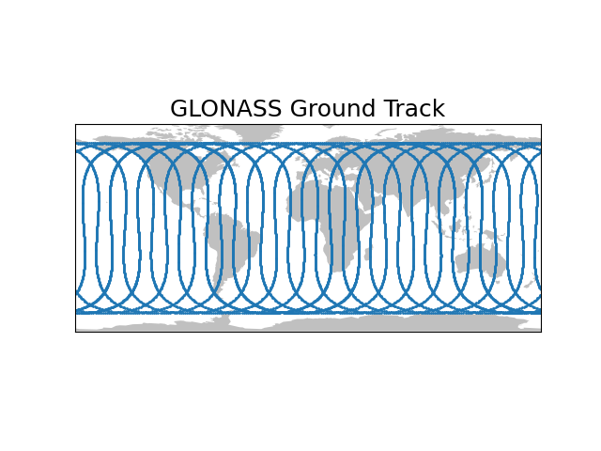
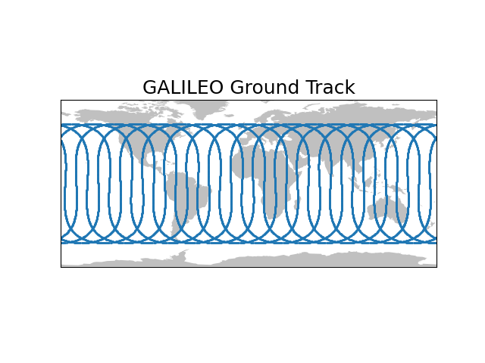

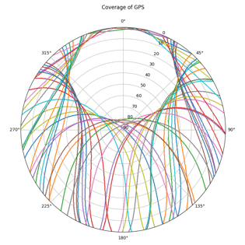
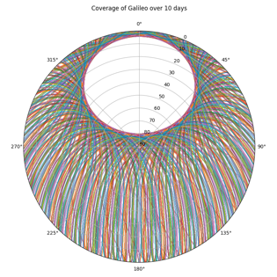
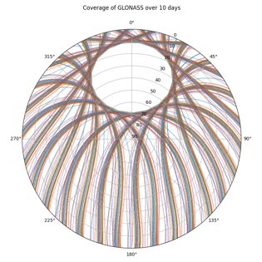
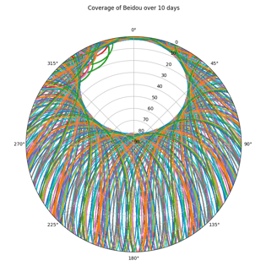
Satellite tracks
Repeats: 1 day
8 days
10 days
7 days

Slide 5
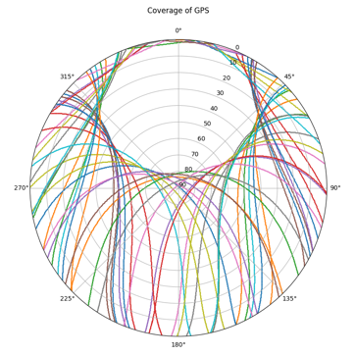
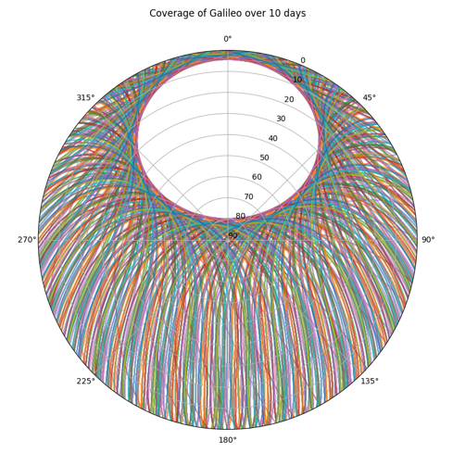


Coverage at DRAO

Slide 6
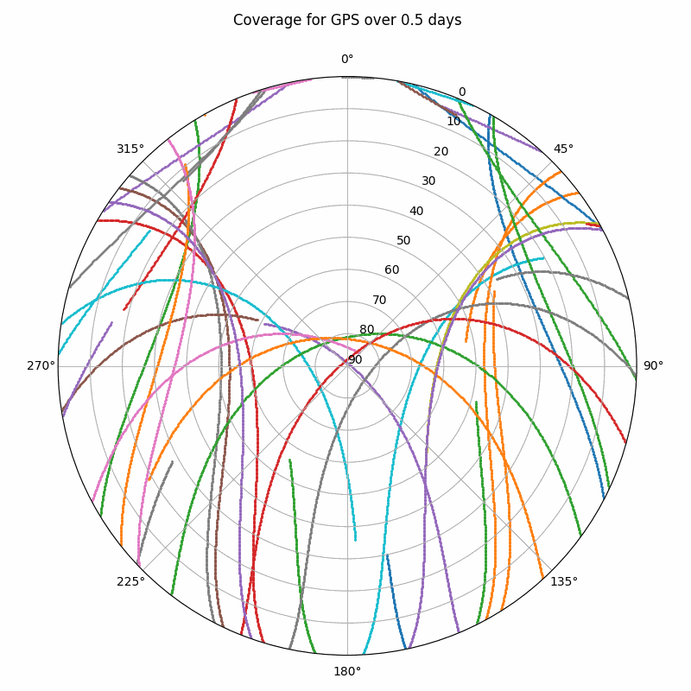
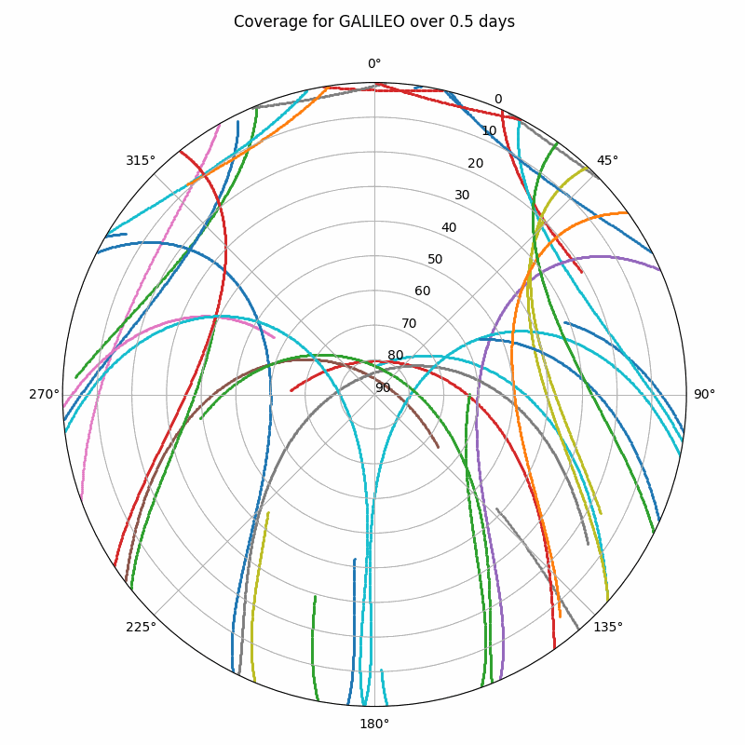
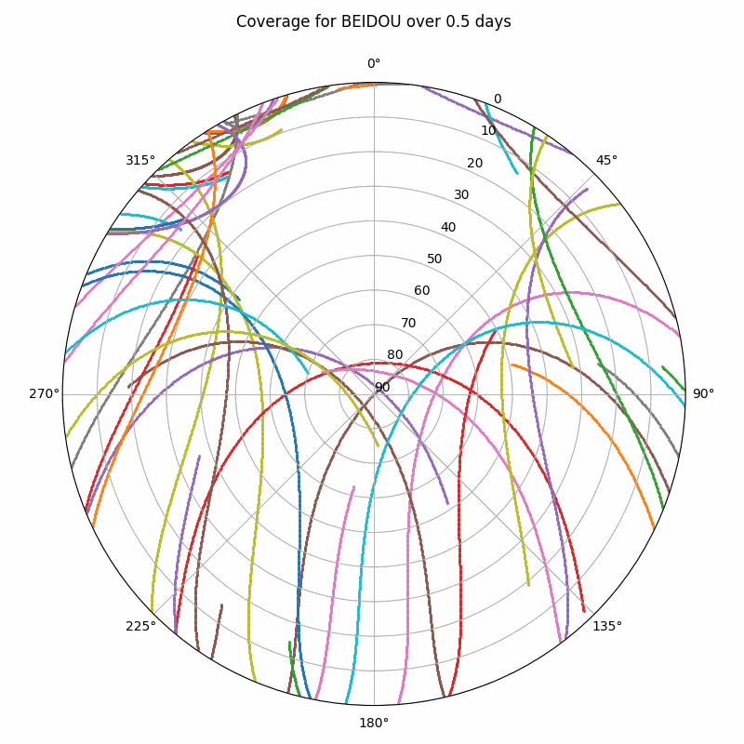
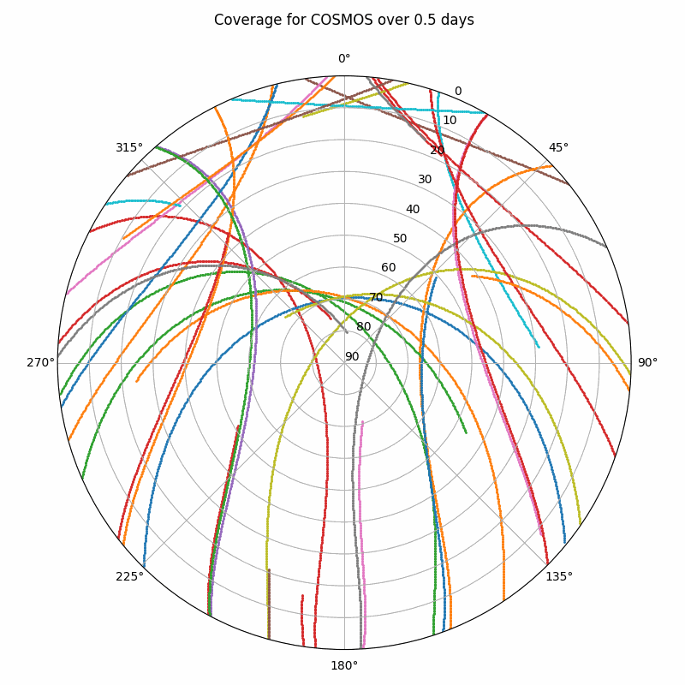
Coverage at DRAO

Slide 7
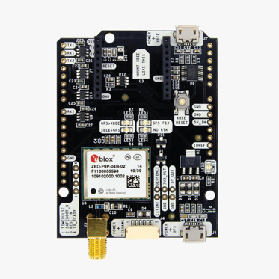
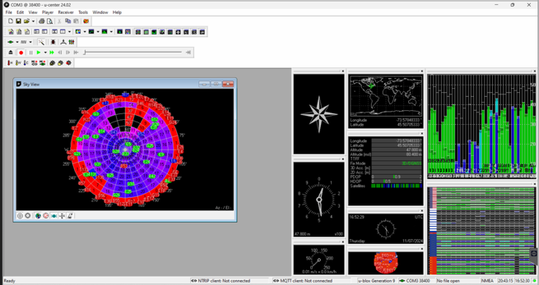
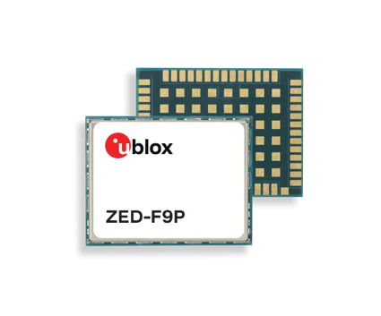
Receiver: simpleRTK2B with ublox ZED-F9P
Multi-band GNSS receiver (L1 and L2)
1583.46 MHz and 1224.01 MHz (span: 128 MHz)
ZED-F9P-02B-00

Slide 8
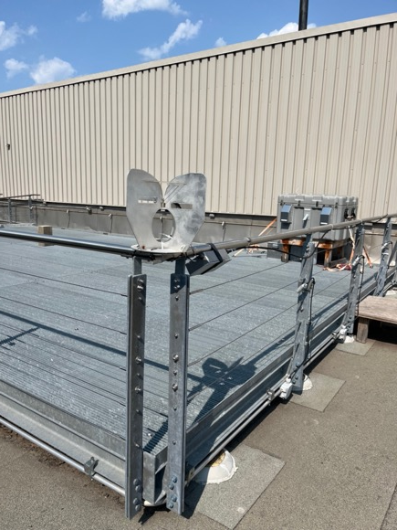
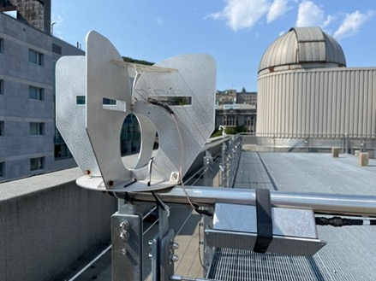
Work with CHORD feed
Roof of Rutherford Physics Building
at McGIll University

Slide 9
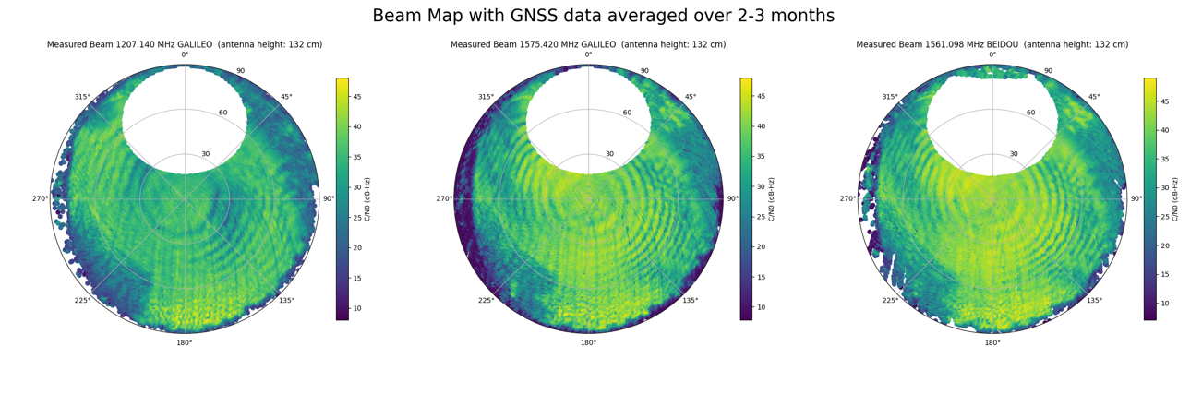
Work with feed

Slide 10
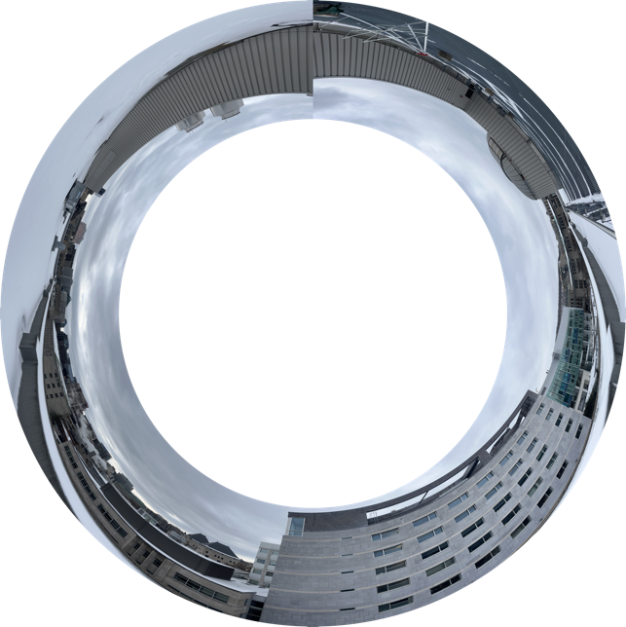
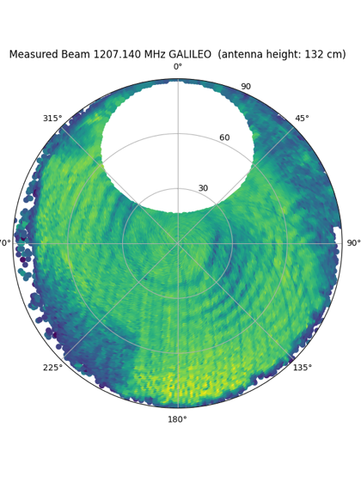


Work with feed
Surrounding visible in the beam

Slide 11
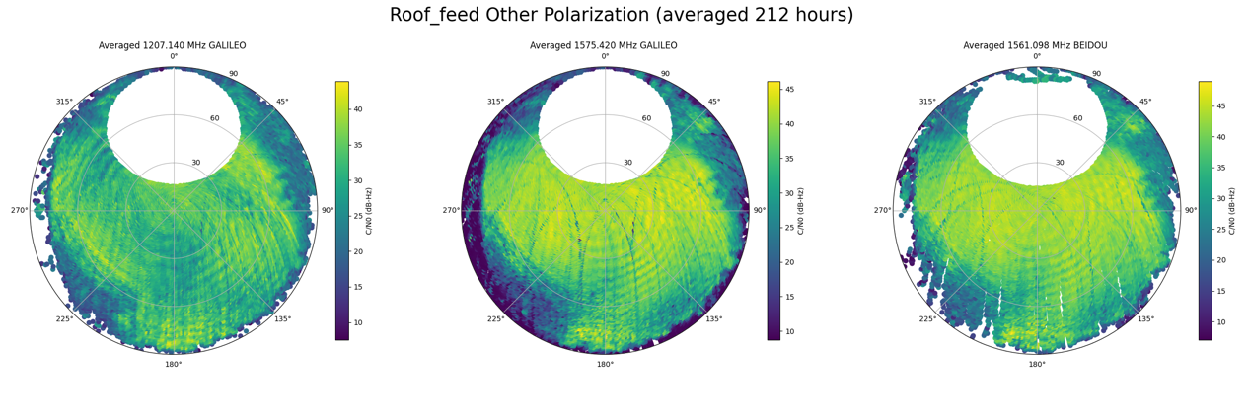
Work with feed (other polarization)

Slide 12

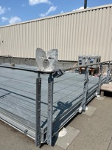

Work with feed

Slide 13
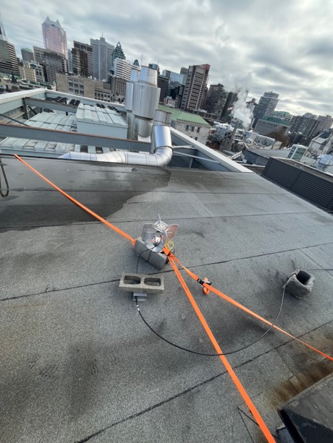
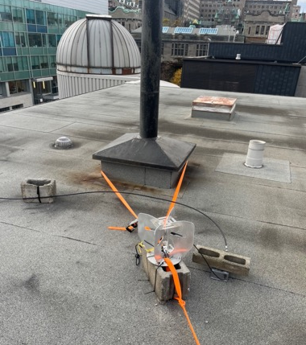
Work with feed
Next location (closer to ground)

Slide 14

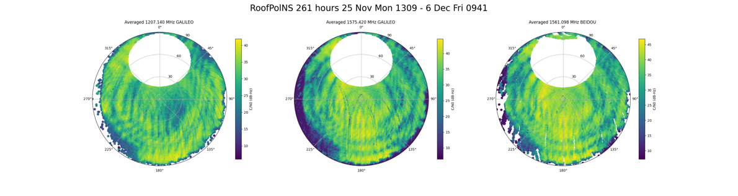
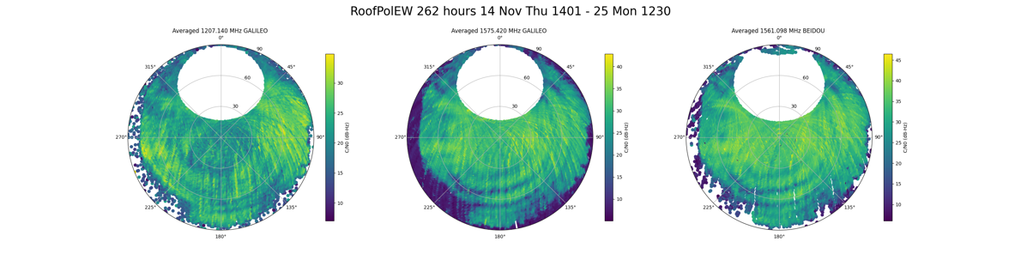
Work with feed
North-South
Polarization
East-West
Polarization

Slide 15
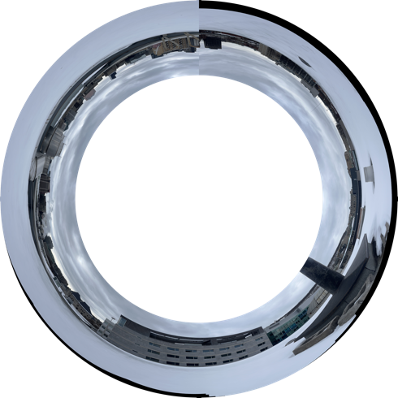

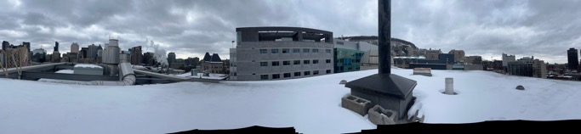
Work with feed

Slide 16
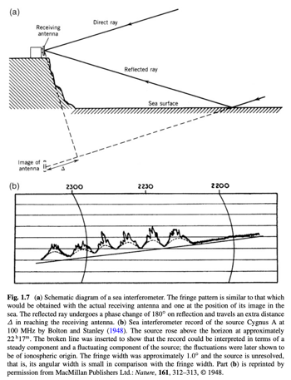
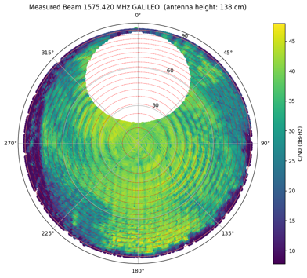
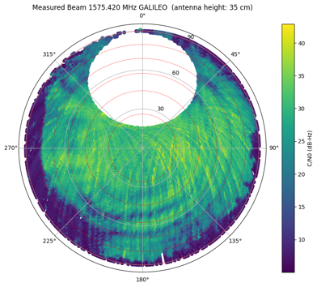
Characterizing ripples
Source: Interferometry and Synthesis in Radio Astronomy, 3rd edition; TMS

Slide 17
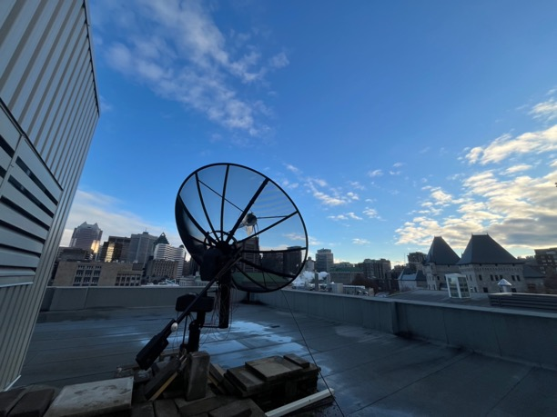
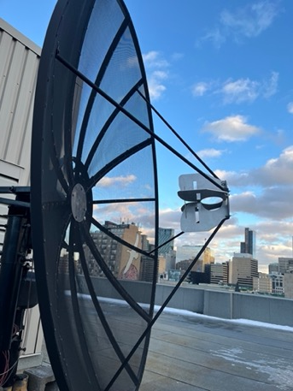
Work with feed (~2m dish)

Slide 18
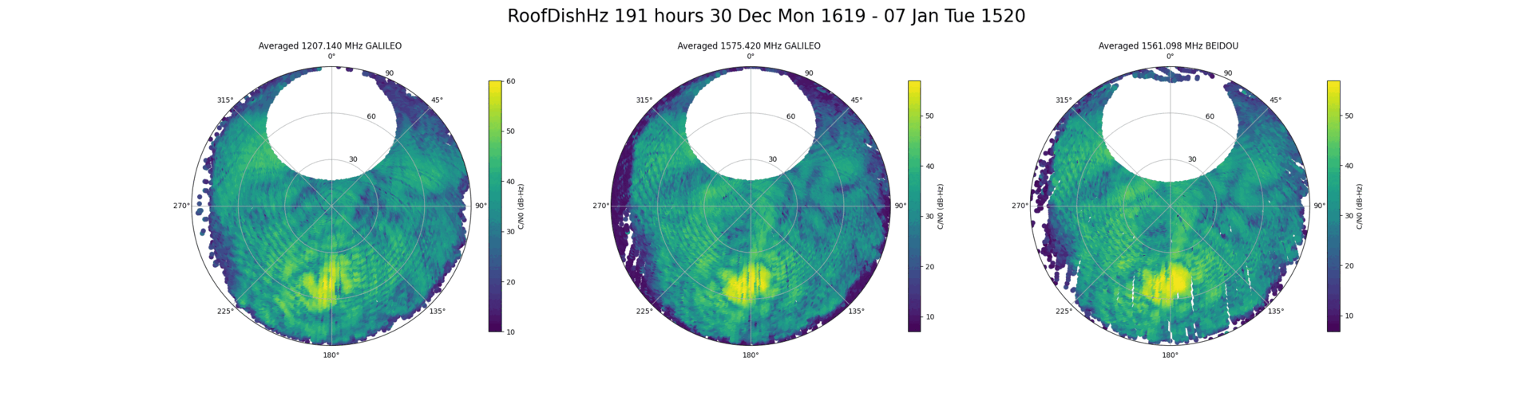
Work with feed
~2m dish on roof of McGill

Slide 19
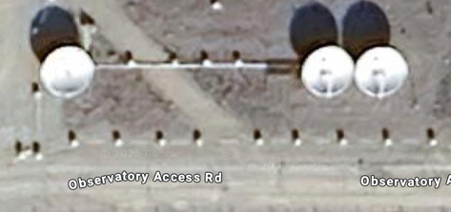
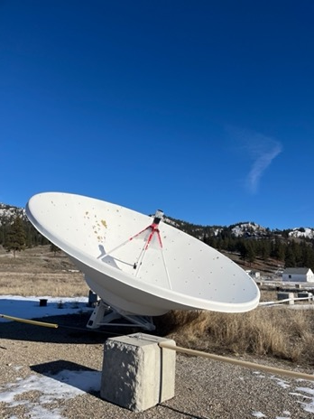
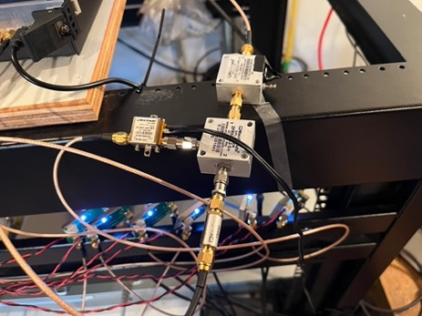
D3A6 dishes at DRAO
West Dish
East Dish
Source: google maps

Slide 20
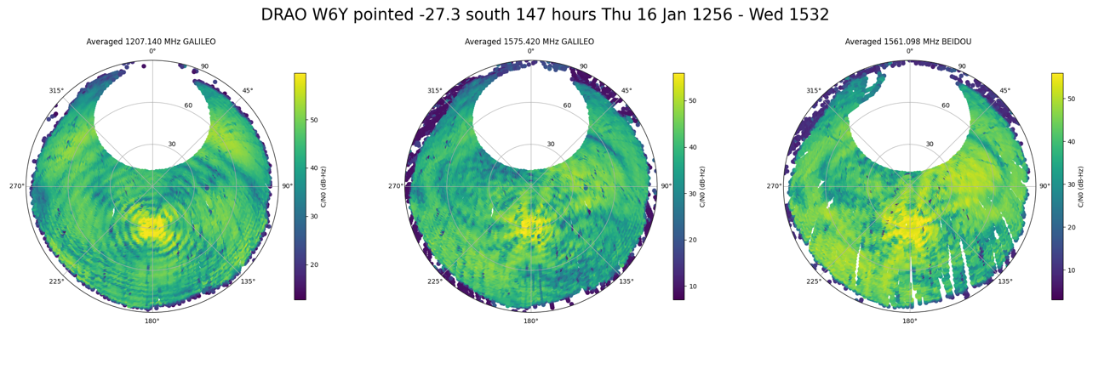
Beam Map from West Dish Y Polarization (D3A6)

Slide 21
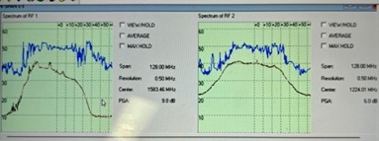
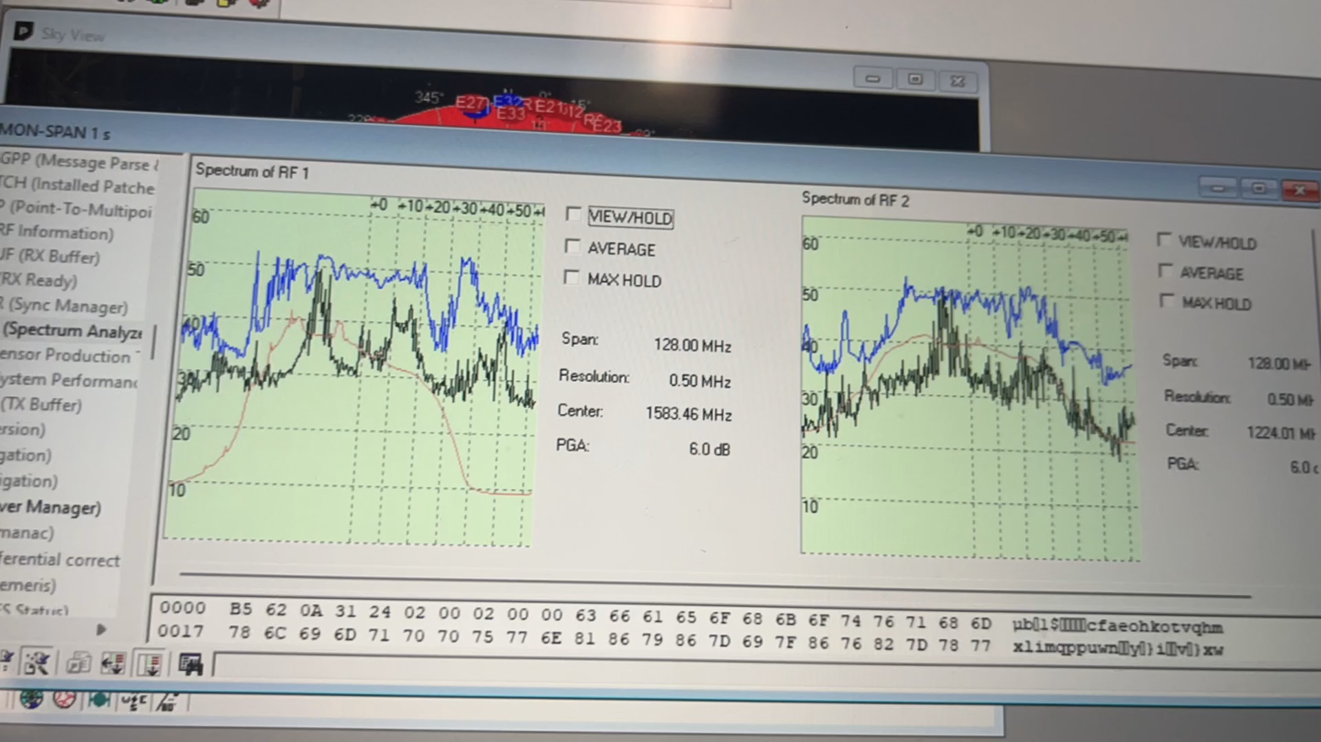
Automatic Gain Control and RFI
Automatic Gain Control (AGC) and Programmable Gain Amplifier (PGA)
Solution:
  Filter out bad data points (to be done!)
  Ideally, do signal processing in backend ourselves without using commercial receiver
RFI from car/vehicle passing by D3A6 dishes

Slide 22
What Next?
Currently recording data for D3A6 East Dish Y Polarization
Quantitative analysis
Compare beam between D3A6 East and West dishes
Compare beam with simulated beam maps
More detailed presentation in a few weeks
Thank You!

