Slide 1
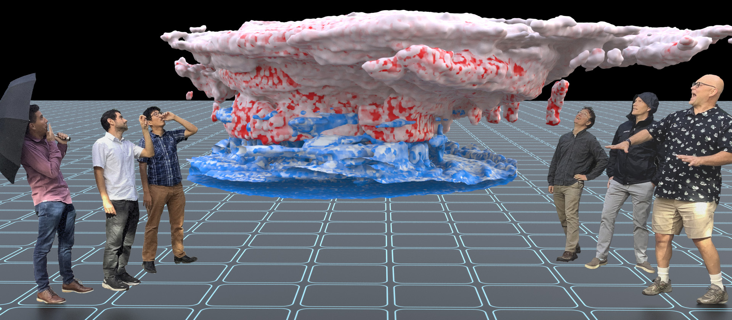


Successes and Challenges for the Simple Cloud-Resolving E3SM Atmosphere Model (SCREAM)
Peter Caldwell, Chris Terai, Andy Salinger, Luca Bertagna, Hassan Beydoun, Peter Bogenschutz, Andrew Bradley, Brad Carvey, Aaron Donahue, Chris Eldred, Jim Foucar, Chris Golaz, Oksana Guba, Ben Hillman, Rob Jacob, Jeff Johnson, Noel Keen, Jayesh Krishna, Wuyin Lin, Weiran Liu, Balwinder Singh, Andrew Steyer, Mark Taylor, Paul Ullrich, Danqing Wu, Xingqiu Yuan, Charlie Zender
This work was performed under the auspices of the U.S. Department of Energy by Lawrence Livermore National Laboratory under Contract DE-AC52-07NA27344 IM Release Number LLNL-PRES-842936
Notes:
SCREAM is the new k-scale global atmosphere model within the Energy Exascale Earth System Model, which is the US Department of Energy’s climate model.

Slide 2
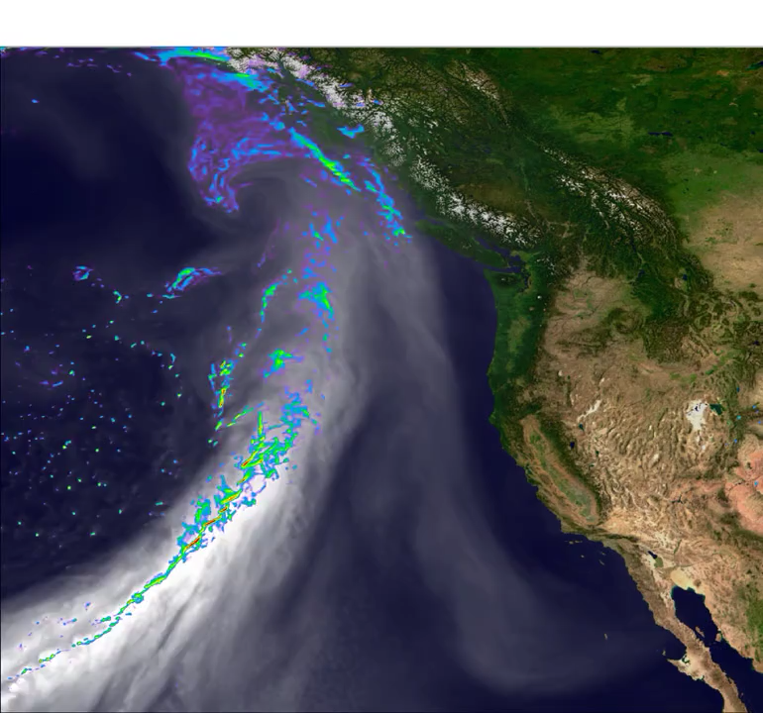
Why Global Storm Resolving Models (GSRMs)? Why Now?
Conventional climate models lack the resolution to capture extreme events
Poorly parameterized sub-grid scale processes limit predictability of even global-scale changes
Exascale computers require huge amounts of parallel work
Fig: An atmospheric river making landfall on the US West Coast as simulated by SCREAM

Slide 3
Why Global Storm Resolving Models (GSRMs)? Why Now?
Questions:
Is partially-resolved convection better than parameterized convection?
Why aren’t regional climate models sufficient? Do GSRMs provide more accurate large-scale predictions?
Can we run GSRMs long enough to simulate climate change?
How do you tune a model which is so expensive to run?
Conventional climate models lack the resolution to capture extreme events
Poorly parameterized sub-grid scale processes limit predictability of even global-scale changes
Exascale computers require huge amounts of parallel work
Fig: An atmospheric river making landfall on the US West Coast as simulated by SCREAM

Slide 4

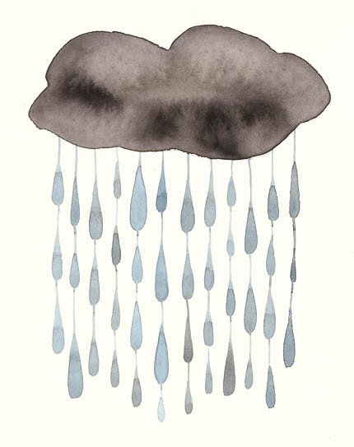
What’s in SCREAM?
parameterized deep convection
Resolved-scale fluid dynamics treated by a non-hydrostatic Spectral Element (SE) approach
Turbulence and cloud formation handled by the Simple Higher-Order Closure (SHOC)
Radiation handled by a C++ port of the RTE+RRTMGP package
Aerosol effects are currently prescribed (similar to MACv2-SP)
Microphysical processes handled by Predicted Particle Properties (P3) scheme
* Using coarser grid for physics parameterizations (Hannah et al., 2021, JAMES) *

Slide 5

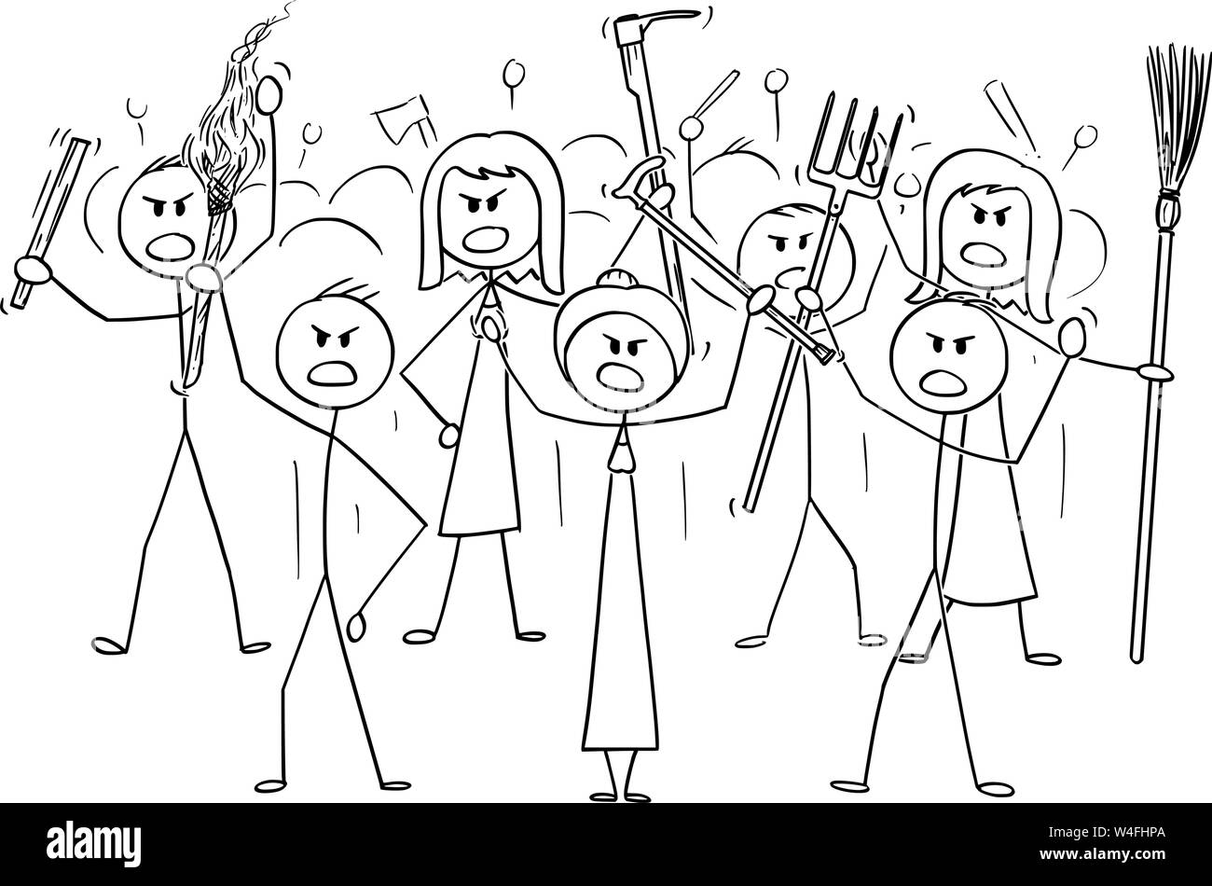
How to Code a GSRM?
Supercomputing is in chaos:
  GPUs from NVIDIA, IBM, and AMD require different coding strategies
  CPUs are still popular
  Chips are evolving fast
⇒ Future-proof GSRMs require abstraction of parallelism-relevant code
SCREAM uses the externally-developed Kokkos library to provide that abstraction and the backends needed for each machine type
  Kokkos relies on C++’s templating capability… so we had to write SCREAM in C++
C++ and abstraction make code more complicated – is this viable?
  Seems to be working for E3SM – SCREAM will be the only atm model in v4 and our ocean is now being rewritten in C++
My hopes for SCREAM
My fears for SCREAM

Slide 6
How Fast is SCREAM?
3 km SCREAM runs at 1.25 simulated years per wallday (SYPD)… on 8,192 nodes of Frontier
  Even at 2048 nodes (our default), we get ~0.5 SYPD
  Since exascale machines are shared, simulating decades in a wall-year is a stretch
GPUs allow us to run 5 to 10x faster than CPUs
  On Perlmutter, GPUs are >3x more efficient per watt
  GPUs help most when there is a lot of work per node
  Rewriting in C++ did not slow down CPU performance
Fig: 100 km model throughput versus node count on various architectures (red=GPU, black =Fortran CPU, blue=C++ CPU). Note log(y) axis.
Notes:
1536 Perlmutter nodes, 3 km SCREAM runs 5.8x faster on GPUs and consumes 1.7x more energy… so

Slide 7
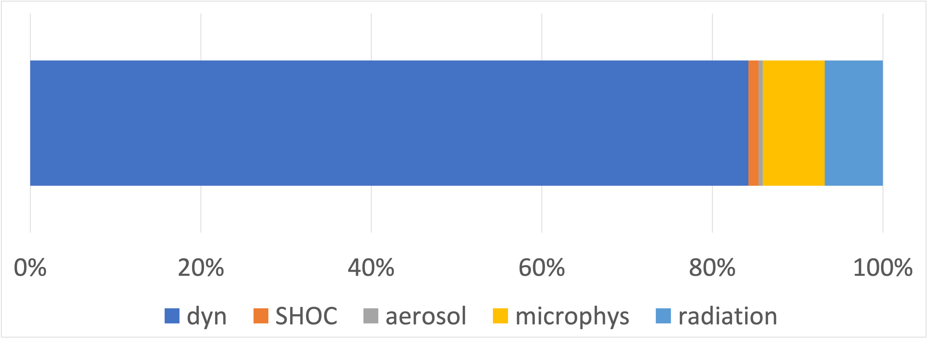
Prospects for Further Speedup?
Fluid dynamics dominates 3 km timing… so improving other processes has limited benefit
  Dynamics is already optimized, but recent largest-kernel work sped the full model up by 10%
  Surface coupling and writing output also needs work (not shown below)
  Single precision would provide substantial speedup
Running SCREAM on GPU leaves the CPUs of each node idle. These idle nodes could be used for ocean calculations
Can we use AI to emulate SCREAM?
Fluid Dynamics
Microphys
Radiation
Fig: Fraction of run time spent in each process for fully-optimized Gordon Bell simulation on 8192 nodes

Slide 8
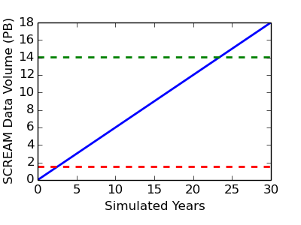
How do we Avoid Drowning in Data?
Just 17 3d snapshots consumes 1 TB of storage – what to do?
  Write output on coarser grids or only at locations where you have observations
  Compute diagnostics online (e.g. probability distributions, output along storm tracks…)
  Save restarts and rerun interesting portions of simulations with detailed output
  Use an output format which makes extraction of what you need cheap (e.g. HEALPix)
  Data compression
Entire CMIP6 Archive
How to share output when you generate 50 TB/simulated month?
  Analyze data where it is created
  Make it easy to download just the data you need
  Anonymously download from NERSC disk via globus (fast!): https://docs.nersc.gov/services/globus/#sharing-data-with-globus
  Anonymously download from NERSC HPSS via webserver: https://docs.nersc.gov/services/science-gateways/#how-to-publish-data-in-hpss-to-the-web
Entire CMIP5 Archive
Fig: SCREAM data holdings as a function of simulation length assuming 50TB/simulated month
Notes:
From disk via globus (fast!): https://docs.nersc.gov/services/globus/#sharing-data-with-globus
From HPSS via webserver: https://docs.nersc.gov/services/science-gateways/#how-to-publish-data-in-hpss-to-the-web

Slide 9
How Are We Using This Model?
Ongoing: Hindcasts/storylines for various historical weather events
Ongoing: doubly-periodic and regionally-refined runs to understand/fix biases
Completed: 40 day simulations for all 4 seasons
Imminent:13 month simulations with current and +4K sea surface temperature (SST) to understand climate sensitivity
Soon: 13 month nudged simulations with current and pre-industrial aerosol forcing to understand aerosol sensitivity
Next year: 10-20 yr fixed-but-varying SST runs for current and future conditions (AMIP-like)
2025: 1 decade(?) of coupled k-scale simulations

Slide 10
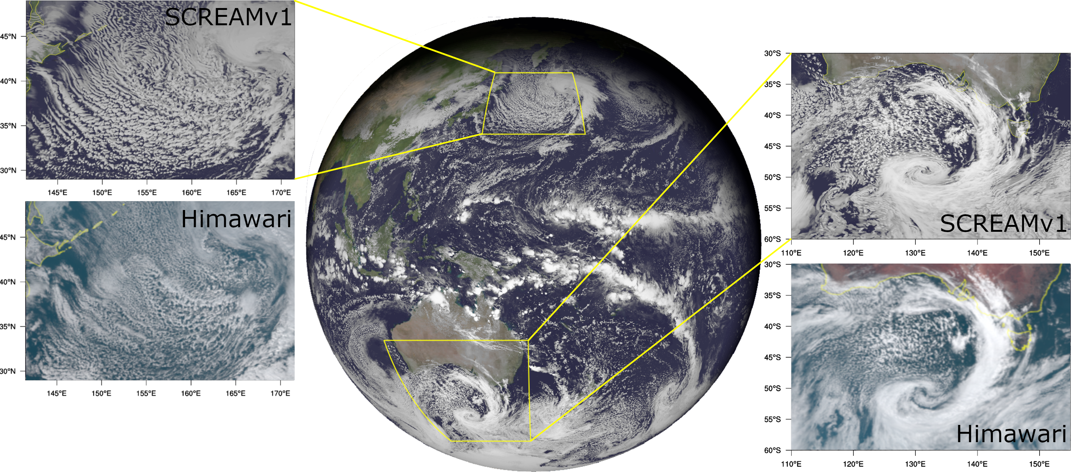
Is SCREAM Skillful?
SCREAM is very good at capturing the gamut of cloud types (see fig)
Precipitation intensity, diurnal cycle, and orographic response are well represented
The frequency and structure of high-impact weather events (cyclones, atmospheric rivers, etc) are very realistic
Fig: Snapshot on January 22, 2020 at 2:00:00 UTC (50 hrs into simulation) of (left) cold-air outbreak in SCREAMv1 and Himawari satellite, (middle) global view from SCREAMv1, and (right) storm south of Australia in SCREAMv1 and satellite.

Slide 11
Growing Pains of a Young Model…
2m temperature too high, particularly at night (due to excessive stable BL mixing – fixed?)
10m wind is too high (due to lack of turbulent mountain stress – fixed)
Liquid water path is too low – can be tuned(?)
Fig: composite diurnal cycle over Southern Great Plains for model (dashed) vs ARMBE obs (solid) for each season (colors)

Slide 12
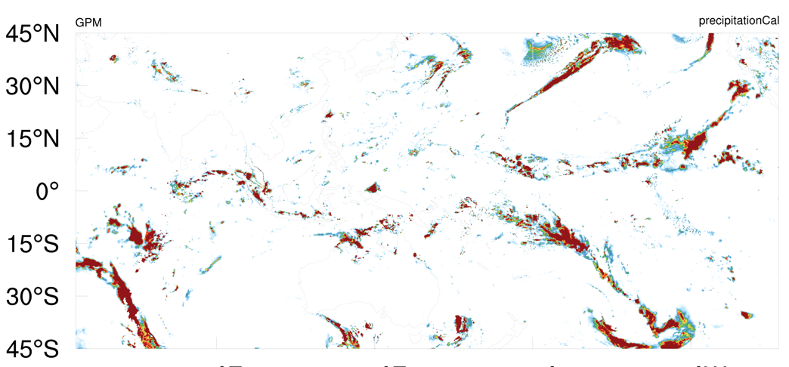
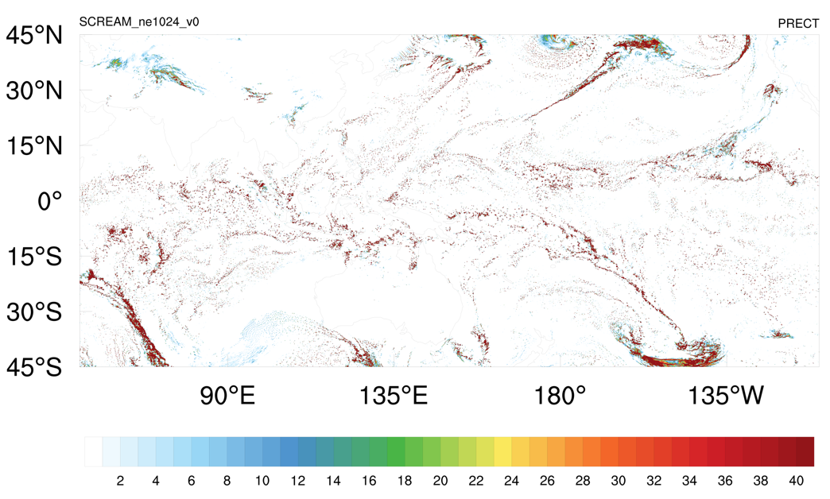
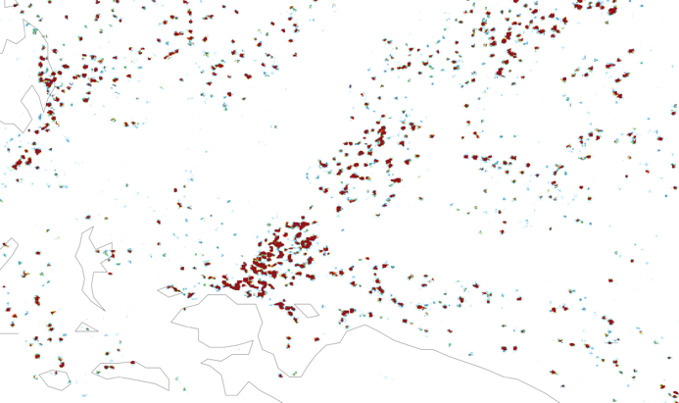
How to deal with popcorn?
Obs
SCREAM has shallow, small, isolated convection in the deep tropics
This causes anemic precipitation in West Pacific/Indian Ocean area(?)
Popcorn has proven very hard to fix
Model
Fig: Snapshot of precipitation on Jan 21 2020 at 0 UTC from GPM obs (top) and EAMxx (bottom)
200km

Slide 13
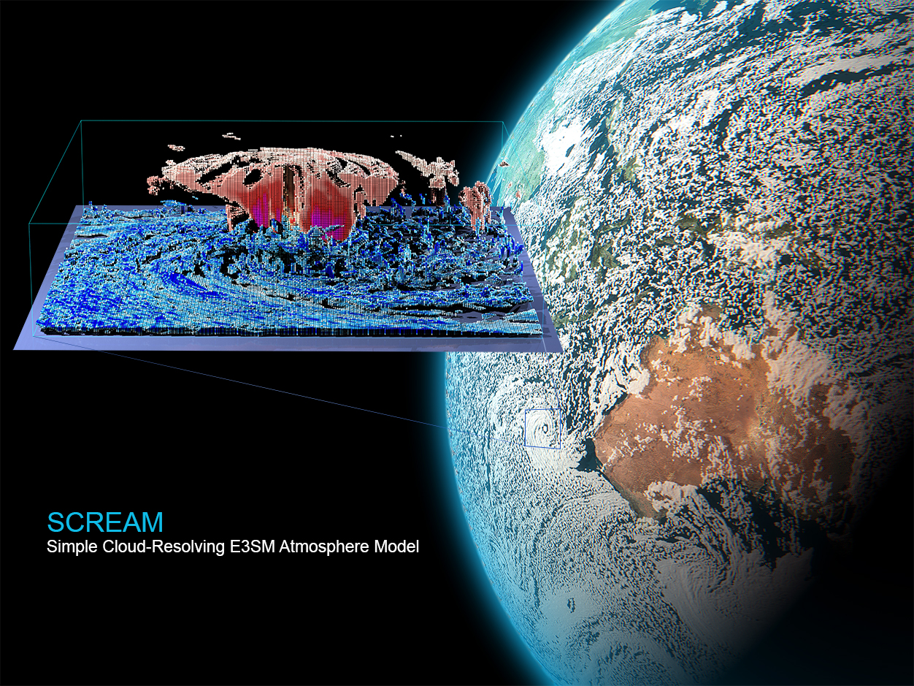
Conclusions
GSRMs solve a lot of problems with conventional climate models, but create a whole new set of challenges!
  How do we fix biases related to partially-resolved convection?
  Are upscale effects of km-scale resolution important?
  How do we get robust statistics from GSRMs?
GPUs allow SCREAM to break the 1 SYPD barrier
  Further performance improvements are possible… but limited
Care is needed to avoid drowning in data

Slide 14
For More Info:
Bogenschutz et al., (JAMES 2023): Horizontal Resolution Sensitivity of the Simple Convection-Permitting E3SM Atmosphere Model in a Doubly-Periodic Configuration
Liu et al., (JAMES 2022): The June 2012 North American Derecho: A Testbed for Evaluating Regional and Global Climate Modeling Systems at Cloud‐Resolving Scales
Caldwell et al., (JAMES 2021): Convection‐permitting simulations with the E3SM global atmosphere model
Feng et al., (GRL 2022): Mesoscale convective systems in DYAMOND global convection‐permitting simulations

Slide 15
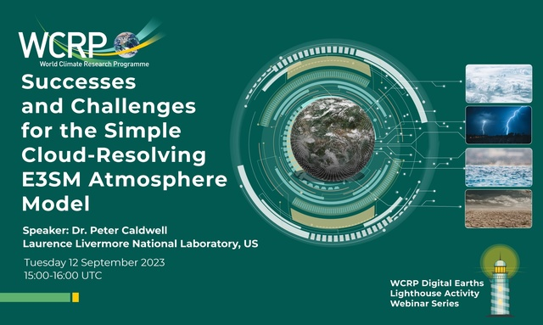
Thanks!
contact: caldwell19@llnl.gov

Slide 16
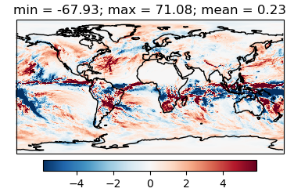
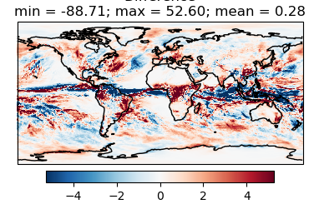
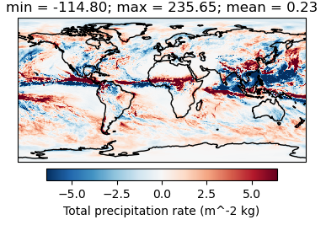
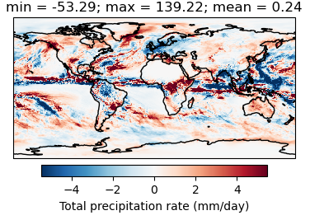
Is SCREAM Skillful?
Precipitation biases:
Double ITCZ/anemic SPCZ
Latitude/width of convergence zone isn’t quite right
West Pacific + Indian Ocean are too dry
NW Atlantic has a persistent wet bias
Jan 20, 2020
Apr 1, 2013
Aug 1, 2016
Oct 1, 2013
Fig: SCREAMv1 precipitation bias (using ERA5 as truth) averaged over all 40 days starting on listed dates. DYAMOND2 and DYAMOND1 are on the top and bottom left, respectively

Slide 17
What’s in SCREAM?
parameterized deep convection
Questions:
Is subgrid cloud variability (e.g. SHOC) needed?
Do GSRMs need parameterized convection?
Do GSRMs converge with decreasing dx, dz, and dt?
What is the coarsest resolution we can get away with?
Resolved-scale fluid dynamics treated by a non-hydrostatic Spectral Element (SE) approach
Turbulence and cloud formation handled by the Simple Higher-Order Closure (SHOC)
Radiation handled by a C++ port of the RTE+RRTMGP package
Aerosol effects are currently prescribed (like MACv2-SP)
Microphysical processes handled by Predicted Particle Properties (P3) scheme
* Using coarser grid for physics parameterizations (Hannah et al., 2021, JAMES) *

Slide 18
How Are We Using This Model?
Ongoing: Hindcasts/storylines for various historical weather events
Ongoing: doubly-periodic and regionally-refined runs to understand/fix biases
Completed: 40 day simulations for all 4 seasons
Imminent:13 month simulations with current and +4K sea surface temperature (SST) to understand climate sensitivity
Soon: 13 month nudged simulations with current and pre-industrial aerosol forcing to understand aerosol sensitivity
Next year: 10-20 yr fixed-but-varying SST runs for current and future conditions (AMIP-like)
2025: 1 decade(?) of coupled k-scale simulations
Questions:
Are process-based analyses at select locations (e.g. ARM sites) sufficient for validating/improving a GSRM?
How do we use GSRMs to answer societally-relevant questions?
What can be done with a decade-long coupled run?
How can we draw statistically robust conclusions from GSRMs?

Slide 19
How to Avoid Drowning in Data?
Just 17 3d snapshots consumes 1 TB of storage – what to do?
  Write output on coarser grids or only at locations where you have observations
  Compute diagnostics online (e.g. probability distributions, output along storm tracks…)
  Save restarts and rerun interesting portions of simulations with detailed output
  Use an output format which makes extraction of what you need cheap (e.g. HEALPix)
  Data compression
Questions:
How can we store data most efficiently?
How should we share data?
How do we tune such an expensive model?
Entire CMIP6 Archive
How to share output when you generate 50 TB/simulated month?
  Analyze data where it is created
  make it easy to download just the data you need
  Anonymously download from NERSC disk via globus (fast!): https://docs.nersc.gov/services/globus/#sharing-data-with-globus
  Anonymously download from NERSC HPSS via webserver: https://docs.nersc.gov/services/science-gateways/#how-to-publish-data-in-hpss-to-the-web
Entire CMIP5 Archive
Fig: SCREAM data holdings as a function of simulation length assuming 50TB/simulated month
Notes:
From disk via globus (fast!): https://docs.nersc.gov/services/globus/#sharing-data-with-globus
From HPSS via webserver: https://docs.nersc.gov/services/science-gateways/#how-to-publish-data-in-hpss-to-the-web

Slide 20
Other Issues
Extreme cold snaps due to non-monotonicity of dycore (will TMS fix?)
“Convective eclipse” where SW @ surf drops to 2 W/m2 during daytime

Slide 21
SCREAM Performance
3 km SCREAM easily breaks 1 SYPD… using all of Frontier
  Even at 2K nodes, we exceed ½ SYPD
  Since we share the exascale machines, simulating decades in a wall-year is a stretch
Fig: 3 km model throughput (without output) versus number of nodes used on the older Summit machine and on Frontier with and without targeted optimizations

Slide 22
Rewriting in C++ didn’t slow down performance on CPUs (blue vs black lines)
GPUs:
  are many times faster at low node counts (high workload)
  don’t help when parallelism is saturated (because ~all time is spent in communication)
Fig: 100 km model throughput versus node count on various architectures (red=GPU, black =Fortran CPU, blue=C++ CPU). Note log(y) axis.

Slide 23
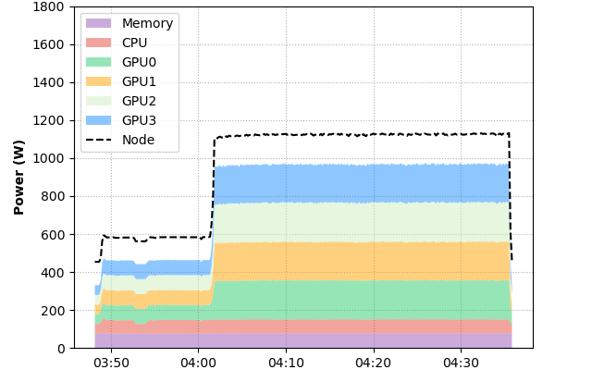
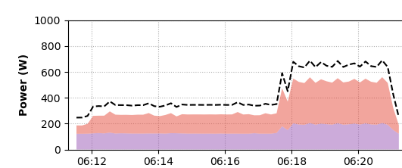
GPUs cost more and are more power-hungry than CPUs – are they worth it?
  3 km SCREAM is 5.8x faster on GPUs vs CPUs
  GPU nodes use only 1.7x more energy
  ⇒Perlmutter GPUs are 3.4x faster per watt
    this is much better than stated GPU power, suggesting that Perlmutter is effective at modulating GPU power usage as needed
Fig: Actual SCREAM energy consumption per Perlmutter node for GPU (top) and CPU (bottom). Courtesy Zhengji Zhao/NERSC

