Slide 1
SCREAM Simulations and Plans
Chris Terai, Susannah Burrows, Aaron Donahue,
Peter Caldwell, Luca Bertagna, Hassan Beydoun,
Peter Bogenschutz, Andrew Bradley, Conrad Clevenger, Oscar Diaz-Ibarra, Jim Foucar, Oksana Guba,
Walter Hannah, Ben Hillman, Meng Huang, Jeff Johnson, Noel Keen, Wuyin Lin, Jaelyn Litzinger, Naser Mahfouz, Johannes Mülmenstädt, James Overfelt, Andy Salinger, Balwinder Singh, Mark Taylor + collaborators
DYAMOND Morioka Meeting, Nov. 20, 2025
Work from LLNL is performed under the auspices of the US DOE by LLNL under Contract DE-AC52-07NA27344. LLNL-PRES-2013702

Slide 2
Simple Cloud-Resolving E3SM Atmosphere Model
What is SCREAM?
Global atmosphere model with dx=3.25 km, 128 vertical layers with top at 40km
Components:
  Non-hydrostatic Spectral Element (SE) dycore
  Simplified Higher-Order Closure (SHOC)
  Predicted Particle Properties (P3)
  RRTMGP
  Prescribed aerosol properties (for now)
  No deep convective scheme
Notes:
virtuous cycle

Slide 3
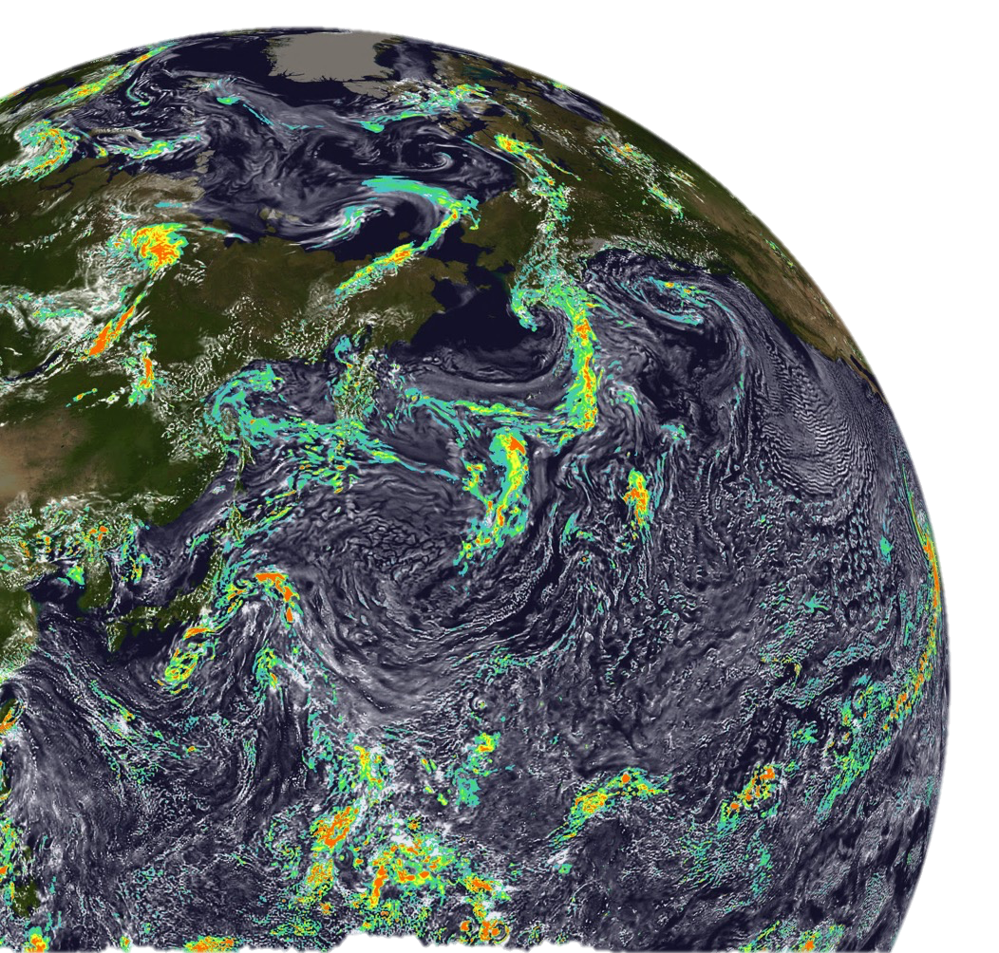
Science simulation campaigns with SCREAM
Science campaign | Length | What we’ve found
Four Seasons | 4 x 40 days | Improvements of going to km-scale but also biases across seasons (Donahue et al., 2024)
Cess (+4K SST) | 2 x 13 months | Realistic clouds (Chao et al., 2025) and stronger radiative feedback due to clouds (Terai et al., 2025; Chao et al., submitted)
Aerosol (PD/PI) | 2 x 13 months | With prescribed aerosol: PD-PI ERF_{aci} is highly sensitive to activation assumptions (Mahfouz et al., 2025)
Decadal | 10 years | Tropical cyclones are resolution sensitive; tropical waves lacking
Ongoing / Upcoming
ECOMIP | N x 2 day | TBD
Cess2 (+4K SST) | 2 x 18 months | TBD (Updates to physics; overlap with DYAMOND3 protocol; resolution sensitivity & high-cloud feedback focus)
DYAMOND1
DYAMOND2
Km-scale hackathon
DYAMOND3 submission

Slide 4
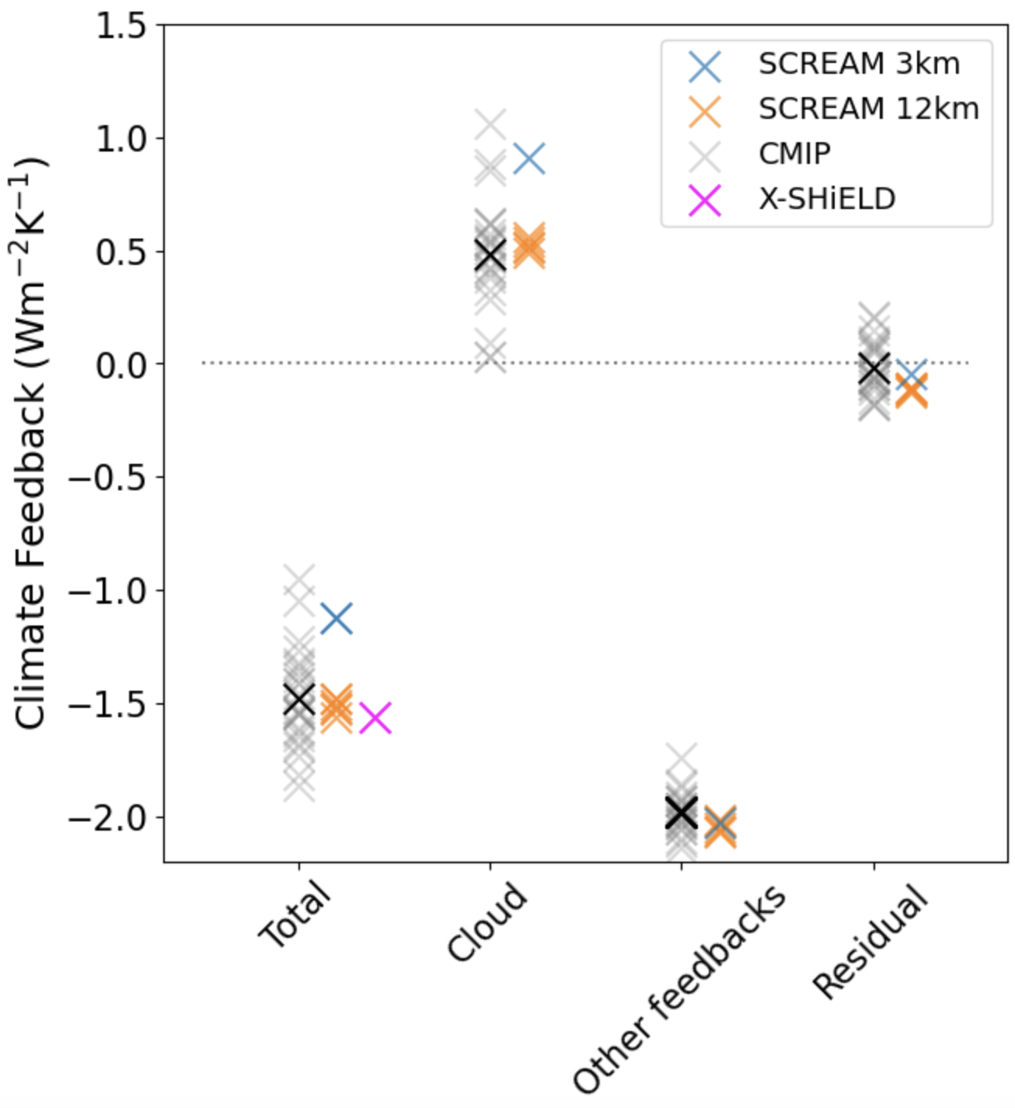
Cess: Global-mean radiative feedbacks in SCREAM
Non-cloud feedbacks within the CMIP5/6 interquartile range
Resolution sensitivity between SCREAM 3km and SCREAM 12km
Cloud feedbacks much more positive in SCREAM 3km than most CMIP models & other GSRM* (Merlis et al., 2024)

Slide 5
Cess: Global-mean radiative feedbacks in SCREAM
Non-cloud feedbacks within the CMIP5/6 interquartile range
Resolution sensitivity between SCREAM 3km and SCREAM 12km
Cloud feedbacks much more positive in SCREAM 3km than most CMIP models & other GSRM* (Merlis et al., 2024)
DYAMOND3-Cess
To study GSRM diversity/agreement in +4K SST response
+4K SST companion simulation to DYAMOND3-Year Long (Takasuka et al., 2024)
https://pcmdi.llnl.gov/research/DYAMOND3/
  Contact: Mark Zelinka (zelinka1@llnl.gov)

Slide 6
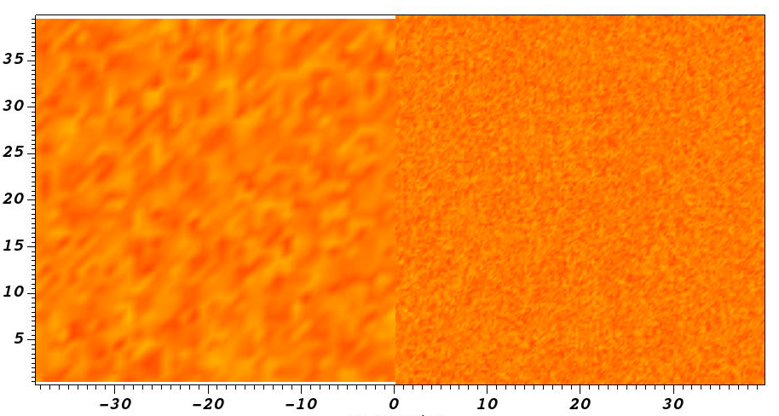
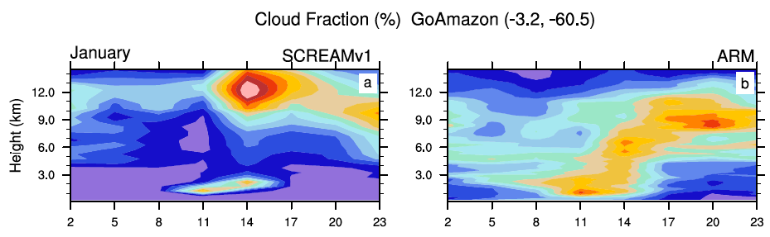

Improving SCREAM
Biases to improve
Tropical free-troposphere dry bias
‘Popcorn’ convection
Quick transition from shallow to deep convection
Lack of tropical variability
Warm land temperatures
2-m T from default (left) and modified rain evaporation (right) GATE DPxx simulations.
Blue = 295 K and red= 298 K.
Modifications to rain evaporation help improve free troposphere dry bias.
Animation by H. Beydoun
default
modified sim
Diurnal cycle of cloud fraction from SCREAMv1 (left) and ARM retrievals (right) over Amazon in January simulations.
Donahue et al., 2024
New processes in development
3D turbulence and Leonard-term
Prognostic supersaturation for condensation and deposition
1
7
13
19
25
31
37%

Slide 7
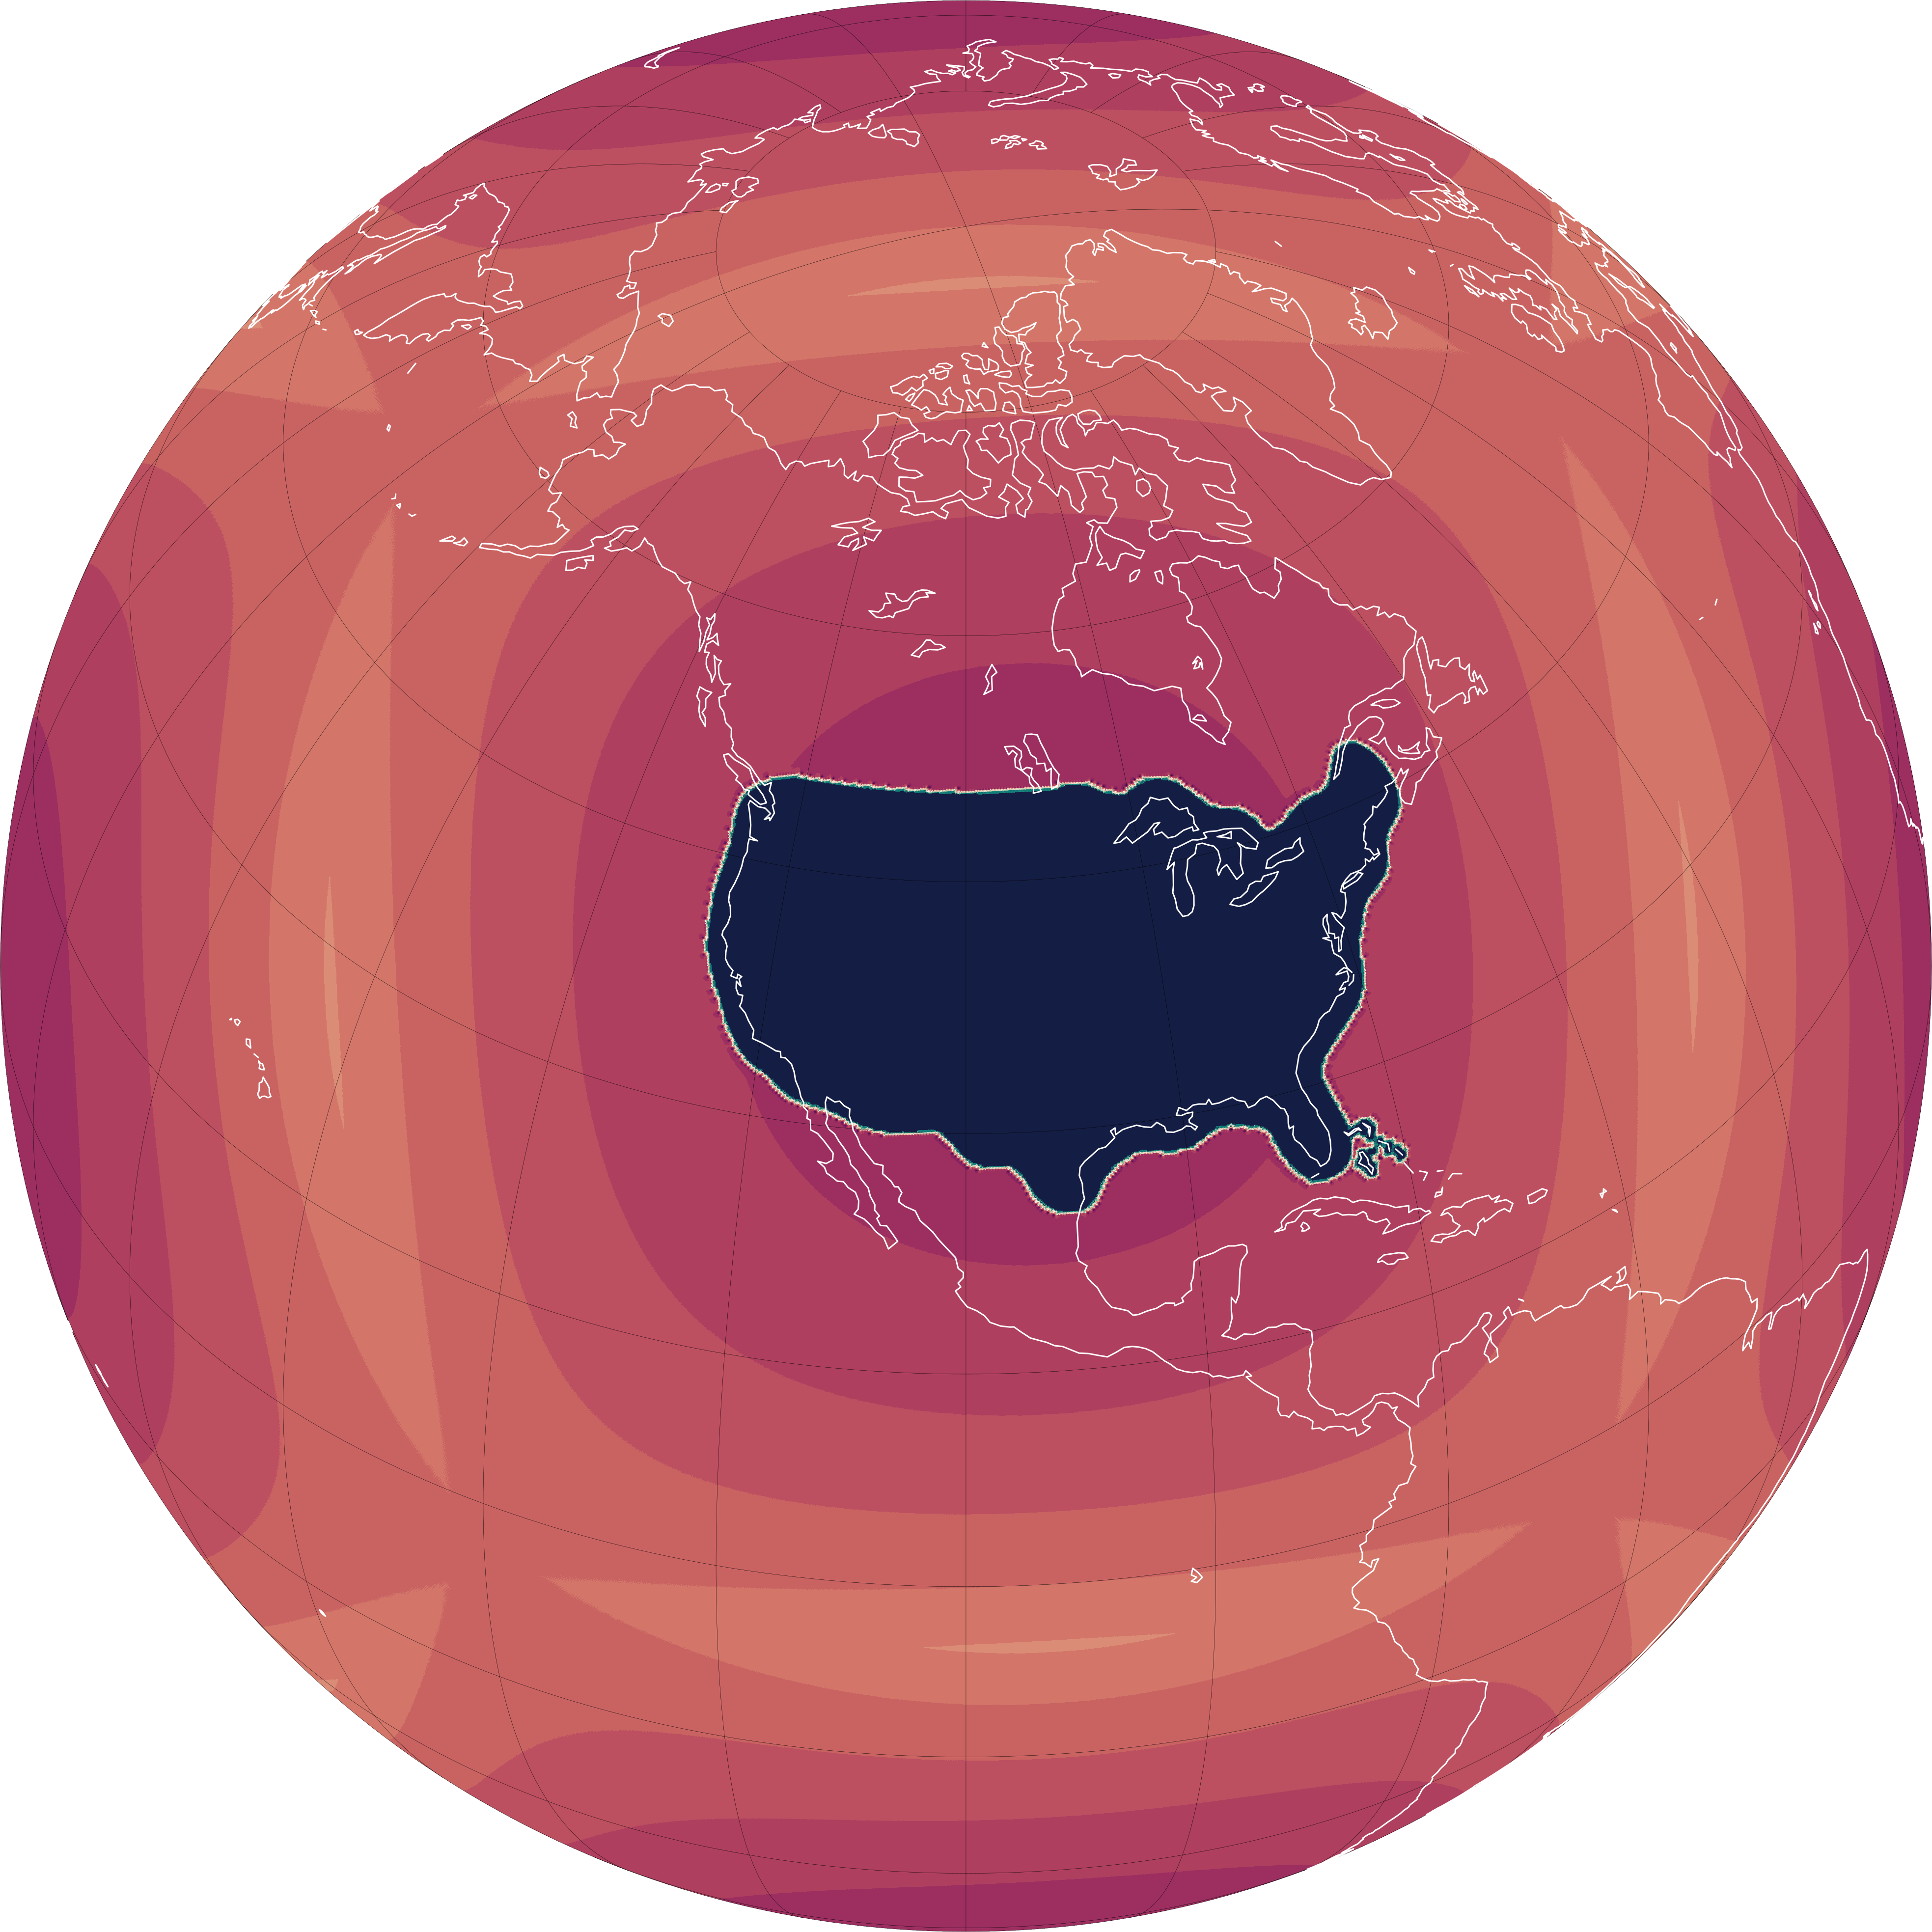
Ongoing work and future priorities
E3SMv4
CONUS-200m
Atmosphere component will be 𝚫x~13km version of EAMxx (code base of SCREAM)
Regionally-refined version of SCREAM with 3km outer domain and 200m over CONUS
Science target
  Seasonal-to-Decadal prediction
Preparing for 13km
  Extending parameterizations to those needed at lower resolution (e.g. deep convection?, gravity wave drag)
  Understanding resolution sensitivities
Adding complexity
  Coupling EAMxx to interactive ocean/sea ice
  Developing, testing, and evaluating process realism of interactive aerosols
Initial simulations
  Week-long hindcasts of weather events that impact electric grid and infrastructure
    Understand SCREAM’s resolution sensitivity
    Identify processes that are better resolved at 200m vs 3km

Slide 9
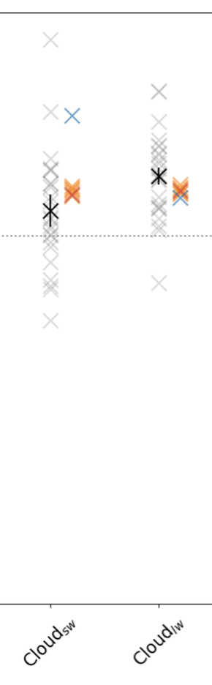
Cess: Global-mean radiative feedbacks in SCREAM
Non-cloud feedbacks within the CMIP5/6 interquartile range
Resolution sensitivity between SCREAM 3km and SCREAM 12km
Cloud feedbacks much more positive in SCREAM 3km than most CMIP models & other GSRM (Merlis et al., 2024)

