Slide 1
Urban tech paper discussion
2025/11/18

Slide 2
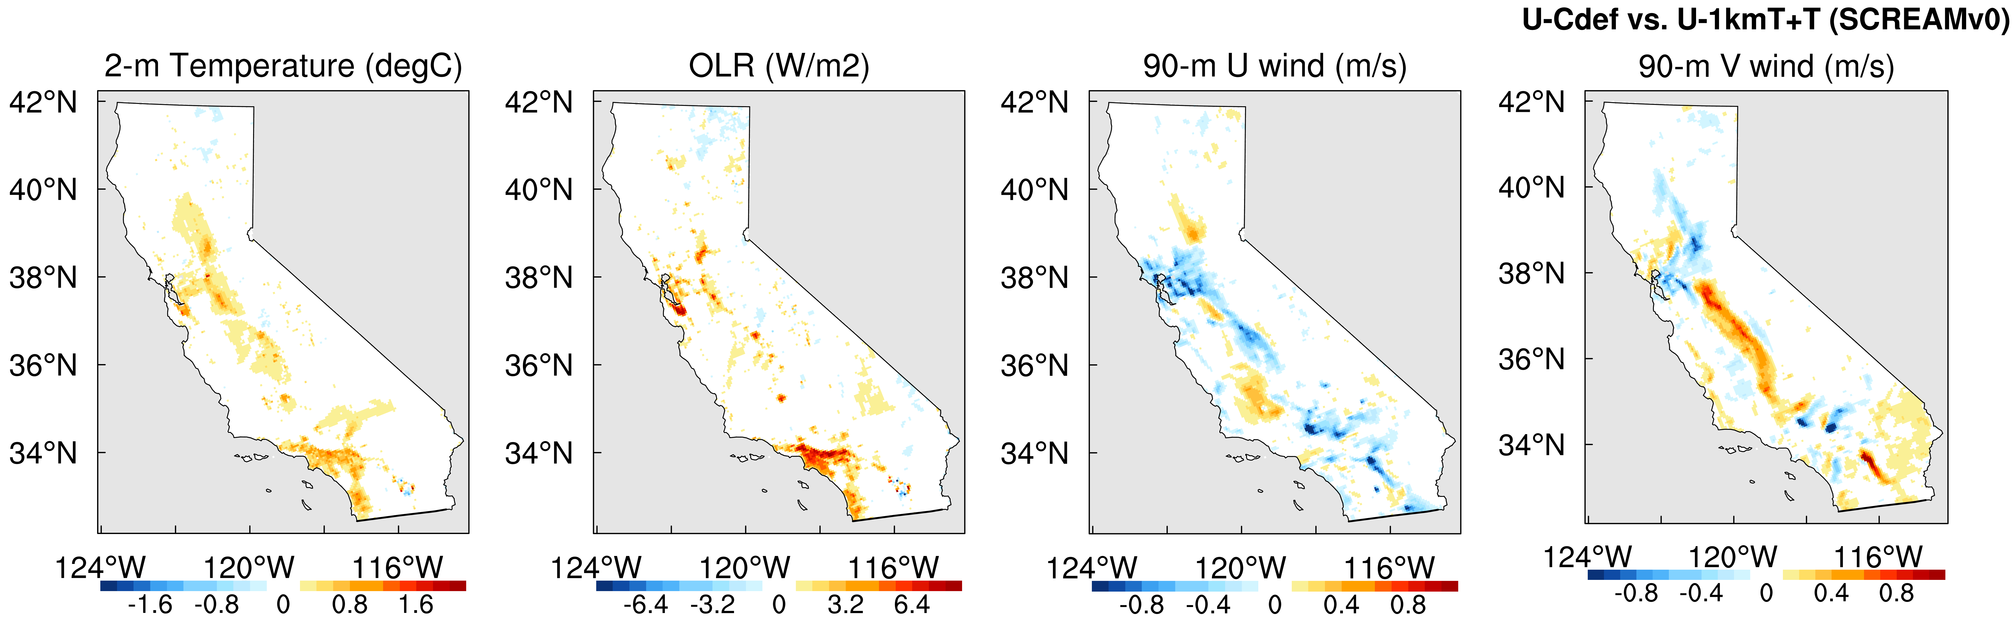

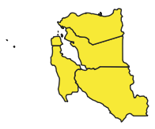
SCREAMv0 3kmCARRM Usurf-1km atm-land coupled simulations: 1. spatial distribution
Simulation configuration:
fsurf def def vs. fsurfTEST
ERA5 6h atm forcing 5yr land-only
atm-land coupled:
46-day run suggested by Yunyan: 2023-06-15 – 2023-07-30
3h UVTQ nudging with a 6h relaxation timescale
1. spatial patthens
CA
LA/SF
daily ⇒ day/night mean
day
night
day
night
day
night
day
night
LA
SF

Slide 3
LA/SF spatial patterns
diurnal contrast
SCREAMv0 vs. HRRR
the overal patterns are similar across all models
the diff between TEST – CTRL of SCREAMv0 is much smaller than the diff among SCREAMv0 vs. HRRR
HRRR, CTRL, TEST, TEST - CTRL
LA
SF

Slide 4
SCREAMv0 3kmCARRM Usurf-1km atm-land coupled simulations: 2.1 ISD site timeseries
core: only SYNOP
SYNOP + METAR
2.1 NCEI/NOAA ISD
Integrated Surface Database
left: core: only SYNOP (WMO Surface Synoptic Stations / Automatic Weather Station) “FM-12” code
right: SYNOP + METAR (Meteorological Aerodrome Report) “FM-12” + “FM-15” codes
var used: T2m, winds, RH2m

Slide 5
SCREAMv0 3kmCARRM Usurf-1km atm-land coupled simulations: 2.1 ISD site timeseries
LA
wind obs might be problematic
SF

Slide 6
SCREAMv0 3kmCARRM Usurf-1km atm-land coupled simulations: 2.2 tidesandcurrents site timeseries
2.1 NOAA tidesandcurrents
local water levels, tide and current predictions, and other oceanographic and meteorological conditions
var used: PSL, winds, T2m

Slide 7
SCREAMv0 3kmCARRM Usurf-1km atm-land coupled simulations: 2.2 tidesandcurrents site timeseries
LA
SF
conlusive results from the site obs eval:
the diff between TEST – CTRL of SCREAMv0 is much smaller than the diff among simulations vs. site obs
some sites show improvement, some show degradation
T2m, winds, PSL, RH2m all show systematic change in TEST:
T2m increases slightly
PSL increases slightly
RH2m decreases slightly
winds decreased (most apparent)

Slide 8
Meeting notes for urban tech paper discussion 11/18 (attendees: Yunyan, Jishi, Qi, Lei, Yifan)
Targets:
given the outline, seek the insights/feedback from Lei and Yifan for the analysis
share analysis for SCREAMv0 3kmCARRM 46-d simulations until now
Discussions:
spatial patterns:
T2m: Lei said it’s good to see the overal ~1-2 K warming over LA/SF in the 46-d averages, which is consistent with the general finding for urban heat island effects (correct magnitue, clean signals). Yunyan and Lei suggested to plot diurnal temperature range (DTR)
OLR: Lei asked if the OLR changes are mostly induced by the surface/urban/emissivity changes, or, by atm feedback (moisture, clouds). Yunyan and Qi suggested to look at surface longwave radiation, instead of TOA, and can check clouds
site timeseries:
10-m winds:
Lei cautioned the implication of 10-m winds vs. obs; in CESM, it should be treated as a parameterized var based on monin–obukhov similarity theory in the surface model; the similarity theory is not good within 10% above PBLH
Qi suggested to distinguish the low troposphere winds resolved by dycore vs. parameterized by the surface model (10-m winds) in the text
Yunyan asked if it’s canopy + 10 m or surface + 10 m, Lei said it depends (?) need to check the details in ELM
data quality control:
Lei cautioned the quality / not apple-to-apple comparison vs. model for some obs sites:
landscape impact: some sites actually belong to ocean => need to make consistent comparison for obs vs. model, at least same types (land vs. ocean)
inspiration from the checking of apparently strange sites in obs: they encountered a LA golf course before, which has man-made humidification to maintain turf quality on golf courses, yet LA itself is extremely arid. This artificial microclimate should be excluded, as there is certainly no corresponding representation for it within the model
Yunyan suggested to use PCT_URBAN to distinguish urban vs. rural for model grids

Slide 9
Next steps:
apply the workflow (spatial distribution, site timeseries) to the land-only simulations, to check the land outputs
check the wind obs issue in ISD, other issues;
continue work on other obs products (CIMIS, etc.)
conduct the other RRM simulations (priorize CA800m, then EPCAPE)
use 0.05 grid sent by Yifan -> def def fsurfCTRL, then Yifan will make the fsurfTEST
Yunyan asked about domain size impact: check clouds
make new plots:
Lei and Yunyan asked about diurnal composite
Yunyan suggested Taylor diagram spectra signals
shapefile mean:
Lei suggested 3km model doesn’t know the subgrid info vs. obs, but have better grid averages vs. coarse model
Qi suggested to identify SCREAM systematic bias, landuse / landcover, still have many problems in model physics
Insights needed from Yifan and Lei:
Which land variables are most important for the land-only sanity check?
we can check all vars sent by Yifan (will send the plots by email)
for DWR CIMIS site obs: ET, precip, SW, vappres, T2m, RH2m, dew, winds, soil T:
ET: QSOIL, QVEGE, QVEGT? LHFLX/(LHFLX+SHFLX)?
ET location: urban vs. other land types (crop etc.) no explicit veg in urban (obs in Park usable? NY central Park not good <= micro climate, small park ok)
EFLX_LH_TOT_U / lambda => ET_U, find comparable obs sites in CIMIS
What observational products can we use?
Can we use Lei group’s 1km 12h T2m ML gridded data? Lei and Yifan will contact Yiwen to see how to share the LA/SF T2m data among us and the Google Earth engine

Slide 11
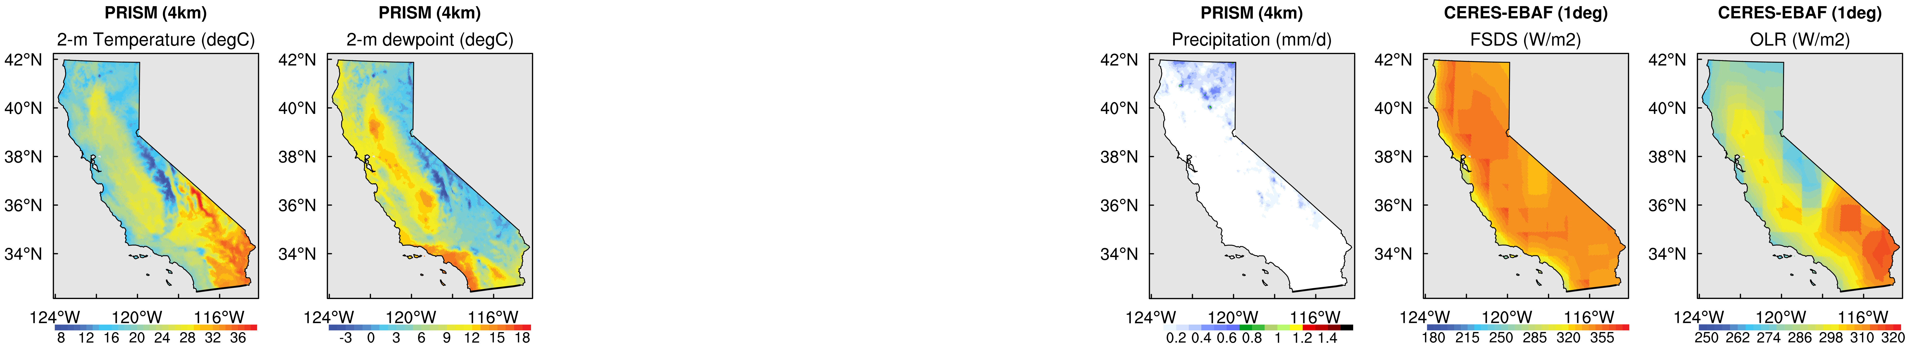

Slide 12
LA
HRRR, CTRL, TEST, TEST - CTRL
SF
HRRR, CTRL, TEST, TEST - CTRL
var: T2m, dew2m, U90M, V90M, precip, FSDS, OLR x {day (08-19PST), night (20-07PST}
first 10-day mean: 2022-09-01 – 2022-09-10

