Slide 1
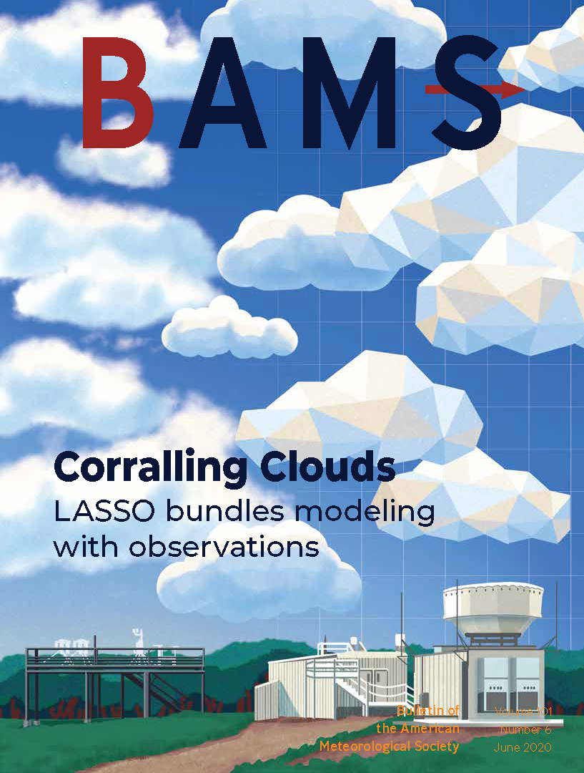
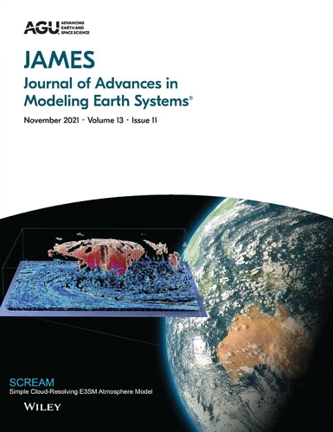
DOE Atmospheric Modeling Supporting and Using ARM:
LASSO/WRF and E3SM/SCREAM
Today’s presenters: William I. Gustafson Jr.¹ and Hsi-Yen Ma²
¹ Pacific Northwest National Laboratory; ² Lawrence Livermore National Laboratory

Slide 2
E3SM & SCREAM
Hsi-Yen Ma
Lawrence Livermore National Laboratory
Acknowledgement: Peter Bogenschutz and Chris Terai for providing E3SM and SCREAM modeling capability slides

Slide 3
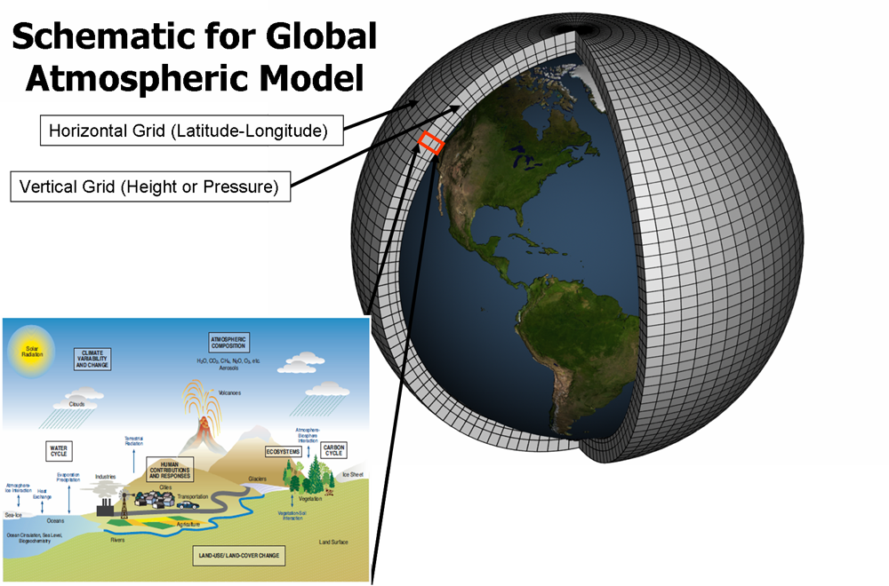
Atmospheric Modeling
Atmospheric Model – a numerical prediction model to solve the primitive equations using the discrete form with numerical methods since the analytical solution of these equations is impossible.
Atmospheric processes:
Dynamical processes– processes that can be resolved by current model resolution (e.g., large-scale advective terms). They are handled by Dynamical Core in the model.
Physical processes - processes that cannot be resolved by current model resolution. These include processes related to aerosol, cloud, convection, radiation, and turbulence, and so on. These are handled by physical parameterizations in the model.
Physical Processes
(Image courtesy of the NOAA)
Atmospheric models divide Earth into a grid with vertical and horizontal intervals, which are called model resolutions.

Slide 4
E3SM Atmospheric Modelv3 (EAMv3) – model physics
ZM: Zhang and McFarlane (1995) with enhancements in convective trigger/closure, mesoscale heating, and convective cloud microphysics
DEEP CONVECTION
RRTM: Rapid Radiative Transfer Model
Mlawer et al. (1997)
RADIATION
SHALLOW CONVECTION,
CLUBB: Cloud Layers Unified by Binormals (CLUBB)
chemUCI (troposphere)
Prather et al. (2011)
Linoz3: (stratosphere)
Hsu & Prather (2010)
TURBULENCE
EAMv3
ATMOSPHERIC CHEMISTRY
Golaz et al., 2002;
Larson, 2017
STRATIFORM CLOUDs
MAM5: A new Modal Aerosol Module (MAM5) with many enhancements to aerosol physics.
Liu et al. (2016), Ke et al (in preparation)
GRAVITY WAVES
AEROSOL
GWD: Richter et al. 2010
STRATIFORM CLOUD MICROPHYSICS
P3: Predicted Particle Properties (P3) Morrison & Milbrandt 2015
Wang et al. 2021

Slide 5

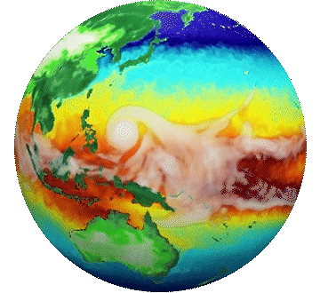
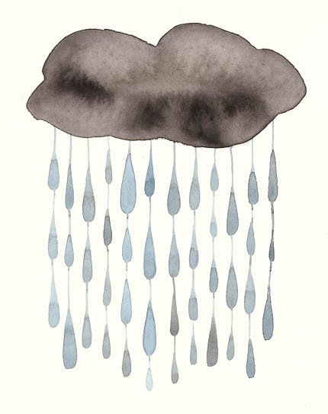
Next Gen E3SM Atmospheric Model v4
SCREAM: Simple Cloud-Resolving E3SM Atmosphere Model
SCREAM physics
Radiation handled by RRTMGP rewritten in C++ for GPUs
Resolved-scale fluid dynamics treated by a non-hydrostatic Spectral Element (SE) approach (hommexx)
Turbulence and cloud formation handled by Simplified Higher-Order Closure (SHOC)
New* parameterizations
Subgrid-scale deep convection handled by Zhang-MacFarlane
Gravity wave drag for frontal and convective GWD (Richter et al., 2010)
Orographic drag based on Beljaars et al. (2004), Tsiringakis et al. (2017), Xie et al. (2020)
Interactive aerosol scheme MAM4xx (to be included in v4.x)
Microphysical processes handled by a modified Predicted Particle Properties (P3) scheme
simple prescribed aerosol: CCN and aerosol optical properties are prescribed from E3SMv3 run
Orographic drag handled by turbulent mountain stress (TMS) (Richter et al., 2010)

Slide 6
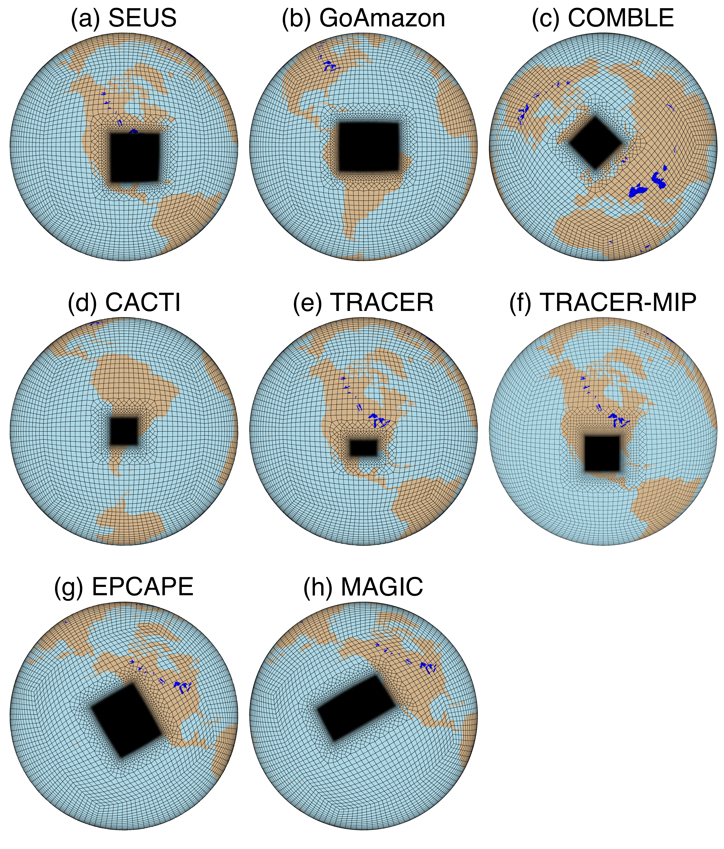
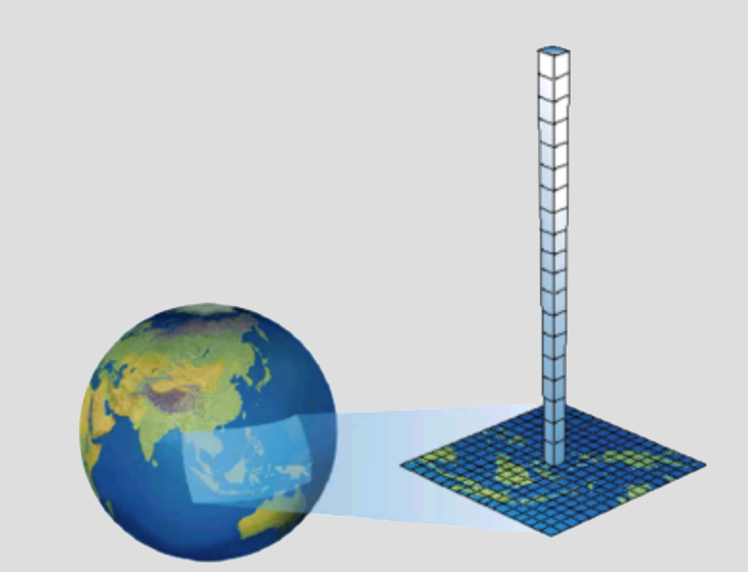
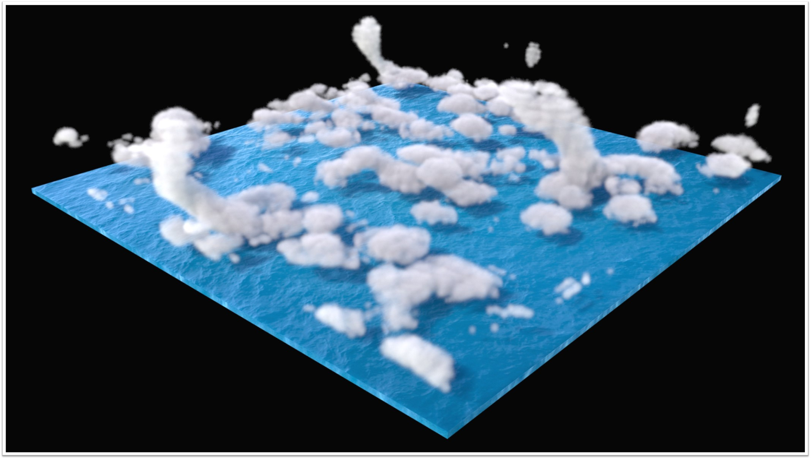
A hierarchy of modeling tools with E3SM
Full atmospheric model (EAM, SCREAM)
  Global simulations; Could be expensive if running on high-resolution simulations (~kms)
Regionally-Refined Model of EAM or SCREAM (RRM-EAM, RRM-SCREAM)
  Computational inexpensive, regional focus, can be very high-resolution locally
Single column EAM (SCM)
  Isolates a single column of the globe and driven by observations or idealized forcing
  Runs in a matter of minutes on a single processor to enable fast feedback of global model physics
Doubly-Periodic SCREAM (DP-SCREAM)
  “Single Point” cloud resolving model; isolates a column of globe (similar to SCM) but with multiple columns and horizontal interaction
  Enables convective permitting simulations at a fraction of the cost of the global model

Slide 7
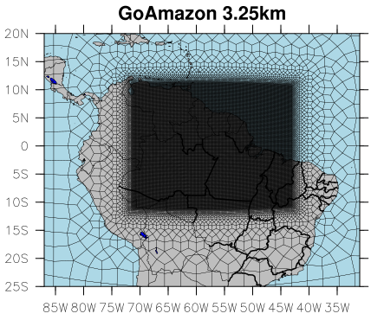
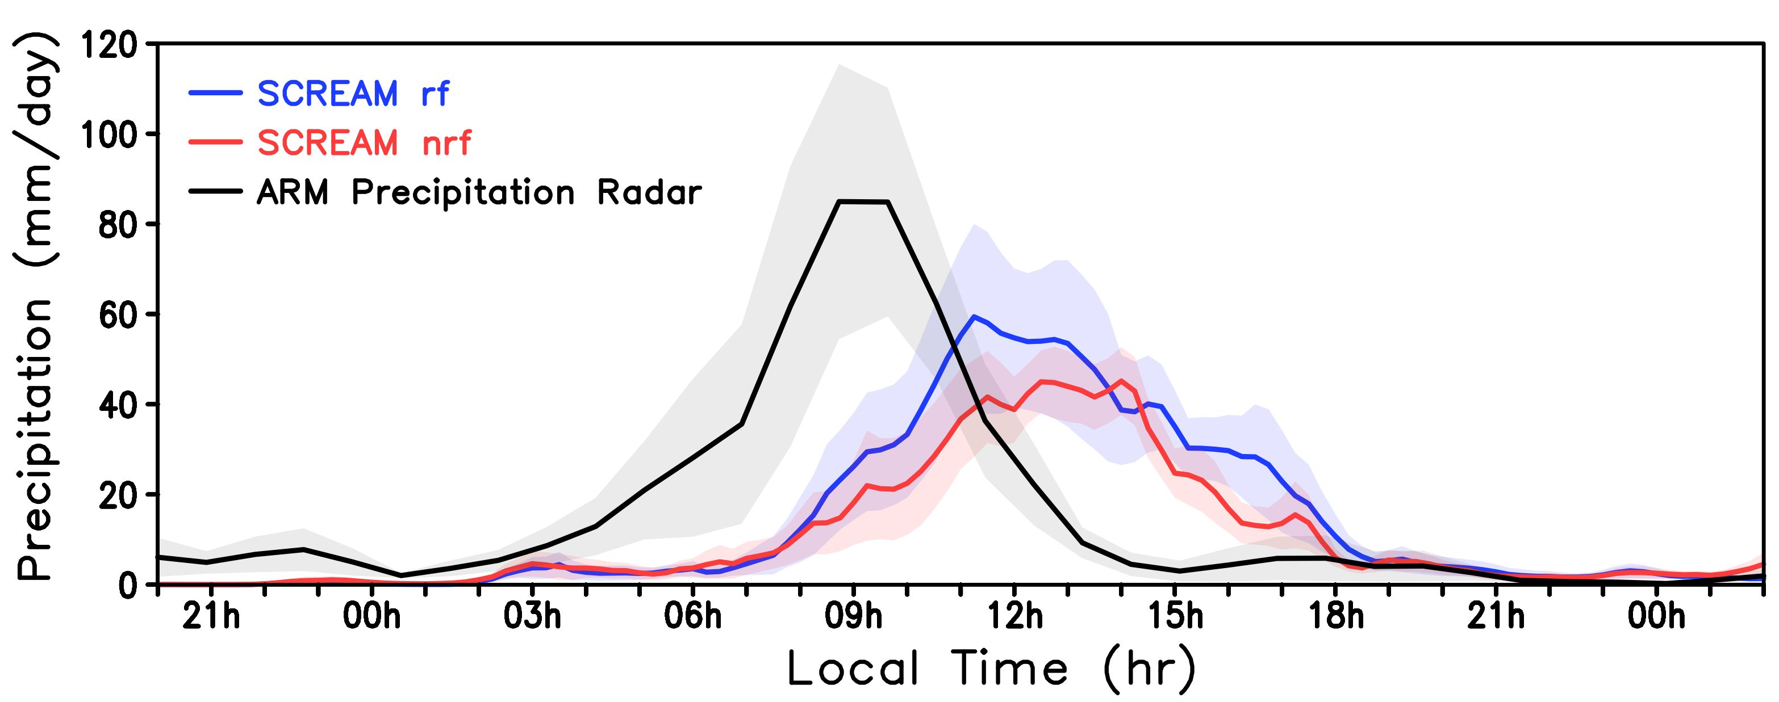




Regionally-Refined Model of E3SM
A regionally refined model (RRM) is a model configuration that simulates a portion of the globe at high horizontal resolution and leaves the remaining area at coarse resolution.
Realistic high-res topography, coastline features and boundary conditions are included in RRM simulations.
Mesoscale Convective System (MCS) case study using SCREAM & ARM data
(domain averages centered around AMF site with radius of ~128km)
Precipitation peaks at 09h local time from ARM precipitation radar with mean magnitude over 80 mm/day.
Simulations show later peaks with both configurations (w/ or w/o rain fraction). Rain frac change improves simulated peak timing and peak values.

Slide 8
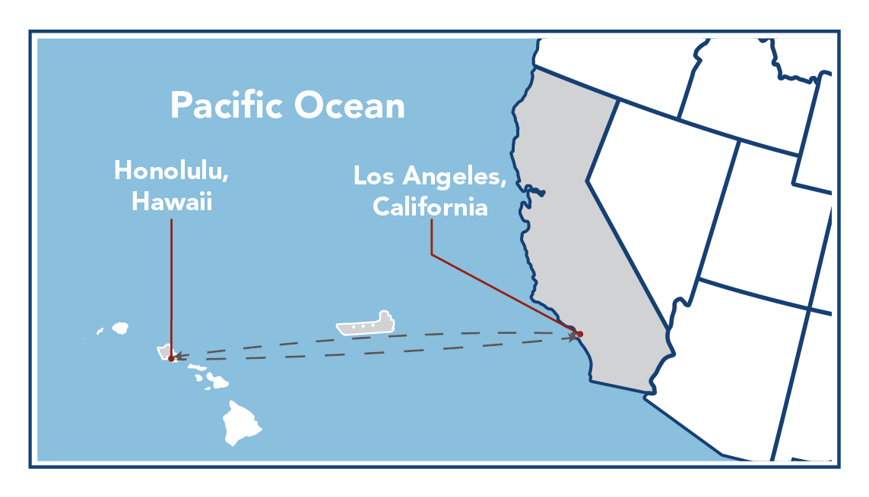

SCM Application: Evaluate clouds at the process level
MAGIC: Marine ARM GPCI Investigation of Clouds
The second ARM Mobile Facility (AMF2) was deployed on the Horizon Lines cargo ship Spirit traversing the route between Los Angeles, California, and Honolulu, Hawaii.
The MAGIC SCM case study found that an overly long microphysics timestep and an unrealistic parameterization of precipitation fraction in E3SMv1 cause unrealistic sub-cloud precipitation profiles.
Notes:
GPCI = GCSS Pacific Cross-section Intercomparison, a working group of GCSS GCSS = GEWEX Cloud Systems Study GEWEX = Global Energy and Water Cycle Experiment, a core project of the World Climate Research Programme.

Slide 9
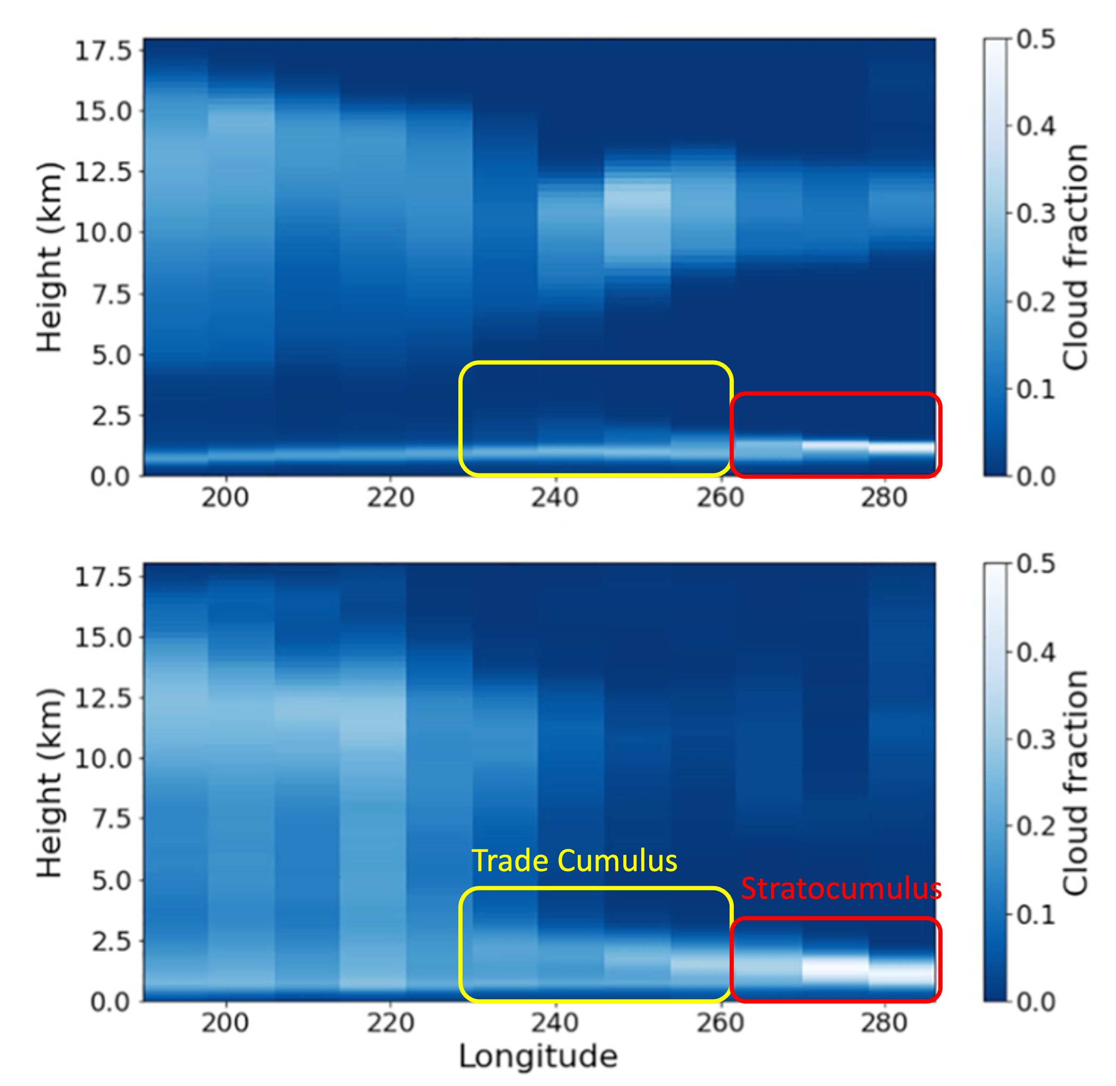
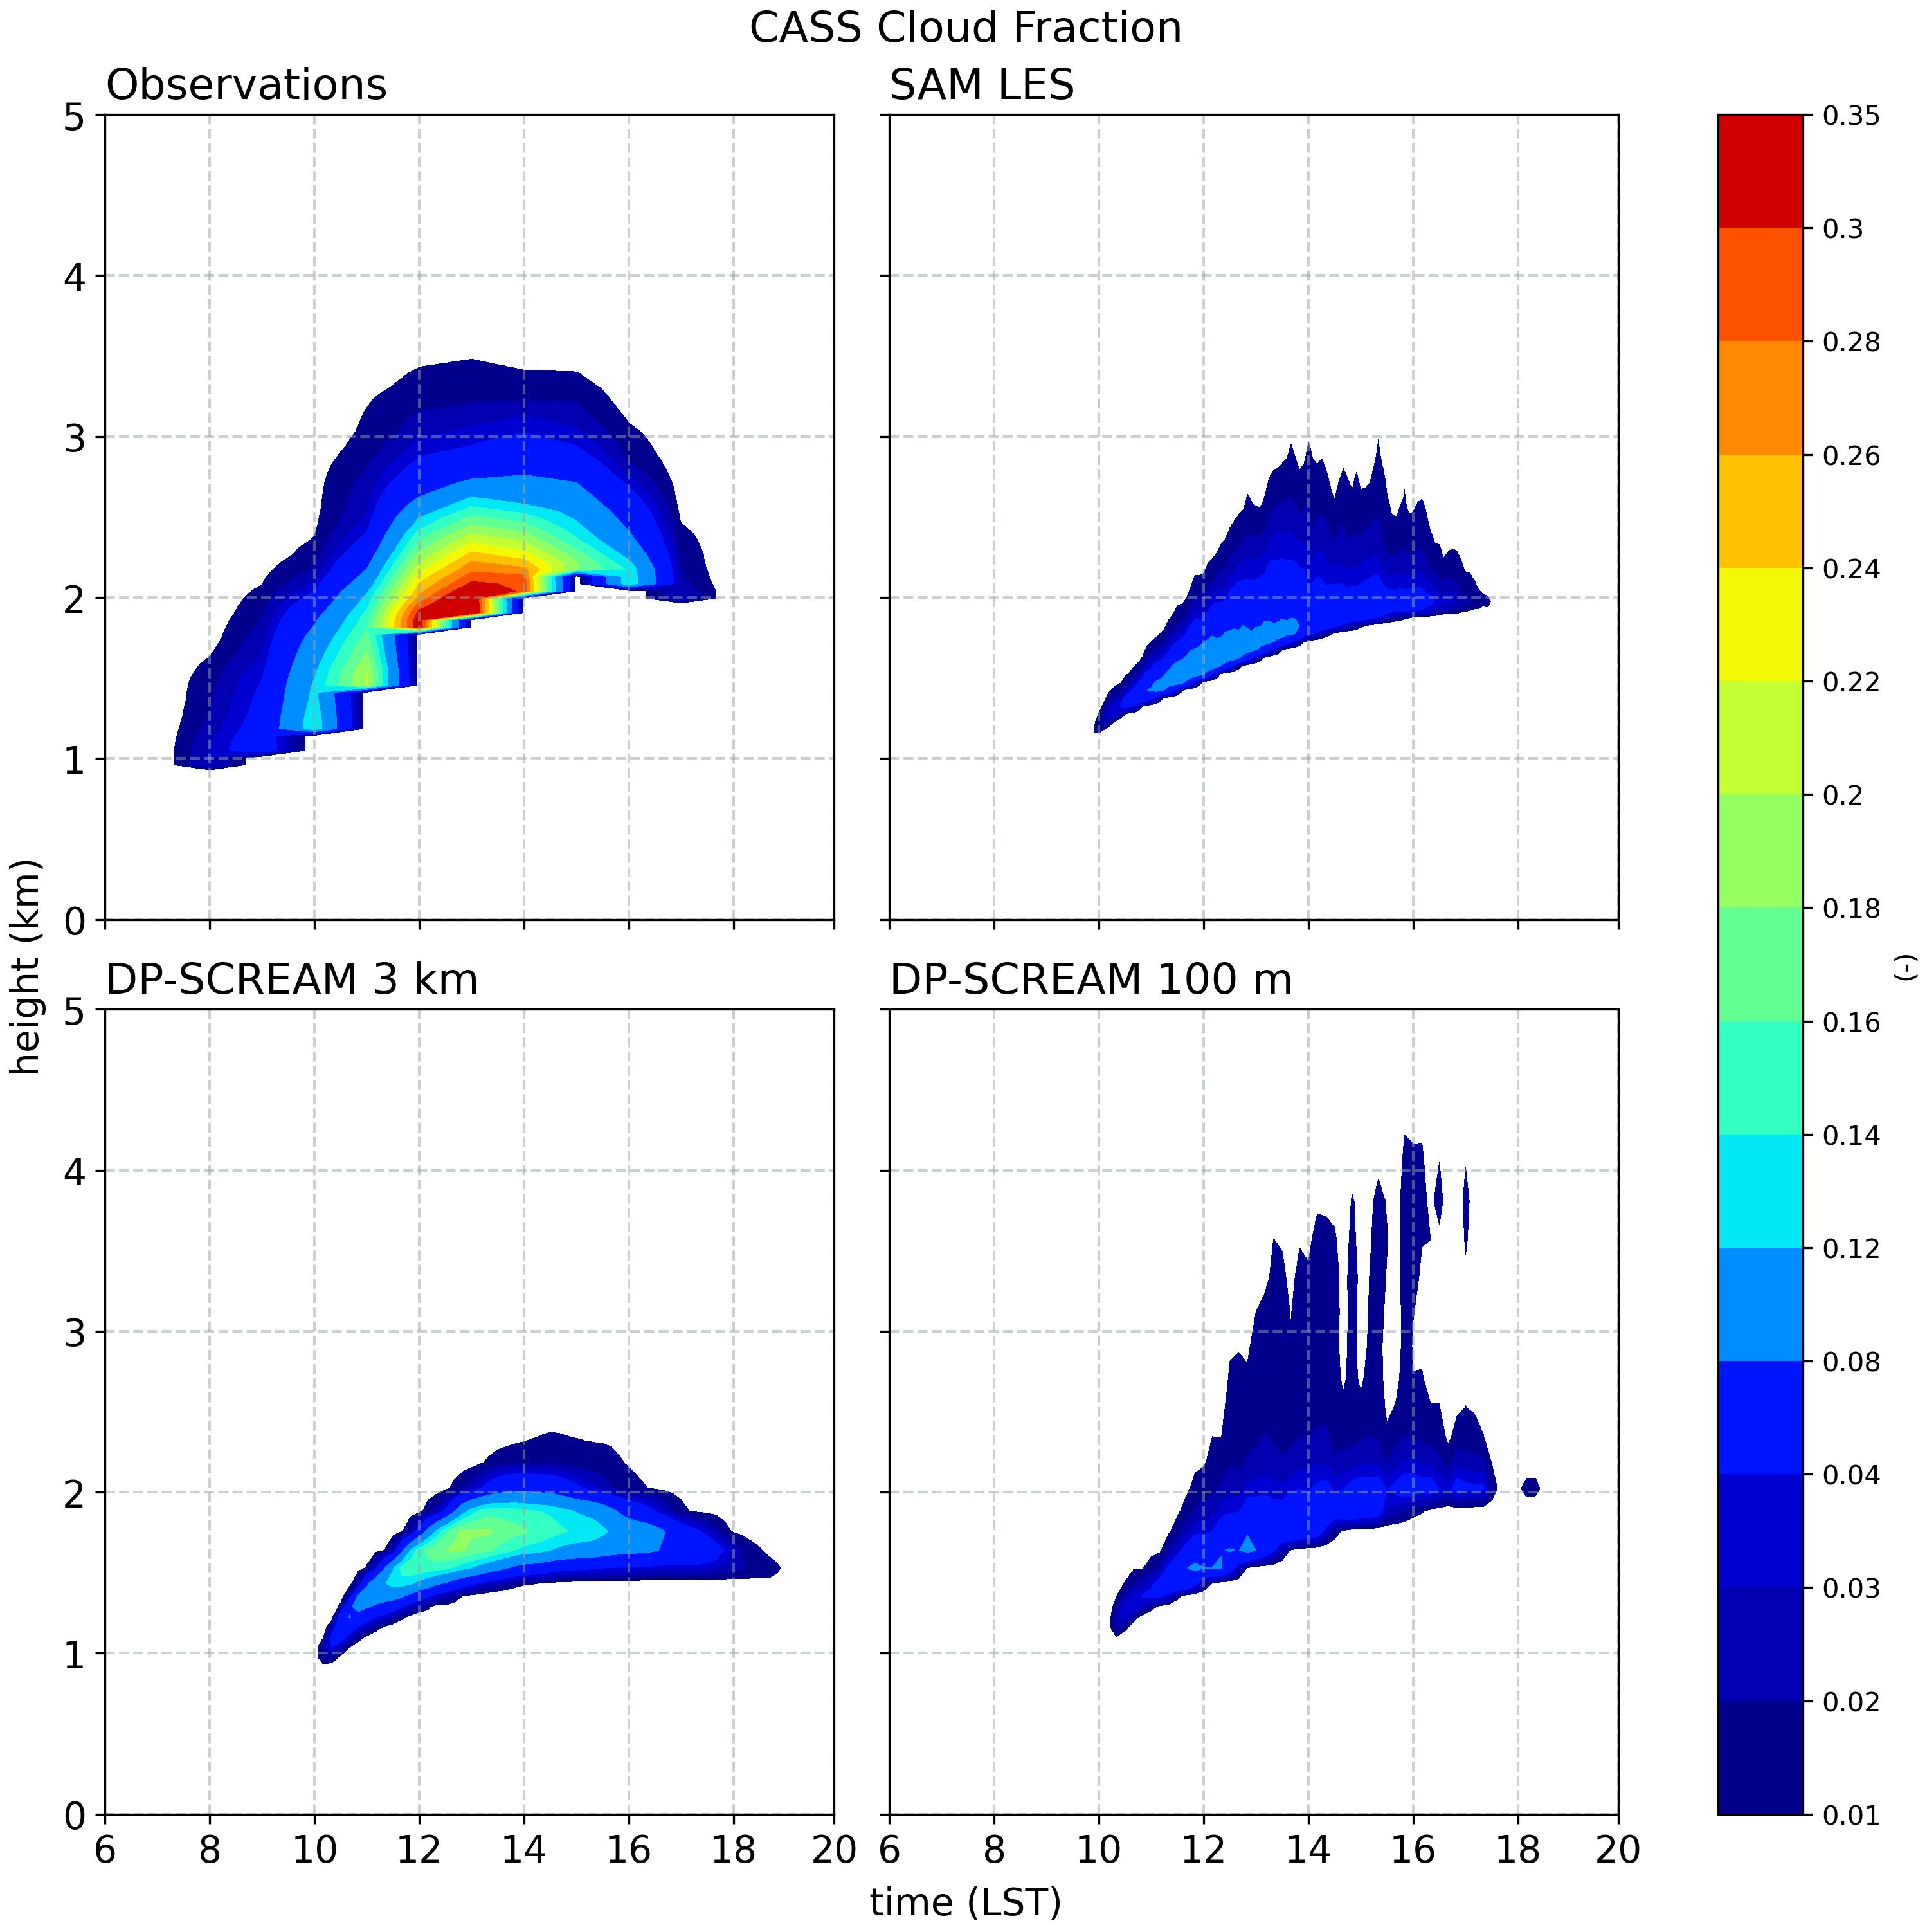
DP-SCREAM Application:
Replicating & Understanding Cloud Biases
Shallow convection over ARM SGP (Zhang et al. 2017)
SCREAM
SCREAM struggles to simulate shallow cumulus.
Clouds are too shallow in depth and resemble stratocumulus.
DP-SCREAM can well replicate this problem.
C3M
Cloud fraction along 20 S transect across Sc to deep Cu transition (Caldwell et al. 2021).
Bogenschutz et al. (2025)

Slide 10
Clouds at SGP: LASSO-SCREAM-ARM comparison

