Slide 1

Bridging the Gap Between Observation and Modeling
The ARM Value-Added Products and Their Applications
Shuaiqi Tang
Lawrence Livermore National Laboratory
Thanks to: Shaocheng Xie (LLNL), Minghua Zhang (SBU) and many others
July 8, 2020

Slide 2
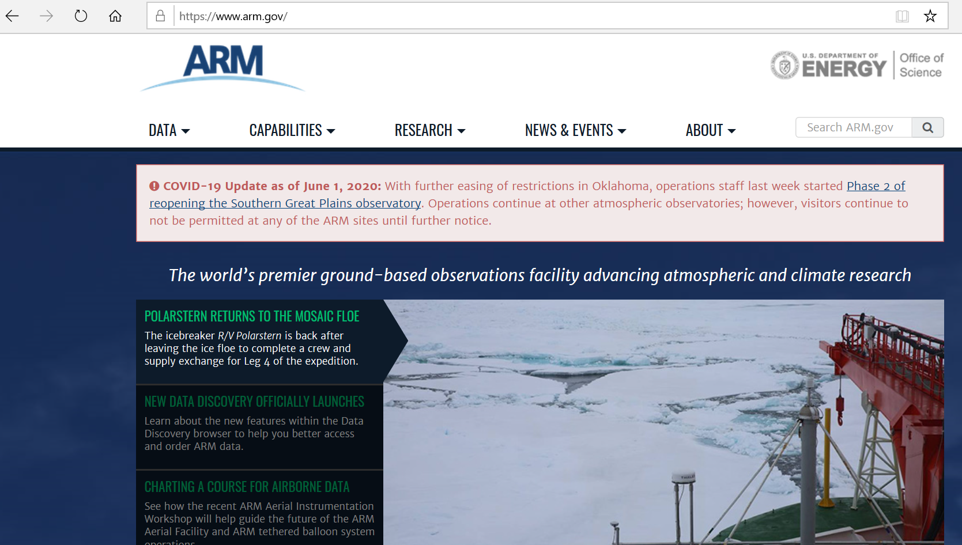
The U.S. DOE’s Atmospheric Radiation Measurement (ARM) Program
Provide the world’s atmospheric scientists with continuous observations of cloud and aerosol properties and their impacts on the Earth’s energy balance.
A broad array of measurements covering cloud properties, aerosol properties, surface properties, atmospheric thermodynamic properties, and radiative fluxes.
Current budget: $65M per year.
Programmatic separation of the observation facility (ARM) from the science team (Atmospheric System Research, ASR).

Slide 3
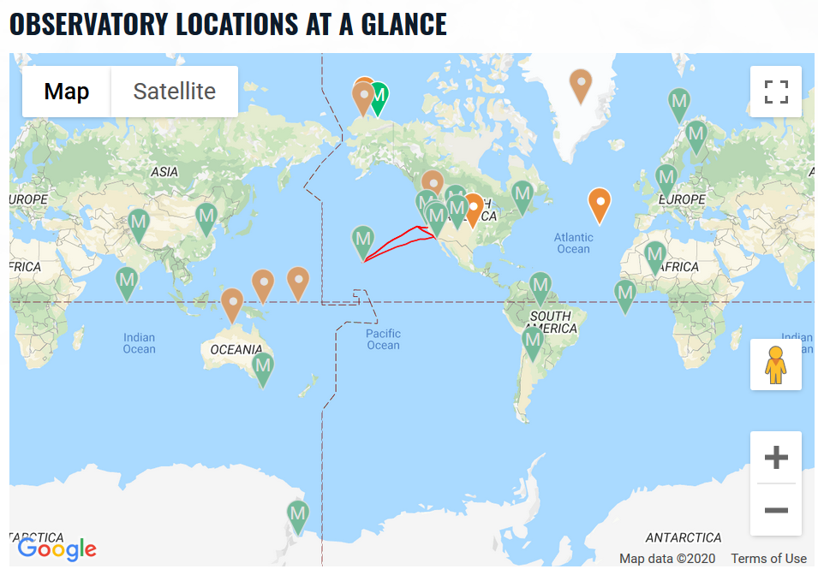
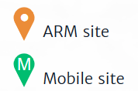
The ARM Observatory Sites
ARM fixed sites:
  the Southern Great Plains (SGP): 1992 – current
  The North Slope of Alaska (NSA): 1997 – current
  The Eastern North Atlantic (ENA): 2013 – current
  The Tropical Western Pacific (TWP): 1996 - 2014
ARM mobile sites

Slide 4
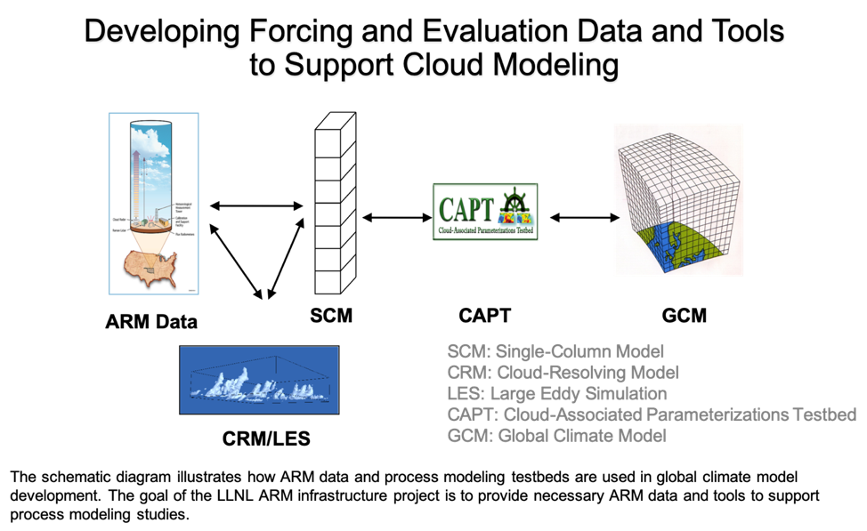
LLNL ARM Project

Slide 5

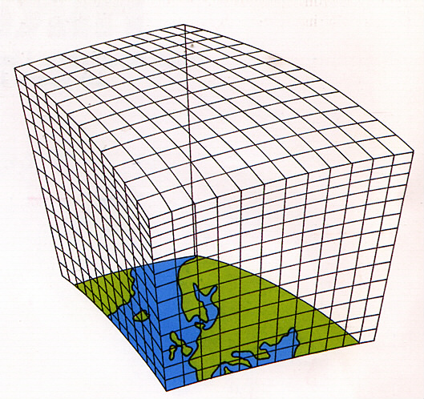
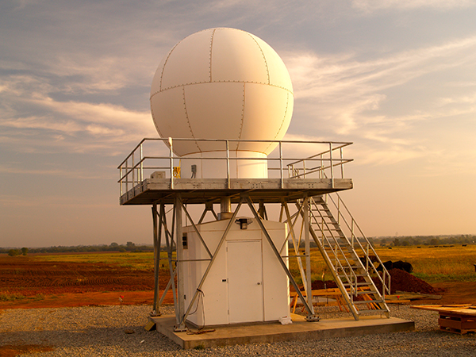
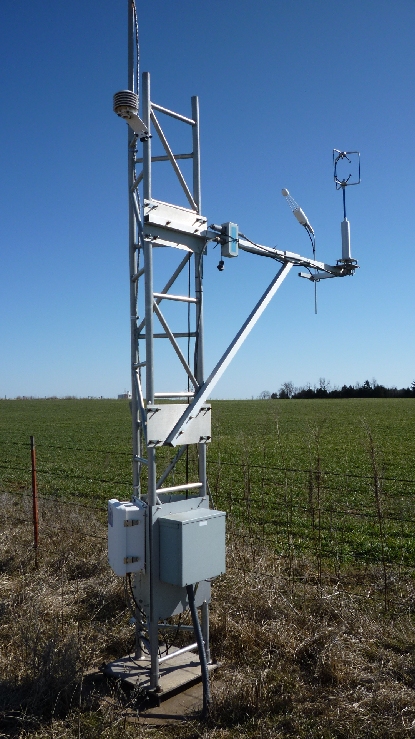
Bridging the gap between observation and model
Value-added products
ARMBE
VARANAL
….
Modeling tools
SCM
CRM/LES
….
observation
Climate models

Slide 6
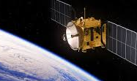
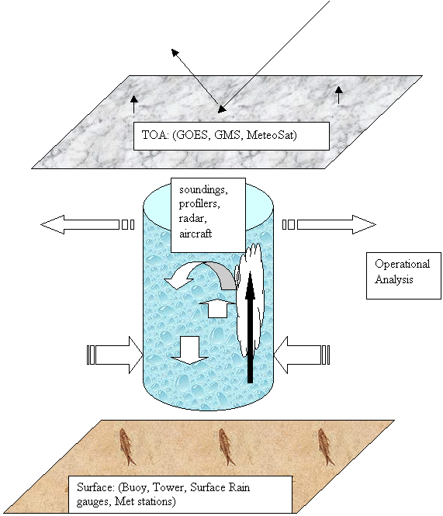
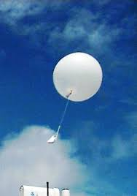
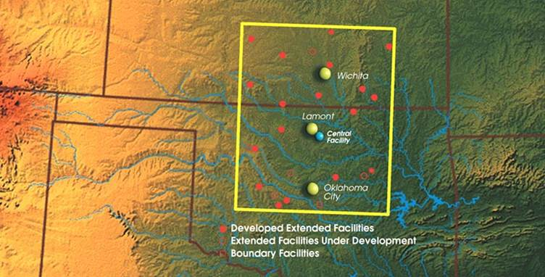
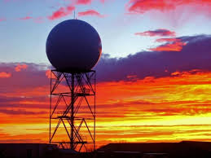
ARMBE: ARM Best Estimate Data Products
Satellite products
Integration of ~10 types of instruments.
armbeatm: u, v, T, q, ps, precip, LH, SH
armbecldrad: rad_fluxes, cld_frac, cld_cover, LWP, PWV
armbeland: soil T/q, soil heat flux, CO2 flux
Specially tailored to evaluate climate models
1-hour temporal resolution
Quality control
Standard deviation within the averaged hour
Radiosonde
Microwave Radiometer
Radar/lidar
Surface/ground instruments

Slide 7
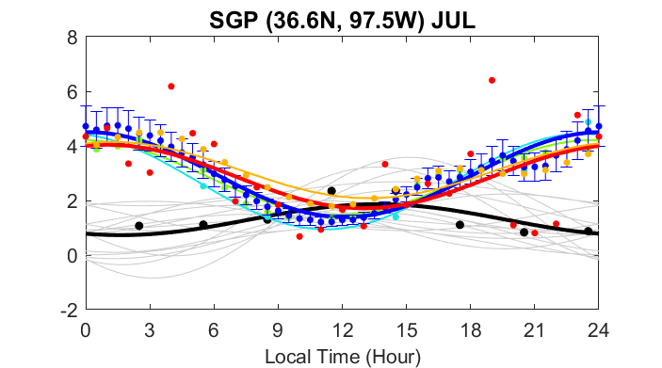
Use ARMBE to Evaluate Climate Models
Diurnal cloud frequency (%) at SGP
Diurnal cycle of precipitation (mm/day)
Mather & Voyles, 2013
Tang et al., 2020 (submitted)
Notes:
Armbecldrad cloud frequency field contains measurements from cloud radar, micropulse lidar and ceilometer.

Slide 8
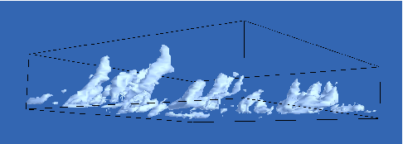
Large-Scale Forcing Data to Drive Models
Large Eddy Simulation (LES) Models
Cloud Resolving Models (CRM)
Single Column Model
Versions of Climate Models
3D-Climate Models
NWP’s
Large-Scale Forcing data
Observations from
Field Campaigns and/or
Observational sites (ARM)
Global observational
Data sets
Development
Testing
Evaluation
(Courtesy of Pier Siebesma)

Slide 9
Constrained Variational Analysis (VARANAL)
Zhang and Lin (1997)
TOA: (radiation)
Zhang et al (2001)
The column-integrated mass, moisture, energy and momentum budgets are conserved:
Large-scale forcing data: (vertical velocity, advection)
state variables: (u, v, q, s)
Surface: (Ps, SH, LH, precip., radiation)
Derived forcing from VA is dynamically and thermodynamically consistent with surface and TOA observations

Slide 10
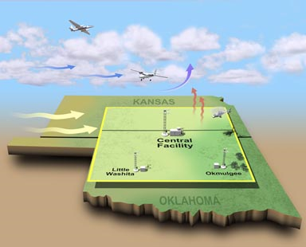
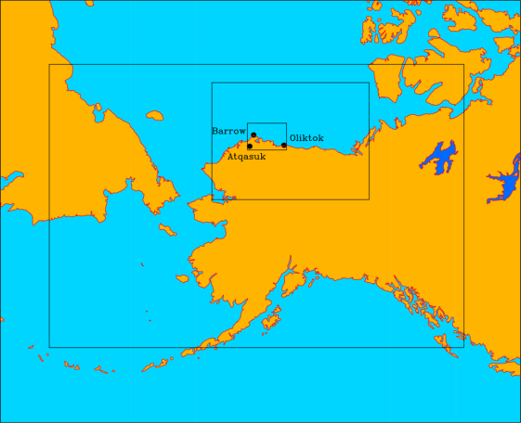
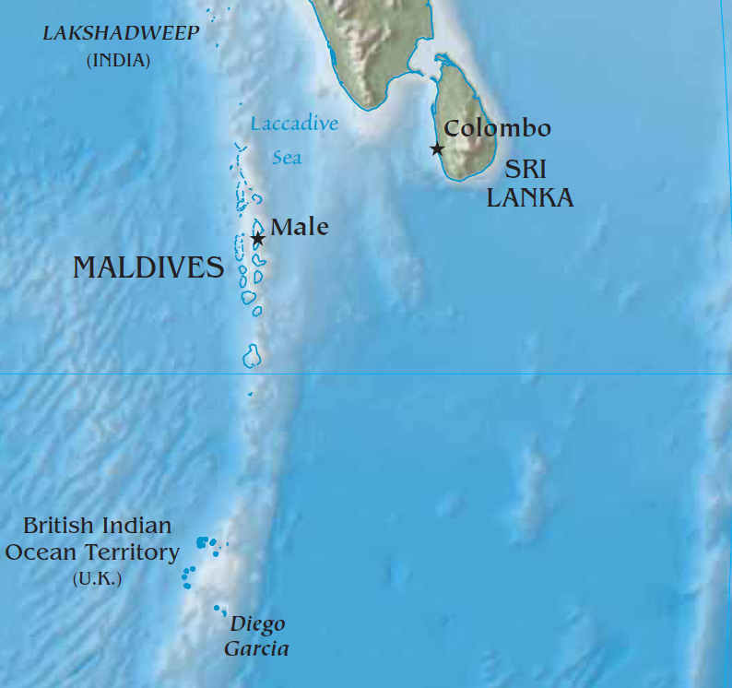
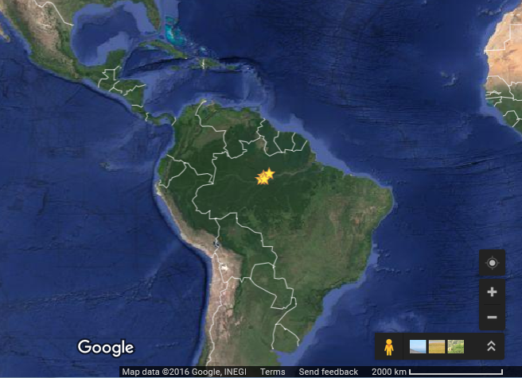
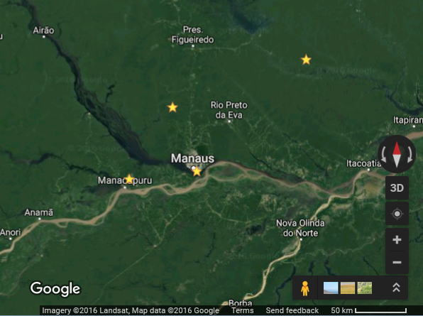
VARANAL is widely used in ARM field campaigns
Data Product | Site and Period
Sounding-Based Forcing | All the ARM major IOPs (~20) at SGP, NSA, Darwin, and the DYNAMO North Sounding Array
Continuous Forcing based on NOAA RUC/RAP analyses or ECMWR analyses | SGP: v1(1999 – 2011), v2(2004 – 2018) DARWIN: Wet seasons of 2014, 2015, and 2016 GOAmazon: 2014 – 2015. AMF-AMIE-GAN, AMF-China
Zhang and Lin (1997), Zhang et al. (2001), Xie et al. (2004), Tang and Zhang (2015), Tang et al. (2016)
NSA
ZF2
ATTO
ARM Site
Ponta Pelada

Slide 11
VARANAL is widely used in ARM field campaigns
scm-forcing (VARANAL) is the mostly requested evaluation data by ARM users
From ARM Quarterly VAP report, Nov. 2019, K. Gaustad

Slide 12
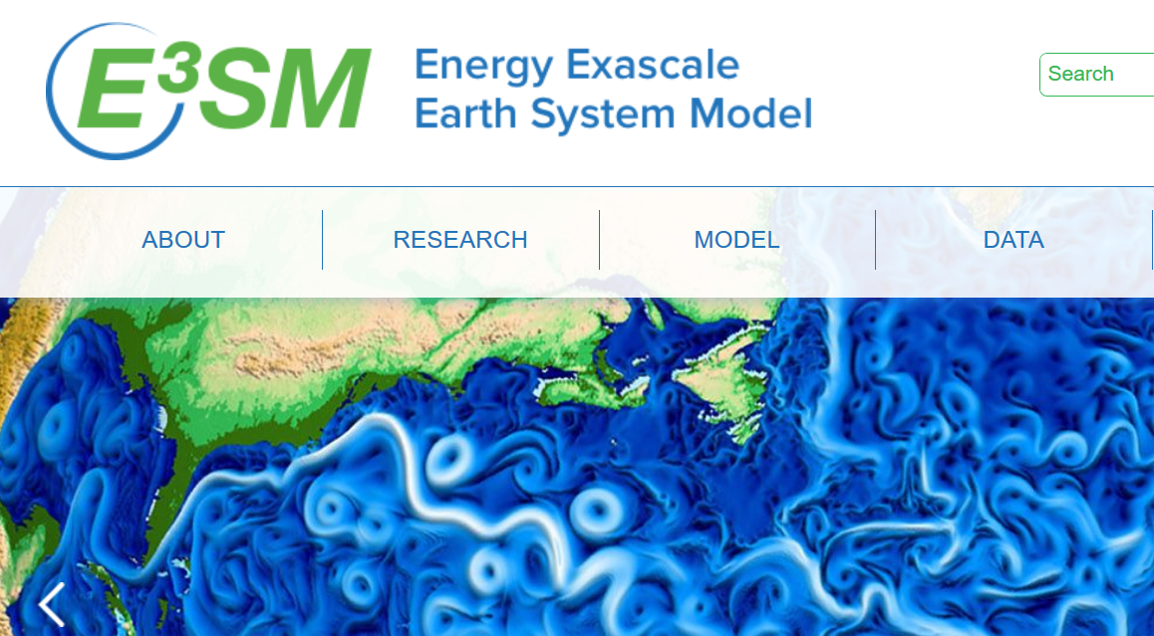
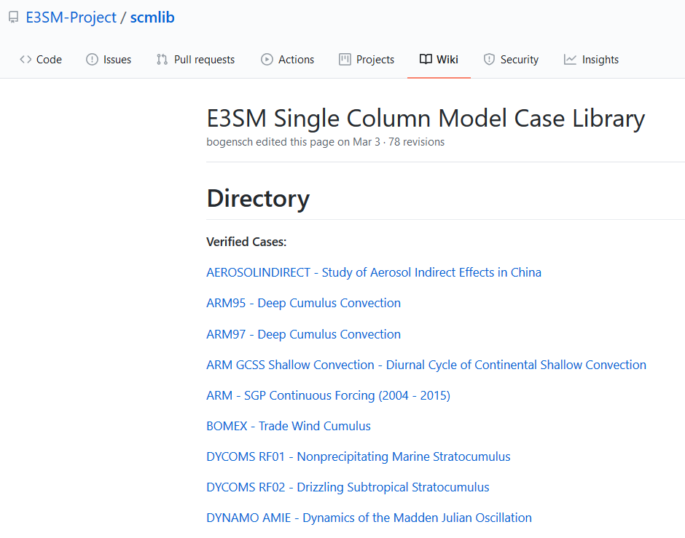
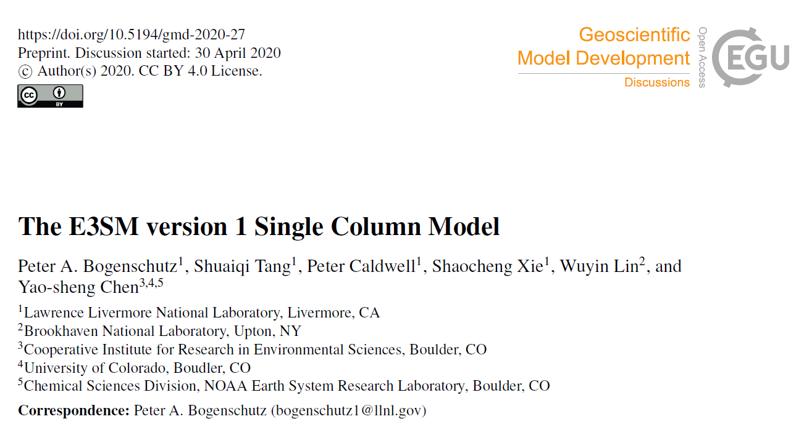
Widely Used Forcing Dataset for SCMs
E3SM SCM and Case Library

Slide 13
Recent Improvements on Variational Analysis
Constrained Variational Analysis over Sloping Terrain
3D Constrained Variational Analysis (3DCVA)

Slide 14
Variational Analysis Over Sloping Terrain
What will the surface terrain impact the large-scale forcing derived from VARANAL?

Slide 15
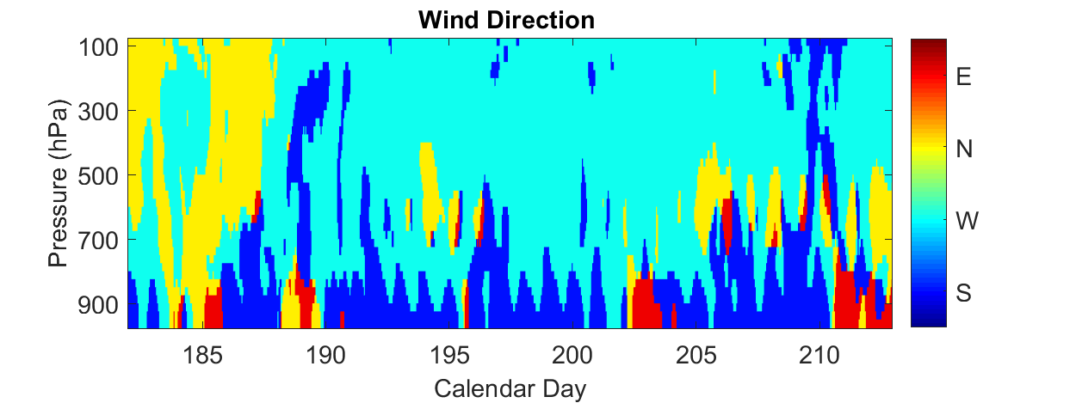

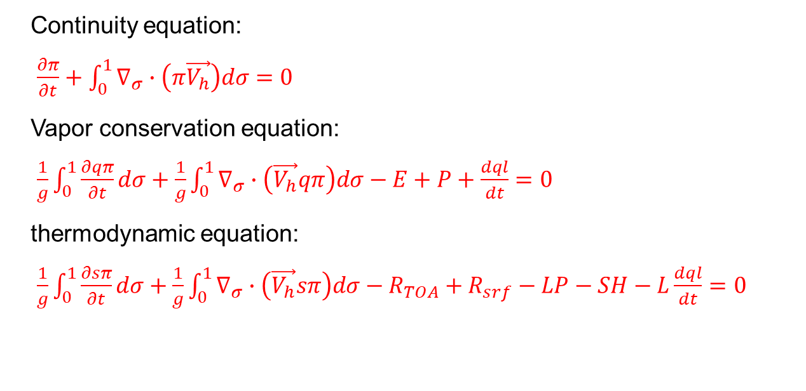
Change from pressure- to sigma- coordinate
Example in July 2015 at ARM SGP site
$$σ=\frac{p−p_{T}}{p_{s}−p_{T}}=\frac{p−p_{T}}{π}$$
N
W
E
Continuity equation:
$\frac{∂π}{∂t}+\int_{0}^{1}{∇_{σ}∙\left(π\vec{V_{h}}\right)dσ}=0$
Vapor conservation equation:
$\frac{1}{g}\int_{0}^{1}{\frac{∂qπ}{∂t}dσ}+\frac{1}{g}\int_{0}^{1}{∇_{σ}∙\left(\vec{V_{h}}qπ\right)dσ}−E+P+\frac{dql}{dt}=0$
thermodynamic equation:
$\frac{1}{g}\int_{0}^{1}{\frac{∂sπ}{∂t}dσ}+\frac{1}{g}\int_{0}^{1}{∇_{σ}∙\left(\vec{V_{h}}sπ\right)dσ}−R_{TOA}+R_{srf}−LP−SH−L\frac{dql}{dt}=0$
S
upper-atmosphere: $\vec{V_{h}}∙∇π>0$
Δ$ω$
Near surface: $\vec{V_{h}}∙∇π<0$
Tang et al., 2020

Slide 16
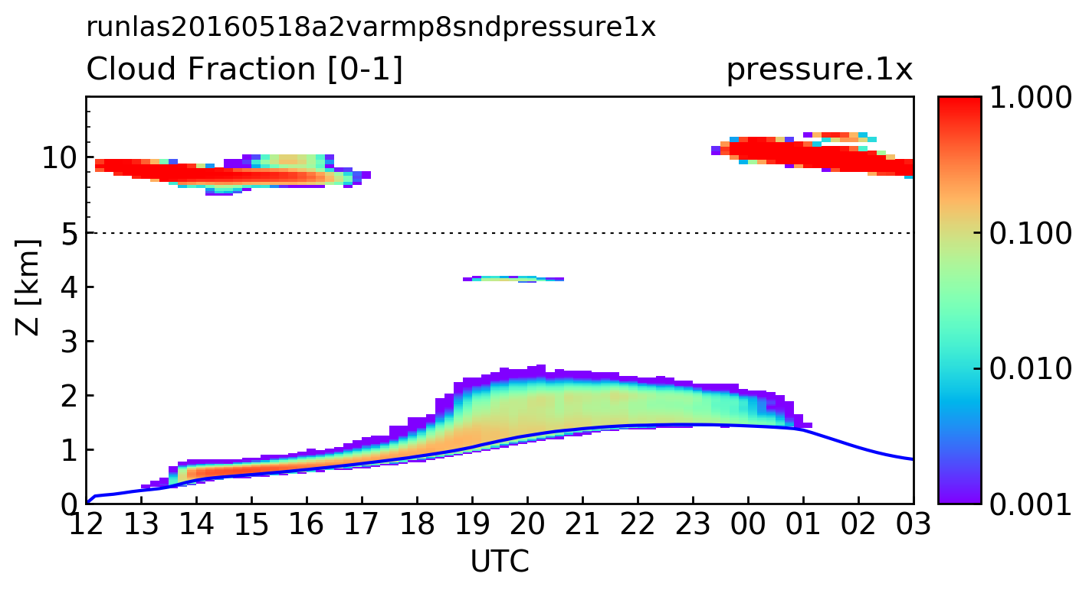
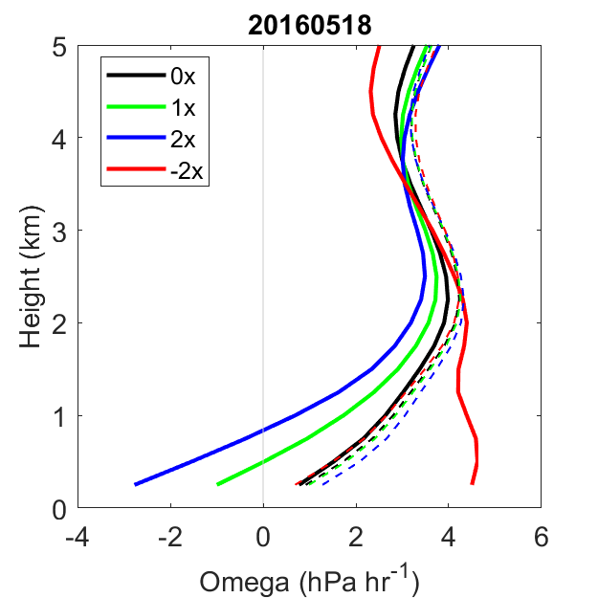
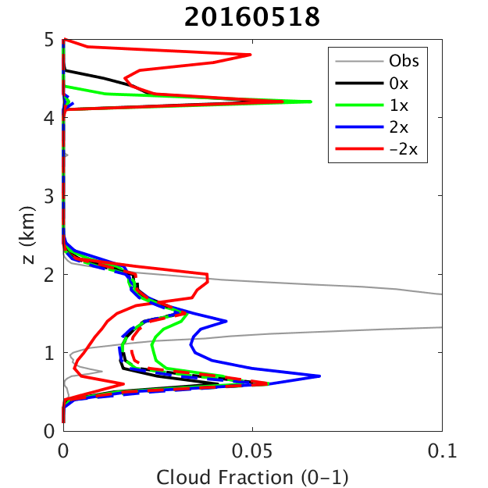
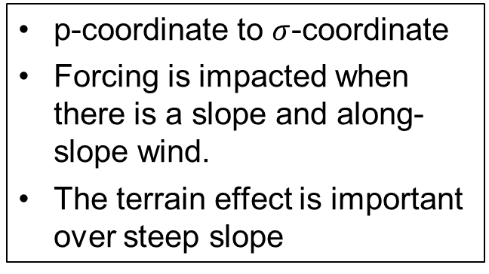
Sensitivity Study Shows the Impact of the Terrain Effect
20160518 Shallow Cumulus Case
vertical Omega profiles
Cloud Fraction
p-coordinate to $σ$-coordinate
Forcing is impacted when there is a slope and along-slope wind.
The terrain effect is important over steep slope
Tang et al., 2020

Slide 17
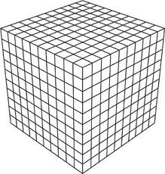
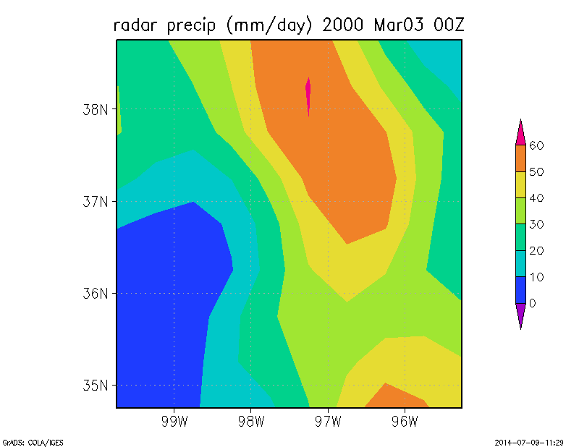
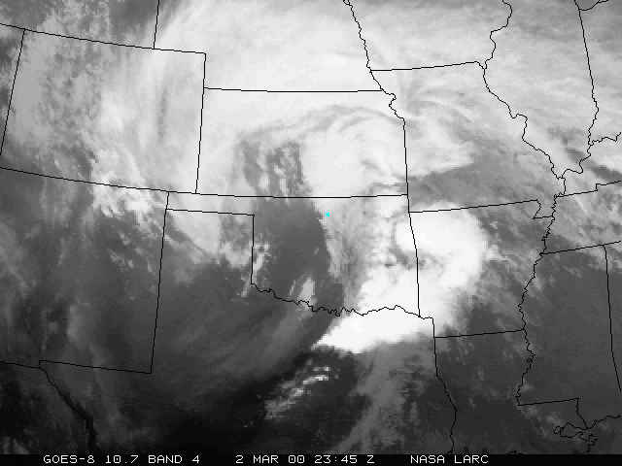
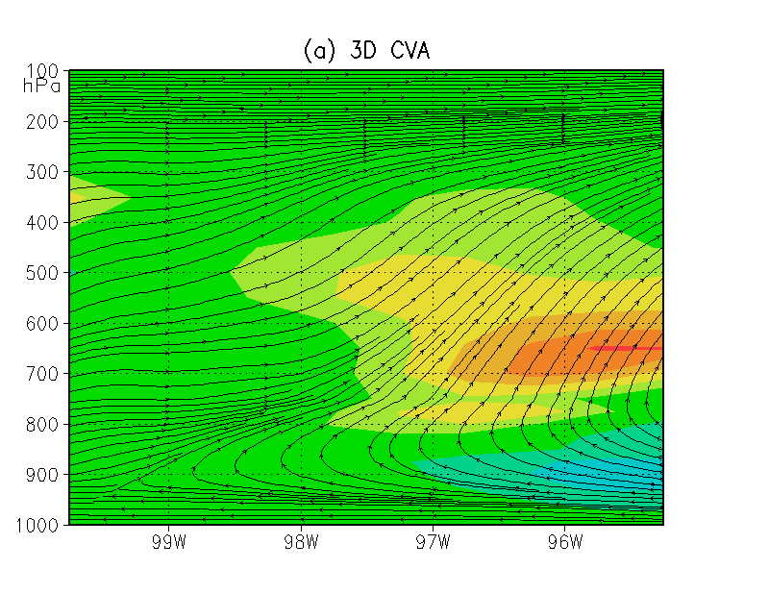
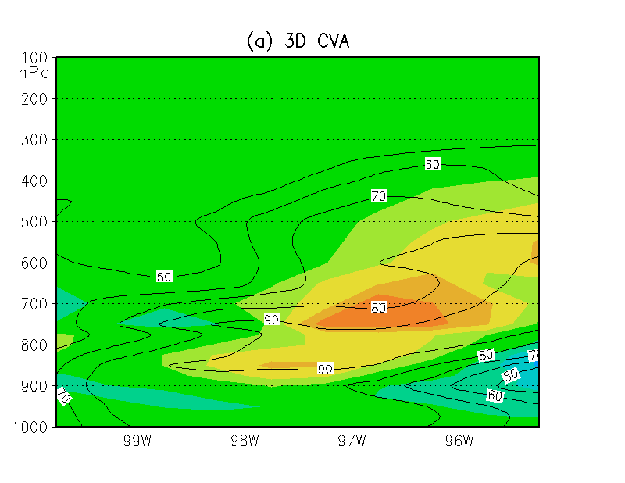
3D Constrained Variational Analysis (3DCVA)
Tang and Zhang 2015
March 3rd 2000, 00UTC
(b)
(a)
SGP
Radar precipitation
(c)
0.5°× 0.5° coupled grids
Mass, moisture and energy conservations are satisfied for every grids
Additional constraints
Improved error covariance matrix
Ensemble framework
Q1 and circulation
Q2 and RH
Tang et al., 2015

Slide 18
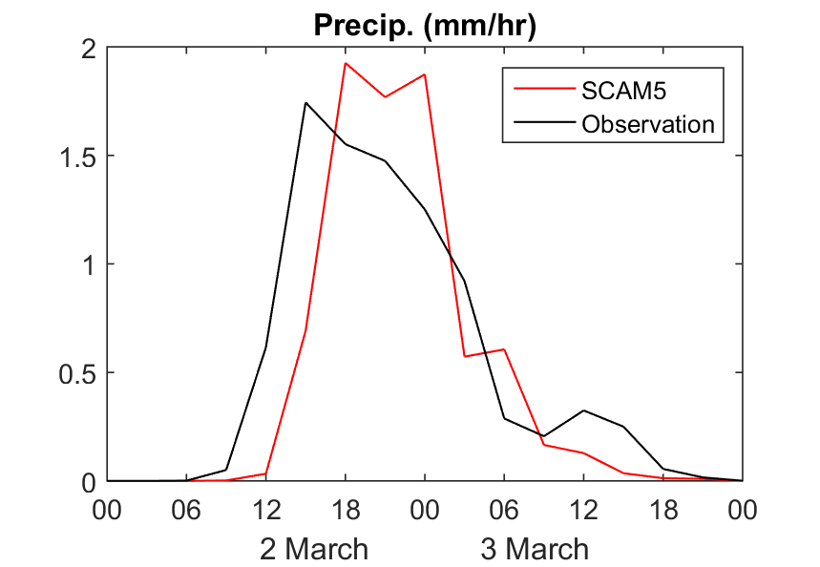
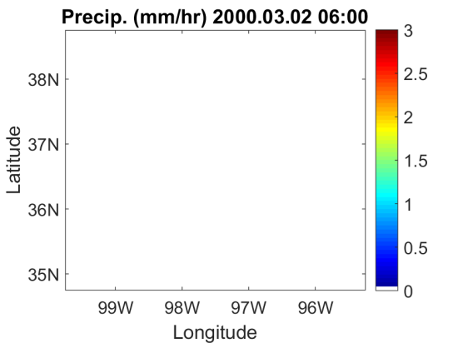
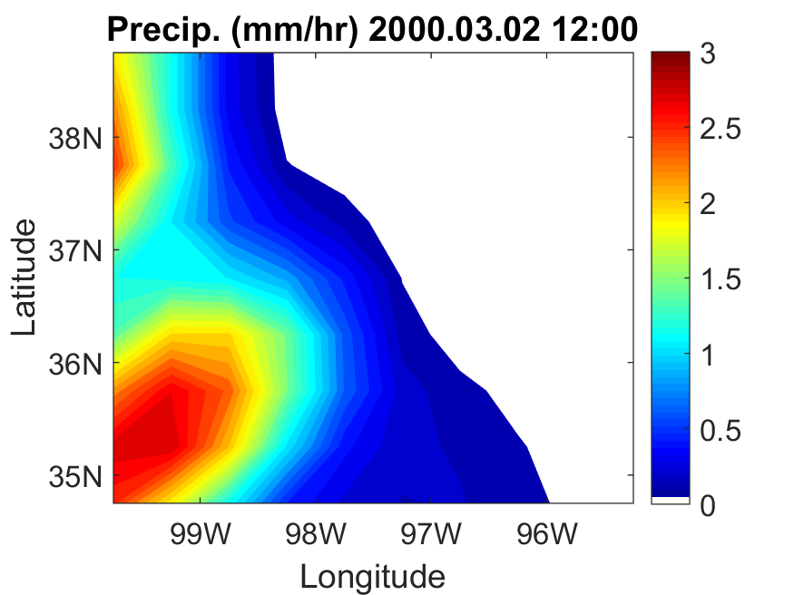
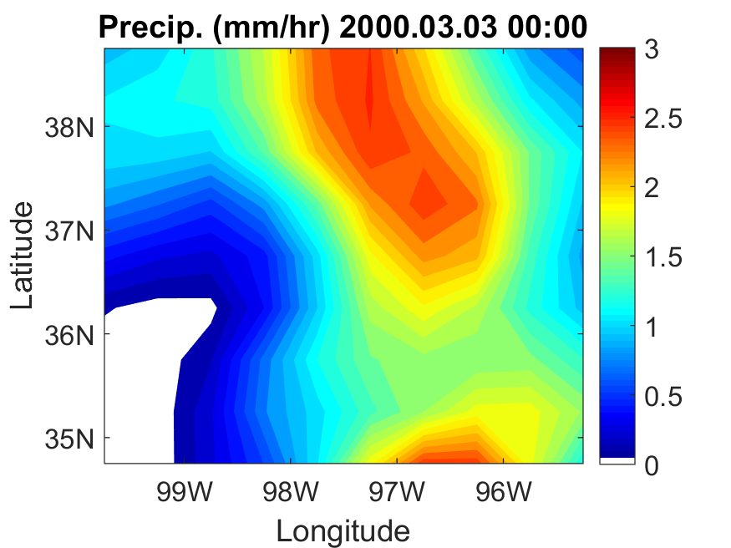
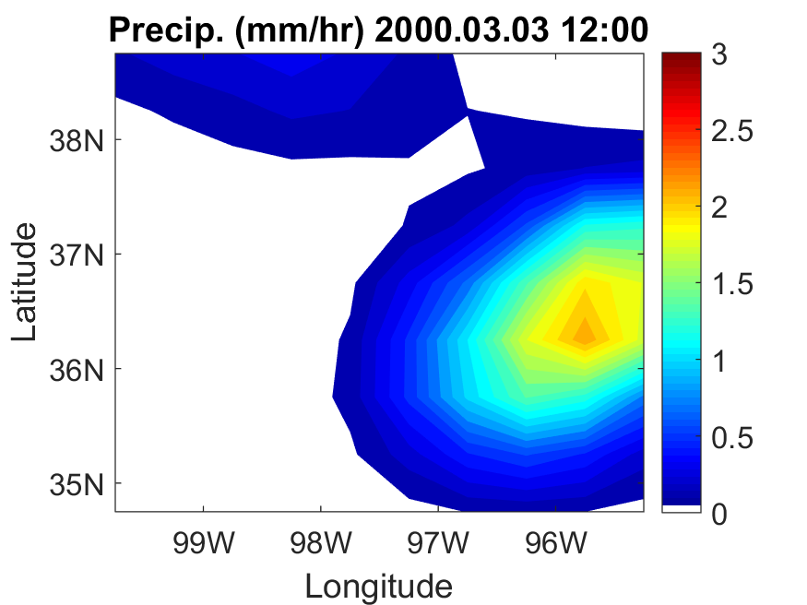
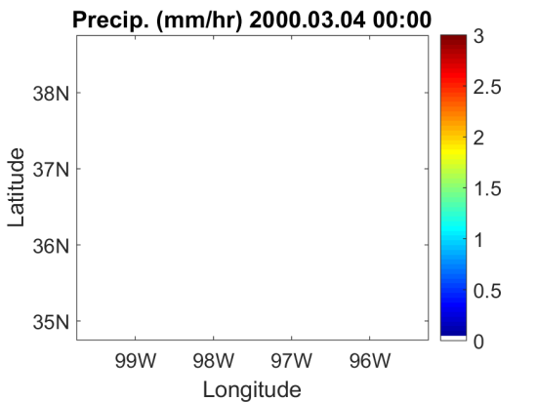
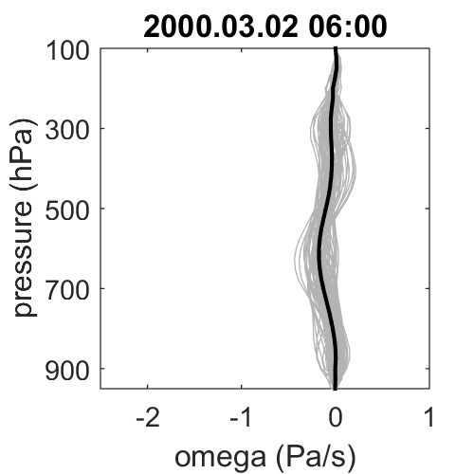
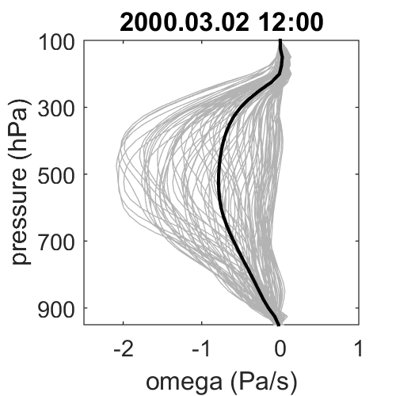
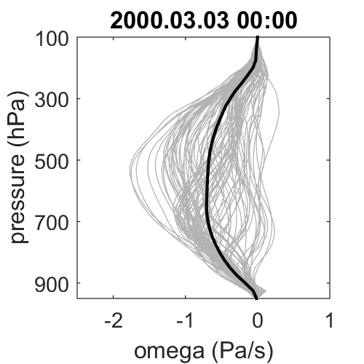
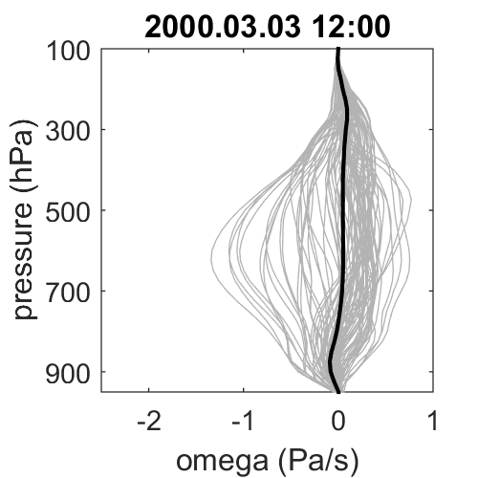
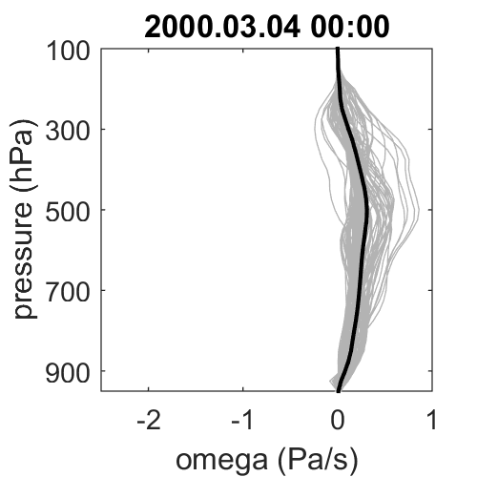
Applications: Investigating the spatial variability
Tang et al., 2017
Spatial variability of a mid-latitude frontal system in March 2000 IOP at SGP
1
2
3
4
5
Surface Precipitation (mm/hr)
Domain-mean and Sub-grid Omega (Pa/s)

Slide 19
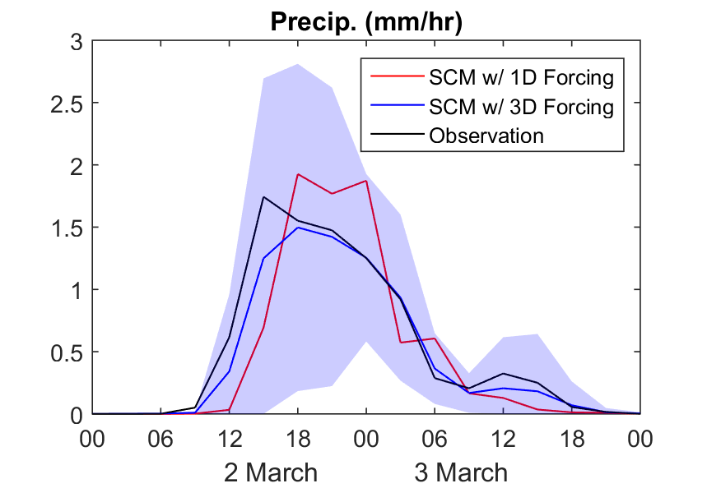
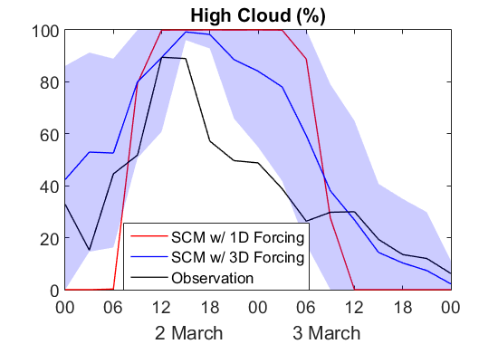
Applications: Investigating the spatial variability
Spatial distribution of Precipitation (mm/hr)
Domain-mean and Sub-grid Omega (Pa/s)
Tang et al., 2017
Some SCM errors of clouds and precipitation are due to lack of spatial variability in the domain-mean large-scale forcing.
The 3D forcing data describe the spatial variability and help cloud models to better capture the timing of the frontal propagation and the small-scale systems.
2000.03.03 12:00

Slide 20
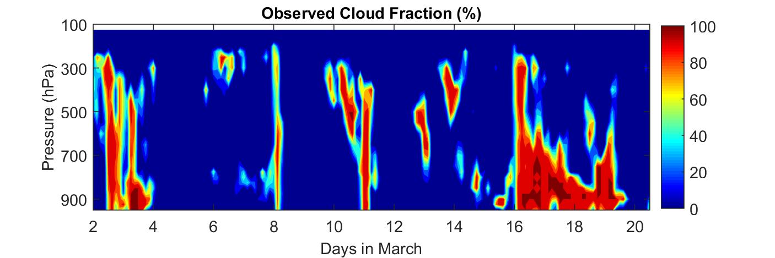
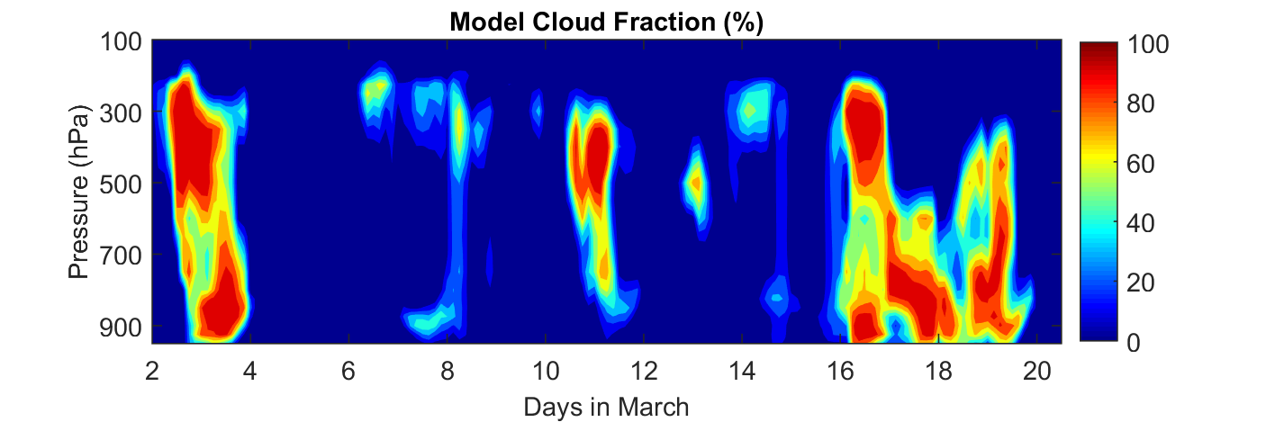
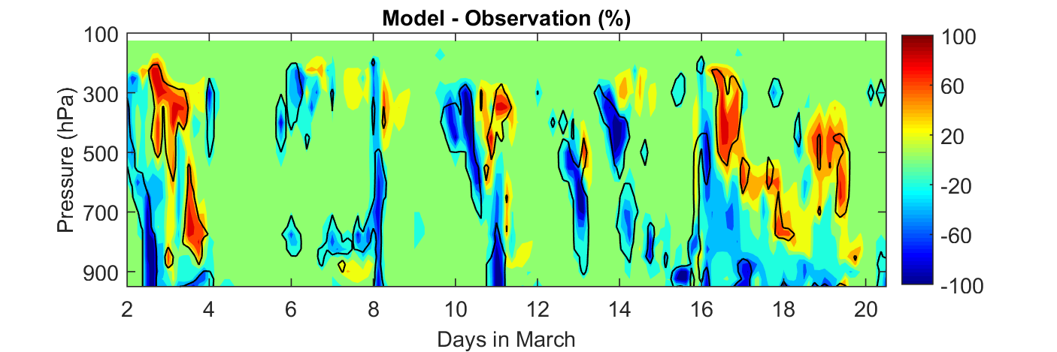
Ensemble framework of 3DCVA
Cloud Fraction (%)
Ensemble framework of 3DCVA
Background data | RUC, ERA-interim, CFSR, JRA55, MERRA, NARR
Error covariance matrix | Calculated from time series, only auto correlation. (timeseries)
 | Calculated from ensemble members, only auto correlation. (independent)
 | Calculated from ensemble members, vertical correlation. (VC)
 | Calculated from ensemble members, horizontal correlation. (HC)
 | Calculated from ensemble members, both horizontal and vertical correlation. (HCVC)
Constraint variables (precipitation only) | ABRFC gridded radar precipitation products
 | Upper bound: 1.4 × ABRFC precip amount
 | Lower bound: 0.6 × ABRFC precip amount
Obs
Model
Model-Obs.
Model bias larger than uncertainties from forcing and obs.
Tang et al., 2016

Slide 21
Application
Climate Model Evaluation and SCM/CRM/LES Simulation on Diurnal Cycle of Precipitation

Slide 22
Motivation
GCMs have difficulties in modeling the diurnal cycle of precipitation (DCP).
    develop convection too early in the day,
    missing nocturnal peak associated to propagating convective systems in some regions.
How is DCP simulated in current GCMs? (CMIP6 Evaluation)
In current GCM parameterizations, what physics processes are needed in order to correctly simulate DCP? (SCM/CRM/LES intercomparison)

Slide 23
CMIP Model Evaluation
15 CMIP6 models
12 CMIP5 models
6 overlapping models in CMIP5 and CMIP6 (e.g., FGOALS-g2 and FGOALS-g3)
3 satellite products (TRMM, CMORPH, IMERG)
2 ground-based products (ARMBE, VARANAL) at ARM sites

Slide 24
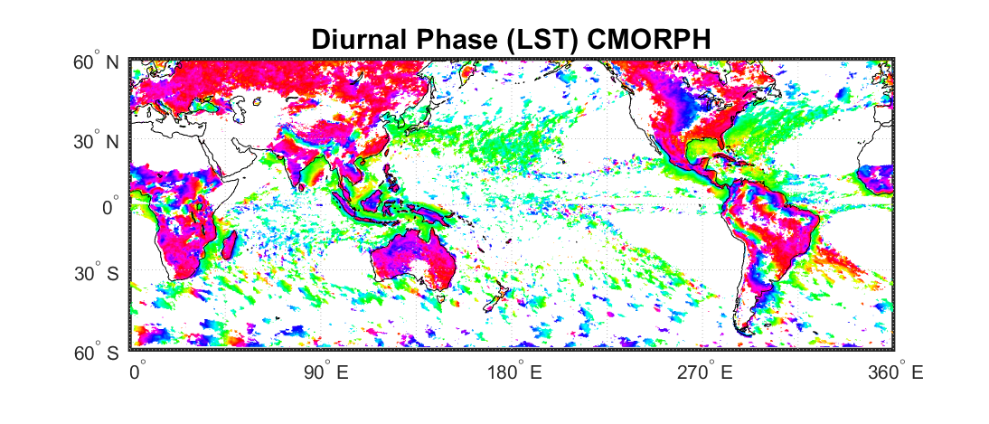

















Summertime harmonic phase (LST) of diurnal maximum precipitation.
0/24
18
6
12
Tang et al., 2020 (submitted)

Slide 25




Harmonic dial plots
Observed DCP peak after 18LST over land and ~06LST over ocean.
CMIP6 models are 3~4 hr earlier over land and 1~2 hr earlier over ocean.
Improvements from CMIP5 to CMIP6 models.
Tang et al., 2020 (submitted)

Slide 26








0/24
18
6
12
Tang et al., 2020 (submitted)
CMIP5
CMIP6

Slide 27









DCP at Selected Locations
Tang et al., 2020 (submitted)
Notes:
Figure 13: Summertime month (July in the Northern Hemisphere and January in the Southern Hemisphere) mean diurnal cycle of precipitation (dot) and the first Fourier component (line) for ten selected locations. The diurnal cycle is averaged over the period of 1996-2005 for CMIP6 models and the periods in Table 3 for individual datasets. One standard error bar is shown for IMERG data. The colors of the arrows pointing to the locations represent the different types of diurnal cycle: black represents afternoon peak over land, red represents morning peak over ocean, and green represents nocturnal peak over land.

Slide 28
Summary
CMIP6 models are still suffering from the problems of DCP
  Early peak of precipitation
  Missing nocturnal peak of precipitation
Great improvements have been made to CMIP6 models comparing to CMIP5, especially on afternoon precipitation over land.
  More sophisticated convective triggering and closure
  Better treatments of the interactions between convection and boundary layer processes
Agreement is seen among different satellite-based products and between satellite-, gauge- and radar-based measurements.
Tang et al., 2020 (submitted)

Slide 29
SCM/CRM/LES Intercomparison
SGP
Experiments:
  Long-term (2004-2015) at ARM SGP (central US)
  Long-term (2014-2015) at ARM MAO (Manaus, Brazil)
  A few case studies will be chosen from the IOPs below
    (SGP) The Midlatitude Continental Convective Clouds Experiment (MC3E), 22 April – 6 June 2011.
    (SGP) The Plains Elevated Convection at Night (PECAN), 1 June – 15 July 2015.
    (MAO) The Green Ocean Amazon (GOAmazon)
      IOP1: 15 February – 26 March 2014
      IOP2: 1 September – 10 October 2014
Model setups
  Prescribed large-scale forcing from VARANAL
  No relaxation
  Short-term hindcast run
  Prescribed surface fluxes
  Optional sensitivity study in individual models
GOAmazon
ZF2
ATTO
ARM Site
Ponta Pelada

Slide 30
Participating models
Model name | Full name | # of vertical levels | Timestep | turbulence | Stratiform clouds | Shallow convection | PI and/or reference
E3SM | Energy Exascale Earth System Model | 72 | 30min | CLUBB | MG2, CLUBB | CLUBB | Golaz et al., 2019
SCAM5 | Single Column Atmosphere Model Version 5 | 30 | 20min | diag_TKE | MG, Park | Park and Bretherton, 2009 | Neale et al., 2012
SCAM6 | Single Column Atmosphere Model Version 6 | 32 | 20min | CLUBB | MG2, CLUBB | CLUBB | Gettelman et al., 2019
SAM0 | Seoul National University Atmosphere Model | 30 | 20min | diag_TKE | MG, Park | UNICON | Sungsu Park
SKIM | Single Column Korean Integrated Model | 64 | 1min | Shin-Hong | WSM5, Park | HanPan | Hong et al., 2013
DALES-ED(MF)^{n} | Dutch Atmospheric Large-Eddy Simulation | 300 | 100sec | ED(MF)^{n} | 1-moment, Bi-modal PDF | ED(MF)^{n} | Roel Neggers
CMC | Canadian Meteorological Center | 84 | 450sec | TKE1.5 | Sundqvist | M-Bechtold | Paul Vaillancourt
SMCPCP | Stochastic Multicloud Plume Convective Parameterization | 30 | 20min | HB | MG, Park | Unified Stochastic Plume-ZM | Khouider et.al. 2019
MONC | Met Office NERC Cloud Model | 99 | 1-3sec | Resolved | CASIM | Resolved | Brown et al., 2015
SCM
CRM

Slide 31




Overall performance
SGP (2004-2015 MJJA)
MAO (2014-2015)

Slide 32








Afternoon and Nocturnal Precipitation
SGP (2004-2015 MJJA)
MAO (2014-2015)
Afternoon
Nocturnal
Afternoon
Nocturnal
136 days
380 days
111 days
73 days

Slide 33


Early onset of afternoon convection
  Models trigger precip. 1-2 hrs earlier at SGP and 1-4 hrs earlier at MAO.
  Do models become unstable too quickly or trigger convection too easily?
  What is the possible reason?
    remnant instability over night too large
    poor interaction between deep convection, shallow convection and boundary layer processes)

Slide 34


Missing nocturnal convection
  Some models can produce nocturnal convective precipitation but some models produce nocturnal precipitation but mostly from stratiform precipitation (prescribed large-scale forcing).
What are the key features that help “good” models capture nocturnal convection?
  Allowing convection triggered above the boundary layer

Slide 35





Case Study
PECAN (2015, central U.S.)
GOAmazon (2014-2015, central Amazonia)
Local occurring system (LOS)
Afternoon convection
Locally driven thermal convection
Nocturnal convection
Costal occurring system (COS)
Basin occurring system (BOS)
Propagating elevated convection
Notes:
Select cases that can reproduce long-term statistical model biases
High-resolution models can provide detailed analysis that observation may be limited
More in-detail analysis on physical processes that control diurnal cycle of convection

Slide 36
Summary
The LLNL ARM team has been working on bridging the gap between observation and modeling from both directions.
We develop and improve value-added products from ARM field campaign observations (e.g., ARMBE, VARANAL) to evaluate and drive models.
We use SCM/CRM/LES models to understand the cloud and convective processes, evaluate and improve GCM physical parameterizations.

