Slide 1
A Tutorial of Earth System Model Aerosol-Cloud Diagnostics Package (ESMAC Diags)
Shuaiqi Tang
Jerome Fast
Adam Varble
Kai Zhang
Joseph Hardin
Po-Lun Ma

Slide 2
What is it?
Diagnostics tool to evaluate earth system models (currently E3SM)
Focusing on aerosols, clouds and aerosol-cloud interactions
Using in-situ and remote-sensing measurements from ARM and other field campaign measurements
Python-based open-source package
The goal is to facilitate the routine evaluation of aerosols, clouds and aerosol-cloud interactions in E3SM and provide insights to guide future model development.

Slide 3
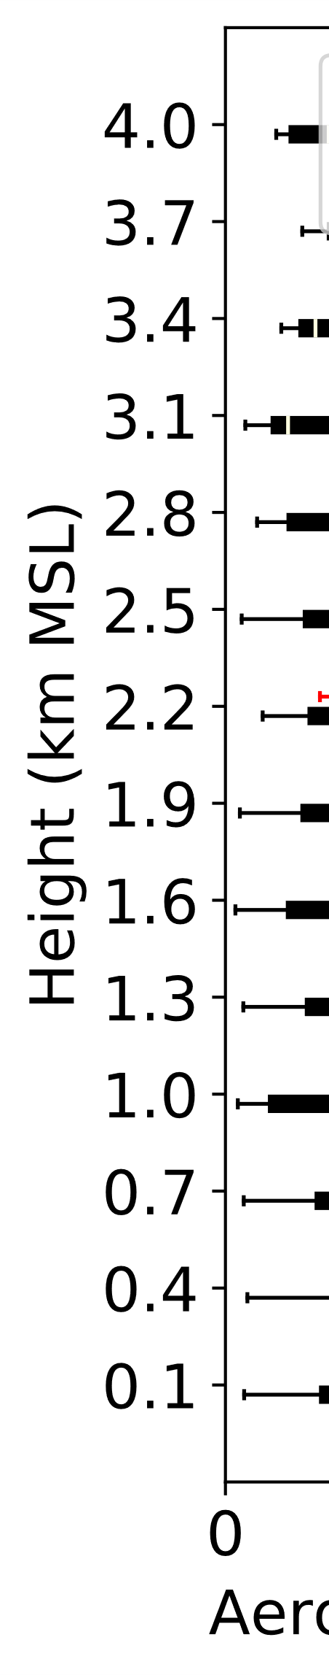
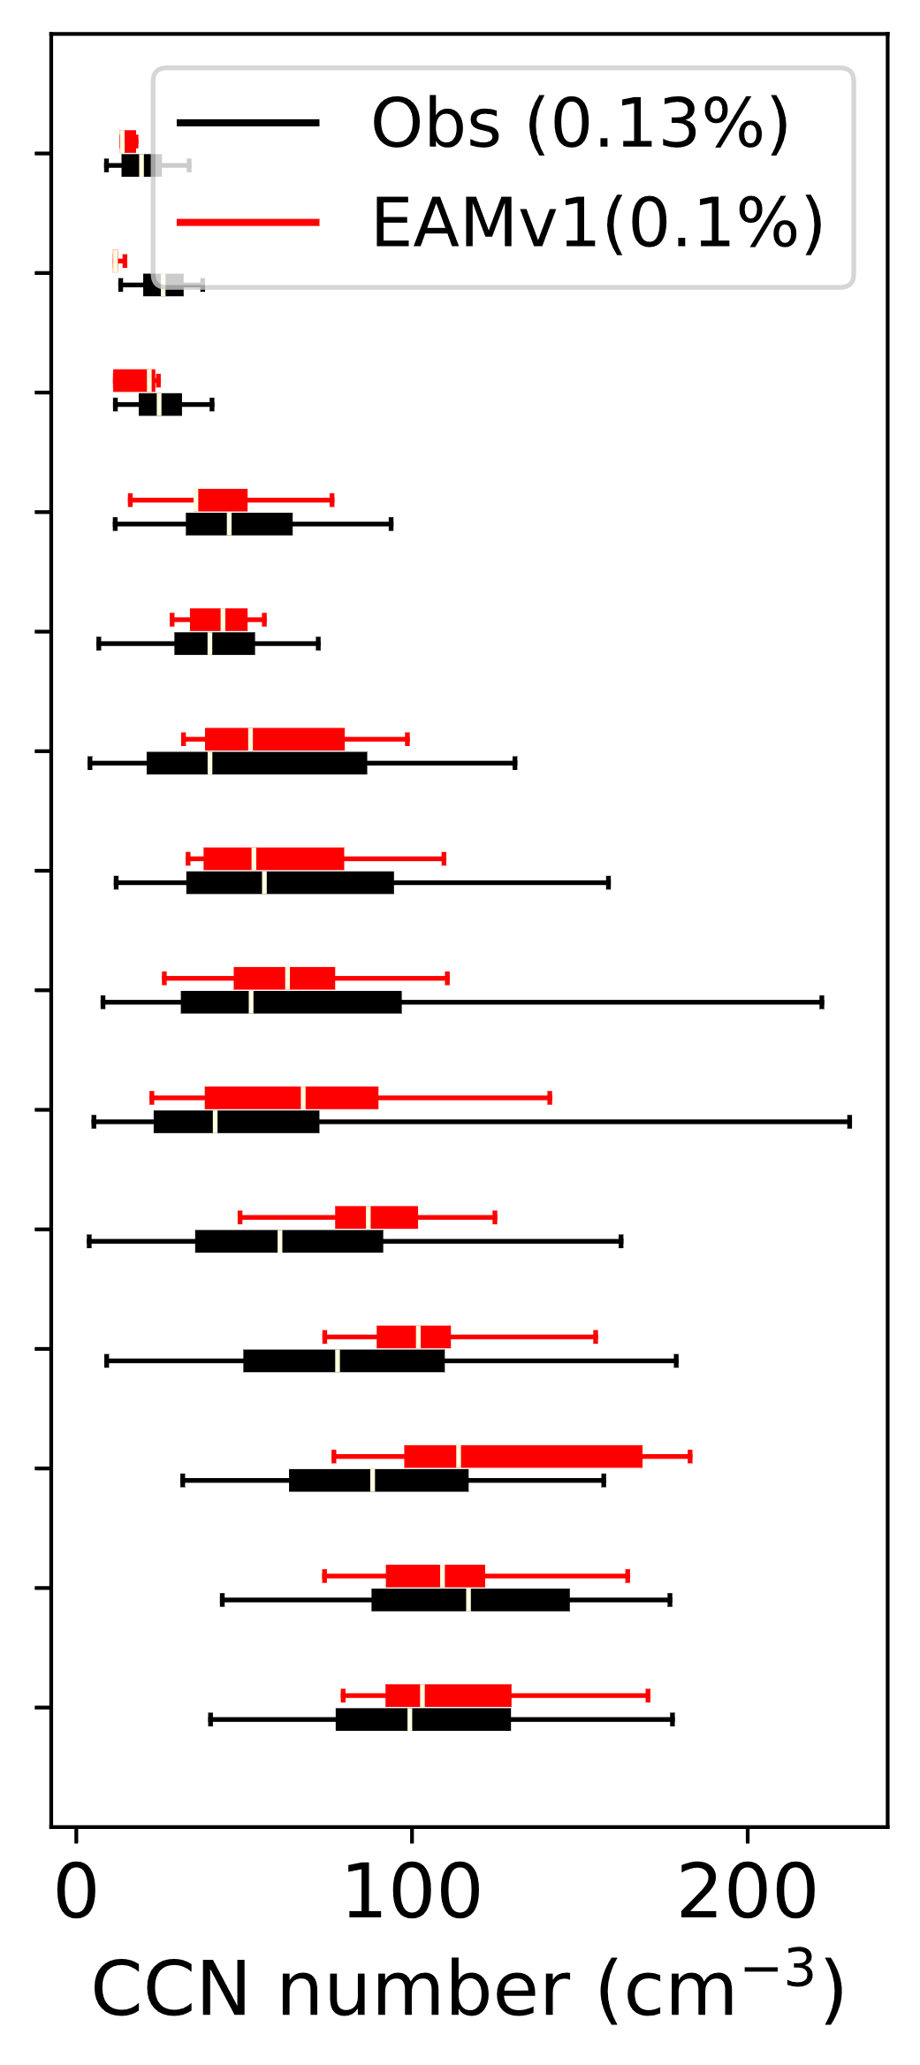
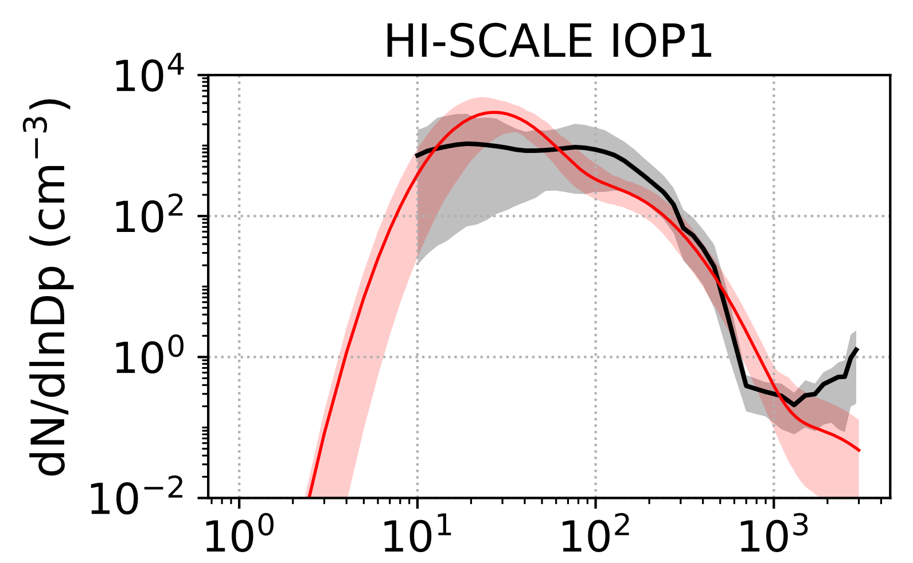
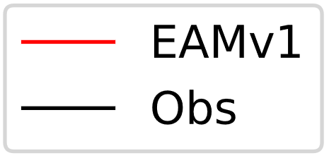
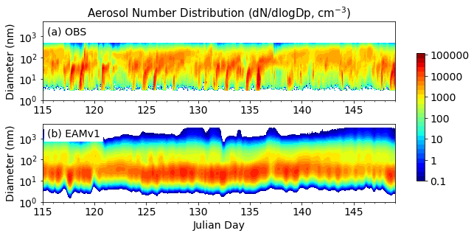
Tutorial Overview
Mean aerosol size distribution
How to download and install it?
How to get prepared observational data?
How to prepare E3SM output?
How to make diagnostics plots and metrics?
References and links
Diameter (nm)

Slide 4
How to download and install it?
Download code from github:
https://github.com/eagles-project/ESMAC_diags
or clone it in a terminal:
> git clone https://github.com/eagles-project/ESMAC_diags
This code is best run using a conda virtual environment. To install it (example shows for NERSC super computer):
    > cd ESMAC_diags/
    > conda env create -f environment.yml
    > conda activate esmac_diags
    > pip install -e .
Use the branch for this tutorial:
> git checkout -b esmac_diags_tutorial origin/esmac_diags_tutorial

Slide 5
How to get prepared observational data?
All the observational data can be downloaded from ARM and other agencies. Information of all observational data can be found in README_ESMAC_Diags_v2.0.0.pdf (on github).
The input observational data are processed, quality-controlled, and changed time resolution (median, mean or interpolate) to facilitate evaluation of E3SM output.
All prepared observational data are currently available on NERSC (temporarily): /global/cscratch1/sd/sqtang/EAGLES/ESMAC_Diags_v2/prep_data/. We are working with ARM to release it as a data bundle, or archive in public repository.
If you have other observations to include, or want to revise the preparation process, you can revise the source code and run prep_* script as following:
    > cd scripts
    > python prep_HISCALE_allobs.py
    (source code are under src/esmac_diags/preprocessing/)

Slide 6
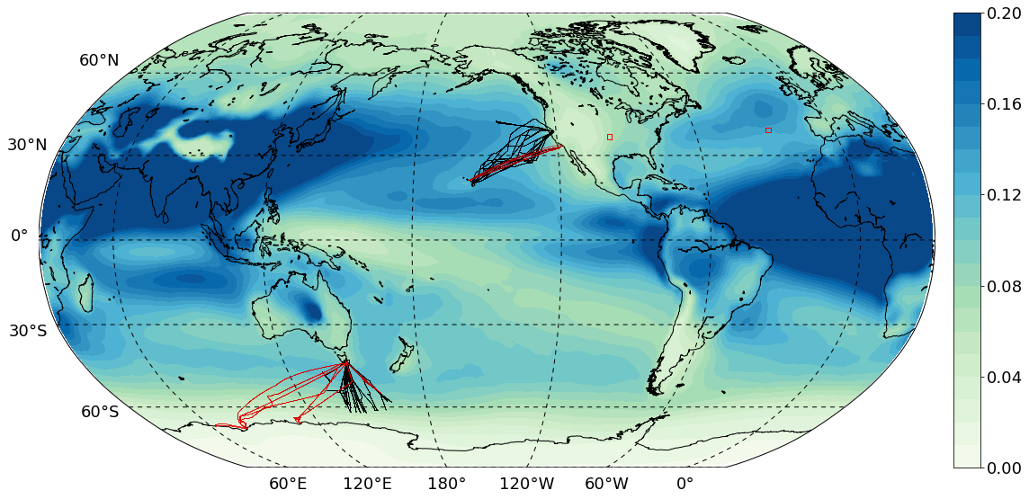
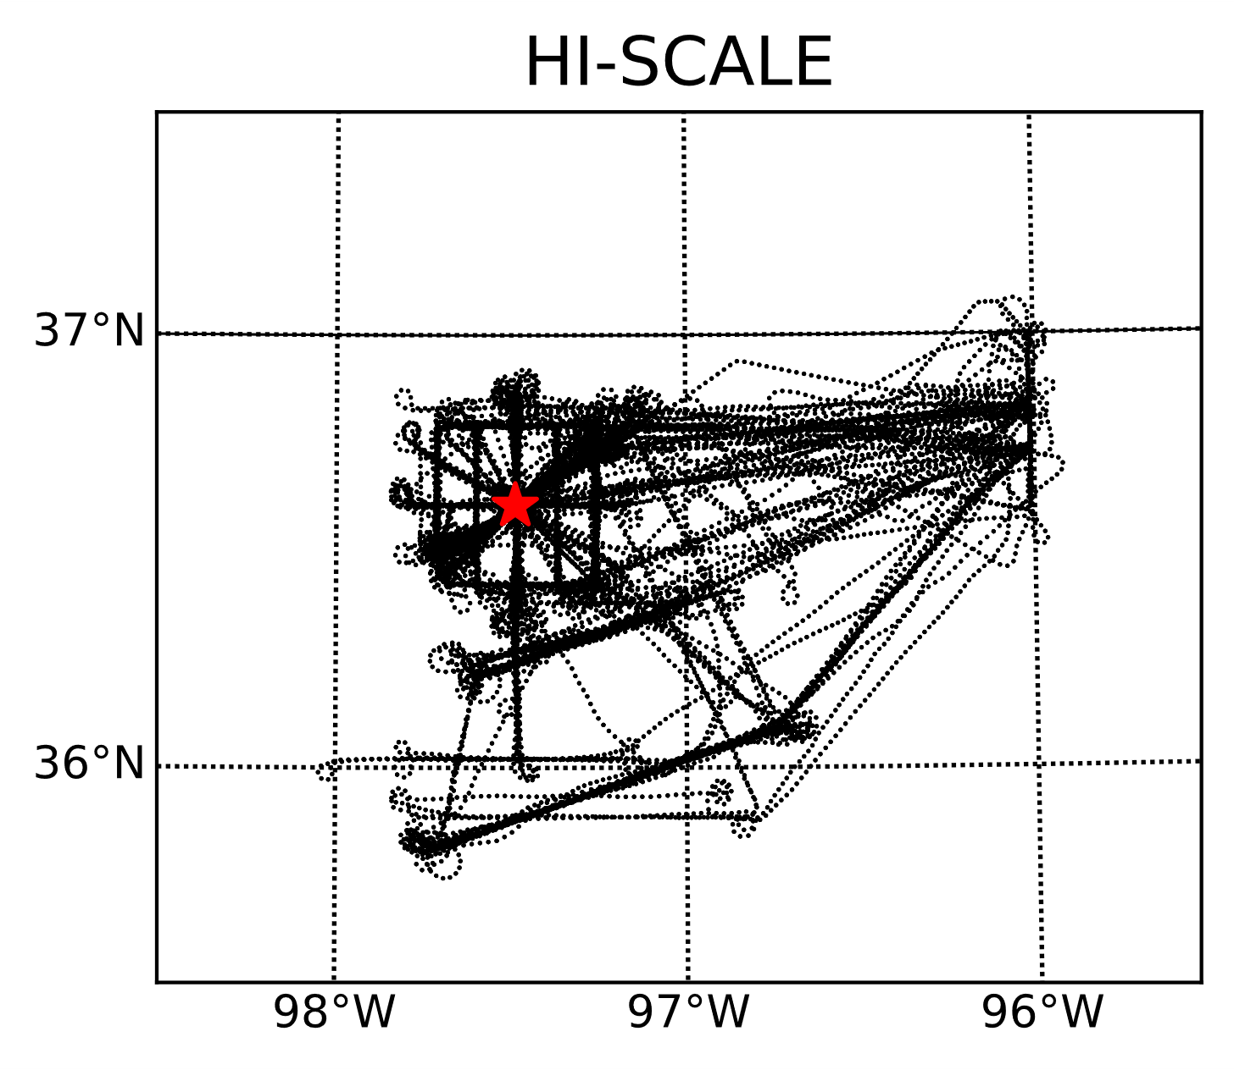
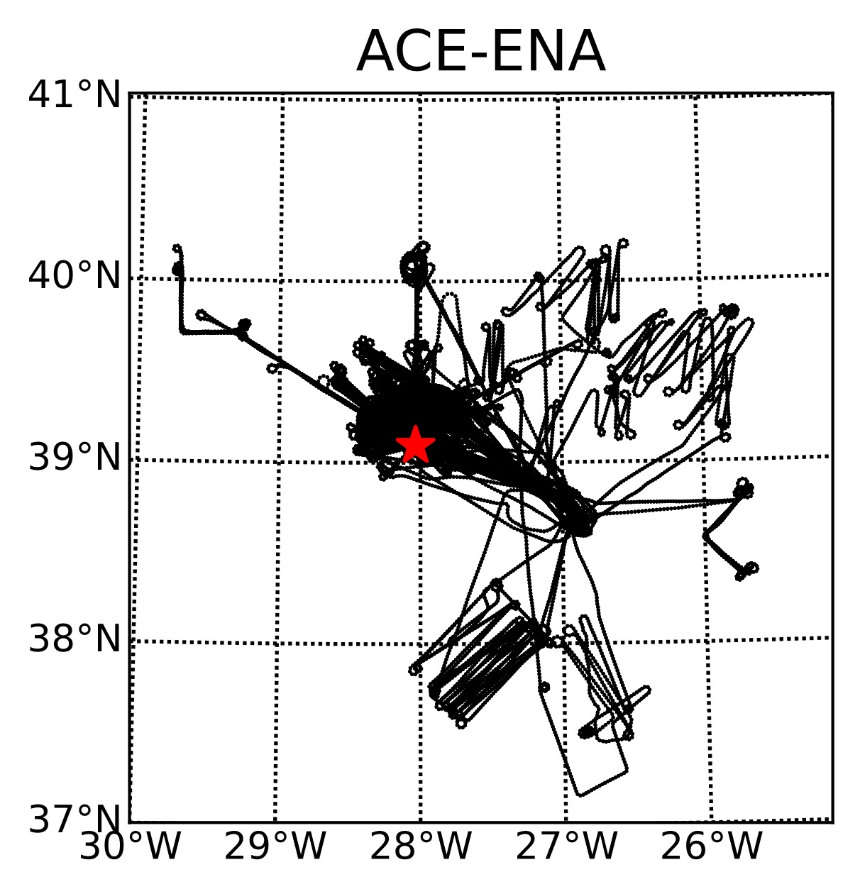
Field campaigns currently included in ESMAC Diags
CSET
MAGIC
MARCUS
SOCRATES
Aircraft (black) and ship (red) tracks of the six field campaigns. Overlaid shading is mean AOD in E3SM

Slide 7
Descriptions of the field campaigns used in this study. Numbers after aircraft or ship represent number of flights or ship trips in each field campaign or IOP.
 | Period | Measuring platform | Cloud/Aerosol properties | Reference
HI-SCALE | IOP1: 24 Apr – 21 May 2016 IOP2: 28 Aug – 24 Sep 2016 | Ground, aircraft (IOP1: 17, IOP2: 21) | Continental shallow cumulus clouds | (Fast et al. 2019)
ACE-ENA | IOP1: 21 Jun – 20 Jul 2017 IOP2: 15 Jan – 18 Feb 2018 | Ground, aircraft (IOP1: 20, IOP2: 19) | Marine PBL clouds | (Wang et al., 2021)
MAGIC | Oct 2012 – Sep 2013 | Ship (18) | Stratocumulus to cumulus transition | (Lewis and Teixeira 2015; Zhou et al. 2015)
CSET | 1 Jul – 15 Aug 2015 | Aircraft (16) | Same as above | (Albrecht et al. 2019)
MARCUS | Oct 2017 – Apr 2018 | Ship (4) | Pristine region with low aerosol loading | (McFarquhar et al. 2021)
SOCRATES | 15 Jan – 24 Feb 2018 | Aircraft (14) | Same as above | (McFarquhar et al. 2021)
ESMAC Diags v2 will also include long-term diagnostics at
SGP (2011-2020) and ENA (2016-2018)

Slide 8
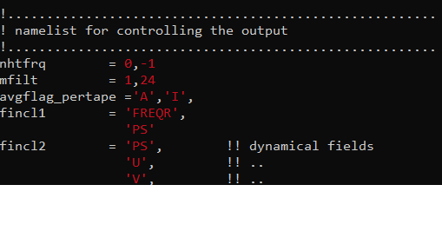
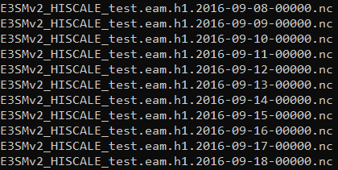
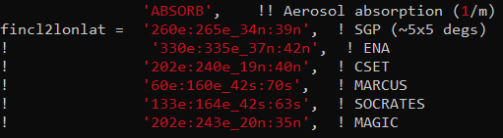
How to prepare E3SM output?
(1) E3SM simulation
High-frequency (e.g., hourly) E3SM output is needed for diagnostics in ESMAC Diags
A full list of variables needed in output is included in the README PDF file (or contact me)
E3SM output needed in ESMAC Diags
Only output hourly data in campaign region

Slide 9

How to prepare E3SM output?
(2) prepare E3SM data
run prep_* script to prepare observational data
    > cd scripts
    > python prep_HISCALE_E3SM.py
    (source code are under src/esmac_diags/preprocessing/)
E3SM output at the nearest grid and time along aircraft track.
Vertical profiles (in pressure and height coordinates) for U, V, T, Q, RH, CLOUD, etc.
Single-level variables, including surface/TOA and column-integrated variables

Slide 10
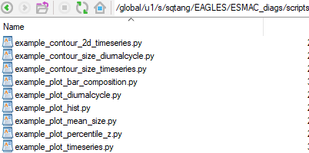
How to make diagnostics plots and metrics?
If you use conda virtual environment, every time when you re-open the terminal, you need to re-activate the package:
> conda activate esmac_diags
Example diagnostics scripts are given in ESMAC_diags/scripts/
Hand-on exercise on diagnostics plots at:
ESMAC_diags/ESMAC_Diags_tutorial_case/scripts/

Slide 11
Useful links and references
ESMAC Diags github: https://github.com/eagles-project/ESMAC_diags
include source code and detailed README file
Reference on ESMAC Diags v1:
Tang, S., Fast, J. D., Zhang, K., Hardin, J. C., Varble, A. C., Shilling, J. E., Mei, F., Zawadowicz, M. A., and Ma, P.-L.: Earth System Model Aerosol–Cloud Diagnostics (ESMAC Diags) package, version 1: assessing E3SM aerosol predictions using aircraft, ship, and surface measurements, Geosci. Model Dev., 15, 4055–4076, https://doi.org/10.5194/gmd-15-4055-2022, 2022.
E3SM information and guidance:
https://e3sm.org/
https://github.com/E3SM-Project/E3SM
Questions or comments: Shuaiqi Tang (shuaiqi.tang@pnnl.gov)

