Slide 1
SuperLU: Application highlight in fusion energy research
(CEMM SciDAC application)
A new fusion reactor ITER is being constructed in France, which is used to study how to harness fusion, creating clean energy using nearly inexhaustible hydrogen as the fuel. If successful, ITER will produce 10 times as much energy than it uses — but that success hinges on accurately designing the device.
  One major simulation goal is to predict microscopic MHD instabilities of burning plasma in ITER. Efficiency of the fusion configuration increases with the ratio of thermal and magnetic pressures, but the MHD instabilities are more likely with higher ratio.
  This involves solving extended and nonlinear Magnetohydrodynamics equations. These are truly multiphysics simulations involving several coupled PDEs: continuity, Maxwell, momentum, electron energy, ion energy, etc. They are also of multiscale with extremely wide range of time and spatial scales, and high anisotropy. Therefore, the discretized linear systems are indefinite and very ill-conditioned.
  Two fluid-based codes have been developed, using different finite element discretization methods: M3D-C1 (Steve Jardin et al. PPPL), and NIMROD (Carl Sovinec, Univ. Wisconsin, and others)
SuperLU_DIST has been used in the production codes. For example, the NIMROD simulation time was improved from 3 weeks to 3 days, compared to using some preconditioned iterative solvers. In many iterations of nonlinear solver, the largest linear systems are of dimension 500K, complex and nonsymmetric.
Notes:
The left plot shows parallel electrical current density in a full 3D computation. This reveals the fine details of the little crescent that rotates as it goes around the torus, showing that the perturbation is large enough to alter the magnetic topology. The right plot shows the plasma particle drift orbits in a typical configuration.

Slide 2
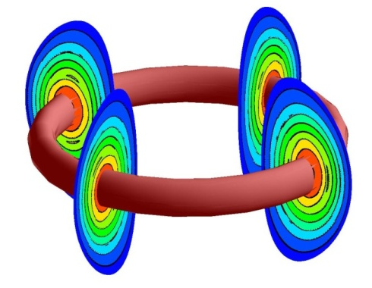
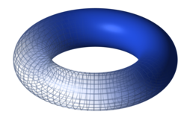
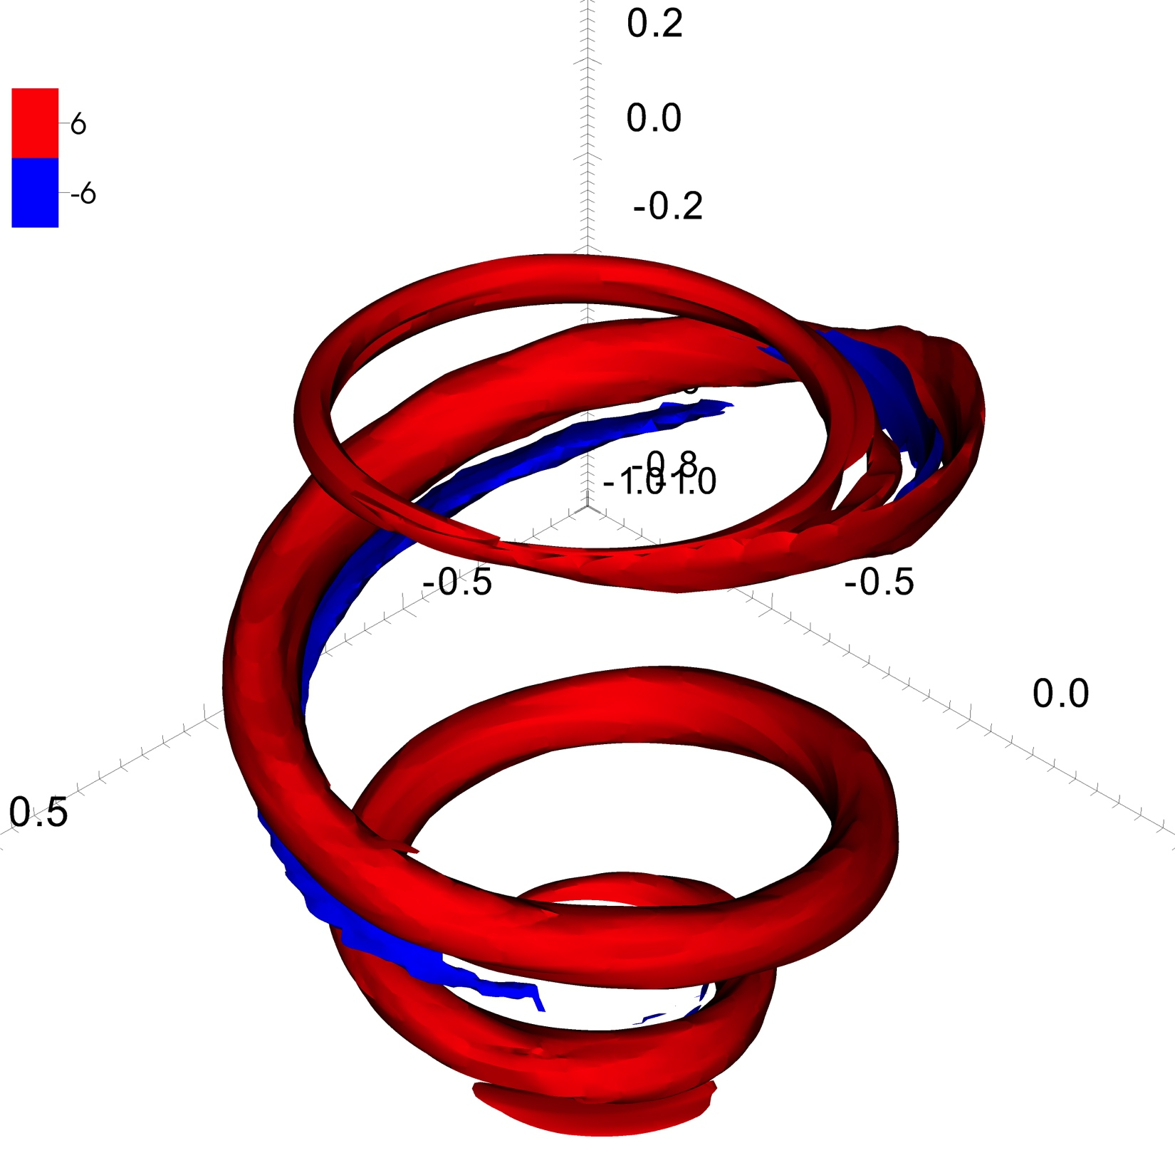
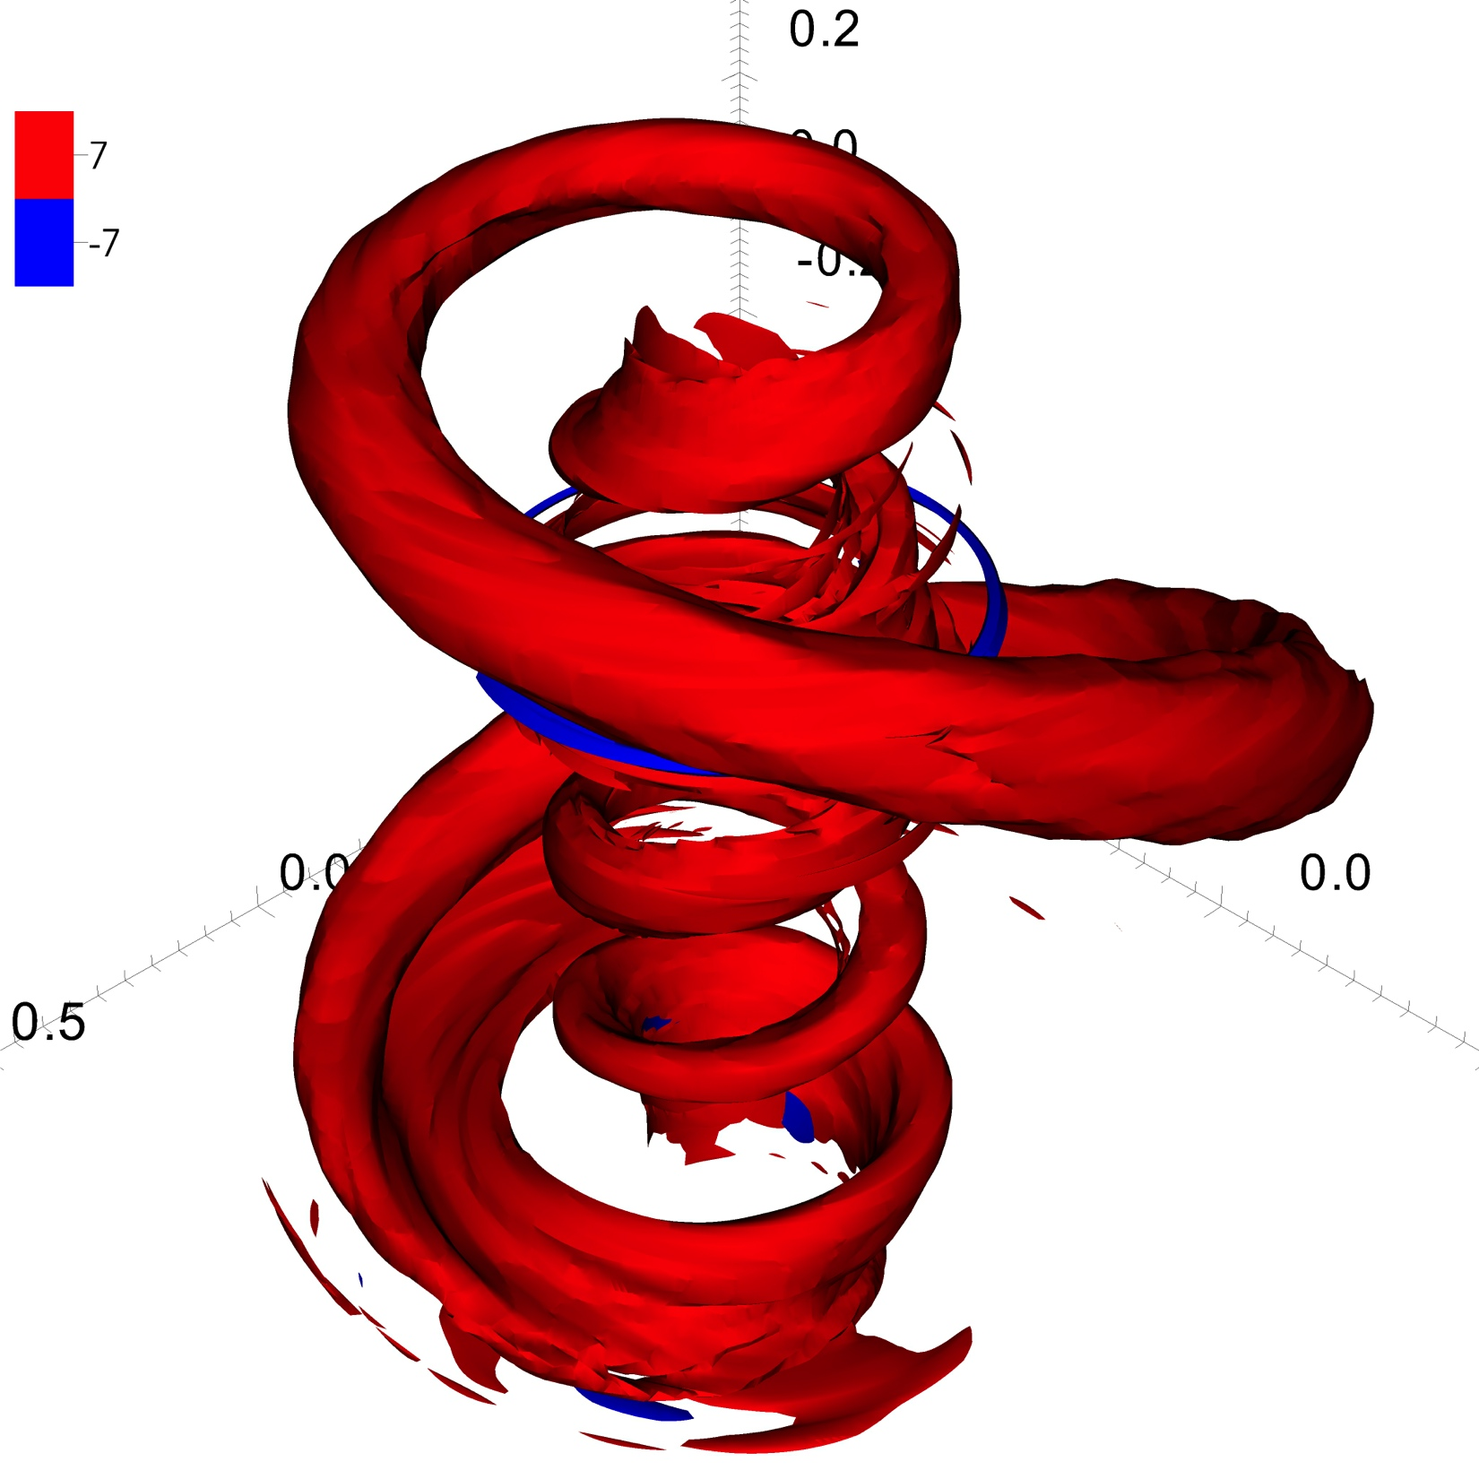
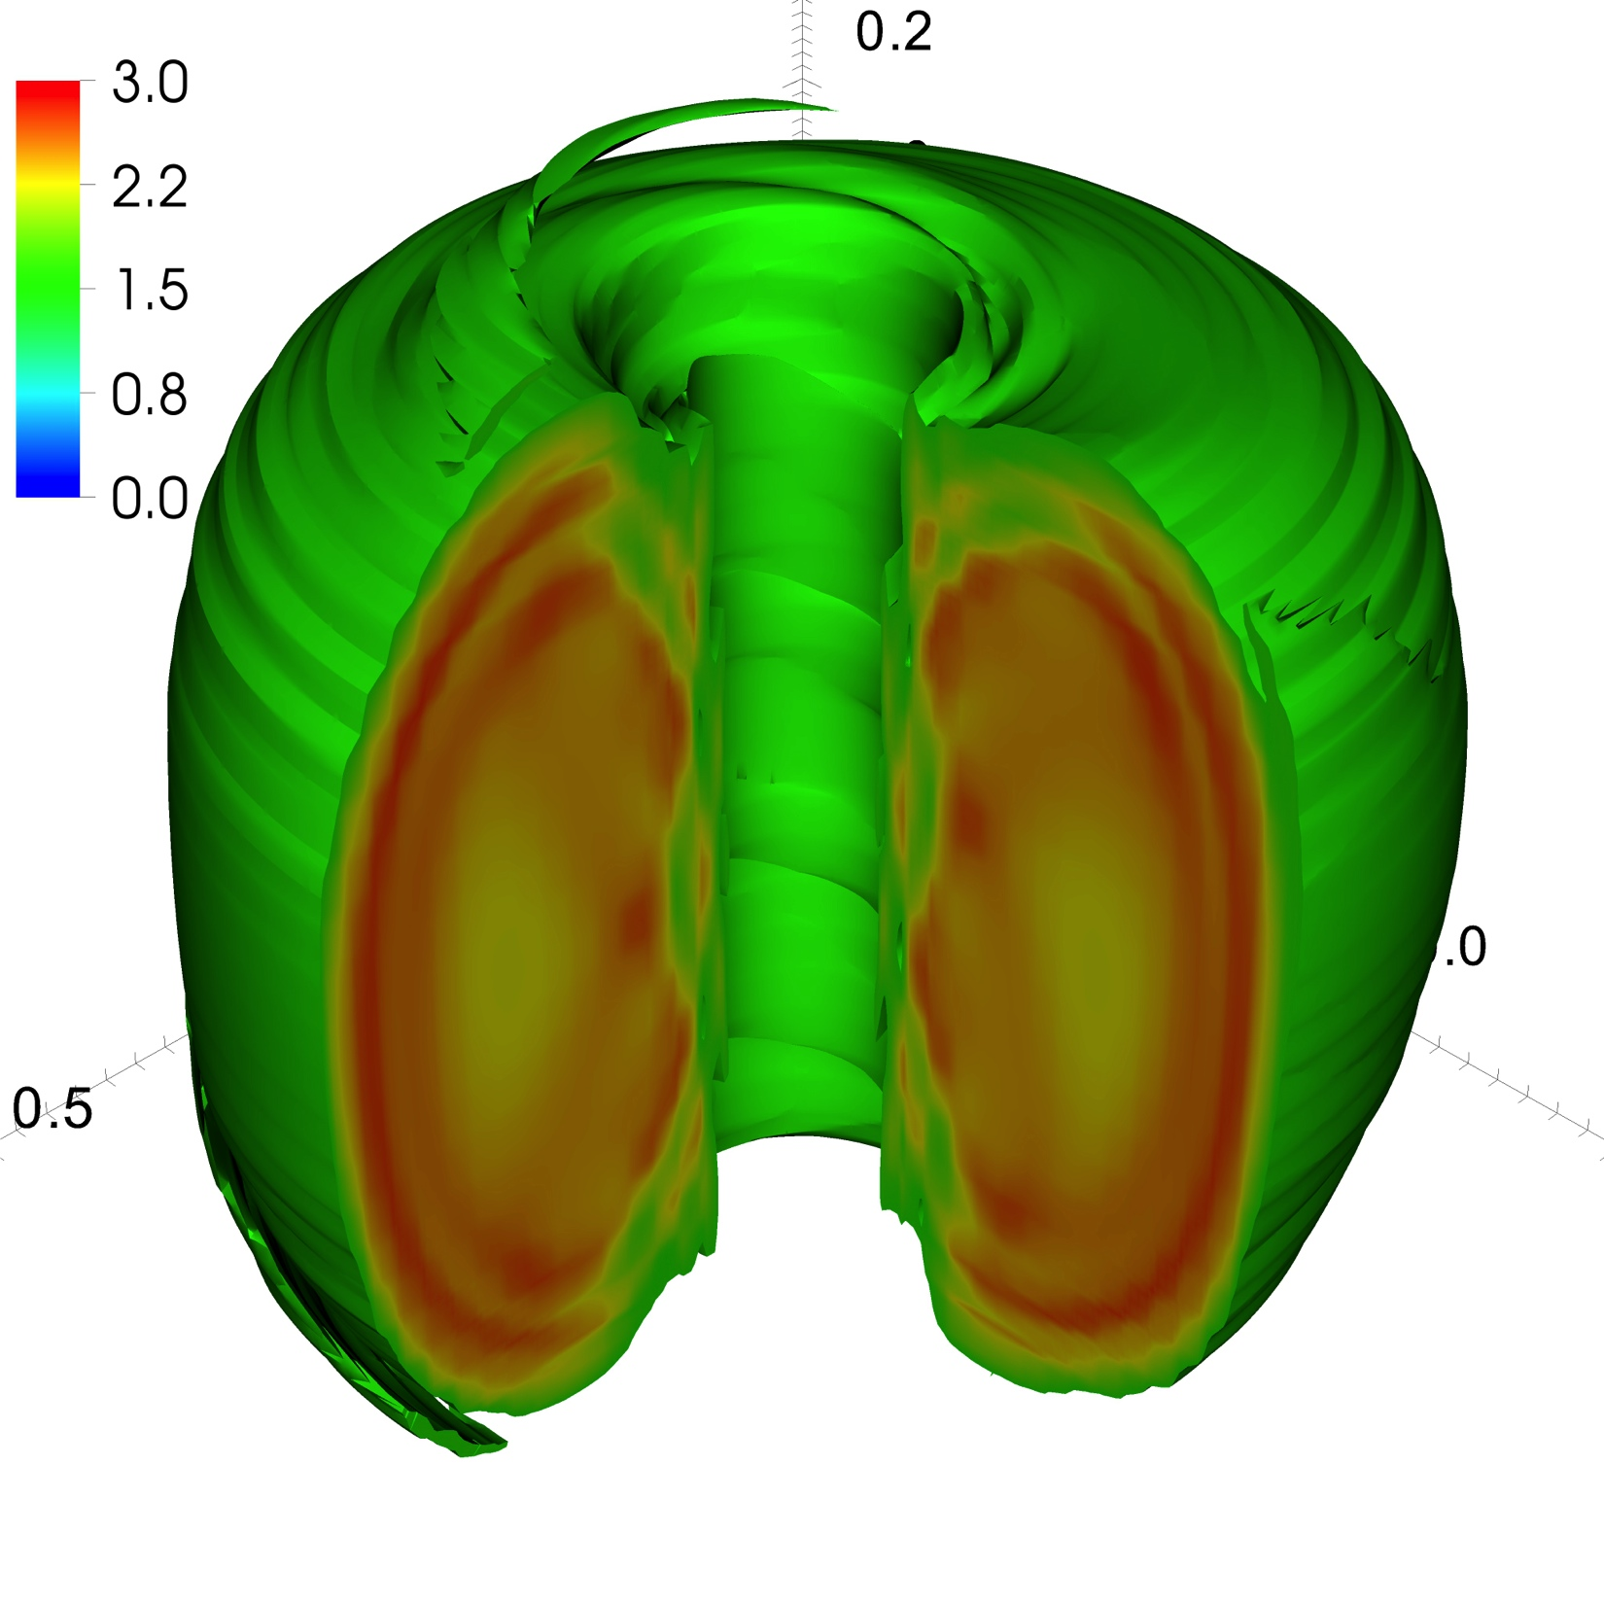
SuperLU: Application highlight in fusion energy research
M3D-C1 – implicit scheme with high-order high-continuity finite elements
  Left plot shows the 3D torus with strong magnetic field in toroidal direction (ϕ), using quintic (Q₁₈) triangular FEM discretization.
  Middle plot shows parallel electrical current density in a full 3D computation. This reveals the fine details of the little crescent that rotates as it goes around the torus, showing that the perturbation is large enough to alter the magnetic topology.
  Right plot shows the plasma particle drift orbits in a typical configuration.
Z
ϕ
R
NIMROD – spectral finite element discretization in two dimensions, finite Fourier series in the third dimension.
  Pictures show evolution (early -> later -> decay) of electrical current density, parallel to magnetic field, in the Pegasus Toroidal Experiment at the University of Wisconsin-Madison, simulated by John O'Bryan with the NIMROD 3D magnetohydrodynamics code [Carl Sovinec and John O'Bryan].
Notes:
The left plot shows parallel electrical current density in a full 3D computation. This reveals the fine details of the little crescent that rotates as it goes around the torus, showing that the perturbation is large enough to alter the magnetic topology. The right plot shows the plasma particle drift orbits in a typical configuration.

