Slide 1
Lecture 4 Sparse Factorization: Data-flow Organization
4th Gene Golub SIAM Summer School, 7/22 – 8/7, 2013, Shanghai
Xiaoye Sherry Li
Lawrence Berkeley National Laboratory, USA
xsli@lbl.gov
crd-legacy.lbl.gov/~xiaoye/G2S3/
Notes:
July 13, TNLIST, Tsinghua Univ.

Slide 2
Lecture outline
Dataflow organization: left-looking, right-looking
Blocking for high performance
Supernode, multifrontal
Triangular solution
Notes:
Gilbert lecture (DAG model),
my vecpar paper, refer to DAG model

Slide 3
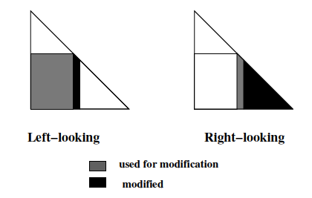
Dense Cholesky
Left-looking Cholesky
for k = 1,…,n do
for i = k,…,n do
for j = 1,…k-1 do
end for
end for
for i = k+1,…,n do
end for
end for
Right-looking Cholesky
for k = 1,…,n do
for i = k+1,…,n do
for j = k+1,…,i do
end for
end for
end for
Notes:
Add pictures from Sparse.pdf

Slide 4
Sparse Cholesky
Reference case: regular 3 x 3 grid ordered by nested dissection. Nodes in the separators are ordered last
Notation:
cdiv(j) : divide column j by a scalar
cmod(j, k) : update column j with column k
struct(L(1:k), j)) : the structure of L(1:k, j) submatrix
1
2
3
4
5
6
7
8
9
1
4
9
1
G(A)
7
2
T(A)
8
3
3
8
6
4
7
5
2
5
3
6
6
9
1
4
7
2
5
8
9
A
Notes:
Picture from Sparse.pdf

Slide 5
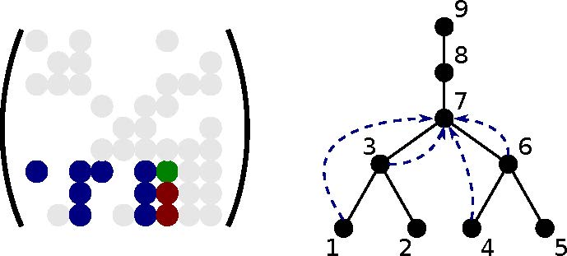
Sparse left-looking Cholesky
for j = 1 to n do
for k in struct(L(j, 1 : j-1)) do
cmod(j, k)
end for
cdiv(j)
end for
Before variable j is eliminated, column j is updated with all the columns that have a nonzero on row j. In the example above, struct(L(7,1:6)) = {1; 3; 4; 6}.
This corresponds to receiving updates from nodes lower in the subtree rooted at j
The filled graph is necessary to determine the structure of each row

Slide 6
Sparse right-looking Cholesky
for k = 1 to n do
cdiv(k)
for j in struct(L(k+1 : n, k)) do
cmod(j,k)
end for
end for
After variable k is eliminated, column k is used to update all the columns corresponding to nonzeros in column k. In the example above, struct(L(4:9,3))={7; 8; 9}.
This corresponds to sending updates to nodes higher in the elimination tree
The filled graph is necessary to determine the structure of each column

Slide 7
Sparse LU
Left-looking: many more reads than writes
U(1:j-1, j) = L(1:j-1, 1:j-1) \ A(1:j-1, j)
for j = 1 to n do
for k in struct(U(1:j-1, j)) do
cmod(j, k)
end for
cdiv(j)
end for
Right-looking: many more writes than reads
for k = 1 to n do
cdiv(k)
for j in struct(U(k, k+1:n)) do
cmod(j, k)
end for
end for
j
U
U
A
DONE
j
L
L
A
NOT
TOUCHED
DONE
ACTIVE
ACTIVE

Slide 8
High Performance Issues: Reduce Cost of Memory Access & Communication
Blocking to increase number of floating-point operations performed for each memory access
Aggregate small messages into one larger message
Reduce cost due to latency
Well done in LAPACK, ScaLAPACK
Dense and banded matrices
Adopted in the new generation sparse software
Performance much more sensitive to latency in sparse case

Slide 9
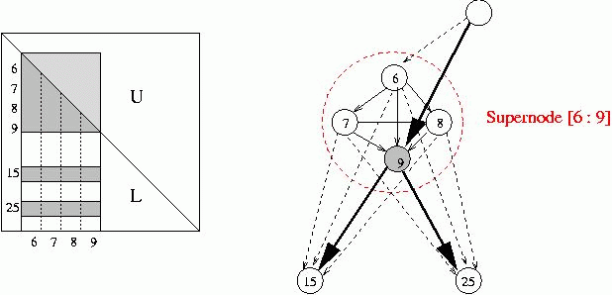
Blocking: supernode
Use (blocked) CRS or CCS, and any ordering method
Leave room for fill-ins ! (symbolic factorization)
Exploit “supernodal” (dense) structures in the factors
Can use Level 3 BLAS
Reduce inefficient indirect addressing (scatter/gather)
Reduce graph traversal time using a coarser graph

Slide 10
Nonsymmetric supernodes
1
1
2
2
3
3
4
4
5
5
6
6
7
7
8
8
9
9
10
10
Original matrix A
Factors L+U

Slide 11
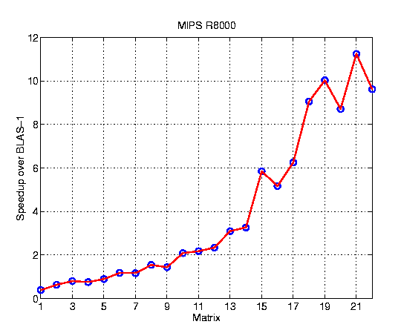
SuperLU speedup over unblocked code
Sorted in increasing “reuse ratio” = #Flops/nonzeros
~ Arithmetic Intensity
Up to 40% of machine peak on large sparse matrices on IBM RS6000/590, MIPS R8000

Slide 12
Symmetric-pattern multifrontal factorization [John Gilbert’s lecture]
1
4
G(A)
7
3
6
1
2
3
4
5
6
7
8
9
8
1
2
2
5
9
3
4
9
5
6
T(A)
8
7
7
8
3
6
9
1
2
4
5
A

Slide 13
Symmetric-pattern multifrontal factorization
1
4
G(A)
7
For each node of T from leaves to root:
Sum own row/col of A with children’s Update matrices into Frontal matrix
Eliminate current variable from Frontal matrix, to get Update matrix
Pass Update matrix to parent
3
6
8
2
5
9
9
T(A)
8
7
3
6
1
2
4
5

Slide 14
Symmetric-pattern multifrontal factorization
1
4
For each node of T from leaves to root:
Sum own row/col of A with children’s Update matrices into Frontal matrix
Eliminate current variable from Frontal matrix, to get Update matrix
Pass Update matrix to parent
G(A)
7
3
6
8
2
5
9
9
T(A)
8
1
3
7
3
7
1
3
7
3
7
3
6
7
1
2
4
5
F₁ = A₁
=> U₁

Slide 15
Symmetric-pattern multifrontal factorization
1
4
For each node of T from leaves to root:
Sum own row/col of A with children’s Update matrices into Frontal matrix
Eliminate current variable from Frontal matrix, to get Update matrix
Pass Update matrix to parent
7
G(A)
3
6
8
2
5
9
9
T(A)
8
1
3
7
3
7
2
3
9
3
9
1
3
2
3
7
3
3
7
9
3
6
7
9
1
2
4
5
F₁ = A₁
=> U₁
F₂ = A₂
=> U₂

Slide 16
Symmetric-pattern multifrontal factorization
1
4
7
G(A)
3
7
8
9
3
6
3
7
8
9
8
7
7
2
5
8
9
8
9
9
F₃ = A₃+U₁+U₂
=> U₃
9
T(A)
8
1
3
7
3
7
2
3
9
3
9
1
3
2
3
7
3
3
7
9
3
6
7
9
1
2
4
5
F₁ = A₁
=> U₁
F₂ = A₂
=> U₂

Slide 17
Symmetric-pattern multifrontal factorization
1
4
7
1
2
3
4
5
6
7
8
9
G⁺(A)
3
6
1
8
2
2
3
5
9
4
5
6
9
7
T(A)
8
8
7
9
3
6
L+U
1
2
4
5

Slide 18
Symmetric-pattern multifrontal factorization
variant of right-looking
Really uses supernodes, not nodes
All arithmetic happens on dense square matrices.
Needs extra memory for a stack of pending update matrices
Potential parallelism:
between independent tree branches
parallel dense ops on frontal matrix
1
4
7
G(A)
3
6
8
2
5
9
9
T(A)
8
7
3
6
1
2
4
5

Slide 19
Sparse triangular solution
Forward substitution for x = L \ b (back substitution for x = U \ b)
Row-oriented = dot-product = left-looking
for i = 1 to n do x(i) = b(i);
// dot-product
for j = 1 to i-1 do
x(i) = x(i) – L(i, j) * x(j); end for x(i) = x(i) / L(i, i);
end for

Slide 20
Sparse triangular solution: x = L \ b
column-oriented = saxpy = right-looking
Either way works in O(nnz(L)) time
x(1:n) = b(1:n);
for j = 1 to n do x(j) = x(j) / L(j, j);
// saxpy
x(j+1:n) = x(j+1:n) – L(j+1:n, j) * x(j);
end for

Slide 21
Sparse right-hand side: x = L \ b, b sparse
Use Directed Acyclic Graph (DAG)
1
2
4
7
5
3
6
A
G(A)
If A is triangular, G(A) has no cycles
Lower triangular => edges directed from higher to lower #s
Upper triangular => edges directed from lower to higher #s

Slide 22
Sparse right-hand side: x = L \ b, b sparse
b is sparse, x is also sparse, but may have fill-ins
1
2
3
4
5
1
=
2
3
5
L
x
b
4
G(L^{T})
Symbolic:
Predict structure of x by depth-first search from nonzeros of b
Numeric:
Compute values of x in topological order
Time = O(flops)

Slide 23
Recall: left-looking sparse LU
sparse right-hand side
U(1:j-1, j) = L(1:j-1, 1:j-1) \ A(1:j-1, j)
for j = 1 to n d
for k in struct(U(1:j-1, j)) do
cmod(j, k)
end for
cdiv(j)
end for
j
U
A
L
NOT
TOUCHED
DONE
ACTIVE
Used in symbolic factorization to find nonzeros in column j

Slide 24
References
M.T. Heath, E. Ng., B.W. Peyton, “Parallel Algorithms for Sparse Linear Systems”, SIAM Review, Vol. 33 (3), pp. 420-460, 1991.
E. Rothberg and A. Gupta, “Efficient Sparse Matrix Factorization on High-Performance Workstations--Exploiting the Memory Hierarchy”, ACM. Trans. Math, Software, Vol. 17 (3), pp. 313-334, 1991
E. Rothberg and A. Gupta, “An Efficient Block-Oriented Approach to Parallel Sparse Cholesky Factorization, SIAM J. Sci. Comput., Vol. 15 (6), pp. 1413-1439, 1994.
J. W. Demmel, S. C. Eisenstat, J. R. Gilbert, X. S. Li, and J. W.H. Liu, “A Supernodal Approach to Sparse Partial Pivoting'’, SIAM J. Matrix Analysis and Applications, vol. 20 (3), pp. 720-755, 1999.
J. W. H. Liu, “The Multifrontal Method for Sparse Matrix Solution: theory and Practice”, SIAM Review, Vol. 34 (1), pp. 82-109, 1992.

Slide 25
Exercises
Study and run the OpenMP code of dense LU factorization in Hands-On-Exercises/ directory

