Slide 1
Lecture 5
Parallel Sparse Factorization, Triangular Solution
4th Gene Golub SIAM Summer School, 7/22 – 8/7, 2013, Shanghai
Xiaoye Sherry Li
Lawrence Berkeley National Laboratory, USA
xsli@lbl.gov
crd-legacy.lbl.gov/~xiaoye/G2S3/

Slide 2
Lecture outline
Shared-memory
Distributed-memory
Distributed-memory triangular solve
Collection of sparse codes, sparse matrices

Slide 3
SuperLU_MT [Li, Demmel, Gilbert]
Pthreads or OpenMP
Left-looking – relatively more READs than WRITEs
Use shared task queue to schedule ready columns in the elimination tree (bottom up)
Over 12x speedup on conventional 16-CPU SMPs (1999)
P₁ P₂
U
A
P2
L
P1
DONE
WORKING
NOT
TOUCHED
DONE
WORKING
Notes:
No notion of processor assignment, as long as do not violate the dependencies
RESULTS: vecpar 2008 paper

Slide 4
Benchmark matrices
 | apps | dim | nnz(A) | SLU_MT Fill | SLU_DIST Fill | Avg. S-node
g7jac200 | Economic model | 59,310 | 0.7 M | 33.7 M | 33.7 M | 1.9
stomach | 3D finite diff. | 213,360 | 3.0 M | 136.8 M | 137.4 M | 4.0
torso3 | 3D finite diff. | 259,156 | 4.4 M | 784.7 M | 785.0 M | 3.1
twotone | Nonlinear analog circuit | 120,750 | 1.2 M | 11.4 M | 11.4 M | 2.3
Notes:
SLU_MT “Symmetric Mode”
ordering on A+A’
pivot on main diagonal

Slide 5
Multicore platforms
Intel Clovertown (Xeon 53xx)
  2.33 GHz Xeon, 9.3 Gflops/core
  2 sockets x 4 cores/socket
  L2 cache: 4 MB/2 cores
Sun Niagara 2 (UltraSPARC T2):
  1.4 GHz UltraSparc T2, 1.4 Gflops/core
  2 sockets x 8 cores/socket x 8 hardware threads/core
  L2 cache shared: 4 MB
Notes:
Reasons:
left vs. right-looking (read vs. write), write bandwidth is half of read
Niagara 2 == VictoriaFalls

Slide 6
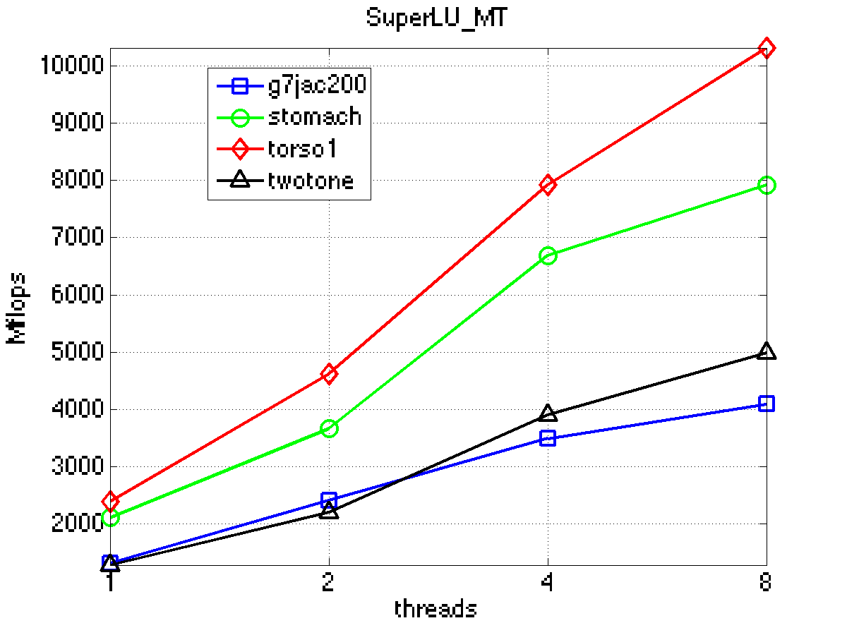
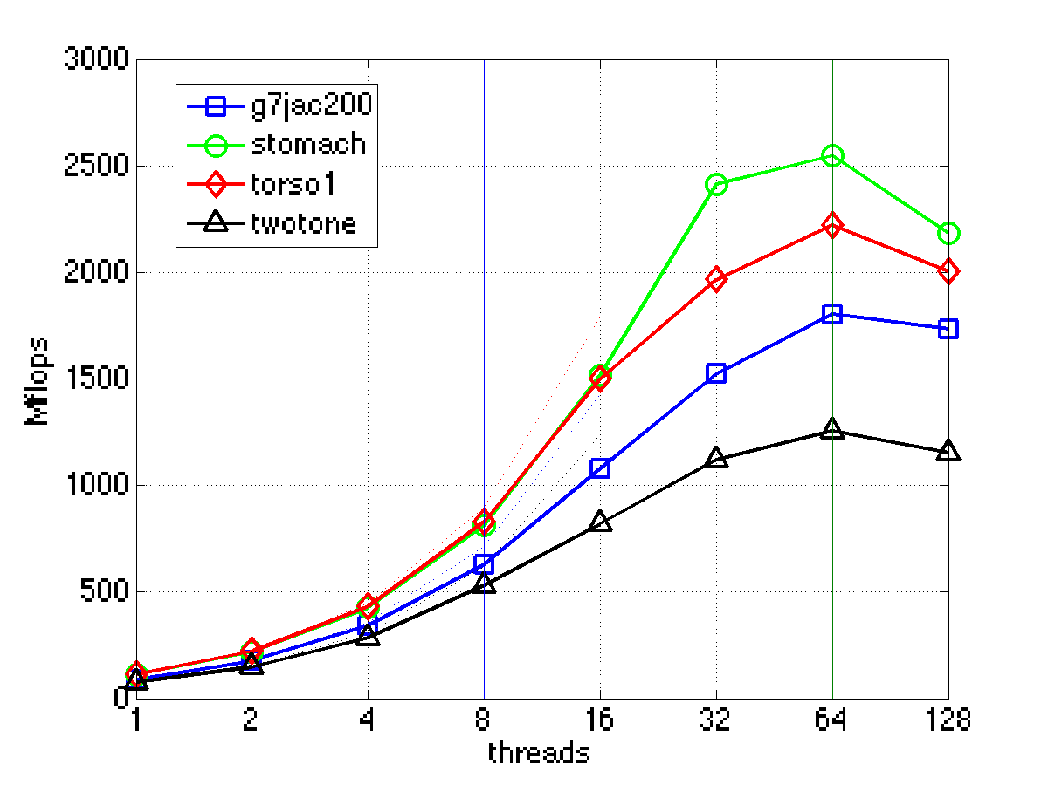
Intel Clovertown, Sun Niagara 2
Maximum speed up 4.3 (Intel), 20 (Sun)
Question: tools to analyze resource contention?
Notes:
The overhead of the scheduling algorithm, synchronization using mutexes (locks) are small.

Slide 7
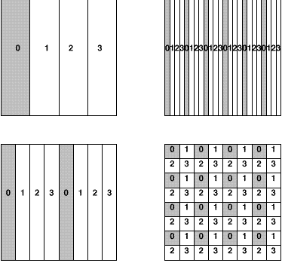
Matrix distribution on large distributed-memory machine
2D block cyclic recommended for many linear algebra algorithms
  Better load balance, less communication, and BLAS-3
1D blocked
1D cyclic
1D block cyclic
2D block cyclic

Slide 8
2D Block Cyclic Distr. for Sparse L & U
SuperLU_DIST : C + MPI
Right-looking – relatively more WRITEs than READs
2D block cyclic layout
Look-ahead to overlap comm. & comp.
Scales to 1000s processors
Matrix
Process(or) mesh
0
1
2
0
1
2
0
0
1
2
3
4
5
3
4
5
3
3
4
5
0
1
2
0
1
2
0
3
4
5
3
4
5
3
0
1
2
0
1
2
0
3
4
5
3
4
5
3
0
1
2
0
1
2
0
ACTIVE

Slide 9
SuperLU_DIST: GE with static pivoting
[Li, Demmel, Grigori, Yamazaki]
Target: Distributed-memory multiprocessors
Goal: No pivoting during numeric factorization
Permute A unsymmetrically to have large elements on the diagonal (using weighted bipartite matching)
Scale rows and columns to equilibrate
Permute A symmetrically for sparsity
Factor A = LU with no pivoting, fixing up small pivots:
  if |a_{ii}| < ε · ||A|| then replace a_{ii} by ±ε^{1/2} · ||A||
Solve for x using the triangular factors: Ly = b, Ux = y
Improve solution by iterative refinement

Slide 10
Row permutation for heavy diagonal [Duff, Koster]
1
2
3
4
5
1
2
3
4
5
1
1
1
4
2
2
2
5
3
3
3
3
4
1
5
4
4
2
A
5
5
PA
Represent A as a weighted, undirected bipartite graph (one node for each row and one node for each column)
Find matching (set of independent edges) with maximum product of weights
Permute rows to place matching on diagonal
Matching algorithm also gives a row and column scaling
to make all diag elts =1 and all off-diag elts <=1

Slide 11
SuperLU_DIST: GE with static pivoting
[Li, Demmel, Grigori, Yamazaki]
Target: Distributed-memory multiprocessors
Goal: No pivoting during numeric factorization
Permute A unsymmetrically to have large elements on the diagonal (using weighted bipartite matching)
Scale rows and columns to equilibrate
Permute A symmetrically for sparsity
Factor A = LU with no pivoting, fixing up small pivots:
  if |a_{ii}| < ε · ||A|| then replace a_{ii} by ±ε^{1/2} · ||A||
Solve for x using the triangular factors: Ly = b, Ux = y
Improve solution by iterative refinement

Slide 12
SuperLU_DIST: GE with static pivoting
[Li, Demmel, Grigori, Yamazaki]
Target: Distributed-memory multiprocessors
Goal: No pivoting during numeric factorization
Permute A unsymmetrically to have large elements on the diagonal (using weighted bipartite matching)
Scale rows and columns to equilibrate
Permute A symmetrically for sparsity
Factor A = LU with no pivoting, fixing up small pivots:
  if |a_{ii}| < ε · ||A|| then replace a_{ii} by ±ε^{1/2} · ||A||
Solve for x using the triangular factors: Ly = b, Ux = y
Improve solution by iterative refinement

Slide 13
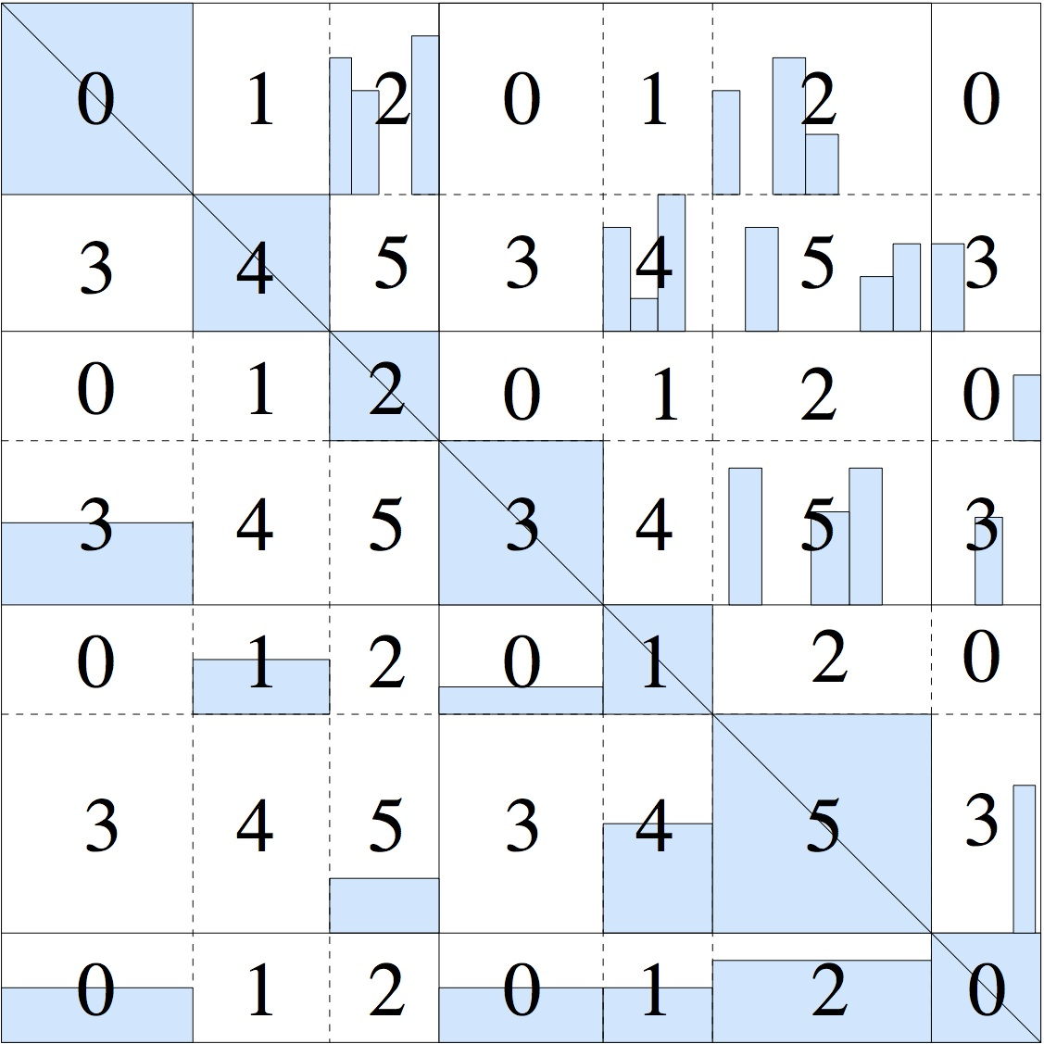
SuperLU_DIST steps to solution
Matrix preprocessing
  static pivoting/scaling/permutation to improve numerical stability and to preseve sparsity
Symbolic factorization
  compute e-tree, structure of LU, static comm. & comp. scheduling
  find supernodes (6-80 cols) for efficient dense BLAS operations
Numerical factorization (dominate)
  Right-looking, outer-product
  2D block-cyclic MPI process grid
Triangular solve with forward, back substitutions
2x3 process grid

Slide 14
SuperLU_DIST right-looking factorization
for j = 1, 2, . . . , Ns (# of supernodes)
// panel factorization (row and column)
- factor A(j,j)=L(j,j)*U(j,j), and ISEND to P_{C}(j) and P_{R}(j)
- WAIT for L_{j,j} and factor row A_{j, j+1:Ns}
and SEND right to P_{C} (:)
- WAIT for U_{j,j} and factor column A_{j+1:Ns, j}
and SEND down to P_{R}(:)
// trailing matrix update
- update A_{j+1:Ns, j+1:Ns}
end for
Scalability bottleneck:
Panel factorization has sequential flow and limited parallelism.
All processes wait for diagonal factorization & panel factorization
2x3 process grid
Notes:
Implementation uses flexible look-ahead
Trailing matrix update has high parallelism, good load-balance, but time-consuming

Slide 15
SuperLU_DIST 2.5 on Cray XE6
Profiling with IPM
Synchronization dominates on a large number of cores
  up to 96% of factorization time
Accelerator (sym), n=2.7M, fill-ratio=12
DNA, n = 445K, fill-ratio= 609

Slide 16
Look-ahead factorization with window size n_{w}
for j = 1, 2, . . . , Ns (# of supernodes)
// look-ahead row factorization
for k = j+1 to j+n_{w} do
if (L_{k,k} has arrived) factor A_{k,(k+1):Ns} and ISEND to P_{C}(:)
end for
// synchronization
- factor A_{j,j} =L_{j,j}U_{j,j}, and ISEND to P_{C}(j) and P_{R}(j)
- WAIT for L_{j,j} and factor row A_{j, j+1:Ns}
- WAIT for L_{:, j} and U_{j, :}
// look-ahead column factorization
for k = j+1 to j+n_{w} do
update A_{:,k}
if ( A_{:,k} is ready ) factor A_{k:Ns,k} and ISEND to P_{R(:)}
end for
// trailing matrix update
- update remaining A _{j+nw+1:Ns, j+nw+1:Ns}
end for
At each j-th step, factorize all “ready” panels in the window
  reduce idle time; overlap communication with computation; exploit more parallelism
Notes:
Implementation uses flexible look-ahead
Trailing matrix update has high parallelism, good load-balance, but time-consuming

Slide 17
Expose more “Ready” panels in window
Schedule tasks with better order as long as tasks dependencies are respected
Dependency graphs:
LU DAG: all dependencies
Transitive reduction of LU DAG: smallest graph, removed all redundant edges, but expensive to compute
Symmetrically pruned LU DAG (rDAG): in between LU DAG and its transitive reduction, cheap to compute
Elimination tree (e-tree):
  symmetric case: e-tree = transitive reduction of Cholesky DAG, cheap to compute
  unsymmetric case: e-tree of |A|^{T}+|A|, cheap to compute

Slide 18
Example: reordering based on e-tree
Window size = 5
Postordering based on depth-first search
Bottomup level-based ordering

Slide 19
SuperLU_DIST 2.5 and 3.0 on Cray XE6
Accelerator (sym), n=2.7M, fill-ratio=12
DNA, n = 445K, fill-ratio= 609
Idle time was significantly reduced (speedup up to 2.6x)
To further improve performance:
  more sophisticated scheduling schemes
  hybrid programming paradigms

Slide 20
Examples
Name | Application | Data type | N | |A| / N Sparsity | |L\U| (10^6) | Fill-ratio
g500 | Quantum Mechanics (LBL) | Complex | 4,235,364 | 13 | 3092.6 | 56.2
matrix181 | Fusion, MHD eqns (PPPL) | Real | 589,698 | 161 | 888.1 | 9.3
dds15 | Accelerator, Shape optimization (SLAC) | Real | 834,575 | 16 | 526.6 | 40.2
matick | Circuit sim. MNA method (IBM) | Complex | 16,019 | 4005 | 64.3 | 1.0
Sparsity-preserving ordering: MeTis applied to structure of A’+A
Notes:
IBM matick: Modified Nodal Analysis (MNA) technique. Very different from Spice matrices

Slide 21
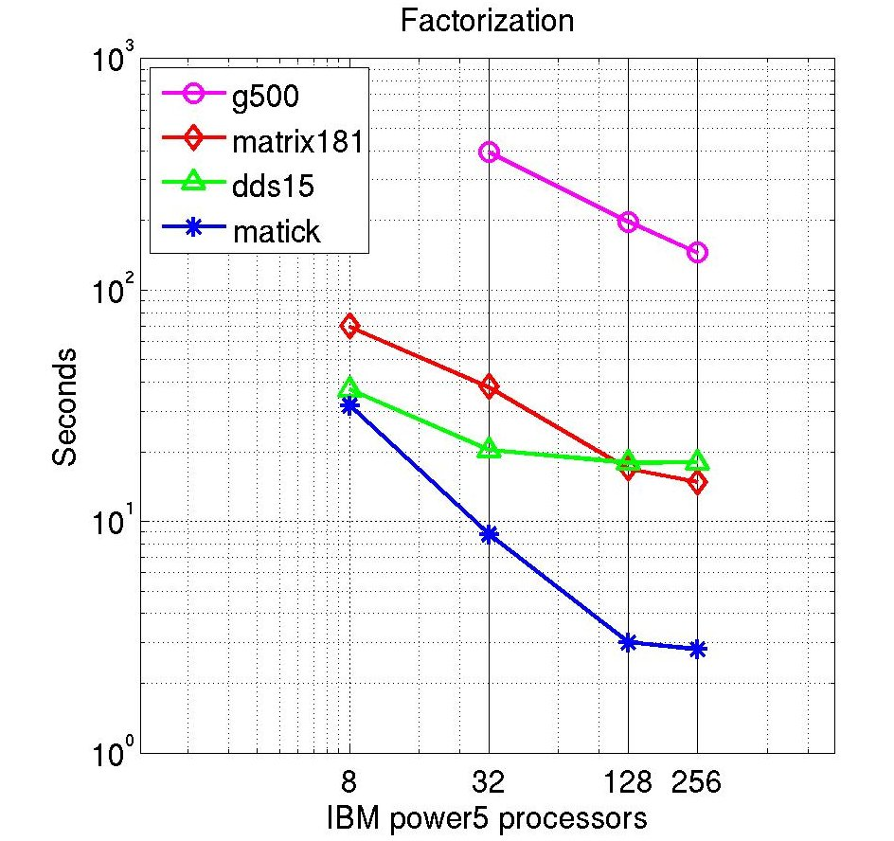
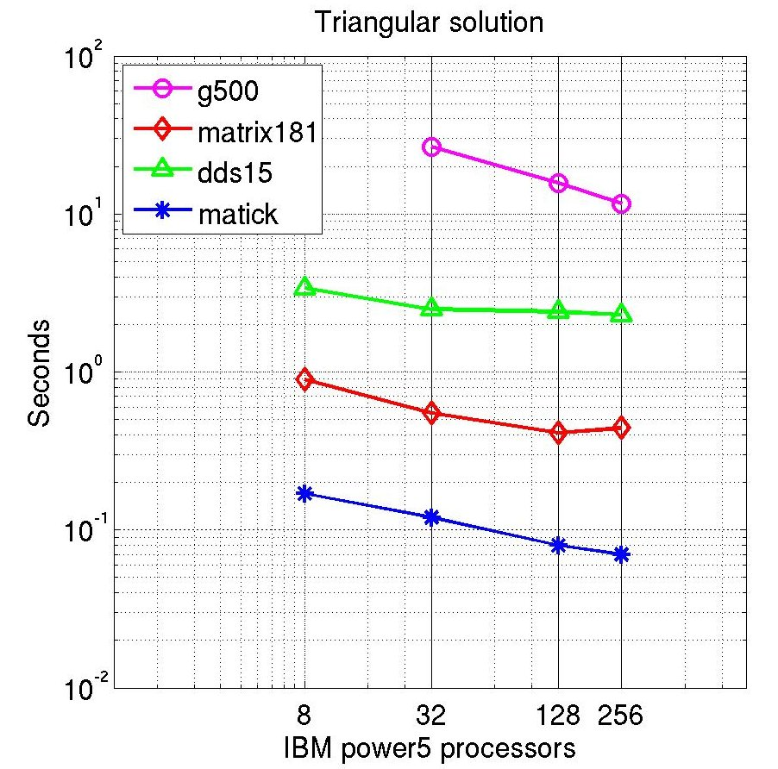
Performance on IBM Power5 (1.9 GHz)
Up to 454 Gflops factorization rate
Notes:
From first sight, solve is less scalable. Solve time is usually < 5%, but scales poorly

Slide 22
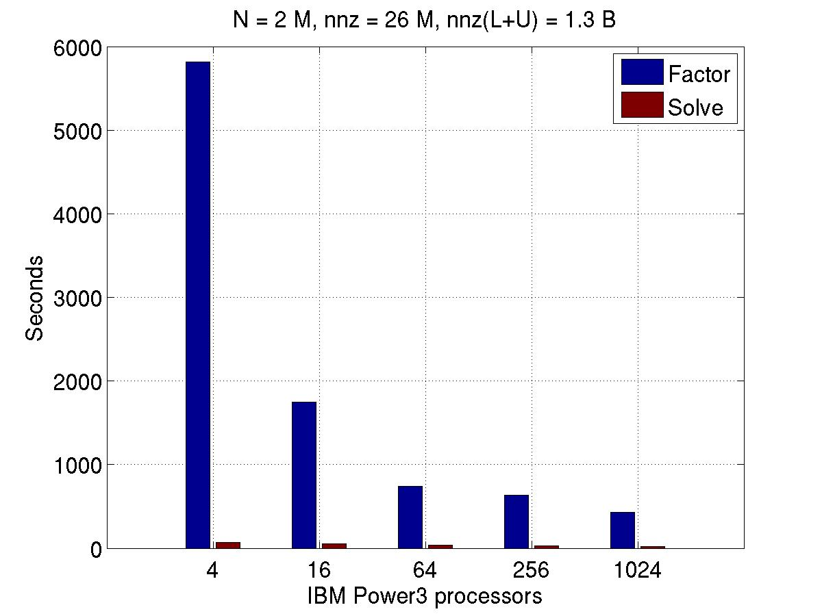
Performance on IBM Power3 (375 MHz)
Quantum mechanics, complex

Slide 23
Distributed triangular solution
Challenge: higher degree of dependency
0
3
4
Process mesh
0
1
2
0
1
2
3
4
5
3
3
4
5
0
1
2
0
1
2
1
3
4
5
3
4
5
0
1
2
0
1
2
0
Diagonal process computes the solution
3
4
5
3
4
5
3
4
3
+
4
Notes:
VECPAR 2008 talk

Slide 24
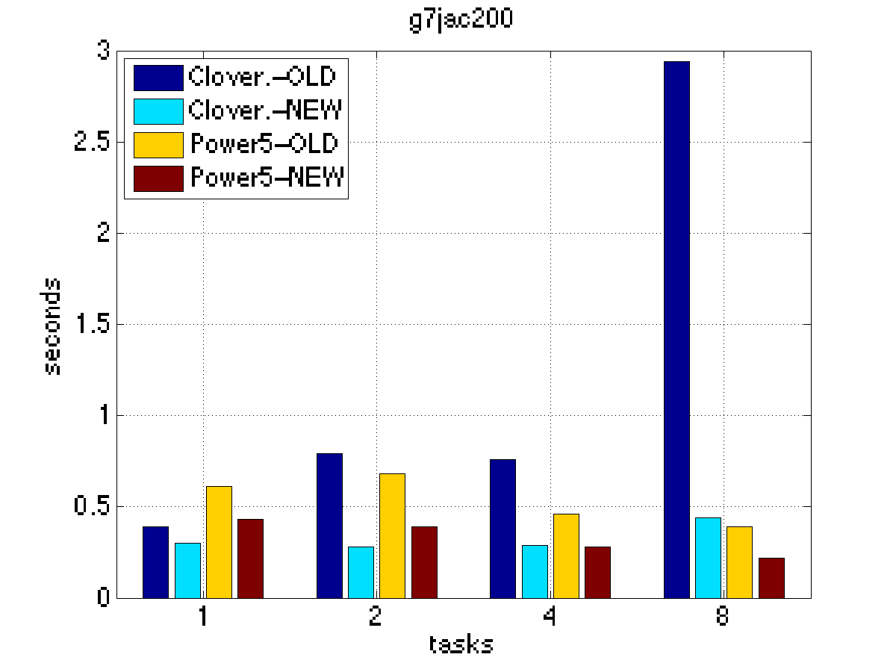
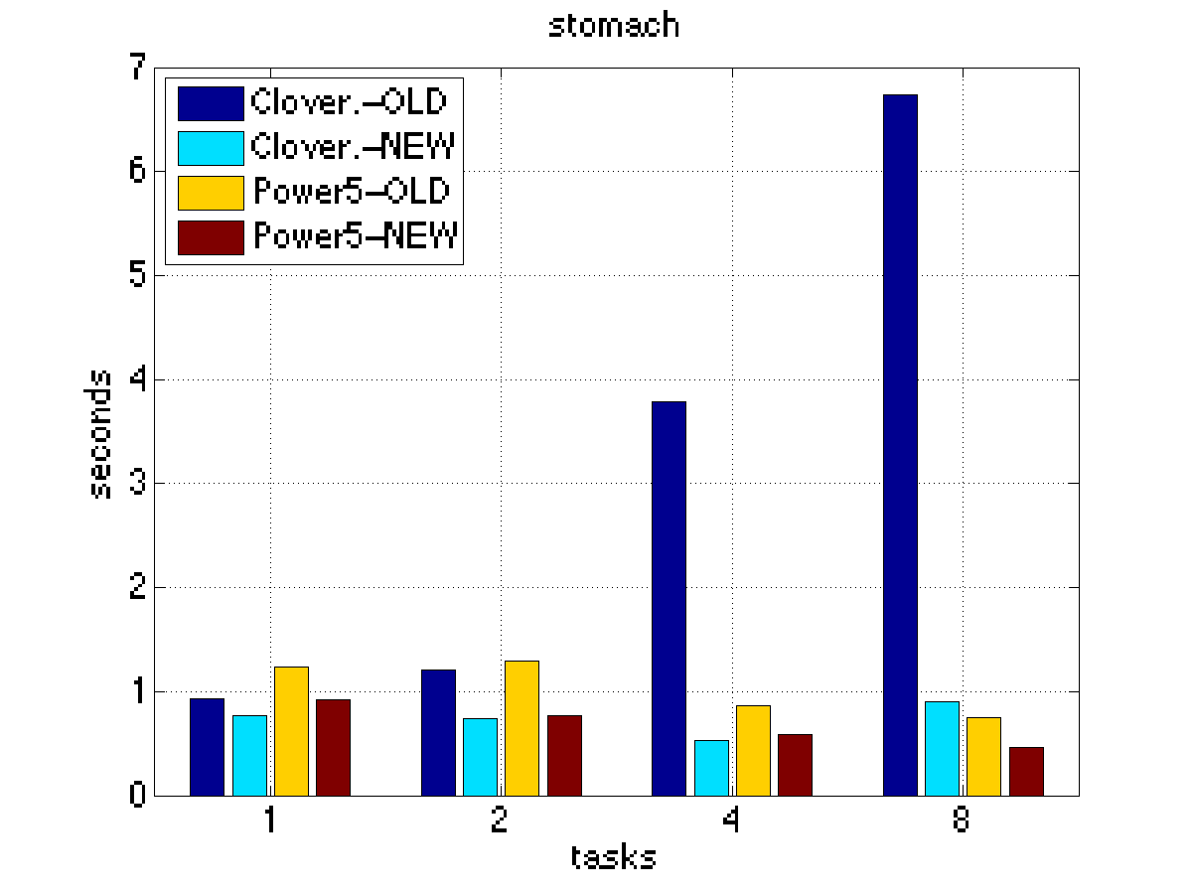
Parallel triangular solution
Clovertown: 8 cores; IBM Power5: 8 cpus/node
OLD code: many MPI_Reduce of one integer each, accounting for 75% of time on 8 cores
NEW code: change to one MPI_Reduce of an array of integers
Scales better on Power5

Slide 25
MUMPS: distributed-memory multifrontal
[Current team: Amestoy, Buttari, Guermouche, L‘Excellent, Uçar]
Symmetric-pattern multifrontal factorization
Parallelism both from tree and by sharing dense ops
Dynamic scheduling of dense op sharing
Symmetric preordering
For nonsymmetric matrices:
  optional weighted matching for heavy diagonal
  expand nonzero pattern to be symmetric
  numerical pivoting only within supernodes if possible
  (doesn’t change pattern)
  failed pivots are passed up the tree in the update matrix

Slide 26
Collection of software, test matrices
Survey of different types of direct solver codes
http://crd.lbl.gov/~xiaoye/SuperLU/SparseDirectSurvey.pdf
  LL^{T} (s.p.d.)
  LDL^{T} (symmetric indefinite)
  LU (nonsymmetric)
  QR (least squares)
  Sequential, shared-memory, distributed-memory, out-of-core
    Accelerators such as GPU, FPGA become active, have papers, no public code yet
The University of Florida Sparse Matrix Collection
http://www.cise.ufl.edu/research/sparse/matrices/

Slide 27
References
X.S. Li, “An Overview of SuperLU: Algorithms, Implementation, and User Interface”, ACM Transactions on Mathematical Software, Vol. 31, No. 3, 2005, pp. 302-325.
X.S. Li and J. Demmel, “SuperLU_DIST: A Scalable Distributed-memory Sparse Direct Solver for Unsymmetric Linear Systems”, ACM Transactions on Mathematical Software, Vol. 29, No. 2, 2003, pp. 110-140.
X.S. Li, “Evaluation of sparse LU factorization and triangular solution on multicore platforms”, VECPAR'08, June 24-27, 2008, Toulouse.
I. Yamazaki and X.S. Li, “New Scheduling Strategies for a Parallel Right-looking Sparse LU Factorization Algorithm on Multicore Clusters”, IPDPS 2012, Shanghai, China, May 21-25, 2012.
L. Grigori, X.S. Li and J. Demmel, “Parallel Symbolic Factorization for Sparse LU with Static Pivoting”. SIAM J. Sci. Comp., Vol. 29, Issue 3, 1289-1314, 2007.
P.R. Amestoy, I.S. Duff, J.-Y. L'Excellent, and J. Koster, “A fully asynchronous multifrontal solver using distributed dynamic scheduling”, SIAM Journal on Matrix Analysis and Applications, 23(1), 15-41 (2001).
P. Amestoy, I.S. Duff, A. Guermouche, and T. Slavova. Analysis of the Solution Phase of a Parallel Multifrontal Approach. Parallel Computing, No 36, pages 3-15, 2009.
A. Guermouche, J.-Y. L'Excellent, and G.Utard, Impact of reordering on the memory of a multifrontal solver. Parallel Computing, 29(9), pages 1191-1218.
F.-H. Rouet, Memory and Performance issues in parallel multifrontal factorization and triangular solutions with sparse right-hand sides, PhD Thesis, INPT, 2012.
P. Amestoy, I.S. Duff, J-Y. L'Excellent, X.S. Li, “Analysis and Comparison of Two General Sparse Solvers for Distributed Memory Computers”, ACM Transactions on Mathematical Software, Vol. 27, No. 4, 2001, pp. 388-421.

Slide 28
Exercises
Download and install SuperLU_MT on your machine, then run the examples in EXAMPLE/ directory.
Run the examples in SuperLU_DIST_3.3 directory.

