Slide 1
Factorization-based Sparse Solvers and Preconditioners
4th Gene Golub SIAM Summer School, 7/22 – 8/7, 2013, Shanghai
Xiaoye Sherry Li
Lawrence Berkeley National Laboratory, USA
xsli@lbl.gov
crd-legacy.lbl.gov/~xiaoye/G2S3/

Slide 2
Acknowledgement
Jim Demmel, UC Berkeley, course on “Applications of Parallel Computers”: http://www.cs.berkeley.edu/~demmel/cs267_Spr13/
John Gilbert, UC Santa Barbara, course on “Sparse Matrix Algorithms”: http://cs.ucsb.edu/~gilbert/cs219/cs219Spr2013/
Patrick Amestoy, Alfredo Buttari, ENSEEIHT, course on “Sparse Linear Algebra”
Jean-Yves L’Excellent, Bora Uçar, ENS-Lyon, course on “High-Performance Matrix Computations”
Artem Napov, Univ. of Brussels
Francois-Henry Rouet, LBNL
Meiyue Shao, EPFL
Sam Williams, LBNL
Jianlin Xia, Shen Wang, Purdue Univ.

Slide 3
Course outline
Fundamentals of high performance computing
Basics of sparse matrix computation: data structure, graphs, matrix-vector multiplication
Combinatorial algorithms in sparse factorization: ordering, pivoting, symbolic factorization
Numerical factorization & triangular solution: data-flow organization
Parallel factorization & triangular solution
Preconditioning: incomplete factorization
Preconditioning: low-rank data-sparse factorization
Hybrid methods: domain decomposition, substructuring method
Course materials online: crd-legacy.lbl.gov/~xiaoye/G2S3/

Slide 4
Lecture 1
Fundamentals: Parallel computing, Sparse matrices
4th Gene Golub SIAM Summer School, 7/22 – 8/7, 2013, Shanghai
Xiaoye Sherry Li
Lawrence Berkeley National Laboratory, USA
xsli@lbl.gov

Slide 5
Lecture outline
Parallel machines and programming models
Principles of parallel computing performance
Design of parallel algorithms
  Matrix computations: dense & sparse
  Partial Differential Equations (PDEs)
  Mesh methods
  Particle methods
  Quantum Monte-Carlo methods
  Load balancing, synchronization techniques

Slide 6
Parallel machines & programming model
(hardware & software)

Slide 7
Idealized Uniprocessor Model
Processor names bytes, words, etc. in its address space
  These represent integers, floats, pointers, arrays, etc.
Operations include
  Read and write into very fast memory called registers
  Arithmetic and other logical operations on registers
Order specified by program
  Read returns the most recently written data
  Compiler and architecture translate high level expressions into “obvious” lower level instructions (assembly)
  Hardware executes instructions in order specified by compiler
Idealized Cost
  Each operation has roughly the same cost
    (read, write, add, multiply, etc.)
Read address(B) to R1
Read address(C) to R2
R3 = R1 + R2
Write R3 to Address(A)
A = B + C ⇒

Slide 8
Uniprocessors in the Real World
Real processors have
  registers and caches
    small amounts of fast memory
    store values of recently used or nearby data
    different memory ops can have very different costs
  parallelism
    multiple “functional units” that can run in parallel
    different orders, instruction mixes have different costs
  pipelining
    a form of parallelism, like an assembly line in a factory
Why need to know this?
  In theory, compilers and hardware “understand” all this and can optimize your program; in practice they don’t.
  They won’t know about a different algorithm that might be a much better “match” to the processor
Notes:
In the old days, the computer architectures are much simpler, compiler can do a very good job.

Slide 9
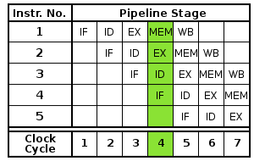
Parallelism within single processor – pipelining
Like assembly line in manufacturing
Instruction pipeline allows overlapping execution of multiple instructions with the same circuitry
  Sequential execution: 5 (cycles) * 5 (inst.) = 25 cycles
  Pipelined execution: 5 (cycles to fill the pipe, latency) + 5 (cycles, 1 cycle/inst. throughput) = 10 cycles
Arithmetic unit pipeline: A FP multiply may have latency 10 cycles, but throughput of 1/cycle
Pipeline helps throughput/bandwidth, but not latency
IF = Instruction Fetch
ID = Instruction Decode
EX = Execute
MEM = Memory access
WB = Register write back
Notes:
Parallelism is everywhere. Hard to find a machine without parallelism.

Slide 10
Parallelism within single processor – SIMD
SIMD: Single Instruction, Multiple Data
Scalar processing
  traditional mode
  one operation produces
  one result
SIMD processing
  with SSE / SSE2
  SSE = streaming SIMD extensions
  one operation produces multiple results
X
X
x3
x2
x1
x0
+
+
Y
Y
y3
y2
y1
y0
X + Y
X + Y
x3+y3
x2+y2
x1+y1
x0+y0
Slide Source: Alex Klimovitski & Dean Macri, Intel Corporation
Notes:
128-bits vector register.

Slide 11
SSE / SSE2 SIMD on Intel
SSE2 data types: anything that fits into 16 bytes, e.g.,
Instructions perform add, multiply etc. on all the data in this 16-byte register in parallel
Challenges:
  Need to be contiguous in memory and aligned
  Some instructions to move data around from one part of register to another
Similar on GPUs, vector processors (but many more simultaneous operations)
4x floats
2x doubles
16x bytes
Notes:
Would hope compiler would recognize this, but not always possible.
You need to build data structure appropriately, eg
aligned on caches line boundaries, i.e. first word has enough trailing zeros in address

Slide 12
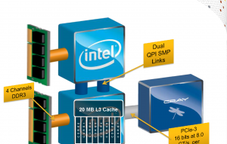
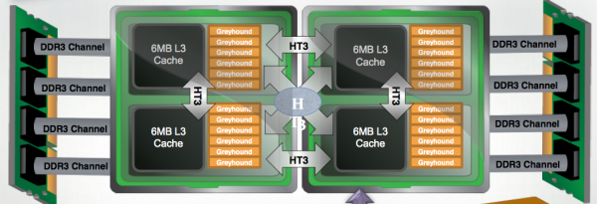
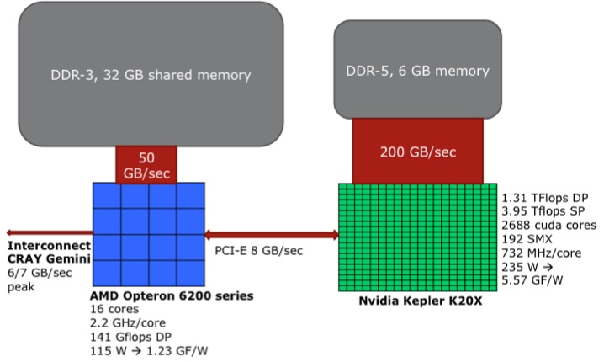
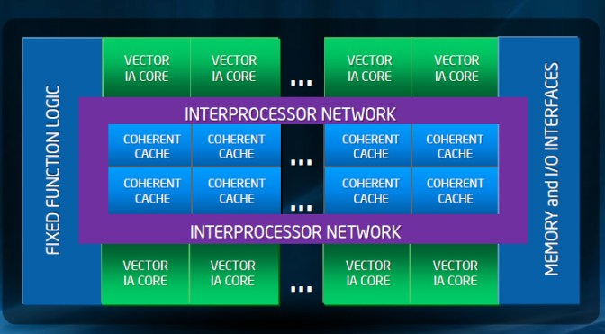
Variety of node architectures
Cray XE6: dual-socket x 2-die x 6-core, 24 cores
Cray XC30: dual-socket x 8-core, 16 cores
Cray XK7: 16-core AMD + K20X GPU
Intel MIC: 16-core host + 60⁺ cores co-processor
Notes:
Socket == Processor

Slide 13
TOP500 (www.top500.org)
Listing of 500 fastest computers
Metric: LINPACK benchmark
  “How fast is your computer?” =
  “How fast can you solve dense linear system Ax=b?”
Current records (June, 2013)
Rank | Machine | Cores | Linpack (Petaflop/s) | Peak (Petaflop/s)
1 | Tianhe-2 – Intel MIC (China National Univ. of Defense Technology) | 3,120,000 | 33.8 (61%) | 54.9
2 | Titan – Cray XK7 (US Oak Ridge National Lab) | 560, 640 | 17.6 (65%) | 27.1
3 | Sequoia – BlueGene/Q (US Lawrence Livermore National Lab) | 1,572,864 | 17.1 (85%) | 20.1
Notes:
Internationally recognized ranking site

Slide 14
Units of measure in HPC
High Performance Computing (HPC) units are:
  Flop: floating point operation
  Flops/s: floating point operations per second
  Bytes: size of data (a double precision floating point number is 8)
Typical sizes are millions, billions, trillions…
  Mega Mflop/s = 10⁶ flop/sec Mbyte = 2²⁰ = 1048576 ~ 10⁶ bytes
  Giga Gflop/s = 10⁹ flop/sec Gbyte = 2³⁰ ~ 10⁹ bytes
  Tera Tflop/s = 10¹² flop/sec Tbyte = 2⁴⁰ ~ 10¹² bytes
  Peta Pflop/s = 10¹⁵ flop/sec Pbyte = 2⁵⁰ ~ 10¹⁵ bytes
  Exa Eflop/s = 10¹⁸ flop/sec Ebyte = 2⁶⁰ ~ 10¹⁸ bytes
  Zetta Zflop/s = 10²¹ flop/sec Zbyte = 2⁷⁰ ~ 10²¹ bytes
  Yotta Yflop/s = 10²⁴ flop/sec Ybyte = 2⁸⁰ ~ 10²⁴ bytes

Slide 15
Memory Hierarchy … Flops is not everything
Most programs have a high degree of locality in their accesses
  spatial locality: accessing things nearby previous accesses
  temporal locality: reusing an item that was previously accessed
Memory hierarchy tries to exploit locality to improve average
processor
control
Second level cache (SRAM)
Main memory
(DRAM)
Secondary storage (Disk)
Tertiary storage
(Disk/Tape)
datapath
registers
on-chip cache
Speed | 1ns | 10ns | 100ns | 10ms | 10sec
Size | KB | MB | GB | TB | PB

Slide 16
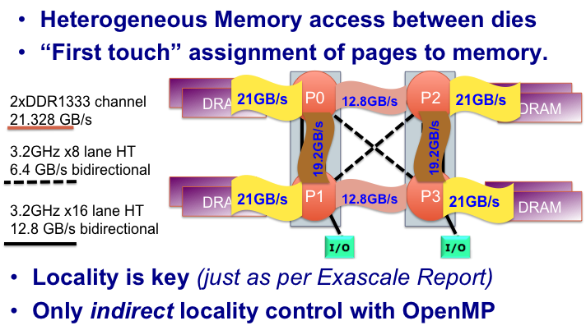
Hopper Node Topology
Understanding NUMA Effects [J. Shalf]
Notes:
Say thick = full link
Thin = ½ link
Complicated - in order to use it effectively does it matter ?

Slide 17
Arithmetic Intensity
O( log(N) )
[S. Williams]
O( 1 )
O( N )
A r i t h m e t i c I n t e n s i t y
SpMV, BLAS1,2
FFTs
Stencils (PDEs)
Dense Linear Algebra
(BLAS3)
PIC codes
Naïve Particle Methods
Lattice Methods
Arithmetic Intensity (AI) ~ Total Flops / Total DRAM Bytes
  E.g.: dense matrix-matrix multiplication: n³ flops / n² memory
Higher AI → better locality → amenable to many optimizations → achieve higher % machine peak

Slide 18
Roofline model (S. Williams) basic concept
Synthesize communication, computation, and locality into a single visually-intuitive performance figure using bound and bottleneck analysis.
  Assume FP kernel maintained in DRAM, and perfectly overlap computation and communication w/ DRAM
  Arithmetic Intensity (AI) is computed based on DRAM traffic after being filtered by cache
Question : is the code computation-bound or memory-bound?
Time is the maximum of the time required to transfer the data and the time required to perform the floating point operations.
Byte’s / STREAM Bandwidth
Flop’s / Flop/s
time

Slide 19
Roofline model simple bound
Roofline
  Given the code AI, can inspect the figure to bound performance
  Provides insights as to which optimizations will potentially be beneficial
Machine-dependent, code-dependent
FLOP/s (with Optimizations_{1-i})
Attainable
Performance_{ij}
= min
AI * Bandwidth (with Optimizations_{1-j})
256.0
Opteron 2356 (Barcelona)
128.0
64.0
peak DP
32.0
attainable GFLOP/s
16.0
Stream Bandwidth
8.0
4.0
2.0
1.0
0.5
¹/₈
¹/₄
¹/₂
1
2
4
8
16
actual FLOP:Byte ratio

Slide 20
Example
Consider the Opteron 2356:
  Dual Socket (NUMA)
  limited HW stream prefetchers
  quad-core (8 total)
  2.3GHz
  2-way SIMD (DP)
  separate FPMUL and FPADD
  datapaths
  4-cycle FP latency
Assuming expression of parallelism is the challenge on this architecture, what would the roofline model look like ?

Slide 21
Roofline Model
Basic Concept
Naively, one might assume peak performance is always attainable.
256.0
Opteron 2356
(Barcelona)
128.0
64.0
peak DP
32.0
attainable GFLOP/s
16.0
8.0
4.0
2.0
1.0
0.5

Slide 22
Roofline Model
Basic Concept
However, with a lack of locality, DRAM bandwidth can be a bottleneck
Plot on log-log scale
Given AI, we can easily bound performance
But architectures are much more complicated
We will bound performance as we eliminate specific forms of in-core parallelism
256.0
Opteron 2356
(Barcelona)
128.0
64.0
peak DP
32.0
attainable GFLOP/s
16.0
Stream Bandwidth
8.0
4.0
2.0
1.0
0.5
¹/₈
¹/₄
¹/₂
1
2
4
8
16
actual FLOP:Byte ratio

Slide 23
Roofline Model computational ceilings
Opterons have dedicated multipliers and adders.
If the code is dominated by adds, then attainable performance is half of peak.
We call these Ceilings
They act like constraints on performance
256.0
Opteron 2356
(Barcelona)
128.0
64.0
peak DP
32.0
mul / add imbalance
attainable GFLOP/s
16.0
Stream Bandwidth
8.0
4.0
2.0
1.0
0.5
¹/₈
¹/₄
¹/₂
1
2
4
8
16
actual FLOP:Byte ratio

Slide 24
Roofline Model computational ceilings
Opterons have 128-bit datapaths.
If instructions aren’t SIMDized, attainable performance will be halved
256.0
Opteron 2356
(Barcelona)
128.0
64.0
peak DP
32.0
mul / add imbalance
attainable GFLOP/s
16.0
w/out SIMD
Stream Bandwidth
8.0
4.0
2.0
1.0
0.5
¹/₈
¹/₄
¹/₂
1
2
4
8
16
actual FLOP:Byte ratio

Slide 25
Roofline Model computational ceilings
On Opterons, floating-point instructions have a 4 cycle latency.
If we don’t express 4-way ILP, performance will drop by as much as 4x
256.0
Opteron 2356
(Barcelona)
128.0
64.0
peak DP
32.0
mul / add imbalance
attainable GFLOP/s
16.0
w/out SIMD
Stream Bandwidth
8.0
4.0
w/out ILP
2.0
1.0
0.5
¹/₈
¹/₄
¹/₂
1
2
4
8
16
actual FLOP:Byte ratio

Slide 26
Roofline Model communication ceilings
We can perform a similar exercise taking away parallelism from the memory subsystem
256.0
Opteron 2356
(Barcelona)
128.0
64.0
peak DP
32.0
attainable GFLOP/s
16.0
Stream Bandwidth
8.0
4.0
2.0
1.0
0.5
¹/₈
¹/₄
¹/₂
1
2
4
8
16
actual FLOP:Byte ratio

Slide 27
Roofline Model communication ceilings
Explicit software prefetch instructions are required to achieve peak bandwidth
256.0
Opteron 2356
(Barcelona)
128.0
64.0
peak DP
32.0
attainable GFLOP/s
16.0
Stream Bandwidth
8.0
w/out SW prefetch
4.0
2.0
1.0
0.5
¹/₈
¹/₄
¹/₂
1
2
4
8
16
actual FLOP:Byte ratio

Slide 28
Roofline Model communication ceilings
Opterons are NUMA
As such memory traffic must be correctly balanced among the two sockets to achieve good Stream bandwidth.
We could continue this by examining strided or random memory access patterns
256.0
Opteron 2356
(Barcelona)
128.0
64.0
peak DP
32.0
attainable GFLOP/s
16.0
Stream Bandwidth
8.0
w/out SW prefetch
w/out NUMA
4.0
2.0
1.0
0.5
¹/₈
¹/₄
¹/₂
1
2
4
8
16
actual FLOP:Byte ratio

Slide 29
Roofline Model computation + communication ceilings
We may bound performance based on the combination of expressed in-core parallelism and attained bandwidth.
256.0
Opteron 2356
(Barcelona)
128.0
64.0
peak DP
32.0
mul / add imbalance
attainable GFLOP/s
16.0
w/out SIMD
Stream Bandwidth
8.0
w/out SW prefetch
w/out NUMA
4.0
w/out ILP
2.0
1.0
0.5
¹/₈
¹/₄
¹/₂
1
2
4
8
16
actual FLOP:Byte ratio

Slide 30
Parallel machines
  Shared memory
  Shared address space
  Message passing
  Data parallel: vector processors
  Clusters of SMPs
  Grid
Programming model reflects hardware
  Historically, tight coupling
  Today, portability is important

Slide 31
A generic parallel architecture
P
P
P
P
M
M
M
M
Interconnection Network
Memory
Where is the memory physically located?

Slide 32
Parallel programming models
Control
  How is parallelism created?
  What orderings exist between operations?
  How do different threads of control synchronize?
Data
  What data is private vs. shared?
  How is logically shared data accessed or communicated?
Operations
  What are the atomic (indivisible) operations?
Cost
  How do we account for the cost of each of the above?

Slide 33
Machine model 1a: shared memory
Processors all connected to a common shared memory.
  Processors → sockets → dies → cores
  Intel, AMD : multicore, multithread chips
Difficulty scaling to large numbers of processors
  <= 32 processors typical
Memory access:
  uniform memory access (UMA)
  Nonuniform memory access (NUMA, more common now)
Cost: much cheaper to access data in cache than main memory.
P1
P2
Pn
$
$
$
$ = cache
bus
memory
Notes:
Scaling bottleneck:
The memory bus becomes bottleneck
Caches need to be kept coherent

Slide 34
Machine model 1b: distributed shared memory
Memory is logically shared, but physically distributed (e.g., SGI Altix)
  Any processor can access any address in memory
  Cache lines (or pages) are passed around machine
  Limitation is cache coherency protocols – how to keep cached copies of the same address consistent
P1
P2
Pn
$
$
$
network
memory
memory
memory
Notes:
Writing program is the same as shared-memory
Cache coherency can be done in hardware or software

Slide 35
Simple programming example
Consider dot product:
Parallel Decomposition:
  Each evaluation and each partial sum is a task.
Assign n/p numbers to each of p procs
  Each computes independent “private” results and partial sum.
  One (or all) collects the p partial sums and computes the global sum.
Two Classes of Data:
Logically Shared
  The original n numbers, the global sum.
Logically Private
  The individual partial sums.

Slide 36
OpenMP shared-memory programming
Share the node address space.
Most data shared within node.
Threads communicate via
memory read & write.
Concurrent write to shared
data needs locking or
atomic operation.
Master thread
Shared data
F o r k
Thread 1
Thread 5
Private data
Private data
J o i n
Master thread

Slide 37
Incorrect program
int s = 0;
Thread 1
for i = 0, n/2-1
s = s + x(i)*y(i)
Thread 2
for i = n/2, n-1
s = s + x(i)*y(i)
There is a race condition on variable s in the program
A race condition or data race occurs when:
  two threads access the same variable, and at least one does a write.
  the accesses are concurrent (not synchronized) so they could happen simultaneously

Slide 38
Correct program
int s = 0;
Lock lk;
Thread 1
local_s1= 0
for i = 0, n/2-1
local_s1 = local_s1 + x(i)*y(i)
s = s + local_s1
Thread 2
local_s2 = 0
for i = n/2, n-1
local_s2= local_s2 + x(i)*y(i)
s = s +local_s2
lock(lk);
lock(lk);
unlock(lk);
unlock(lk);
Since addition is associative, it’s OK to rearrange order
Most computation is on private variables
  Sharing frequency is also reduced, which might improve speed
  Race condition is fixed by adding locks to critical region (only one thread can hold a lock at a time; others wait for it)
Shared-memory programming standards: OpenMP, PTHREADS

Slide 39
Dot-product using OpenMP in C
int n = 100;
double x[100], y[100];
double s = 0, local_s;
#pragma omp parallel shared (s) private (local_s)
{
local_s = 0.0;
#pragma omp for
for (i = 0; i < n; ++i) {
local_s = local_s + x[i] * y[i];
}
#pragma omp critical
{
s = s + local_s;
}
}
Exercise: complete this program, and run it with at least 4 threads.

Slide 40
OpenMP tutorial:
https://computing.llnl.gov/tutorials/openMP/
OpenMP sample programs:
https://computing.llnl.gov/tutorials/openMP/exercise.html

Slide 41
Machine model 2: distributed memory
Cray XE6, IBM SP, PC Clusters ..., can be large
Each processor has its own memory and cache, but cannot directly access another processor’s memory.
Each “node” has a Network Interface (NI) for all communication and synchronization.
P0
NI
P1
NI
Pn
NI
memory
memory
memory
. . .
interconnect

Slide 42
Programming Model 2: Message Passing
Program consists of a collection of named processes
  Usually fixed at program startup time
  Thread of control plus local address space -- NO shared data
Processes communicate by explicit send/receive pairs
  Coordination is implicit in every communication event.
  Message Passing Interface (MPI) is the most commonly used SW
Private memory
s: 12
s: 14
s: 11
receive Pn,s
y = ..s ...
i: 2
i: 3
i: 1
P0
P1
send P1,s
Pn
Network

Slide 43
Distributed dot product
Processor 1
s = 0
for i = 0, n/2-1
s = s + x(i)*y(i)
MPI_Recv(s_remote, p2,...)
MPI_Send(s, p2, ...)
s = s + s_remote
Processor 2
s = 0
for i = 0, n/2-1
s = s + x(i)*y(i)
MPI_Send(s, p1, ...)
MPI_Recv(s_remote, p1,...)
s = s + s_remote

Slide 44
MPI – the de facto standard
MPI has become the de facto standard for parallel computing using message passing
Pros and Cons
  MPI created finally a standard for applications development in the HPC community → portability
  The MPI standard is a least common denominator building on mid-80s technology, so may discourage innovation
MPI tutorial:
https://computing.llnl.gov/tutorials/mpi/
https://computing.llnl.gov/tutorials/mpi/exercise.html

Slide 45
Other machines & programming models
Data parallel
  SIMD
  Vector machines (often has compiler support)
    SSE, SSE2 (Intel: Pentium/IA64)
    Altivec (IBM/Motorola/Apple: PowerPC)
    VIS (Sun: Sparc)
  GPU, at a larger scale
Hybrid: cluster of SMP/multicore/GPU node
MPI + X
  X = OpenMP, CUDA/OpenCL, …
Global Address Space programming (GAS languages)
  UPC, Co-Array Fortran
  Local and shared data, as in shared memory model
  But, shared data is partitioned over local processes

Slide 46
Outline
Parallel machines and programming models
Principles of parallel computing performance
  Models of performance bound
Design of parallel algorithms

Slide 47
Principles of Parallel Computing
Finding enough parallelism (Amdahl’s Law)
Granularity – how big should each parallel task be
Locality – moving data costs more than arithmetic
Load balance – don’t want 1K processors to wait for one slow one
Coordination and synchronization – sharing data safely
Performance modeling/debugging/tuning

Slide 48
Finding enough parallelism
Suppose only part of an application is parallel
Amdahl’s law
  Let s be the fraction of work done sequentially, so (1-s) is fraction parallelizable
  P = number of cores
( e.g., s = 1% → speedup <= 100 )
Even if the parallel part speeds up perfectly, performance is limited by the sequential part
Speedup(P) = Time(1)/Time(P)
<= 1/(s + (1-s)/P)
<= 1/s

Slide 49
Overhead of parallelism
Given enough parallel work, this is the biggest barrier to getting desired speedup
Parallelism overheads include:
  cost of starting a thread or process
  cost of communicating shared data
  cost of synchronizing
  extra (redundant) computation
Each of these can be in the range of milliseconds
(= millions of flops) on some systems
Tradeoff: Algorithm needs sufficiently large units of work to run fast in parallel (I.e. large granularity), but not so large that there is not enough parallel work

Slide 50
Performance properties of a network
Latency: delay between send and receive times
  Latency tends to vary widely across machines
  Vendors often report hardware latencies (wire time)
  Application programmers care about software latencies (user program to user program)
  Latency is important for programs with many small messages (e.g., sparse matrices)
The bandwidth of a link measures how much volume can be transferred in unit-time (e.g., MBytes/sec)
  Bandwidth is important for applications with mostly large messages (e.g., dense matrices)

Slide 51
Latency-bandwidth model
Time to send a message of length n is roughly
Called “α−β model” and written:
Usually α >> β >> time per flop
→Can do hundreds or thousands of flops for cost of one message
One long message is cheaper than many short ones.
Time = latency + n * time_per_word
= latency + n / bandwidth
α + n∗β << n∗(α + 1∗β)
Notes:
More sophisticated model, such as LogP, more realistic, but at the theoretical level

Slide 52
Communication versus F.P. speed
Cray XE6 at NERSC, LBNL: dual-socket x 2-die x 6-core, 24 cores
Inter-node
  FP Peak/core: 8.5 Gflops → time_per_flop = 0.11 nanosec
  Communication using MPI
Intra-node (on-node memory): 24 cores
  1.3 - 2.6 GB/core
→ Extremely difficult for accurate performance prediction.

Slide 53
BLAS – Basic Linear Algebra Subroutines http://www.netlib.org/blas/blast-forum/
Building blocks for all linear algebra
Parallel versions call serial versions on each processor
  So they must be fast!
Reuse ratio: q = # flops / # mem references (i.e. Arithmetic Intensity)
  The larger is q, the faster the algorithm can go in the presence of memory hierarchy
BLAS level | Ex. | # mem refs | # flops | q
1 | “Axpy”, Dot prod | 3n | 2n¹ | 2/3
2 | Matrix-vector mult | n² | 2n² | 2
3 | Matrix-matrix mult | 4n² | 2n³ | n/2

Slide 54
BLAS performance

Slide 55
Parallel data layouts for matrices
0 | 1 | 2 | 3
0 | 1 | 2 | 3 | 0 | 1 | 2 | 3 | 0 | 1 | 2 | 3 | 0 | 1 | 2 | 3
1) 1D Column Blocked Layout
2) 1D Column Cyclic Layout
0 | 1 | 2 | 3 | 0 | 1 | 2 | 3
4) Row versions of the previous layouts
b
3) 1D Column Block Cyclic Layout
0 | 1
2 | 3
0 | 1 | 0 | 1 | 0 | 1 | 0 | 1
2 | 3 | 2 | 3 | 2 | 3 | 2 | 3
0 | 1 | 0 | 1 | 0 | 1 | 0 | 1
2 | 3 | 2 | 3 | 2 | 3 | 2 | 3
0 | 1 | 0 | 1 | 0 | 1 | 0 | 1
2 | 3 | 2 | 3 | 2 | 3 | 2 | 3
0 | 1 | 0 | 1 | 0 | 1 | 0 | 1
2 | 3 | 2 | 3 | 2 | 3 | 2 | 3
Generalizes others
6) 2D Row and Column Block Cyclic Layout
5) 2D Row and Column Blocked Layout

Slide 56
Summary
Performance bounds and models
  Roofline model: captures on-node memory speed
  Amdahl’s Law: upper bound of speedup
  “α−β model” (latency-bandwidth): captures network speed
  Strong/weaking scaling: algorithm scalability (Lectures 3-4)
Hybrid programming becomes necessary
  MPI + X
Sparse matrix algorithms have much lower arithmetic density
  Critical to reduce memory access and communication

Slide 57
References
OpenMP tutorial: https://computing.llnl.gov/tutorials/openMP/
MPI tutorial: https://computing.llnl.gov/tutorials/mpi/
“The Landscape of Parallel Processing Research: The View from Berkeley”
  http://www.eecs.berkeley.edu/Pubs/TechRpts/2006/ECS-2006-183.pdf
  Contains many references
Jim Demmel, Kathy Yelick, et al., UCB/CS267 lecture notes for parallel computing class
  http://www.cs.berkeley.edu/~demmel/cs267_Spr13/
S. Williams, A. Waterman, D. Patterson, "Roofline: An Insightful Visual Performance Model for Floating-Point Programs and Multicore Architectures", Communications of the ACM (CACM), April 2009.
MAGMA, Matrix Algebra on GPU and Multicore Architectures,
  http://icl.cs.utk.edu/magma/index.html
PLASMA, The Parallel Linear Algebra for Scalable Multi-core Architectures
  http://icl.cs.utk.edu/plasma/

Slide 58
Exercises
Complete and run the OpenMP code to perform dot-product.
  Other examples: https://computing.llnl.gov/tutorials/openMP/exercise.html
Write an OpenMP code to perform GEMM
  Validate correctness
  How fast does your program run on one node of the cluster?
Run the following MPI codes in Hands-On-Exercises/
  Hello-MPI
  DOT-MPI (Is it simpler than OpenMP DOT ?)
Write an MPI program to find the Maximum and Minimum entries of an array.
Run the MPI ping-pong benchmark code in Hands-On-Exercises/LatencyBandwidth/ directory, to find {alpha, beta} on your machine.

Slide 59
Exercises
Run the MPI code to perform GEMM
  How to distribute the matrix?
  The parallel algorithm is called SUMMA
Write a hybrid MPI + OpenMP code to perform GEMM
  Use 2 nodes of the cluster (2 x 12 cores)
  Can have various MPI and OpenMP configurations:
    2 MPI tasks X 12 threads, 4 MPI tasks X 6 threads, …
  Other tuning parameters:

Slide 60
Cannon’s matrix-multiplication algorithm
Views the processes as being arranged in a virtual two-dimensional square array. It uses this array to distribute the matrices A, B, and the result matrix C in a block fashion.
If n x n is the size of each matrix and p is the total number of processes, then each matrix is divided into square blocks of size
n/√p x n/√p
Process P_{i,j} in the grid is assigned the A_{i,j,} B_{i,j}, and C_{i,j} blocks of each matrix.
The algorithm proceeds in √p steps. In each step, every process multiplies the local blocks of matrices A and B, and then sends the block of A to the leftward process, and the block of B to the upward process.

